Slide 1
Semantic Web Technologies
Werner Nutt

Slide 2
The Semantic Web Idea
Semantic Technologies

Slide 3
The Semantic Web Idea
Semantic Technologies

Slide 4
The Web
All aspects of daily life are being “webized”:
everyday information (news, weather forecast)
entertainment
buying and selling
administration (eGovernment)
education (eLearning, eEducation)
social contacts (social networking plattforms, dating sites)

Slide 5
Why Semantic Web?
Syntax vs. Semantik
“4+) = (“ syntactically wrong, semantically …
“3 + 4 = 12” syntactically correct, semantically wrong
“3 + 4 = 7” syntactically correct, semantically correct
Syntax
Semantik
(from greek συνταξις composition,sentential structure) denotes the (normative) structure of data, i.e., it characterizes what makes data “well-formed”
(greek σημαυτικoς belonging to the sign) denotes the meaning of data, i.e., it characterizes what conclusions can be drawn from it.

Slide 6
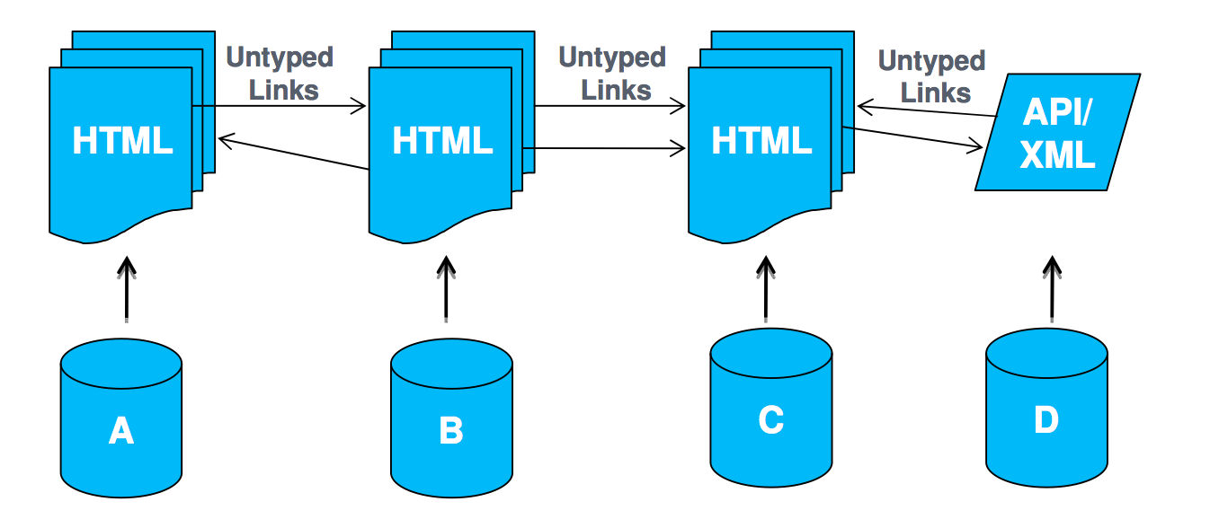
Web of Documents
Primary objects: documents Links between documents
Degree of structure in data: low
Semantics of content: implicit
Designed for: human consumption

Slide 7
Problems of the Web
wealth of information
… targeted at human users

Slide 8
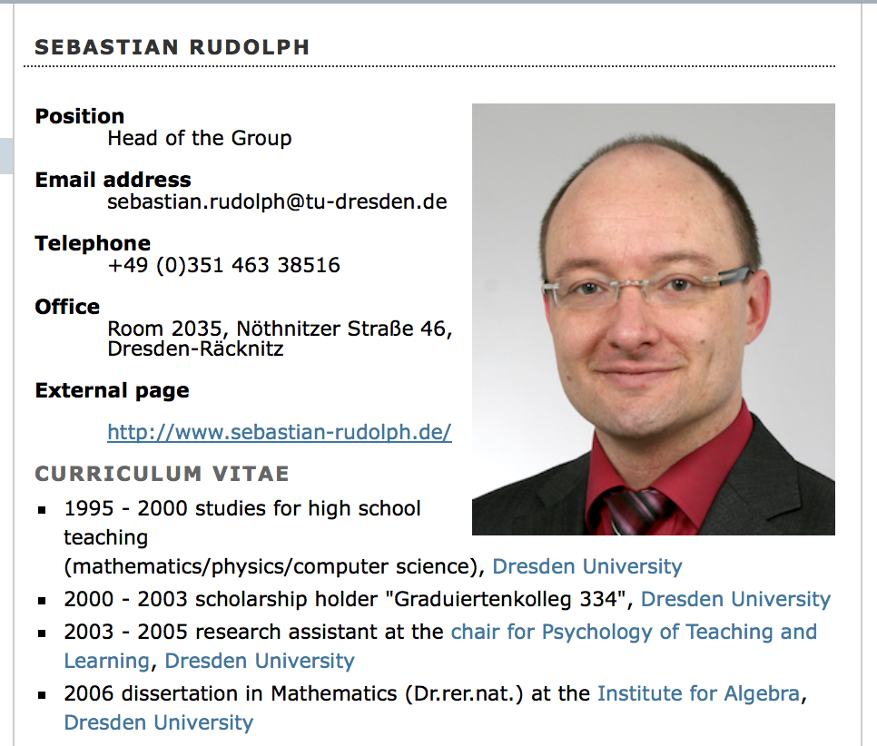
Problems of the Web
wealth of information
… targeted at human users

Slide 9
Pages with Computer-readable Layout Information
<h1 class="documentFirstHeading">Sebastian Rudolph</h1>
<div id="bodyContent" class="plain">
<img src="/content/institutes/ki/cl/people/images/Rudolph.png" width="200" alt="portrait" style="float: right;" />
<dl>
<dt>Position</dt>
<dd>Head of the Group</dd>
<dt>Email address</dt>
<dd>sebastian.rudolph@tu-dresden.de</dd>
<dt>Telephone</dt>
<dd>+49 (0)351 463 38516</dd>
<dt>Office</dt>
<dd>Room 2035, N&ouml;thnitzer Stra&szlig;e 46, Dresden-R&auml;cknitz</dd>
<dt>External page</dt>
</dl>
<dl>
<dd><a href="http://www.sebastian-rudolph.de/">http://www.sebastian-rudolph.de/</a></dd>
</dl>
<h2>Curriculum vitae</h2>
<ul>

Slide 10
Web of documents

Slide 11
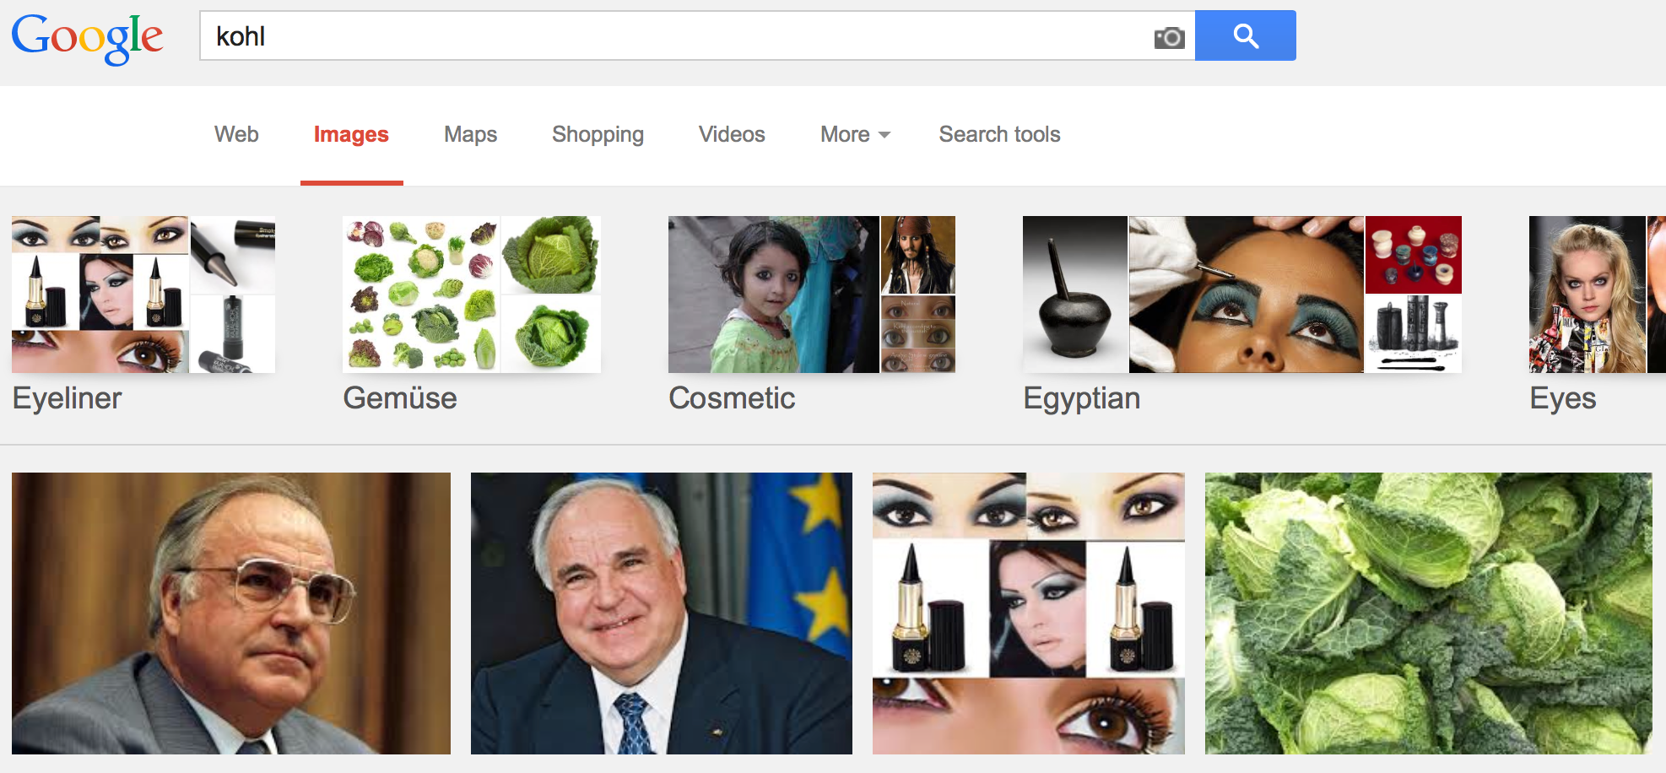
Problems of the Web
localizing information problematic
today’s search engines are good, but still keyword-based

Slide 12
Problems of the Web
How about this query:
How many romantic comedy Hollywood movies are directed by a person who is born in a city that has average temperature above 15 degrees!?
You need to:
Find reliable sources containing facts about movies (genre & director), birthplaces of famous artists/directors, average temperature of cities across the world, etc.
➔ The result: several lists of thousands of facts
Integrate all the data, join the facts that come from heterogeneous sources
Even if possible, it may take hours to answer just a single query!

Slide 13
Problems of the Web
Heterogeneity of present information on diverse levels:
character encoding (e.g.ASCII vs.Unicode)
used natural languages
positioning of information on web pages
desirable: information integration across the Web

Slide 14
Problems of the Web
implicit knowledge, i.e. many pieces of information are not provided explicitly, but follow from the combination of the given data
requires “logical thinking”
➔ automated deduction

Slide 15
Problems of the Web
Approaches toward a solution:
Ad hoc: Deployment of AI methods (most notably NLP techniques) to evaluate existing unstructured information on the Web
A priori: structure information on the Web at authoring time in a way facilitating later automated deployment
➔ Semantic Web

Slide 16
The Vision
I have a dream for the Web in which computers become capable of analyzing all the data on the Web - the content, links, and transactions between people and computers. A Semantic Web, which should make this possible, has yet to emerge, but when it does, the day-to-day mechanisms of trade, bureaucracy and our daily lives will be handled by machines talking to ma- chines. The intelligent agents people have touted for ages will finally materialize.
Barners-Lee, 1999

Slide 17
Semantic Web
Two essential prerequisites for the implementation:
open standards for describing information
clearly defined
flexible
extendable
methods for retrieving information from such descriptions

Slide 18
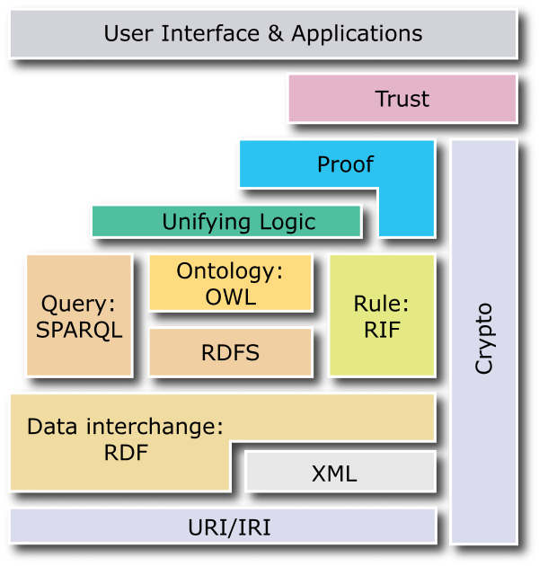
Semantic Web: Standards
1994 First public presentation of the Semantic Web idea
1998 Start of standardization of data model (RDF) and a first ontology languages (RDFS) at W3C
2000 Start of large research projects about ontologies in the US and Europe
2002 Start of standardization of a new ontology language (OWL) based on research results
2004 Finalization of the standard for data (RDF) and ontology (OWL)
2008 Standardization of a query language (SPARQL)
2009 Extension of OWL to OWL 2.0
2010 Standard Rule Interchange Format (RIF)
^{2013 SPARQL 1.1}

Slide 19
The Semantic Web Idea
Semantic Technologies

Slide 20
Not only about the Web
The Semantic Web vision has generated technologies that are applied outside the web context including:
Enterprise intelligence
Government
Research (Bio, Geo, Cultural heritage, etc.)
Software development
…
Semantic technologies provide flexible and powerful tools to accomplish things that were not possible or not practical in the past.

Slide 21
Introduction to the Semantic Web Approach
How does the Semantic Web approach help us
merge data sets
infer new relations, and
integrate outside data sources?
Notes:
We will use a simplistic example to introduce the main Semantic Web concepts
We take, as an example area, data integration

Slide 22
Sketch of Data Integration with SWT
Map the various data onto an abstract data representation ➔ Make the data independent of its internal representation …
Merge the resulting representations
Start querying the whole merged set
➔ We can answer queries not possible on the individual data sets

Slide 23
Data set “A”: A simple Book Store
Books
ID | Author | Title | Publisher | Year
ISBN0-00-651409-X | id_xyz | The Glass Palace | id_qpr | 2000
Authors
ID | Name | Home page
id_xyz | Ghosh, Amitav | http://www.amitavghosh.com
Publishers
ID | Publisher Name | City
id_qpr | Harper Collins | London

Slide 24
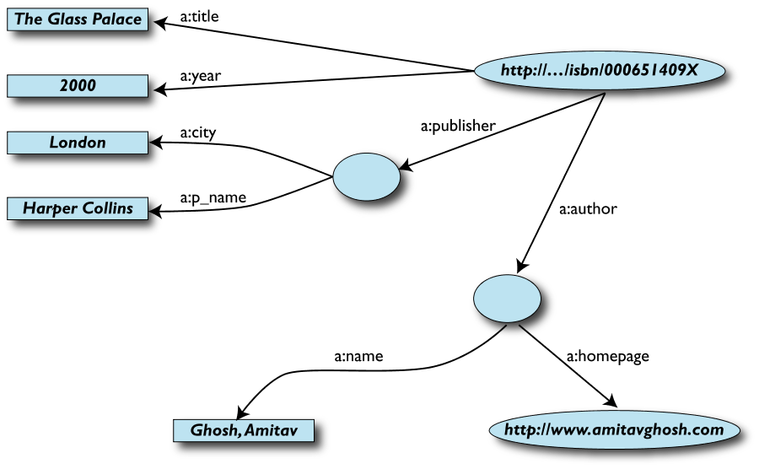
1st: Export your data as a labeled graph

Slide 25
Remarks on the Data Export
Data export does not necessarily mean physical conversion of the data
Relations can be virtual, generated on-the-fly at query time
via SQL “bridges”
scraping HTML pages
extracting data from Excel sheets
etc.
One can export part of the data

Slide 26
Data set “F”: Another Book Store’s Data
Notes:
This time, stored in a spreadsheet!

Slide 27
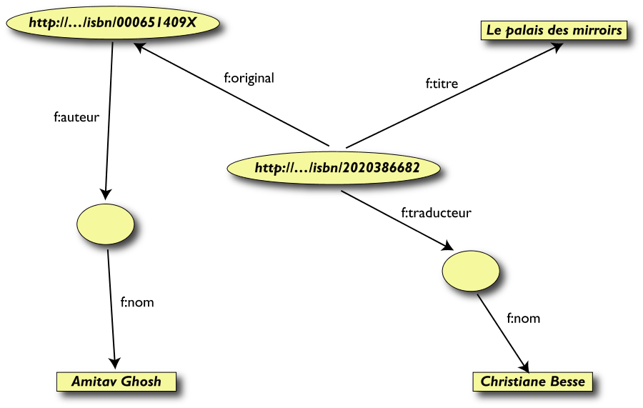
2nd: Export your second set of data

Slide 28
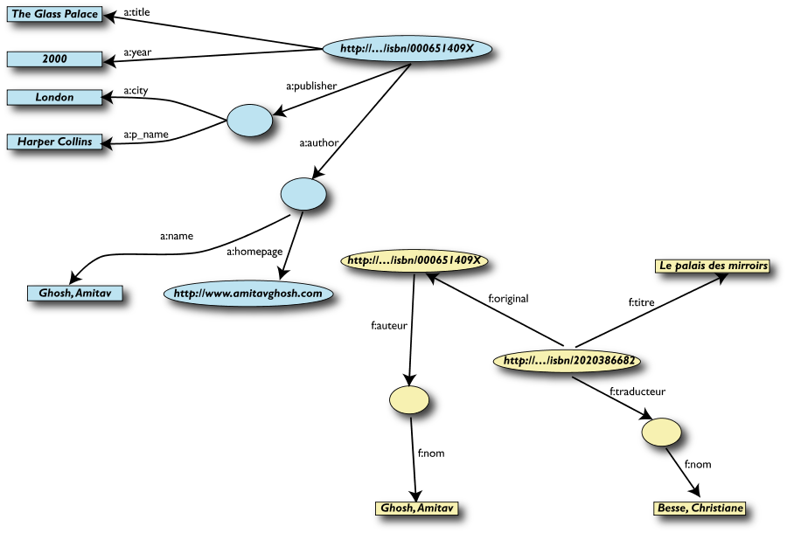
3rd: Start merging your data

Slide 29
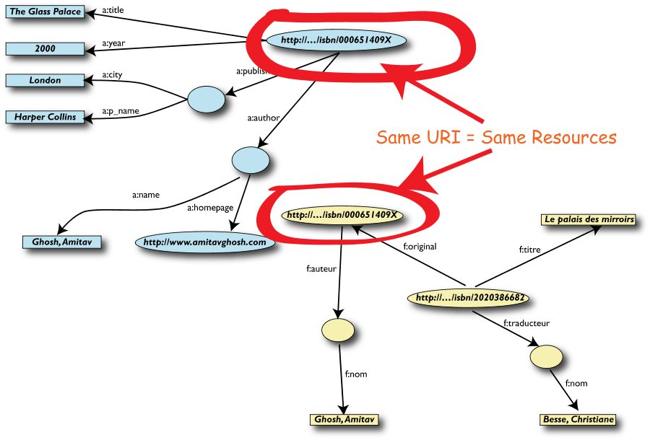
3rd: start merging your data (cont’d)

Slide 30
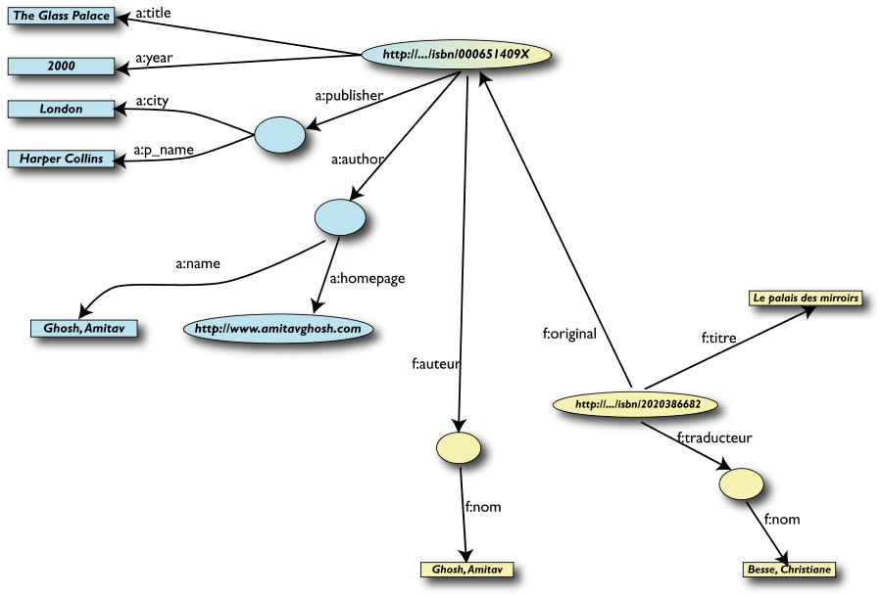
4th: Merge identical resources

Slide 31
Start posing queries…
User of data set “F” can now ask queries like:
“What is the title of the original version of Le Palais des miroirs?”
This information is not in the data set “F”...
…but can be retrieved after merging with data set “A”!

Slide 32
5th: Query the merged data set

Slide 33
However, we can achieve more …
We “know” that a:author and f:auteur are really the same
But our automatic merge does not know that!
Let us add some extra information to the merged data:
a:author is equivalent to f:auteur
both denote a Person, a category (type) for certain resources
a:name and f:nom are equivalent to foaf:name

Slide 34
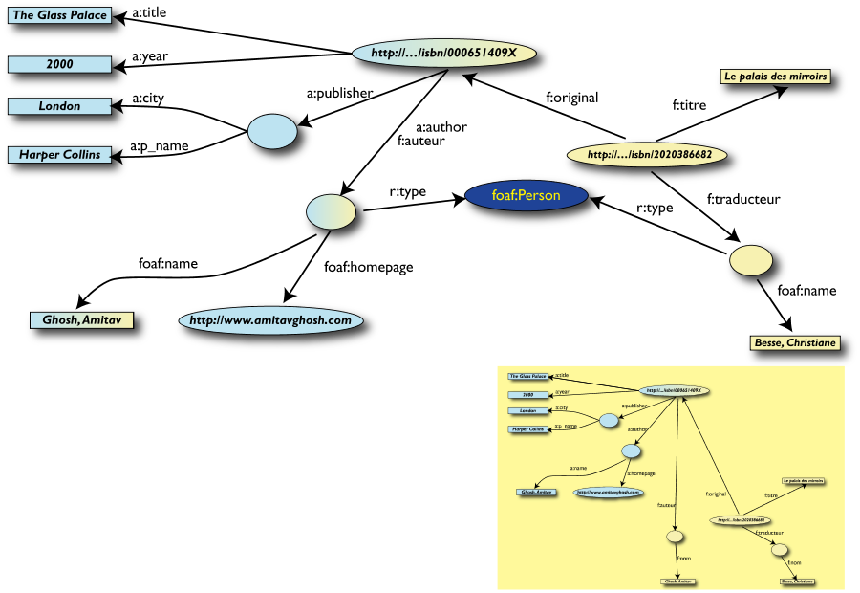
3rd revisited: Use the extra knowledge

Slide 35
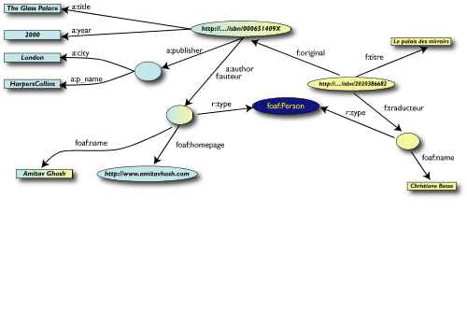
Start making richer queries!
User of data set “F” can now query:
“What is the home page of the ‘auteur’ of the orignal version of Le Palais des miroirs ?”
The information is not in data set “F” or “A”…
…but was made available by:
Merging data sets “A” and “F”
Adding three simple “glue” statements

Slide 36
6th: Richer queries

Slide 37
Bring in other data sources
We can integrate new information into our merged data set from other sources
e.g. additional information about author Amitav Ghosh
Perhaps the largest public source of general knowledge is Wikipedia
Structured data have been extracted from Wikipedia and put into a resource called DBpedia

Slide 38
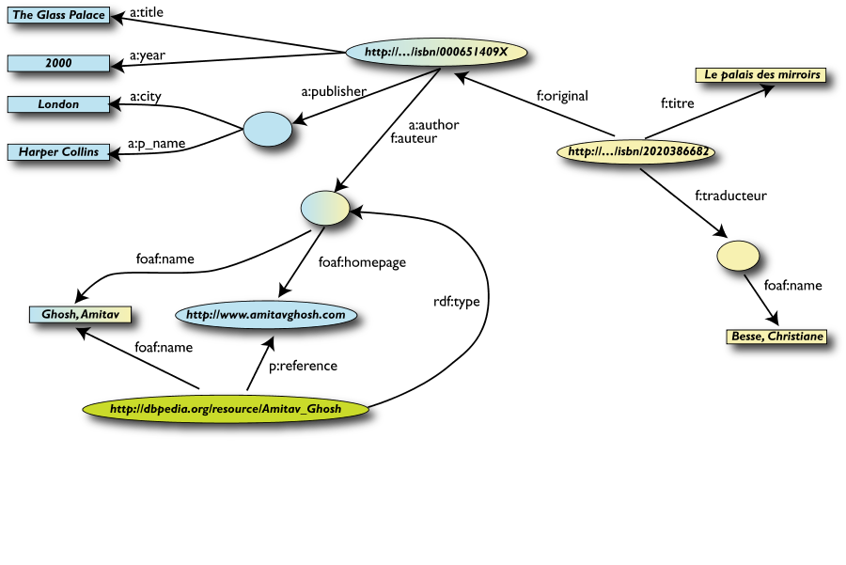
7th: Merge with DBpedia data
owl:sameAs

Slide 39
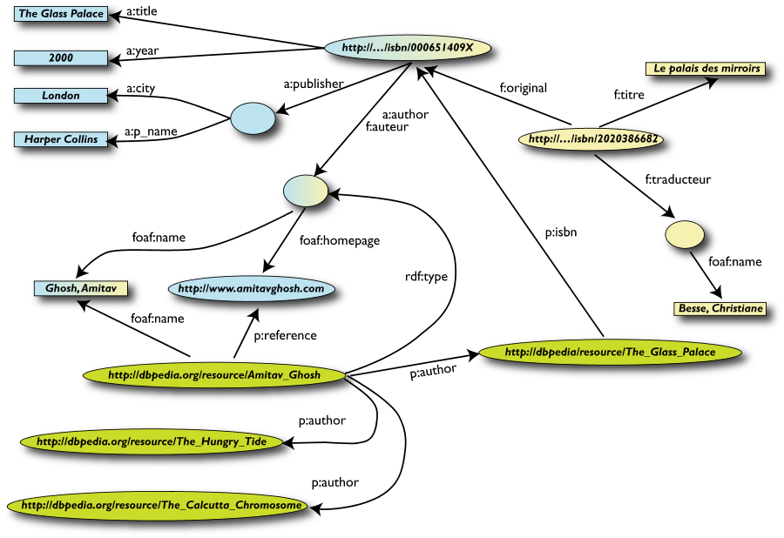
7th (cont’d): Merge with DBpedia data
owl:sameAs

Slide 40
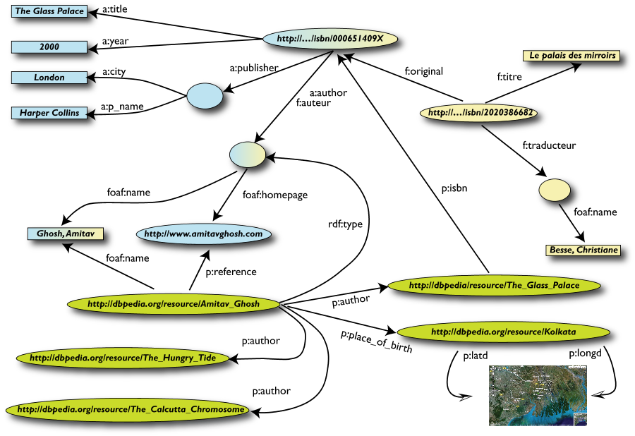
7th (cont’d): Merge with DBpedia data
owl:sameAs

Slide 41
Rigour Makes the Difference
What happened via automatic means is done every day by Web users!
The difference: a bit of extra rigour so that machines can do this, too

Slide 42
What Did We Do?
We combined different data sets that
may be internal or somewhere on the Web
are of different formats (RDBMS, Excel spreadsheet, (X)HTML, etc)
have different names for the same relations
We could combine the data because some URIs were identical
i.e. the ISBNs in this case
We could add some simple additional information (the “glue”) to help further merge data sets
➔ We could answer queries that previously could not even be asked

Slide 43
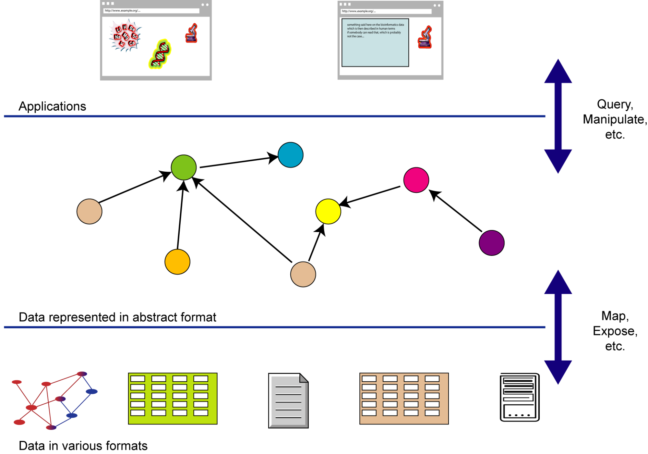
What Did We Do? (cont’d)

Slide 44
The Abstraction Pays off Because…
…the graph representation is independent of the details of the native structures
…a change in local database schemas, HTML structures, etc. does not affect the whole
“schema independence”
…new data, new connections can be added seamlessly & incrementally
… it doesn’t matter if you are at the enterprise level or at the web level

Slide 45
So where is the Semantic Web?
Semantic Web technologies make such integration possible

Slide 46
Semantic Technologies in Business
SNOMED
Oracle (Server)
IBM (DB2, Watson)
Schema.org
Good-relations
SAP
BBC
Best Buy
Startups

Slide 47
Semantic Technologies: Overview
A set of technologies and frameworks that enable semantic data management, data integration and the web of data
Resource Description Framework (RDF)
A variety of data interchange formats (e.g., RDF/XML, N3, Turtle, N-Triples)
Semantic languages such as RDF Schema (RDFS), the Web Ontology Language (OWL) and the Query language (SPARQL)
Software infrastructure (RDF/SPARQL frameworks, Triple stores, Data integrators, Query engines, Reasoners)
Publicly available connected dataset and open data initiatives (LOD)

Slide 48
Reading Material
PSW Chapter 1
SWP Part I, Chapter 1
FTW Section 1.4

