Slide 1
Distributed Systems 11. RPC and Java RMI
Simon Razniewski
Faculty of Computer Science
Free University of Bozen-Bolzano
A.Y. 2014/2015

Slide 2
Outline
Remote Procedure Call (RPC)
Distributed Objects Paradigm
Using the Java Remote Method Invocation (RMI)
Inside Java RMI

Slide 3
Message-oriented Communication
This kind of communication is based on two main primitives: send and receive.
With this approach the communication is not invisible to the user
Birrel and Nelson proposed an alternative way (early 80’s)
Allow programs to invoke procedures located at remote machines!
→Remote Procedure Call (RPC)

Slide 4
Remote Procedure Call (RPC)
The most common framework for newer distributed applications and for middleware.
Used both by operating systems and by applications.
NFS (network file system) is implemented as a set of RPCs
DCOM, CORBA, Java RMI, etc., are RPC/distributed object systems

Slide 5
Remote Procedure Call (RPC)
Fundamental idea:
A server process exports an interface of procedures or functions that can be called by client programs
similar to library API, class definitions, etc.
Clients make local procedure/function calls
As if directly linked with the server process
Under the cover:
procedure/function call is converted into a message exchange with remote server process.

Slide 6
Classical procedure/function call
file
buffer
bytes to read
count = read(fd, buf, bytes)
Parameters are inserted in the stack by the push primitive
Stack before the call is issued
When read terminates, it puts the value in a registry, removes the return address and returns the control to the caller

Slide 7
Remote Procedure Call
Would like to do the same if the called procedure or function is on a remote server.

Slide 8
RPC Stubs
A client-side stub is a function that looks to the client as if it were a callable server function
I.e., same API as the server’s implementation of the function
A server-side stub looks like a caller to the server
I.e., like a piece of code invoking the server function
The client program thinks it is invoking the server
but it’s calling into the client-side stub
The server program thinks it is called by the client
but it’s really called by the server-side stub
The stubs send messages to each other to make the RPC happen transparently (almost!)

Slide 9
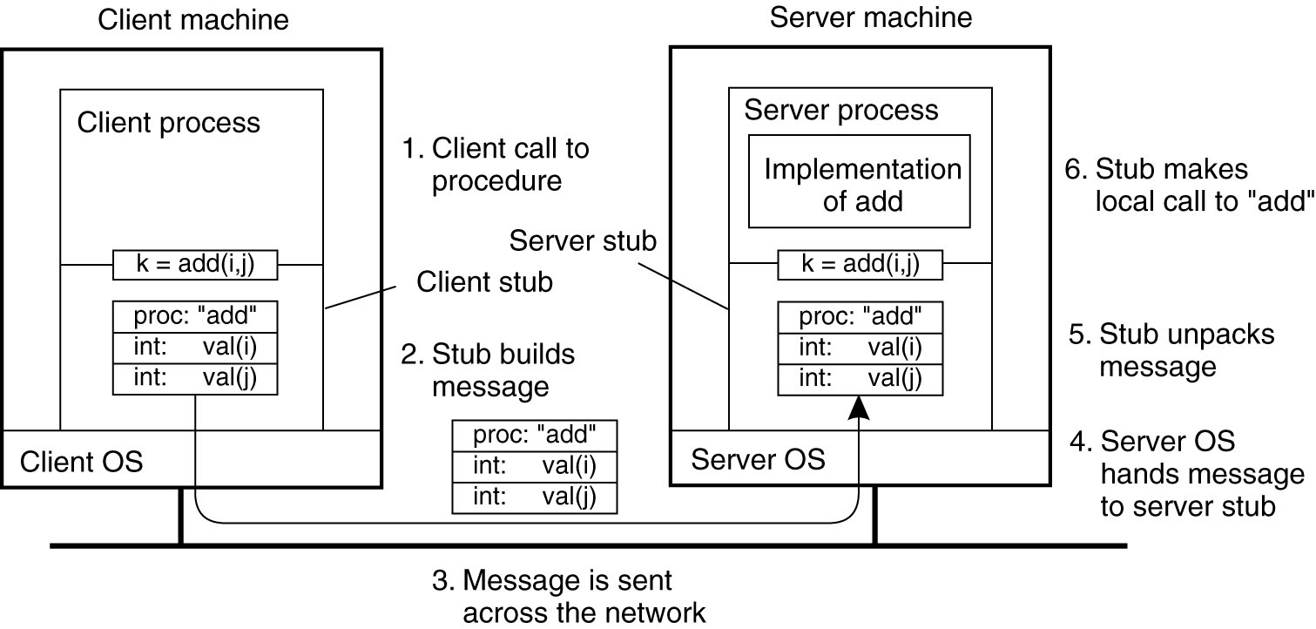
Illustration
Figure 4-7. The steps involved in a doing a remote computation through RPC.

Slide 10
Remote Procedure Call message exchanging
The hard work of building messages, formatting, uniform representation, etc., is buried in the stubs
have to take care encode parameters and send them over the network
→Client and server designers can concentrate on the semantics of application
Stubs usually created automatically

Slide 11
RPC – Issues
How to make the “remote” part of RPC invisible to the programmer?
What are semantics of parameter passing?
E.g., pass by reference?
How to bind (locate & connect) to servers?
How to handle heterogeneity?
OS, language, architecture, …
How to make it go fast?

Slide 12
RPC Model
A server defines the service interface using an interface definition language (IDL)
the IDL specifies the names, parameters, and types for all client-callable server procedures
A stub compiler reads the IDL declarations and produces two stub functions for each server function
Server-side and client-side

Slide 13
Marshaling Arguments
Marshaling is the packing of function parameters into a message packet
the RPC stubs call type-specific functions to marshal or unmarshal the parameters of an RPC
Client stub marshals the arguments into a message
Server stub unmarshals the arguments and uses them to invoke the service function
on return:
the server stub marshals return values
the client stub unmarshals return values, and returns to the client program

Slide 14
Representation of Data
Basic problem: Big endian vs little endian encoding
IDL must also define representation of data on network
Multi-byte integers
Strings, character codes
Floating point, complex, …
…
example: Sun’s XDR (external data representation)
Java’s object serialization

Slide 15
Issue #2 — Pointers and References
read(int fd, char* buf, int nbytes)
Pointers are only valid within one address space
Cannot be interpreted by another process
Even on same machine
Pointers and references are ubiquitous in C, C++
But also in Java
Solution: Copy and possibly overwrite on return

Slide 16
Transport of Remote Procedure Call
Option — TCP
Connection-based, reliable transmission
Useful but heavyweight, less efficient
Necessary if repeating a call produces different result
Alternative — UDP
If message fails to arrive within a reasonable time, caller’s stub simply sends it again
Okay if repeating a call produces same result
Java RMI: TCP

Slide 17
Asynchronous RPC
Analogous to generating a thread
Caller must eventually wait for result
Analogous to join

Slide 18
Asynchronous RPC (cont’d)
Analogous to generating a thread
Caller must eventually wait for result
Analogous to join
Or be interrupted (software interrupt)

Slide 19
How to locate RPC services?
Binding is the process of connecting the client to the server
the server, when it starts up, exports its interface
identifies itself to a network name server
tells RPC runtime that it is alive and ready to accept calls
the client, before issuing any calls, imports the server
RPC runtime uses the name server to find the location of the server and establish a connection
The import and export operations are explicit in the server and client programs

Slide 20
Remote Procedure Call is used …
Between processes on different machines
E.g., client-server model
Between processes on the same machine
More structured than simple message passing
Between subsystems of an operating system
Windows XP (called Local Procedure Call)

Slide 21
Distributed Objects

Slide 22
The Distributed Objects paradigm
Local Objects: objects whose methods can be invoked by a “local” process. Local means that the process is located on the same machine of the object.
Usual Object-Oriented Programming paradigm
Distributed (Remote) Objects: objects whose methods can be invoked by a “remote” process. Remote means that the process is running on a remote machine.

Slide 23
Architecture of a Distributed-Object System
Object Registry
lookup
register
Method invocation
Object Client
Object Server
Client Stub
Server Stub
Runtime Support
Runtime Support
Network Support
Network Support
Physical information flow
Logical information flow

Slide 24
Java Remote Method Invocation (RMI)‏
RMI extends the Java Object model to support programming with Distributed Objects
The intention is to make distributed programming as easy as standard Java programming
Focus on application logic not distribution
Network-related stuff hidden to the user
Enables different virtual machines to share objects, like in a shared address space

Slide 25
A Simple Overview
Java RMI allows one Java object to call methods on another Java object in a different JVM
Client JVM
Method parameters
Local
Object
Remote
Object
Result or exception
Server JVM

Slide 26
Java RMI
Java RMI is interface based
A remote object (or distributed service) is specified by its interface
“interfaces define behaviour and classes define implementations”
in RMI: Remote Interface
Interface
Implementation
RMI System
Client Program
Server Program

Slide 27
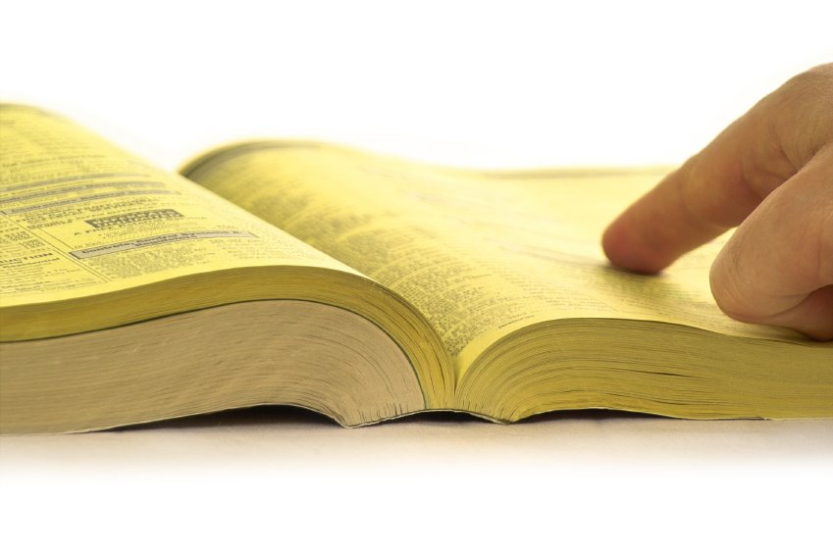
Java RMI
Before you invoke a method on a remote object you need a reference to this object
Look for an object with a specific interface type
There are various ways to find this information
Discovery Protocols
Naming Service, e.g. RMI Registry

Slide 28
The RMI Registry
The RMI Registry is a naming service
It is a separately Running service
Can be initiated within a program or using Java’s “rmiregistry” tool
Server programs register remote objects
Given the object a name under which it can be found
Client programs lookup object references that match this service name
Registry names have a URL format
rmi://<hostname>:<port>/<ServiceName>
E.g. rmi://localhost:1099/CalculatorService
E.g. rmi://194.80.36.30:1099/ChatService

Slide 29
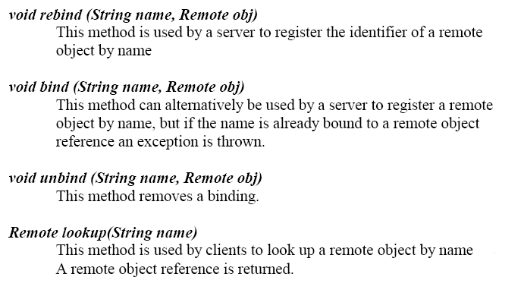
The RMI Registry Interface

Slide 30
Lookup in Java RMI
Interface
Remote Object
Client Program
Server Program
naming.lookup(“rmi://localhost:1099/ TestService”)‏
naming.rebind(“rmi://localhost/TestService”, RemoteObjectReference)‏
Server
Client
RMIRegistry
Local Machine

Slide 31
The RMI Architecture

Slide 32
Interaction between Stub and Skeleton

Slide 33
Parameter Passing
Parameter Passing in Java RMI is different from standard Java
Reminder: In Java, primitives are passed by value, Objects are passed by reference
In Java RMI
Primitives are passed by value
Objects are passed by value
Remote objects are passed by reference

Slide 34
Parameter Passing (2)‏
RMI-Pass by Value
All ordinary objects and primitives are serialized and a copy is passed
Any changes to the copy do not affect the original
RMI-Pass by Reference
Remote Object is the parameter, a stub (reference) is sent
the stub is used to modify the object, the original object is modified

Slide 35
Note on server-side objects
When a remote object is executed on a server, the latter starts accepting incoming (from clients) connections on a specific port
Since a remote object can be accessed by several clients:
safe access to this object must be guaranteed (i.e., use concurrent programming techniques where needed)‏

Slide 36
Marshaling / Unmarshaling in RMI
Primitive types (int, boolean, etc.) can be handled easily
Remote objects passed by reference (basically, by address)
Java RMI uses serialization / deserialization to handle marshaling / unmarshalling
of local objects, which are passed by value
– Serialization: converting an object into a sequence of bytes
•
•
•
•
•
Bytes may stored in a file / sent across network / etc.
Entire persistent state of object is stored
– Deserialization: reconstruction of an object from a sequence of bytes
•
•
Persistent state of object is rebuilt from bytes
Exceptions thrown if bytes contain error, or class is unknown, etc.
•
To support serialization, class must implement the java.io.Serializable
interface, and all fields must be serializable
–
–
–
No methods in interface
Implementing interface is just a signal to compiler that serialization is allowed
If you try to serialize / deserialize an object that is not serializable,
NotSerializableException is thrown

Slide 37
Note
The discussion is with respect to Java 5.0
and later
•
–
Earlier versions of RMI required the use of a separate
compiler, rmic, to produce stubs
Disseminating stubs to clients was more complicated
–
–
In pre-5.0 Java there were also skeletons, which sat
the server side and handled communications with
stubs
on
•
The Java 5.0 and later approach is simpler, but
you may still encounter legacy code using the
older approach

Slide 38
Building a Java RMI system
An RMI system must be composed of the following parts:
1. An interface definition of the remote services;
2. The implementations of the remote services;
3. A server to host the remote services;
4. An RMI Naming service
5. A client program that uses the remote services.

Slide 39
The java.rmi.Remote Interface
Classes of remote objects must implement the Remote interface
java.rmi
Here is the interface
interface Remote { }
???
•
in
•
•
–
–
Remote is an example of a “marker interface” (like Serializable)
Marker interfaces indicate that classes implementing them are
intended for special purposes
Remote objects will generally implement interfaces that extend
Remote
–
•
Requirement on methods in such interfaces: they must throw
RemoteException
This exception is raised when there are problems with the remote invocation
(e.g. network disruptions, host problems, etc.)
•

Slide 40
Creating Object Registries
Approach 1: rmiregistry
•
–
A command distributed with Java that can be run at the OS command line to
start a registry
Takes an option argument: the port on which to listen for requests (default is
1099)
The registry created in this fashion continues to run even if the server JVM
terminates
–
–
•
•
Such a registry can be used by several servers
If a server terminates, any references to remote objects on the server in such a registry
will continue to exist
If a client tries to access a nonexistent remote object, an exception is thrown
•
•
Approach 2: LocateRegistry.createRegistry()
–
–
LocateRegistry is a class in java.rmi.registry
static Registry createRegistry (int port)
•
(From Java 7 documentation): “Creates and exports a Registry instance on the local
host that accepts requests on the specified port”
“Exports” here means “makes the object remote”
What is returned is a stub for the remote Registry instance!
•
•

Slide 41
Launching an RMI Registry
Required before remote objects are accessible
Two approaches
Execute the command rmiregistry at the command prompt
In Windows: start rmiregistry
In Linux: rmiregistry &
The directory holding the rmiregistry executable must be in your path!
This registry may be shared by multiple servers
Such a registry can be used by several servers
If a server terminates, any references to remote objects on the server in such a registry
will continue to exist
If a client tries to access a nonexistent remote object, an exception is thrown
Default port: 1099
If problems, try “start rmiregistry -J-Djava.rmi.server.useCodebaseOnly=false”
In your Java (server) program, execute LocateRegistry.createRegistry(port);
•
•

Slide 42
Example:
Addition Server
•
Application contains four files
–
AdderInterface.java
Remote interface for adding two integers
Adder.java
Remote object class
AdditionServer.java
Server hosting an Adder
AdditionClient.java
Client accessing the adding function
–
–
–

Slide 43
Interface
public interface AdderInterface extends Remote {
public int add(int a,int b) throws Exception;
}

Slide 44
Object implementing the remote interface
public class Adder extends UnicastRemoteObject implements AdderInterface {
public Adder () throws RemoteException { }
public int add(int a, int b) throws Exception {
int result = a+b;
return result;
}
}

Slide 45
Server hosting the service
public class AdditionServer {
public static void main (String[] args) {
try {
System.setSecurityManager(new SecurityManager());
LocateRegistry.createRegistry(1099);
Adder a = new Adder();
Naming.rebind("rmi://localhost/ABC", a);
System.out.println("Addition Server is ready.");
}catch (Exception e) {
System.out.println("Addition Server failed: " + e);
}
}
}

Slide 46
Client calling the service
public class AdditionClient {
public static void main (String[] args) {
AdderInterface a;
try {
System.setSecurityManager(new SecurityManager());
a = (AdderInterface)Naming.lookup("rmi://localhost/ABC");
int result = a.add(9,10);
System.out.println("Result is: " + result);
}catch (Exception e) {
System.out.println(“Exception: " + e);
}
}
}

Slide 47
Security Policy
grant {
permission java.security.AllPermission;
};
VM arguments
-Djava.security.policy=file:${workspace_loc}/RMIClientSide/security.policy -Djava.rmi.server.codebase=file:${workspace_loc}/RMIClientSide/bin/

Slide 48
Inside
Java
RMI

Slide 49
Recall
Java RMI applications consist of three entities
•
–
Remote object servers
•
•
Host remote objects
Handle communications coming into / going out from these objects
–
Clients
•
•
Issue calls to methods in remote objects
Handle communications going out to / coming in from these objects
–
Object registries
•
•
Maintain bindings between names, remote objects
Have a “bootstrapping” function
–
–
Provide initial access point for clients needing remote objects
Once a client has stub for such an object, no need to consult registry!
•
We’ve seen how some of this works
–
–
–
Marshaling / unmarshaling via serialization
Registration of remote objects in registries
Stubs

Slide 50
RMI in More Detail
“Remote-izing” (aka exporting) an object
•
–
Server for a remote object must set up infrastructure for
unmarshaling arguments to remote object, marshaling results
Server must also invoke method in remote object
–
•
Registering a remote object
–
–
Server must provide name, stub for remote object
Name / object binding must be made available to potential
clients
•
Accessing a remote object
–
–
Client must be able to access remote object
Client must be able to marshal arguments to remote object
method, unmarshal results

Slide 51
Exporting an Object
Recall: “exportable” objects must come from a class that implements the Remote interface
What does an exported object need?
•
•
–
–
–
–
Incoming method-invocation requests need to be listened for
Arguments need to be unmarshaled
Methods in the actual object need to be invoked
Results need to be marshaled, returned to calling side
•
java.rmi.server.UnicastRemoteObject provides support for this
–
–
A class of remote objects
Constructor sets up infrastructure for listening for incoming method-invocations, marshaling / unmarshaling,
actual method invocation
Class also includes
static RemoteStub exportObject(Remote obj)
This method exports any object matching the Remote interface, returning a stub
–
–
•
•
Stub matches same (sub)interface of Remote that original object does
Stub is used on client side
•
So:
–
two ways to export an object
Make a class that extends UnicastRemoteObject; objects created in such a class are automatically
exported
Make a class that implements Remote, then export using UnicastRemoteObject.exportObject
Similar to threads (Thread vs Runnable)
–

Slide 52
Behind the Scenes with
exportObject()
What does exportObject() do?
•
–
–
–
A new socket (server socket) on the host is created
A thread is created to listen for connections on the socket
Infrastructure is also created to allocate other threads to handle
incoming calls (this enables first thread to continue listening)
A stub is created for use on the client side
–
•
•
Contains information about which socket the remote object listens on
Implements argument mashaling, result unmarshaling
–
A skeleton is created for use on the server side
Handles argument umarshaling, result marshaling of results, actual call of method
•
Remember: multiple threads can access a remote object!
–
If there are multiple method invocations in progress, more than one
thread on the host will be accessing the object
You must ensure that remote objects are thread-safe
–

Slide 53
Stubs and Skeletons
Both are objects in classes that are (as of Java 5)
created automatically from the class of the object
being exported
•
–
–
If the class of the remote object is Foo …
… then the class for stubs is Foo_Stub and the class
skeletons is Foo_Skel
Before Java 5 the programmer had to create these
using a command rmic
for
–
•
•
Both objects handle marshaling, unmarshaling
Stub class also implements same Remote
(sub)interface that original class does

Slide 54
Object Registration
Purpose of registration is to make it easier for clients to
use remote objects
RMI uses object registries to handle this task
•
•
–
–
Object registry is a separate thread from server
Often, it even runs in a different JVM from the server, but it
must run on the same host as server
This last fact implies that there can be several different
registries running in a given application
–
•
The registry binds names (strings) to stubs for remote
objects
Clients looking for remote objects must first locate a
registry
•

Slide 55
rmi.Naming
Registry objects allow names to be looked up, bound, etc.
•
–
These are instance methods, so the registry object must first be retrieved, e.g.
Registry registry = LocateRegistry.getRegistry();
registry.rebind(name, object);
Remote registries often accessed via URLs and port numbers, e.g.
Registry registry = LocateRegistry.getRegistry(“www.cs.umd.edu”,1099);
–
•
The class Naming includes “shortcuts” for these registry manipulations
–
The versions of bind / rebind / etc. assume the string argument is a URL including a host name,
port and object name
The appropriate registry is also obtained automatically
So, instead of
Registry registry = LocateRegistry.getRegistry(“www.cs.umd.edu”,1099);
registry.rebind(“foo”, object); You can do this: Naming.rebind(“rmi://www.cs.umd.edu:1099/foo”, object);
If you leave off the “rmi//www.cs.umd.edu:1099” part, Naming.rebind will look for the registry running on the local host on the default port (1099)
–
–
–

Slide 56
Security
Downloading remote code (stubs) poses security risks
•
–
–
The code may be buggy
The code may be malicious
•
Java enables the definition of security managers and
policies to limit the access downloaded code has to system
resources
These can be defined in system properties like
java.security.manager and
java.security.policy
Your JVM may have these set already, and they may
interfere with remote downloading
You can also set a security manager in your Java program
using System.setSecurityManager()
•
•
•

Slide 57
Terminating RMI Servers
Once an object is exported, the server will create a thread to serve incoming requests
How to terminate a server
Registry.unbind() or
UnicastRemoteObject.unexportObject(obj,true)
Otherwise, the server JVM continues to run even after its main method has terminated

Slide 58
Further Links and Acknowledgement
http://www.ejbtutorial.com/java-rmi/a-step-by-step-implementation-tutorial-for-java-rmi
http://www.cs.umd.edu/class/spring2014/cmsc433-0101/ (Lectures 22 and 23)

Slide 59
Take home
RPC is a common paradigm for distributed applications
Hides networking complexity
Distributed objects extend this paradigm
Java RMI implements the distributed object paradigm
Initial connection using the RMI registry
Stubs

