Slide 1
Distributed Systems 23. Cryptography
Simon Razniewski
Faculty of Computer Science
Free University of Bozen-Bolzano
A.Y. 2016/2017

Slide 2
Outline
Symmetric methods
Diffie-Hellman key exchange
Asymmetric methods
RSA
Example protocols/methods
Digital signatures
TLS (former SSL)
Man-in-the-middle and the importance of certificates
VPN
Appendix: RSA in Java

Slide 3
Network Security
Security concerns a variety of threats and defenses across all layers
Encryption is an important building block of secure networking
But best security is avoidance ☺
Application
Transport
Network
Link
Physical

Slide 4
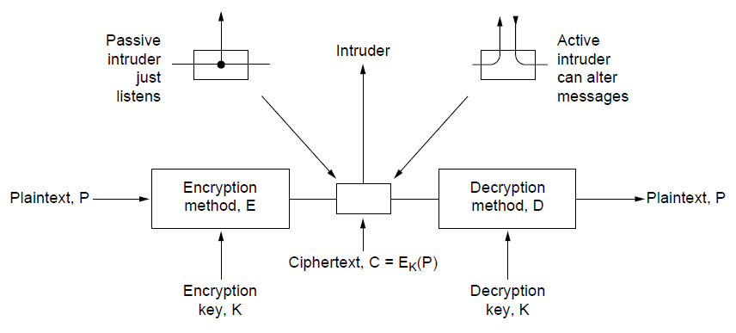
Encryption: General model
The encryption model
Kerckhoff’s principle: Algorithms (E, D) are public; only the keys (K, K’) are secret
Symmetric methods: K=K’
Trudy
Alice
Bob
‘
Notes:
Reason otherwise: once alg is exposed, lost

Slide 5
Terminology
Plain text
Cipher text
Cipher: Algorithm for encryption and decryption
Encryption: Plain text → Cipher text
Decryption: Cipher text →Plain text
Key
Symmetric key ciphers: Same key used for encryption and decryption
Asymmetric key ciphers: Keys used for encryption and decryption are different

Slide 6
Symmetric-Key Algorithms
Encryption and decryption key are the same

Slide 7
Caesar cipher
Letters are shifted by a fixed offset n
Offset 3:
Plaintext: abcdefghijk
Ciphertext: defghijklmn
How many possible keys?

Slide 8
Substitution Ciphers
Substitution ciphers replace each group of letters in the message with another group of letters to disguise it
Plaintext: Hello John. How are you doing?
Ciphertext: ITSSG PGIF. IGV QKT NGX RGOFU?
How many possible keys?

Slide 9
Building blocks of state-of-the art ciphers
Block ciphers operate a block at a time
Product cipher combines transpositions/substitutions
Permutation
(transposition)
box
Substitution
box
Product with multiple P- and S-boxes

Slide 10
Advanced Encryption Standard (1)
State of the art for symmetric techniques
Symmetric block cipher, key lengths up to 256 bits
Openly designed by public competition (1997-2000)
Winner was Rijndael cipher
Available for use by everyone
Built as software (e.g., C) or hardware (e.g., x86)
Now a widely used standard

Slide 11
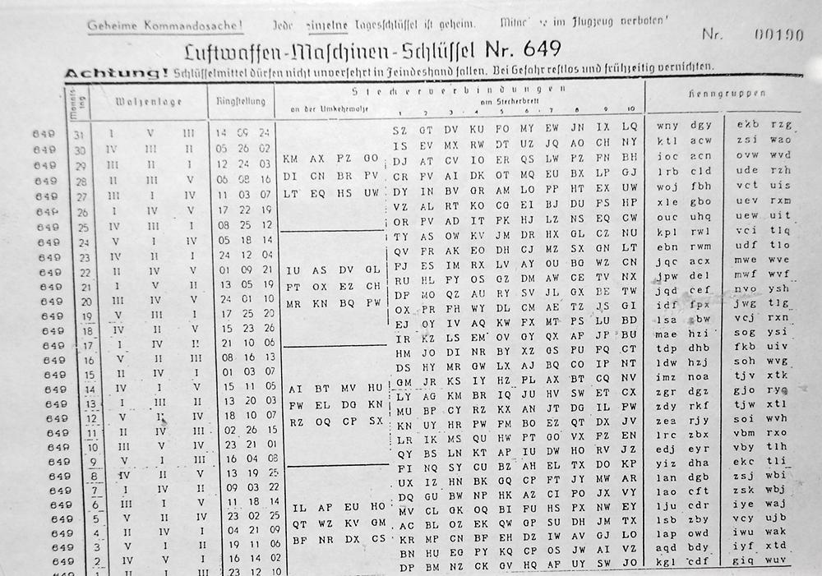
Notes:
enigma

Slide 12
Diffie–Hellman key exchange
Publicly agree on a modulo m (a reasonably small prime number)
Publicly agree on a base b (a smaller prime number)
Partner 1: Secretly choose an arbitrary number x and calculate r=b^{x} mod m Partner 2: Secretly choose an arbitrary number y and calculate s=b^{y} mod m
Publicly tell each other the numbers r and s
Partner 1: Calculate the shared secret as s^{x} mod m Partner 2: Calculate the shared secret as r^{y} mod m
Mathematical foundation: Exponentiation in modulo rings is easy, factorization is difficult

Slide 13
Remember: Modulo exponentiation by squaring
7⁴³ mod 11 = ?
https://en.wikipedia.org/wiki/Exponentiation_by_squaring
Notes:
49^21*7
5^21*7
25^10*5*7
…
=2

Slide 14
Asymmetric Techniques
Keys for encryption and decryption are different
→ Solves the key-setup problem of symmetric methods!
RSA (by Rivest, Shamir, Adleman – 1977)
equivalent technique four years earlier at GCHQ

Slide 15
Asymmetric Techniques (2)
Downsides of keys for symmetric-key designs:
Key must be secret, yet be distributed to both parties
For N users there are N² pairwise keys to manage
Asymmetric algorithms split the key into public and private parts that are mathematically related:
Private part is not distributed; easy to keep secret
Only one public key per user needs to be managed
Security depends on the chosen mathematical property
Much slower than symmetric-key, e.g., 1000X
So used to set up per-session symmetric keys

Slide 16
RSA
RSA is a widely used public-key encryption method whose security is based on the difficulty of factoring large numbers
Key generation:
Choose two large primes, p and q
Compute n = p × q and z = ( p − 1) × (q − 1).
Choose d to be relatively prime to z
Find e such that (e × d) mod z = 1
Public key is (e, n), and private key is (d, n)
Encryption (for single numbers up to n):
Cipher = Plain^{e} (mod n)
Decryption:
Plain = Cipher^{d} (mod n)
Let’s try….

Slide 17
Safety of RSA
To break it: Factorize n
Factorization: No efficient algorithm known to date
Largest factorized difficult number so far: 768 bits (RSA768), required utilizing hundreds of machines over a span of two years.
300 bit numbers can be factorized on standard laptops in hours!
However, no proof for the nonexistence of efficient algorithms known
Does the NSA already have such an algorithm?
Quantum computers allow polynomial factorization
….???
Strong random number generators needed

Slide 18
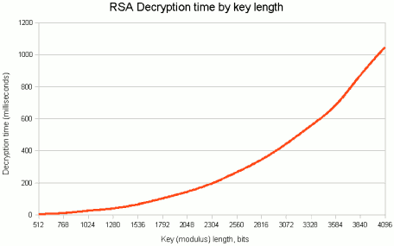
(Decryption with known key, not code breaking!)
Recommended key length: >2048 bits
→ Slow decryption is reason for use of symmetric cryptosystems

Slide 19
Acoustic Attack
https://www.youtube.com/watch?v=DU-HruI7Q30

Slide 20
One-Time Pads
Simple scheme for perfect secrecy:
XOR message with secret pad to encrypt, decrypt
Pad is as long as the message and can’t be reused!
It is a “one-time” pad to guarantee secrecy
Different secret pad decrypts to the wrong plaintext
→For highest security:
1) Create offline a large random file
2) Transmit it offline to your communication partner
3) Use it for your communication
Still, hacker might aim towards the random file itself

Slide 21
Digital Signatures
Allow verification of messages
What does that mean?
Receiver can verify claimed identity of sender.
Sender cannot later repudiate contents of message.
Receiver cannot have modified message himself.

Slide 22
Public-Key Signatures
Assumes encryption and decryption are inverses that can be applied in either order (as is the case for RSA)
Relies on private key kept and secret
RSA & DSS (Digital Signature Standard) widely used

Slide 23
Public Key Signatures - Requirements?
Receiver can verify claimed identity of sender?
Sender cannot later repudiate contents of message?
Receiver cannot have modified message himself?

Slide 24
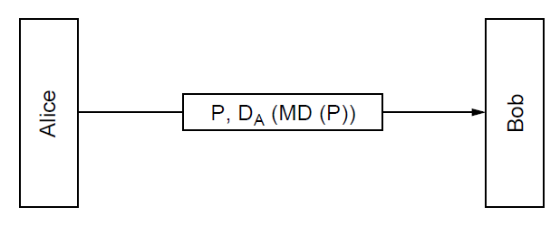
Message Digests
Public-key signature for message authenticity but not confidentiality with a message digest
Message sent in the clear
Alice signs
message digest

Slide 25
Message Digests (3)
In more detail: example of using SHA-1 message digest and RSA public key for signing nonsecret messages

Slide 26
Management of Public Keys (1)
Is RSA safe?
What if public keys are forged?
Trudy replaces E_{B} with E_{T} and acts as a “(wo)man in the middle”
Alice thinks she is encrypting messages with Bob’s public key
But it is Trudy’s public key
Trudy then encrypts the messages with Bob’s public key
→Bob does not notice

Slide 27
Management of Public Keys
Homepages?
https://suchanek.name/
We need a trusted way to distribute public keys
Certificates
Public Key infrastructures

Slide 28
Certificates
CA (Certification Authority) issues signed statements about public keys; users trust CA and it can be offline
- need to trust public key of CA
A possible certificate

Slide 29
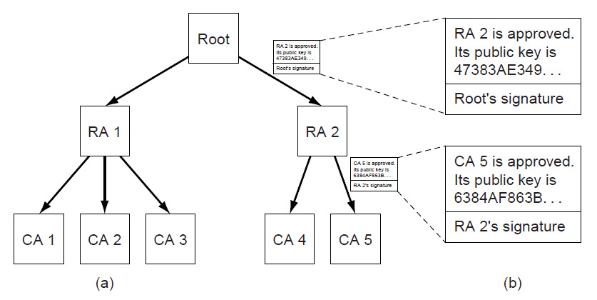
Public Key Infrastructures (PKIs)
PKI is a system for managing public keys using CAs
Scales with hierarchy, may have multiple roots
Also need CRLs (Certificate Revocation Lists)
Trust anchor
Chain of certificates for CA 5
Hierarchical PKI

Slide 30
http://dab-bank.de
→ Firefox>Options>Advanced
see also https://wiki.mozilla.org/CA:IncludedCAs

Slide 31
Web Security
Applications of security to the Internet
Secure naming
SSL—Secure Sockets Layer
IPSec
Many other issues with downloaded code

Slide 32
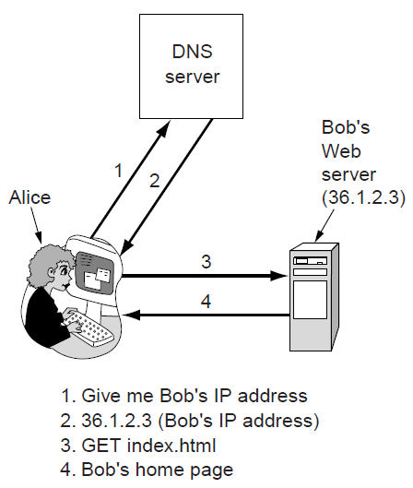
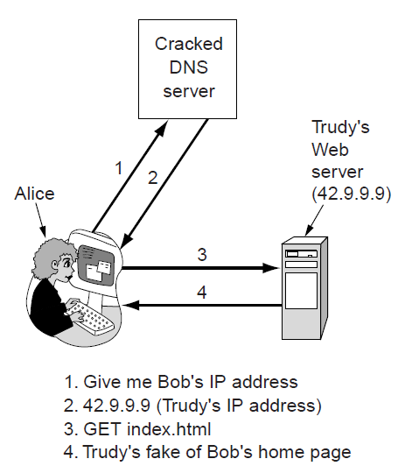
Secure Naming (1)
DNS names are included as part of URLs – so spoofing DNS resolution causes Alice contact Trudy not Bob (remember: DNS over UDP)
Trudy sends spoofed reply

Slide 33
Secure Naming (2)
DNSsec (DNS security) adds strong authenticity to DNS
Responses are signed with private keys
Public keys are included; client starts with top-level
Deployment slow
For current status, see e.g. http://en.wikipedia.org/wiki/List_of_Internet_top-level_domains
Resource Record set for bob.com.
Has Bob’s public key (KEY), and is signed by .com server (SIG)
=> Allows to verify whether answers to DNS lookups at bob.com are really from Bob

Slide 34
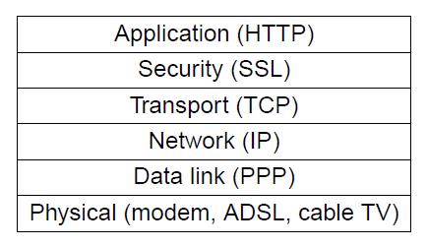
SSL—Secure Sockets Layer (1)
SSL provides an authenticated, secret connection between two sockets; uses public keys with X.509
TLS (Transport Layer Security) is the IETF version of Netscape’s SSL
SSL runs on top of TCP and below
the application
HTTPS means
HTTP over SSL
SSL in the protocol stack

Slide 35
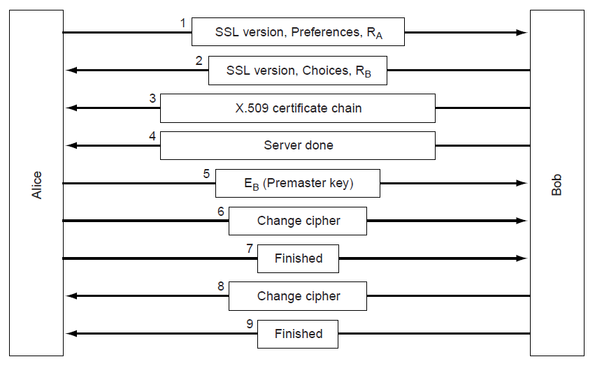
SSL—Secure Sockets Layer (2)
Phases in SSL V3 connection establishment (simplified)
Only the client (Alice) authenticates the server (Bob)
Session key computed on both sides (E_{B}, R_{A}, R_{B})

Slide 36
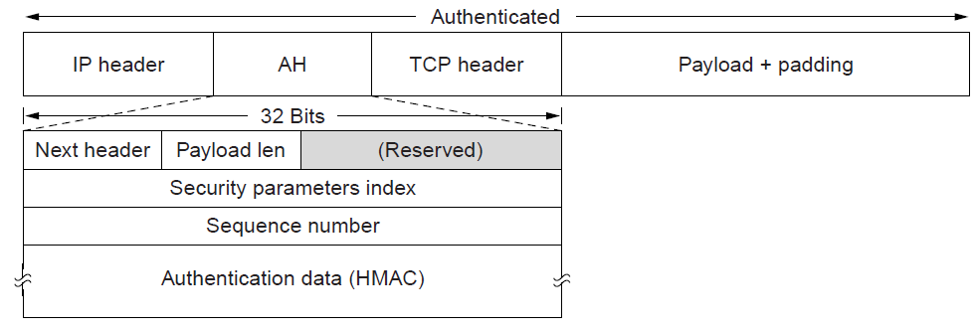
IPsec (1)
IPsec adds confidentiality and authentication to IP
Secret keys are set up for packets between endpoints called security associations
Adds AH header; inserted after IP in transport mode
Identifies security association
AH (Authentication Header) provides integrity and anti-replay

Slide 37
Private Networks
Quite secure
attacks require physical tapping
expensive
Virtual private networks (VPNs) allow private networks over public networks
Ease of use of the network
Only VPN needs to be secured, instead of each internal application individually

Slide 38
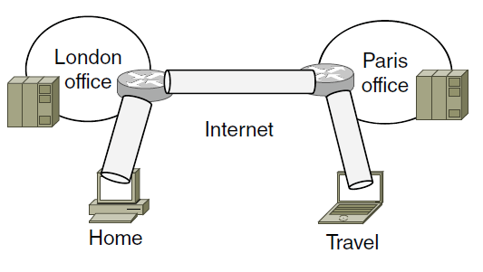
Virtual Private Networks (1)
VPNs (Virtual Private Networks) join disconnected islands of a logical network into a single virtual network
Islands are joined by tunnels over the Internet
Tunnel
VPN joining London, Paris, Home, and Travel

Slide 39
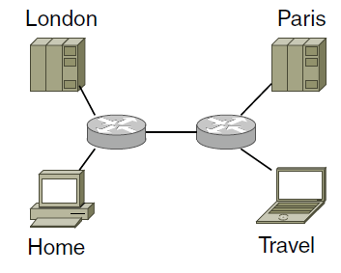
Virtual Private Networks (2)
VPN traffic travels over the Internet but VPN hosts are separated from the Internet
Need a gateway to send traffic in/out of VPN
Topology as seen from inside the VPN

Slide 40
Tunneling
Can happen at different layers/using different technology
IPSec
Network Layer
setting done (in principle) in network adapter settings
VPN Clients
Link Layer
commonly setup using virtual network adapters that use SSL
Common solution for individuals (e.g. Cisco AnyConnect, OpenVPN)
Router-to-router
Tunneling becomes transparent to connected devices
Common solution for connecting offices

Slide 41
Only a glimpse
Other relevant topics
Denial of service attacks
Traffic analysis
Privacy
TOR network
Freedom of speech
…

Slide 42
Learned today
Symmetric vs. asymmetric encryption
Symmetric is faster
Requires key exchange protocols such as Diffie-Hellman
Asymmetric techniques require no key exchange, only trusted lookup
Done via certificate agencies
How RSA works
VPNs as a generic way of securing network traffic

Slide 43
Create Keys
KeyPairGenerator keyGen = KeyPairGenerator.getInstance("RSA");
keyGen.initialize(1024);
KeyPair key = keyGen.generateKeyPair();
File privateKeyFile = new File(PRIVATE_KEY_FILE);
File publicKeyFile = new File(PUBLIC_KEY_FILE);
privateKeyFile.createNewFile();
publicKeyFile.createNewFile();
// Saving the Public key in a file
ObjectOutputStream publicKeyOS = new ObjectOutputStream(
new FileOutputStream(publicKeyFile));
publicKeyOS.writeObject(key.getPublic());
publicKeyOS.close();
// Saving the Private key in a file
ObjectOutputStream privateKeyOS = new ObjectOutputStream(
new FileOutputStream(privateKeyFile));
privateKeyOS.writeObject(key.getPrivate());
privateKeyOS.close();

Slide 44
Encrypt
public static byte[] encrypt(String text, PublicKey key) throws NoSuchAlgorithmException, NoSuchPaddingException, InvalidKeyException, IllegalBlockSizeException, BadPaddingException
{
byte[] cipherText = null;
// get an RSA cipher object and print the provider
final Cipher cipher = Cipher.getInstance("RSA");
// encrypt the plain text using the public key
cipher.init(Cipher.ENCRYPT_MODE, key);
cipherText = cipher.doFinal(text.getBytes());
return cipherText;
}

Slide 45
Decrypt
public static String decrypt(byte[] text, PrivateKey key) throws NoSuchAlgorithmException, NoSuchPaddingException, InvalidKeyException, IllegalBlockSizeException, BadPaddingException
{
byte[] decryptedText = null;
// get an RSA cipher object and print the provider
final Cipher cipher = Cipher.getInstance("RSA");
// decrypt the text using the private key
cipher.init(Cipher.DECRYPT_MODE, key);
decryptedText = cipher.doFinal(text);
return new String(decryptedText);
}

Slide 46
Print Keys in Human-readable Form
private static void printKeys(PrivateKey privateKey, PublicKey publicKey) throws InvalidKeySpecException, NoSuchAlgorithmException
{
KeyFactory fact = KeyFactory.getInstance("RSA");
RSAPublicKeySpec pub = fact.getKeySpec(publicKey,
RSAPublicKeySpec.class);
RSAPrivateKeySpec priv = fact.getKeySpec(privateKey,
RSAPrivateKeySpec.class);
System.out.println("Printing keys...");
System.out.println(" Public exponent: " + pub.getPublicExponent().toString());
System.out.println(" Public modulus: " + pub.getModulus().toString());
System.out.println(" Private exponent: " + priv.getPrivateExponent().toString());
System.out.println(" Private modulus: " + priv.getModulus().toString());
}

Slide 47
Further References
http://www.javamex.com/tutorials/cryptography/rsa_encryption_2.shtml
https://javadigest.wordpress.com/2012/08/26/rsa-encryption-example/
(http://www.java2s.com/Tutorial/Java/0490__Security/BasicRSAexample.htm)

