Slide 1
Distributed Systems 11. Transport Layer
Simon Razniewski
Faculty of Computer Science
Free University of Bozen-Bolzano
A.Y. 2016/2017

Slide 2
Notes
Youtube Pakete?
UDP, RTP
https://ask.wireshark.org/questions/5597/how-to-capture-traffic-from-youtube

Slide 3
Transport Layer
Transport Service
Elements of Transport Protocols
Internet Protocols – UDP
Internet Protocols – TCP

Slide 4
The Transport Layer
Responsible for delivering data between applications across networks with the desired reliability or quality
2 differences to network layer?
Application
Transport
Network
Link
Physical

Slide 5
Services Provided to the Upper Layers (1)
Transport layer adds reliability to the network layer
Offers connectionless (e.g., UDP) and connection-oriented (e.g, TCP) service to applications
Adds multiplexing via ports
Congestion-handling
Flow-control

Slide 6
Transport Service
Elements of Transport Protocols
Adressing
Connection handling
Flow control
Congestion control
Internet Protocols – UDP
Internet Protocols – TCP

Slide 7
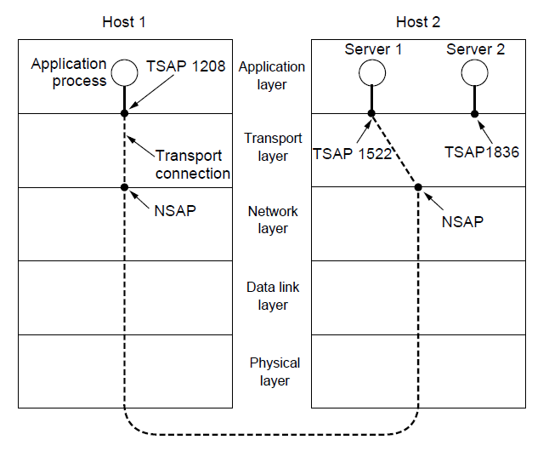
Addressing
Transport layer adds ports
Multiple clients and servers can run on a host with a single network (IP) address
Analogy: Office numbers
Connections are differentiated by quadruple of source and destination IPs and ports)

Slide 8
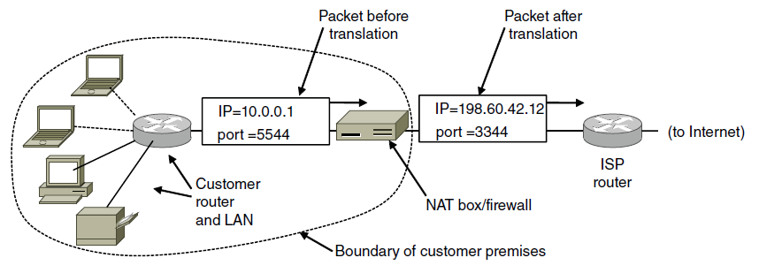
Network address translation (NAT)
NAT (Network Address Translation) box maps one external IP address to many internal IP addresses
Uses TCP/UDP port to tell connections apart
How can two machines connect to the same webserver?
How can we set up our own web/game server?
http://stackoverflow.com/questions/1982222/how-do-two-computers-connect-to-same-external-address-through-nat

Slide 9
Connection Establishment (1)
Key problem is to ensure reliability even though packets may be lost, corrupted and duplicated
Don’t treat an old or duplicate packet as new
(Use ACKs and checksums for loss/corruption)
Approach:
Don’t reuse sequence numbers within 2 minutes
Three-way handshake for establishing connection

Slide 10
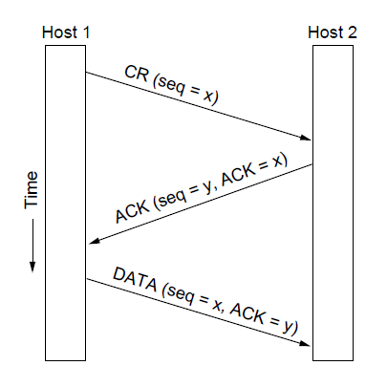
Connection Establishment (2)
Three-way handshake used for initial packet
Since no state from previous connection
Both hosts contribute fresh seq. numbers
CR = Connect Request

Slide 11
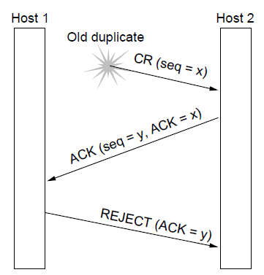
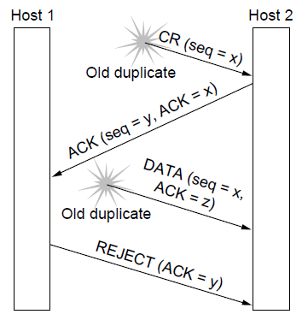
What if we used a simpler connection setup?
Three-way handshake protects against odd cases:
Duplicate CR. Spurious ACK does not connect
Duplicate CR and DATA. Same plus DATA will be rejected (wrong ACK).
a)
X
b)
X
X

Slide 12
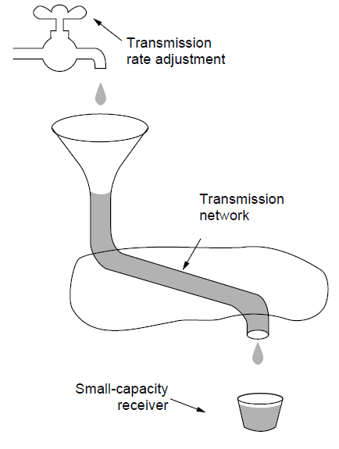
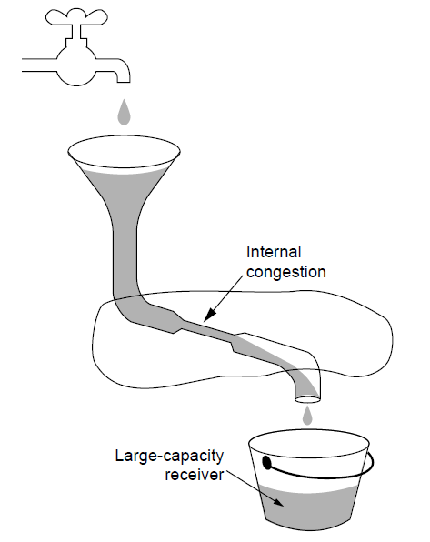
Flow vs. congestion control
Sender may need to slow down for different reasons:
Flow control, when the receiver is not fast enough
Congestion control, when the network is not fast enough

Slide 13
Flow Control (1)
Foundation for flow control is a sliding window with checksums and retransmissions
Flow control manages buffering at sender/receiver
Issue is that data goes to/from the network and applications at different times
Window tells sender available buffering at receiver
Makes a variable-size sliding window

Slide 14
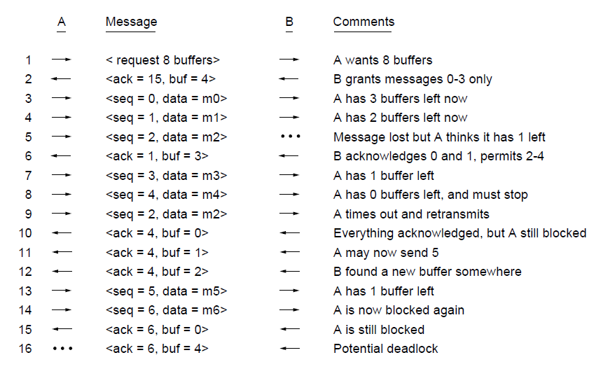
Flow Control (2)
Flow control example: A’s data is limited by B’s buffer
B’s Buffer
0
1
2
3
0
1
2
3
0
1
2
3
0
1
2
3
1
2
3
4
1
2
3
4
1
2
3
4
1
2
3
4
1
2
3
4
2
3
4
5
3
4
5
6
3
4
5
6
3
4
5
6
3
4
5
6
7
8
9
10

Slide 15
Congestion Control
Two layers are responsible for congestion control:
Transport layer, controls the offered load [here]
Network layer, experiences congestion [previous lecture]

Slide 16
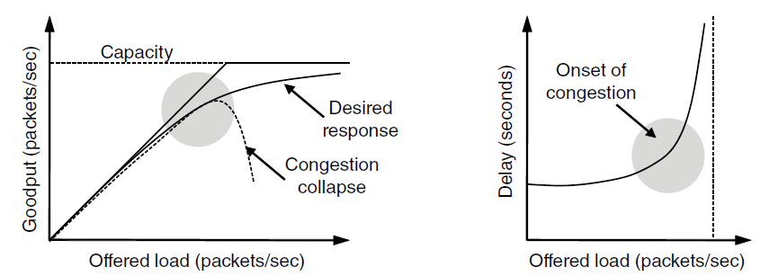
Desirable Bandwidth Allocation
Efficient use of bandwidth gives high goodput, low delay
Goodput rises more slowly than load when congestion sets in
Delay begins to rise sharply when congestion sets in

Slide 17
Regulating the Sending Rate
Different congestion signals the network may use to tell the transport endpoint to slow down (or speed up)

Slide 18
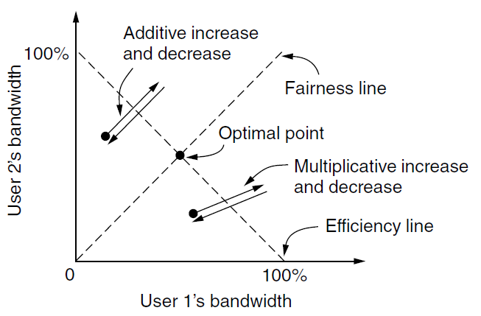
Regulating the Sending Rate (3)
If two flows increase/decrease their bandwidth in the same way when the network signals free/busy they will not converge to a fair allocation
+ /– constant
+/– percentage

Slide 19
Magic solution: Additive increase, multiplicative decrease
Increase: +10
Decrease: -20%
Let’s try it. Suppose A, B and C share a link.
Sender A starts with 70% link utilization, Sender B with 20%, Sender C with 0%. All would like to use as much as possible bandwidth.

Slide 20
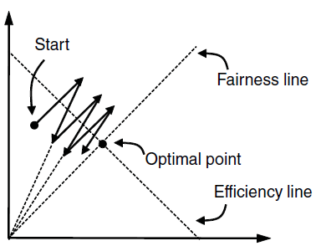
Regulating the Sending Rate (4)
The AIMD (Additive Increase Multiplicative Decrease) control law does converge to a fair and efficient point!
TCP uses AIMD for this reason
User 2’s bandwidth
User 1’s bandwidth

Slide 21
In Java

Slide 22
MIAD
Does it work?

Slide 23
Wireshark and packet sniffing…

Slide 24
Transport Service
Elements of Transport Protocols
Internet Protocols – UDP
Internet Protocols – TCP

Slide 25
Introduction to UDP (1)
UDP (User Datagram Protocol) is a minimal extension on top of IP
Header has ports (TSAPs), length and checksum.

Slide 26
Wireshark…

Slide 27
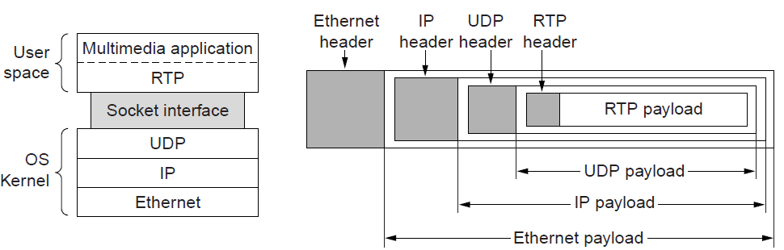
Real-Time Transport (1)
RTP (Real-time Transport Protocol) provides support for sending real-time media over UDP
Often implemented as part of the application
Application also takes care of buffering (jitter)

Slide 28
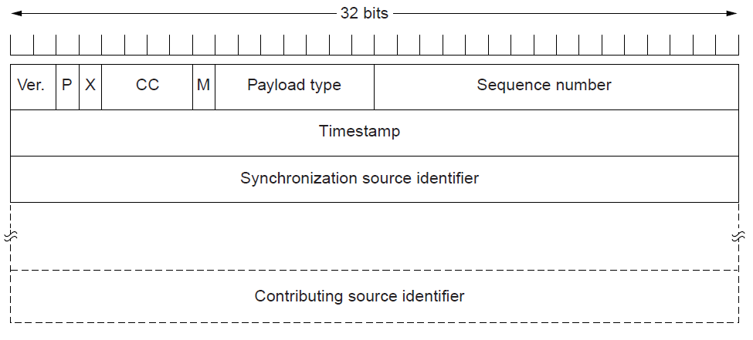
Real-Time Transport (2)
RTP header contains fields to describe the type of media and synchronize it across multiple streams

Slide 29
Transport Service
Elements of Transport Protocols
Internet Protocols – UDP
Internet Protocols – TCP

Slide 30
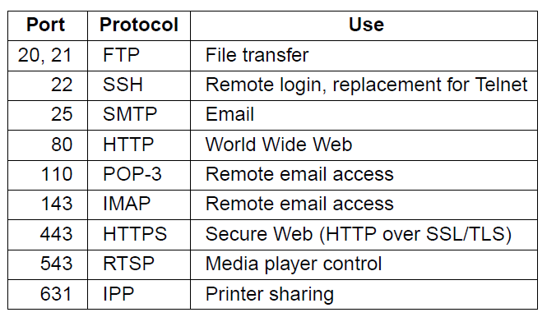
The TCP Service Model (1)
TCP provides applications with a reliable byte stream between processes; it is the workhorse of the Internet
Popular servers run on well-known ports

Slide 31
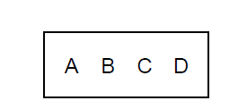
The TCP Service Model (2)
Applications using TCP see only the byte stream [right] and not the segments [left] sent as separate IP packets
Four segments, each with 512 bytes of data and carried in an IP packet
2048 bytes of data delivered to application in a single READ call

Slide 32
Wireshark…

Slide 33
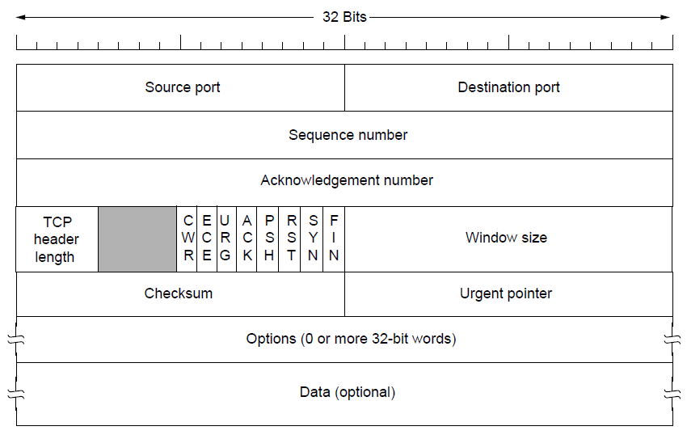
The TCP Segment Header
TCP header includes addressing (ports), sliding window (seq. / ack. number), flow control (window), error control (checksum) and more.

Slide 34
TCP Connection Establishment
TCP sets up connections with the three-way handshake
Release is symmetric

Slide 35
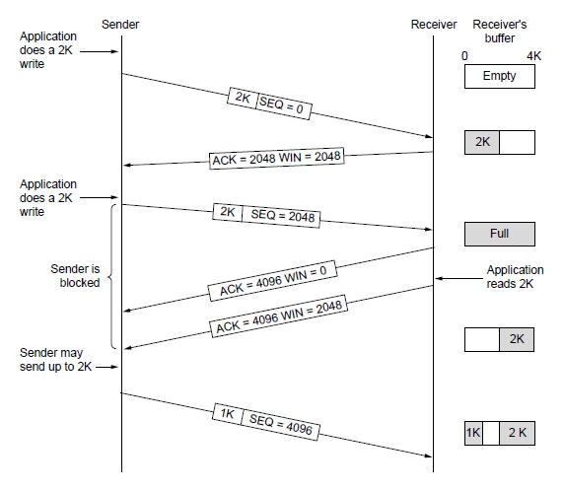
TCP Sliding Window
TCP adds flow control to the sliding window as before
WIN is window size

Slide 36
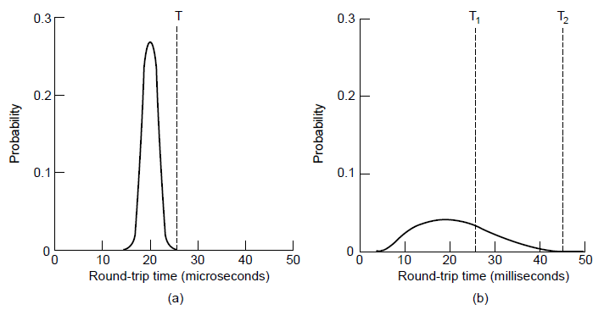
TCP Timer Management
TCP estimates retransmit timer from segment RTTs
Tracks both average and variance
Timeout is set to average plus 4 x variance
LAN case – small, regular RTT
Internet case – large, varied RTT

Slide 37
TCP Congestion Control (1)
TCP uses AIMD with loss signal to control congestion
Implemented as a congestion window (cwnd) for the number of segments that may be in the network
Congestion window controls the sending rate
Rate is cwnd / RTT; window can stop sender quickly
Cwnd typically much smaller than flow control window (WIN)

Slide 38
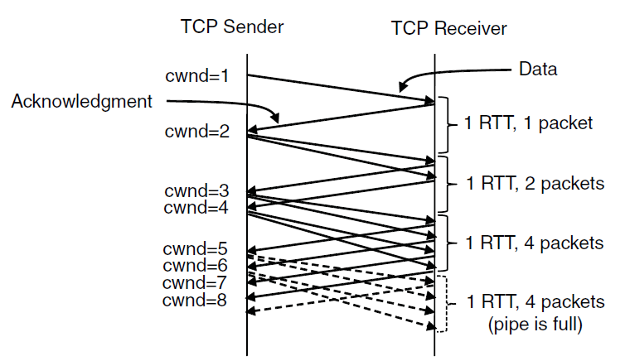
TCP Congestion Control (2)
Slow start grows congestion window exponentially by sending increasing cwnd with every ACK
Increment cwnd for each new ACK

Slide 39
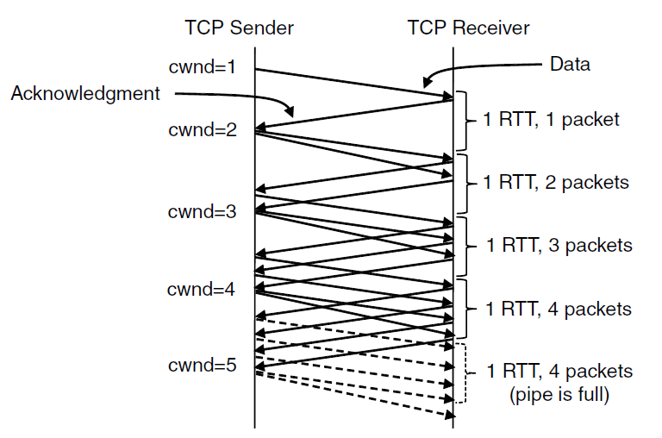
TCP Congestion Control (3)
Additive increase grows cwnd slowly
Adds 1 every RTT
ACK

Slide 40
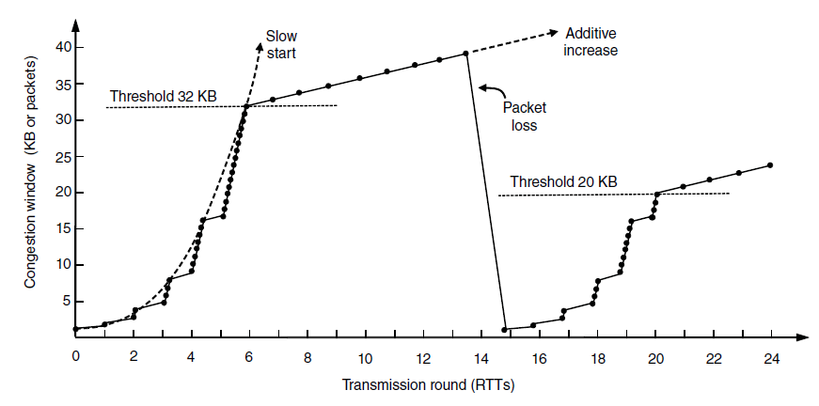
TCP Congestion Control (4)
Slow start followed by additive increase (TCP Tahoe)
Threshold is half of previous loss cwnd
Loss causes timeout;
so slow-start again
Is this AIMD?

Slide 41
TCP Congestion Control (7)
SACK (Selective ACKs) extend ACKs with a vector to describe received segments and hence losses
Allows for more accurate retransmissions / recovery
No way for us to know that 2 and 5 were lost with only ACKs
Negotiated at connection setup, whether both hosts support it

Slide 42
Learned today
Adressing with ports
TCP versus UDP
TCP:
3-way-handshake and why
TCP:
Sliding window for flow control
Congestion control using AIMD
I'd tell you a UDP joke, but you might not get it.

