Slide 1
Distributed Systems Course Overview
Simon Razniewski
Faculty of Computer Science
Free University of Bozen-Bolzano
A.Y. 2015/2016

Slide 2
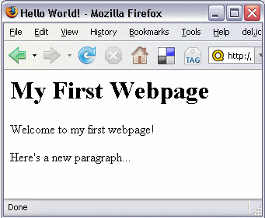
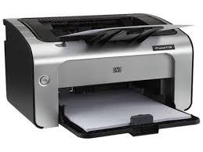
Why?
Make resources accessible

Slide 3
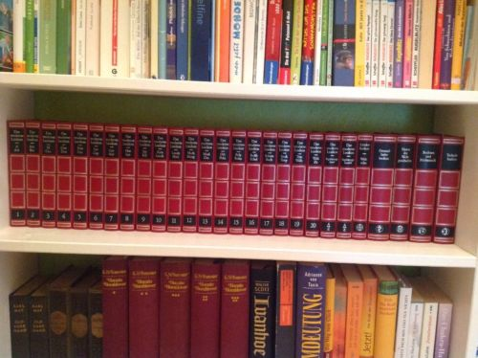
Why?
Make information accessible

Slide 4
Why?
Enable distant communication

Slide 5
Why?
Solve tough problems

Slide 6
Goals
Understand principles and concepts underlying computer networks and distributed systems
Layering, communication, coordination
Learn how to design reliable, cooperative (basic) distributed applications
Gain practical skills on the development of simple distributed systems (in Java)
Improve your software engineering expertise

Slide 7
Areas
Distributed systems hide the network complexity …
… but in order to understand and develop them, we need competencies in
Computer networks
Concurrency & Inter-process communication
Distributed
Systems
Computer
Networks
Concurrency
&
Inter-process
Communication

Slide 8
Lecturer Lab Assistant
Simon Razniewski
Florian Klement
Faculty of Computer Science
FUB – POS 1.04
Piazza Domenicani 3
Florian.Klement@stud-inf.unibz.it
Office hours:
To be decided
KRDB Research Centre
Faculty of Computer Science
FUB – POS 2.08
Piazza Domenicani 3
razniewski@inf.unibz.it
Office hours:
Tuesday 12:30 - 13:30 (Mensa)
13:30 - 14:30 (Office)

Slide 9
Course Structure
20 lectures
4 pen&paper labs
show up in the schedule as lectures too
12 programming labs in 2 groups
4 of these are with Raspberry PIs
5 Assignments

Slide 10
Tentative Schedule
01.03. Introduction
03.03. OSI Overview
08.03. Physical Layer
10.03. Data Link Layer
15.03. Link Layer (P&P Lab)
16.03. Link Layer Simulation (Lab)
17.03. Medium Access Control Layer
22.03. Network Layer Theory
23.03. Wireshark I (Lab)
29.03. Network Layer on the Internet
30.03. RPI 1: Networking basics (Lab)
31.03. Transport Layer
05.04. Transport Layer/Java Sockets
6.4./11.4. Java Sockets (Lab)
12.4. Application Layer
13.04. Wireshark II (Lab)
14.04. Conceptual Exercises (P&P Lab)
15.04. Conceptual Exercises (P&P Lab)
19.04. RMI
20.04. RMI (Lab)
21.04. Networking@Brennercom (Guest lecture)
26.04. Bobo (Guest lecture)
27.04. RPI 2: Distributed Algorithms (Lab)
28.04. P2P
03.05. P2P (continued)
04.05. RPI 3: Distributed MD5 Cracker (Lab)
05.05. P2P (Lab)
10.05. Cryptography
11.05. RPI 4: RIAK ring (Lab)
12.05. Cryptography (P&P Lab)
17.05. Multiagents+AntMe
18.05. AntMe (Lab)
19.05. Coordination
25.05. Coordination (Lab)
31.05. AntMe competition
15.06. Mock exam

Slide 11
Software
Used languages/tools/environments:
Java
C# (MS Visual Studio 2012 or later)
Wireshark
Raspberry PIs provided by university
Some Java and Wireshark labs will not be in computer rooms, so please install that software on your laptops or form groups

Slide 12
Assignments
Hamming Codes (15.3.-25.3.)
Java Socket Chat (5.4.-15.4.)
Java RMI Chat (19.4.-29.4.)
Distributed MD5 Cracker on RPIs (4.5.-13.5.)
AntMe (17.5.-30.5.)
You can work in teams of 2
First three assignments count 5% each, last two 10% each towards the final grade (→ total max. 35%).
Only assignments that are better than the exam grade are taken into account
Automatic plagiarism detection will be used
plagiarism → 0 points for all assignments
Assignments are optional

Slide 13
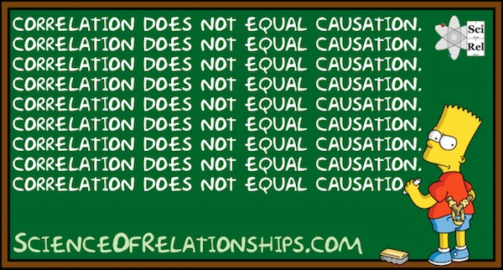
Assignments are optional… Should I do them?
All but one student submitting less than 3 assignments failed
All students submitting at least 3 assignments passed

Slide 14
Exam
Allowed to bring one handwritten A4 cheatsheet (both sides)
Develop it yourself and magic will happen: The things you put there, you won’t need to look up
Dictionaries
Pens
Nothing else (no calculators, no textbooks, …)
Anything covered in the lectures and labs can be on the exam
No coding questions
But modelling/design questions are possible
You do not need to know everything (achieving ~90% of the points is enough to get grade 30)
Mock exam and summer 2015 exam can be found online

Slide 15
Grade composition
Exam: 65%
Five assignments: Up to 35%
Only the assignments with a grade higher than the exam mark count
→ Assignments only improve the overall grade
To pass the course, the exam grade has to be at least 18
Assignments are valid for all three exam sessions

Slide 16
Language
Academic language of Computer Science is English
Official course language (decided by the university management) is German
Slides are in English
I will speak Denglisch (mostly)
You can ask questions in any language
Exam language is German

Slide 17
Material
The first half of the course is well covered in
A.S. Tanenbaum. Computer Networks. Prentice Hall
J.F. Kurose, K.W. Ross. Computer Networking – A Top-Down Approach (5th edition). Pearson Education
For the second half, the best resource are the slides and online resources
Some content regarding RPC, P2P, Cryptography and Coordination is in
A.S. Tanenbaum, M. van Steen. Distributed Systems: Principles and Paradigms. Prentice Hall.
G. Coulouris, J. Dollimore, T. Kindberg. Distributed Systems: Concepts and Design. Addison-Wesley.

Slide 18
Acknowledgment
Part of the slides are based on:
Slides by Tanenbaum
Previous versions of this course by Nutt, Montali and Pirro

Slide 19
Questions?

