Slide 1
Distributed Systems 12. Transport Layer
Simon Razniewski
Faculty of Computer Science
Free University of Bozen-Bolzano
A.Y. 2015/2016

Slide 2
Transport Layer
Transport Service
Elements of Transport Protocols
Congestion Control
Internet Protocols – UDP
Internet Protocols – TCP

Slide 3
The Transport Layer
Responsible for delivering data between applications across networks with the desired reliability or quality
Application
Transport
Network
Link
Physical

Slide 4
Services Provided to the Upper Layers (1)
Transport layer adds reliability to the network layer
Offers connectionless (e.g., UDP) and connection-oriented (e.g, TCP) service to applications
Adds multiplexing via ports
Congestion-handling
Flow-control
Primitives that applications might call to transport data for a simple connection-oriented service:
Client calls connect, send, receive, disconnect
Server calls listen, receive, send, disconnect

Slide 5
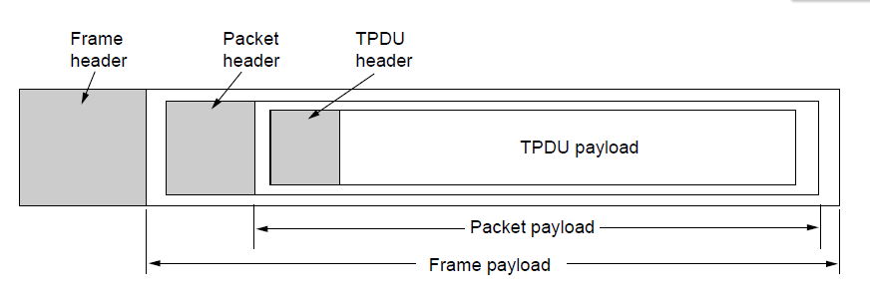
Services Provided to the Upper Layers (2)
Transport layer sends segments in packets (in frames)
Segment
Segment

Slide 6
Transport Service
Elements of Transport Protocols
Congestion Control
Internet Protocols – UDP
Internet Protocols – TCP

Slide 7
Elements of Transport Protocols
Addressing
Connection establishment
Connection release
Error control and flow control
Multiplexing

Slide 8
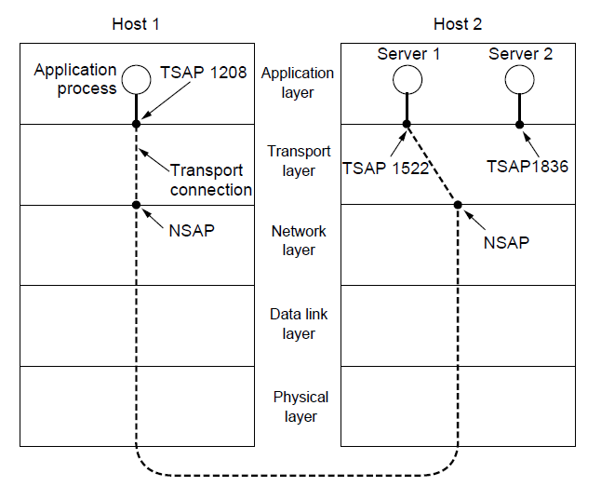
Addressing
Transport layer adds TSAPs
Multiple clients and servers can run on a host with a single network (IP) address
TSAPs are ports for TCP/UDP

Slide 9
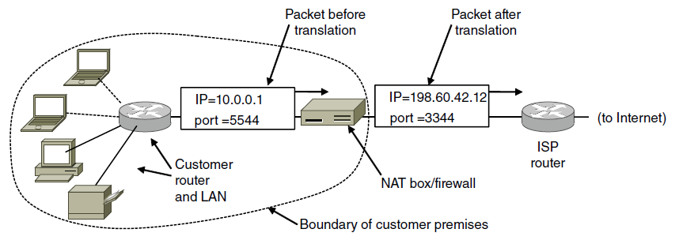
IP Addresses (6) – NAT
NAT (Network Address Translation) box maps one external IP address to many internal IP addresses
Uses TCP/UDP port to tell connections apart
Violates layering; very common in homes, etc.
Aside: What does a firewall do?
http://stackoverflow.com/questions/1982222/how-do-two-computers-connect-to-same-external-address-through-nat

Slide 10
Connection Establishment (1)
Key problem is to ensure reliability even though packets may be lost, corrupted, delayed, and duplicated
Don’t treat an old or duplicate packet as new
(Use ARQ and checksums for loss/corruption)
Approach:
Don’t reuse sequence numbers within twice the MSL (Maximum Segment Lifetime) of 2T=240 secs
Three-way handshake for establishing connection

Slide 11
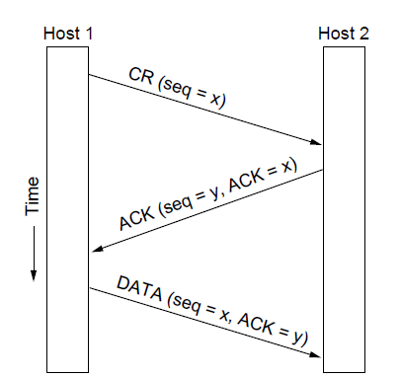
Connection Establishment (2)
Three-way handshake used for initial packet
Since no state from previous connection
Both hosts contribute fresh seq. numbers
CR = Connect Request

Slide 12
What if we used a simpler connection setup?

Slide 13
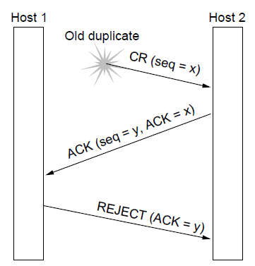
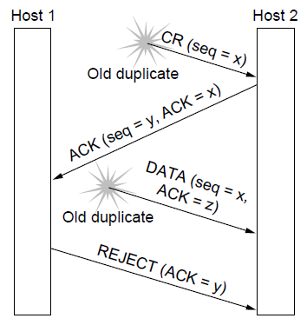
Connection Establishment (3)
Three-way handshake protects against odd cases:
Duplicate CR. Spurious ACK does not connect
Duplicate CR and DATA. Same plus DATA will be rejected (wrong ACK).
a)
X
b)
X
X

Slide 14
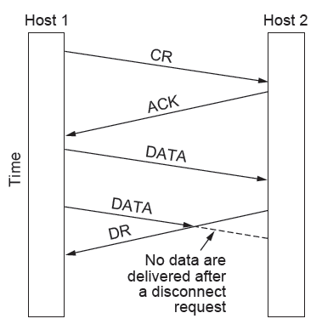
Connection Release (1)
Key problem is to ensure reliability while releasing
Asymmetric release (when one side breaks connection) is abrupt and may lose data
X

Slide 15
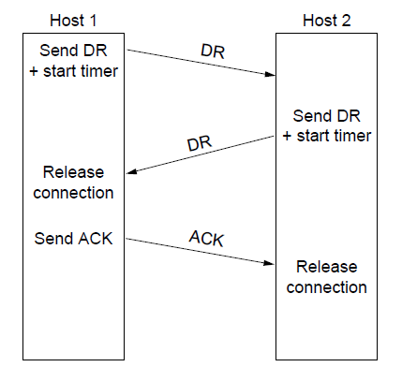
Connection Release (2)
Normal release sequence, initiated by transport user on Host 1
DR=Disconnect Request
Both DRs are ACKed by the other side

Slide 16
Error Control and Flow Control (1)
Foundation for error control is a sliding window (from Link layer) with checksums and retransmissions
Flow control manages buffering at sender/receiver
Issue is that data goes to/from the network and applications at different times
Window tells sender available buffering at receiver
Makes a variable-size sliding window

Slide 17
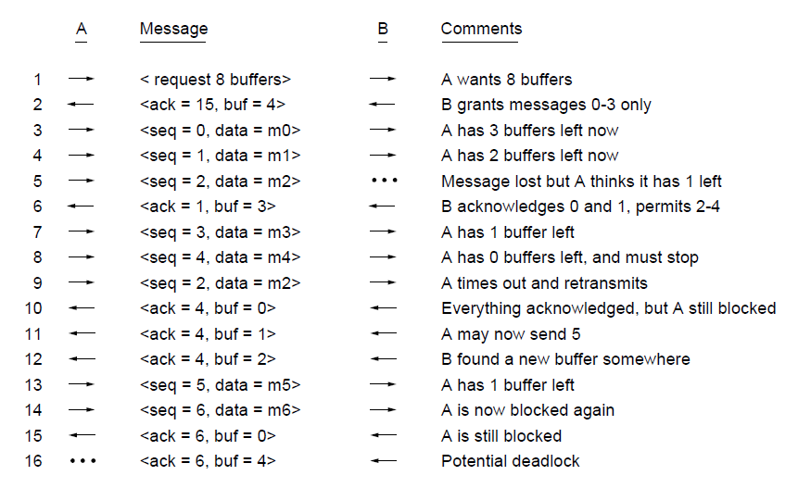
Error Control and Flow Control (3)
Flow control example: A’s data is limited by B’s buffer
B’s Buffer
0
1
2
3
0
1
2
3
0
1
2
3
0
1
2
3
1
2
3
4
1
2
3
4
1
2
3
4
1
2
3
4
1
2
3
4
2
3
4
5
3
4
5
6
3
4
5
6
3
4
5
6
3
4
5
6
7
8
9
10

Slide 18
Transport Service
Elements of Transport Protocols
Congestion Control
Internet Protocols – UDP
Internet Protocols – TCP

Slide 19
Congestion Control
Two layers are responsible for congestion control:
Transport layer, controls the offered load [here]
Network layer, experiences congestion [previous lecture]
Desirable bandwidth allocation
Regulating the sending rate
Wireless issues

Slide 20
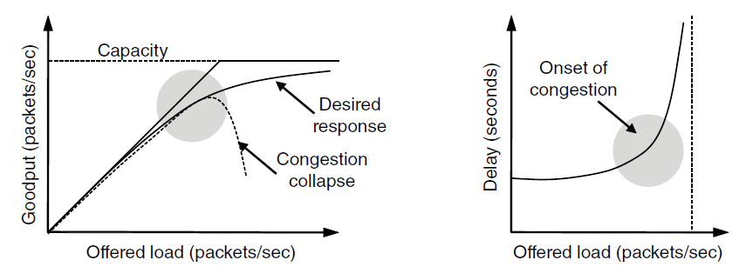
Desirable Bandwidth Allocation (1)
Efficient use of bandwidth gives high goodput, low delay
Goodput rises more slowly than load when congestion sets in
Delay begins to rise sharply when congestion sets in

Slide 21
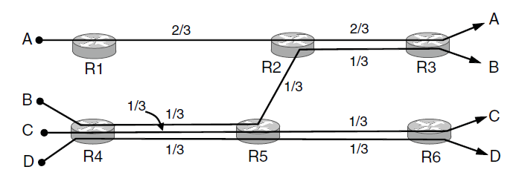
Desirable Bandwidth Allocation (2)
Fair use gives bandwidth to all flows (no starvation)
Max-min fairness gives equal shares of bottleneck
Different from optimal
Bottleneck link

Slide 22
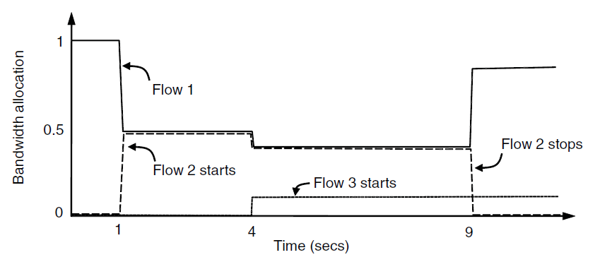
Desirable Bandwidth Allocation (3)
We want bandwidth levels to converge quickly when traffic patterns change
Flow 1 slows quickly when Flow 2 starts
Flow 1 speeds up quickly when Flow 2 stops

Slide 23
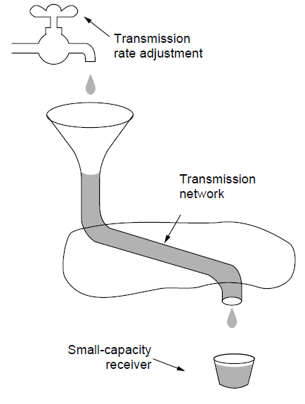
Regulating the Sending Rate (1)
Sender may need to slow down for different reasons:
Flow control, when the receiver is not fast enough
Congestion, when the network is not fast enough
A fast network feeding a low-capacity receiver → flow control is needed

Slide 24
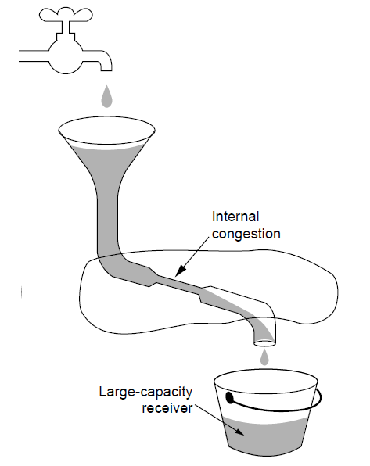
Regulating the Sending Rate (2)
Our focus is dealing with this problem – congestion
A slow network feeding a high-capacity receiver → congestion control is needed

Slide 25
Regulating the Sending Rate (3)
Different congestion signals the network may use to tell the transport endpoint to slow down (or speed up)

Slide 26
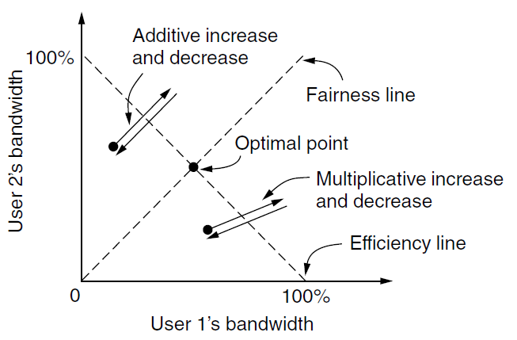
Regulating the Sending Rate (3)
If two flows increase/decrease their bandwidth in the same way when the network signals free/busy they will not converge to a fair allocation
+ /– constant
+/– percentage

Slide 27
Magic solution: Additive increase, multiplicative decrease
Increase: +10
Decrease: -20%

Slide 28
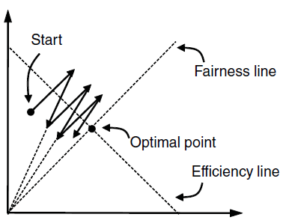
Regulating the Sending Rate (4)
The AIMD (Additive Increase Multiplicative Decrease) control law does converge to a fair and efficient point!
TCP uses AIMD for this reason
User 2’s bandwidth
User 1’s bandwidth

Slide 29
Your turn: 3 hosts
Let’s try it. Suppose A, B and C share a link.
Sender A starts with 70% link utilization, Sender B with 40%, Sender C with 0%. All would like to use as much as possible bandwidth.

Slide 30
In Java

Slide 31
MIAD
Does it work?

Slide 32
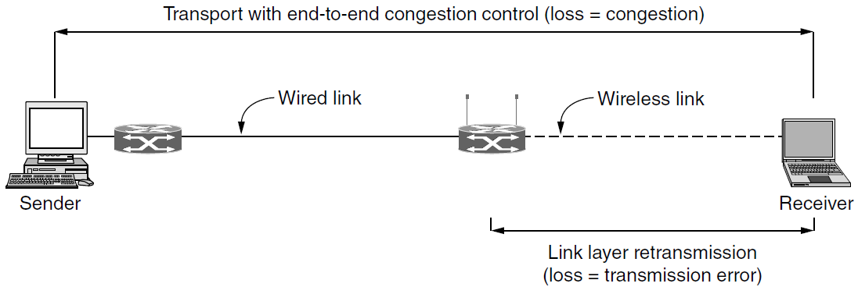
Wireless Issues
Wireless links lose packets due to transmission errors
Do not want to confuse this loss with congestion
Or connection will run slowly over wireless links!
Strategy:
Wireless links use ARQ, which masks errors

Slide 33
Transport Service
Elements of Transport Protocols
Congestion Control
Internet Protocols – UDP
Internet Protocols – TCP

Slide 34
Internet Protocols – UDP
Introduction to UDP
Real-Time Transport

Slide 35
Introduction to UDP (1)
UDP (User Datagram Protocol) is a minimal extension on top of IP
Header has ports (TSAPs), length and checksum.

Slide 36
Wireshark…

Slide 37
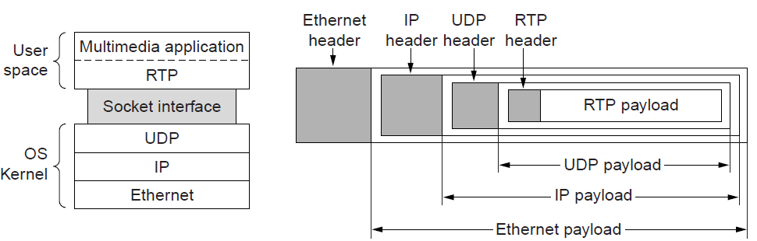
Real-Time Transport (1)
RTP (Real-time Transport Protocol) provides support for sending real-time media over UDP
Often implemented as part of the application

Slide 38
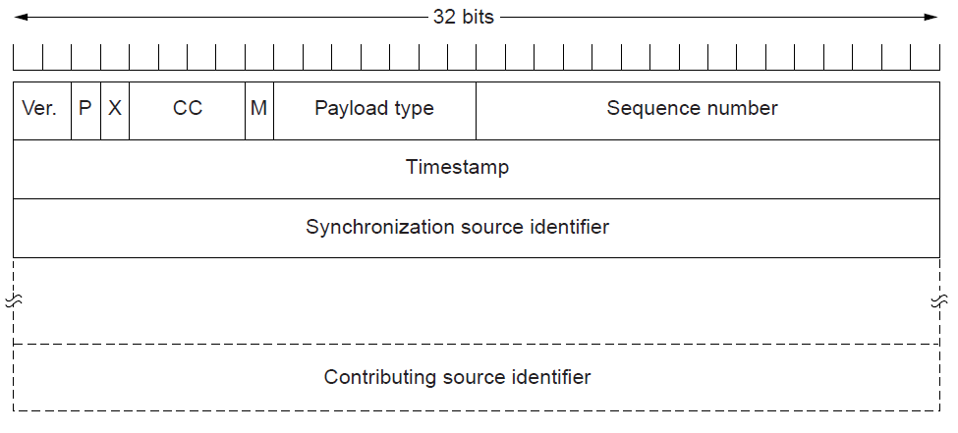
Real-Time Transport (2)
RTP header contains fields to describe the type of media and synchronize it across multiple streams

Slide 39
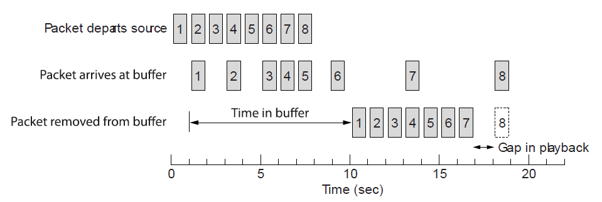
Real-Time Transport (3)
Buffer at receiver is used to delay packets and absorb jitter so that streaming media is played out smoothly
Packet 8’s network delay is too large for buffer to help
Constant rate
Variable rate
Constant rate

Slide 40
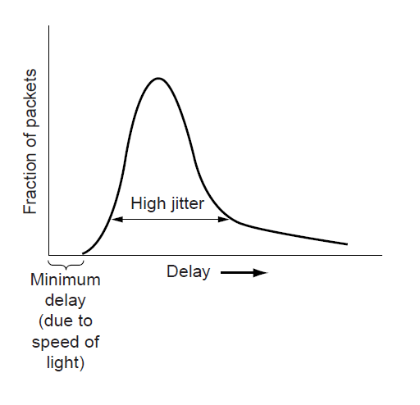
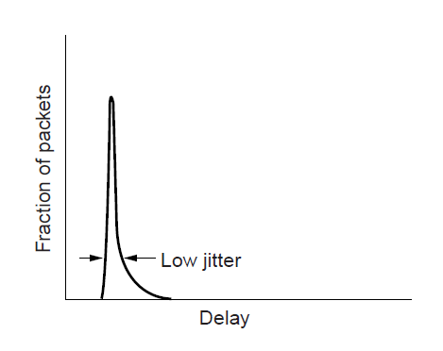
Real-Time Transport (3)
High jitter, or more variation in delay, requires a larger playout buffer to avoid playout misses
Tradeoff between delay and quality
Buffer
Misses

Slide 41
Transport Service
Elements of Transport Protocols
Congestion Control
Internet Protocols – UDP
Internet Protocols – TCP

Slide 42
Internet Protocols – TCP
The TCP service model
The TCP segment header
TCP connection establishment
TCP connection state modeling
TCP sliding window
TCP timer management
TCP congestion control

Slide 43
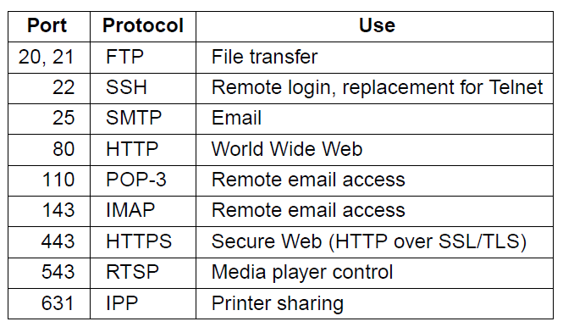
The TCP Service Model (1)
TCP provides applications with a reliable byte stream between processes; it is the workhorse of the Internet
Popular servers run on well-known ports

Slide 44
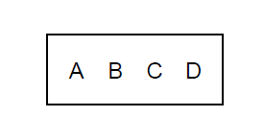
The TCP Service Model (2)
Applications using TCP see only the byte stream [right] and not the segments [left] sent as separate IP packets
Four segments, each with 512 bytes of data and carried in an IP packet
2048 bytes of data delivered to application in a single READ call

Slide 45
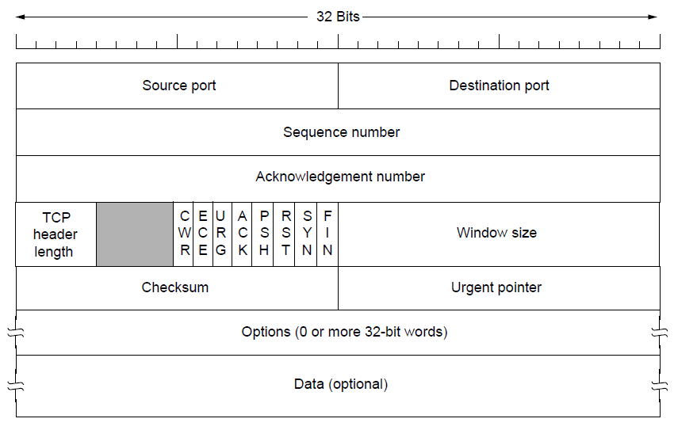
The TCP Segment Header
TCP header includes addressing (ports), sliding window (seq. / ack. number), flow control (window), error control (checksum) and more.

Slide 46
Wireshark…

Slide 47
TCP Connection Establishment
TCP sets up connections with the three-way handshake
Release is symmetric, also as described before

Slide 48
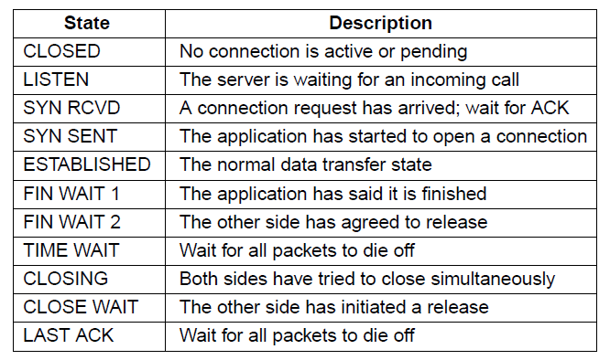
TCP Connection State Modeling (1)
The TCP connection finite state machine has more states than our simple example from earlier.

Slide 49
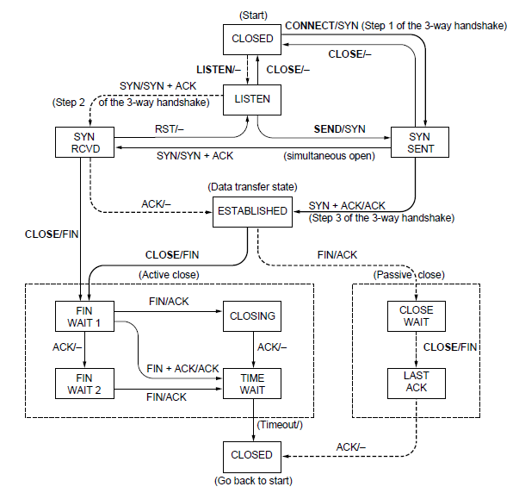
TCP Connection State Modeling (2)
Solid line is the normal path for a client.
Dashed line is the normal path for a server.
Light lines are unusual events.
Transitions are labeled by the cause and action, separated by a slash.
Task: Model a connection lifecycle

Slide 50
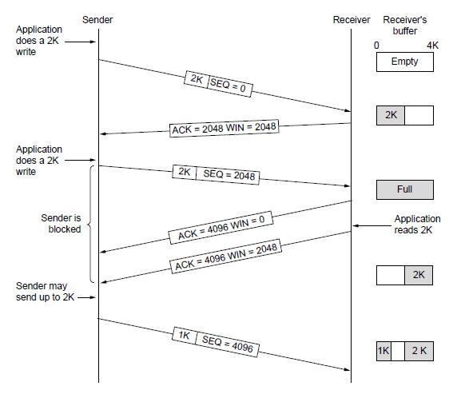
TCP Sliding Window (1)
TCP adds flow control to the sliding window as before
ACK + WIN is the sender’s limit

Slide 51
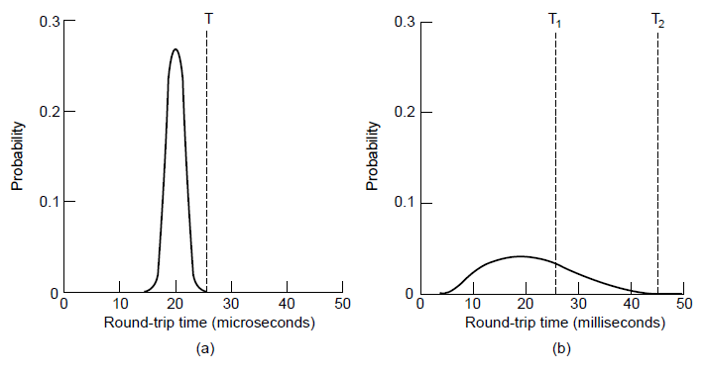
TCP Timer Management
TCP estimates retransmit timer from segment RTTs
Tracks both average and variance (for Internet case)
Timeout is set to average plus 4 x variance
LAN case – small, regular RTT
Internet case – large, varied RTT

Slide 52
TCP Congestion Control (1)
TCP uses AIMD with loss signal to control congestion
Implemented as a congestion window (cwnd) for the number of segments that may be in the network
Congestion window controls the sending rate
Rate is cwnd / RTT; window can stop sender quickly
Regular receipt of ACKs paces traffic and smoothes out sender bursts
ACKs pace new segments into the network and smooth bursts

Slide 53
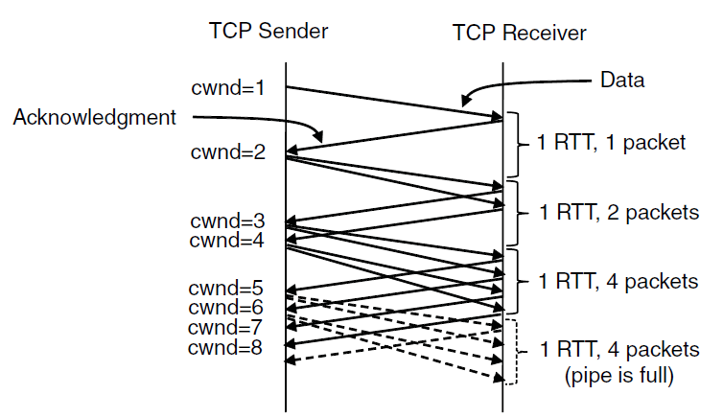
TCP Congestion Control (2)
Slow start grows congestion window exponentially by sending increasing cwnd with every ACK
Increment cwnd for each new ACK

Slide 54
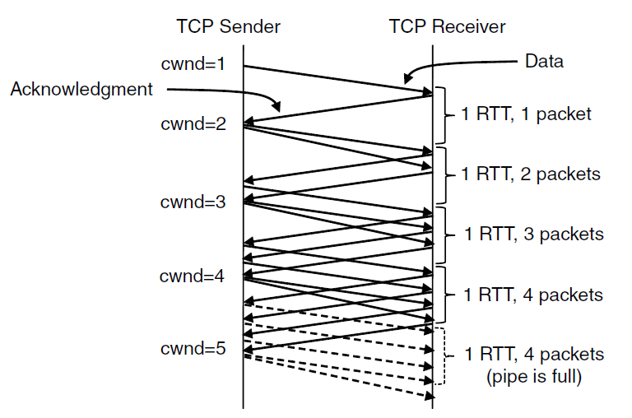
TCP Congestion Control (3)
Additive increase grows cwnd slowly
Adds 1 every RTT
ACK

Slide 55
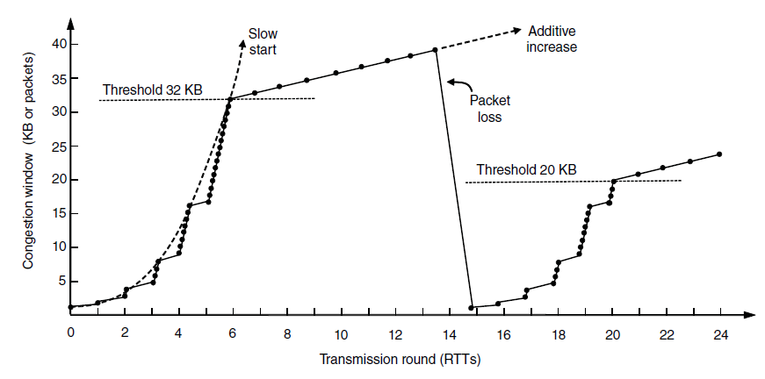
TCP Congestion Control (4)
Slow start followed by additive increase (TCP Tahoe)
Threshold is half of previous loss cwnd
Loss causes timeout;
so slow-start again
What about cheating?
Is this AIMD?

Slide 56
TCP Congestion Control (7)
SACK (Selective ACKs) extend ACKs with a vector to describe received segments and hence losses
Allows for more accurate retransmissions / recovery
No way for us to know that 2 and 5 were lost with only ACKs
Negotiated at connection setup, whether both hosts support it

Slide 57
Take home
TCP versus UDP
TCP:
3-way-handshake and what could go wrong without it
Sliding window in TCP
Flow-control using AIMD
I'd tell you a UDP joke, but you might not get it.

