Slide 1
Distributed Systems 8. Network Layer Theory
Simon Razniewski
Faculty of Computer Science
Free University of Bozen-Bolzano
A.Y. 2015/2016

Slide 2
Network Layer
Design Issues
Routing Algorithms
Distance vector
Link state routing
Congestion Control
Quality of Service

Slide 3
The Network Layer
Service: Delivering packets between endpoints over multiple links
Which service does it use from the link layer?
Application
Transport
Network
Link
Physical

Slide 4
Design Issues
Forward packet switching
Connectionless service – datagrams
Connection-oriented service – virtual circuits
Comparison of virtual-circuits and datagrams

Slide 5
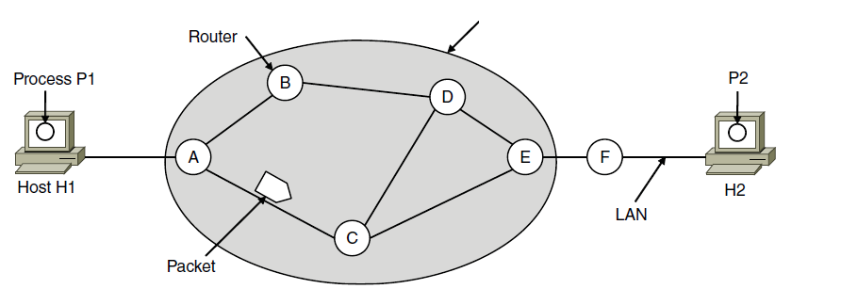
Core function: Forward Packet Switching
Hosts send packets into the network; packets are forwarded by routers
ISP’s equipment

Slide 6
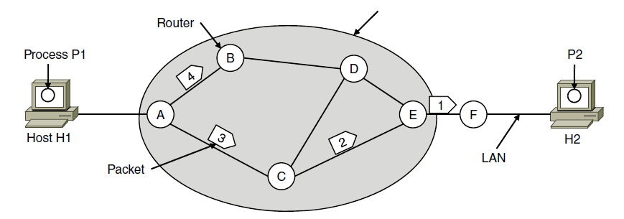
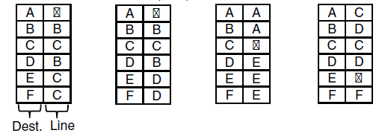
Connectionless Service – Datagrams
Packet is forwarded using destination address inside it
Different packets may take different paths
ISP’s equipment
A’s table (initially) A’s table (later) C’s Table E’s Table
Routing tables:
Dest. Line

Slide 7
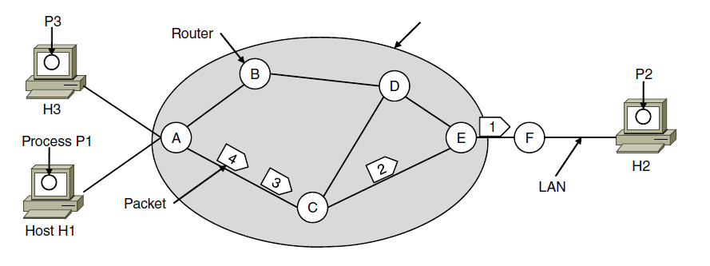
Connection-Oriented – Virtual Circuits
Packet is forwarded along a virtual circuit using tag inside it
Virtual circuit (VC) is set up ahead of time
ISP’s equipment
A’s table C’s Table E’s Table
In: Line Tag
Line Tag: Out

Slide 8
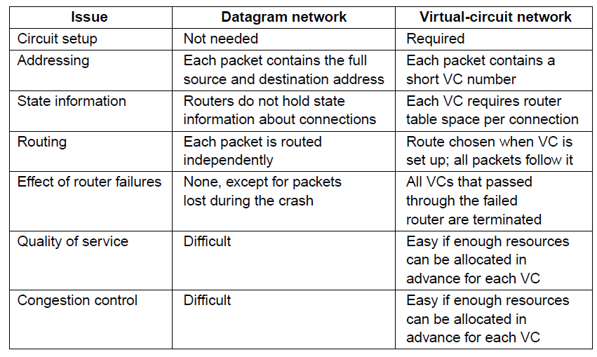
Comparison of Virtual-Circuits & Datagrams

Slide 9
7. Network Layer
Design Issues
Routing Algorithms
distance vector
link state routing
Congestion Control
Quality of Service

Slide 10
Routing Algorithms (1)
Dijkstra’s Shortest path algorithm
Distance vector routing
Link state routing
Hierarchical routing
Routing for mobile hosts

Slide 11
Routing Algorithms (2)
Routing is the process of discovering network paths (creating a routing table)
Model the network as a graph of nodes and links
Decide what to optimize (e.g., fairness vs efficiency)
Update routes for changes in topology (e.g., failures)
Forwarding is the sending of packets along a path, using routing tables

Slide 12
Shortest Path Algorithm (1)
Dijkstra’s algorithm computes shortest path to all nodes from one node in a graph
Foundations:
Each link is assigned a non-negative weight/distance
Shortest path is the one with lowest total weight
Using weights of 1 gives paths with fewest hops
Algorithm:
Start with source, set distance to other nodes to infinity
Update distances to reachable nodes
Pick the lowest distance node, add it to set of visited nodes
Repeat until all nodes are visited

Slide 13
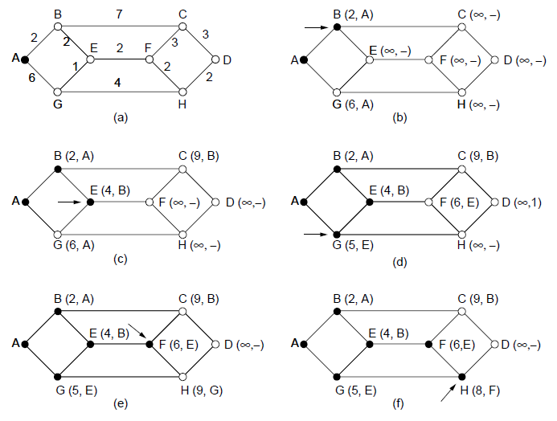
Shortest Path Algorithm (2)
How to formalize this?
A network and first five steps in computing the shortest paths from A to D. Pink arrows show the sink tree so far.

Slide 14
Dijkstra(StartingNode A) {
Queue<HashMap<Node,Integer> theQueue;
theQueue.addAll(A.reachableNodesWithDistance);
Integer[] shortestDistances = new Integer[maxNodeCount];
while (theQueue.isNotEmpty()) {
Node nearest = theQueue.removeNearest();
shortestDistances[nearest.id] = nearest.distance;
for (Node n : nearest.reachableNodesWithinDistance) {
int newDistance = nearest.distanceTo(n) + nearest.Distance;
if (!queue.containsKey(n) && shortestDistances[n.id] == null
|| queue.containsKey(n) && queue.get(n)>newDistance)
queue.put(n,newDistance);
}
}
}
N.B.: This is close to java, the queue could be implemented as PriorityQueue

Slide 15
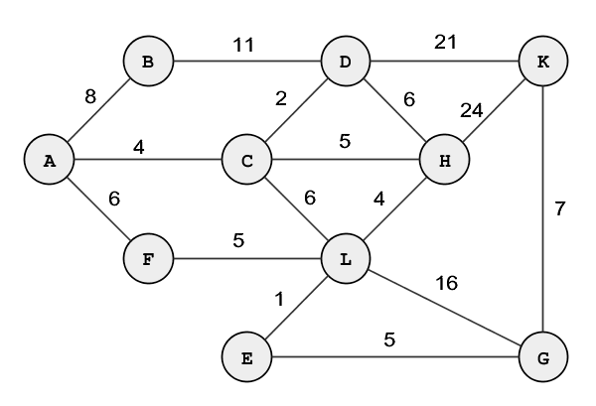
Your turn
Shortest paths from A?

Slide 16
Dijkstra’s algorithm is nice, but…
…how do we actually compute it?
Decentralized (Distance vector routing)
Centralized (Link state routing)

Slide 17
Distance Vector Routing (1)
Distance vector is a distributed routing algorithm
Shortest path computation is split across nodes
Algorithm:
Each node knows distance of links to its neighbors
Each node advertises vector of lowest known distances to all neighbors
Each node uses received vectors to update its own
Repeat periodically

Slide 18
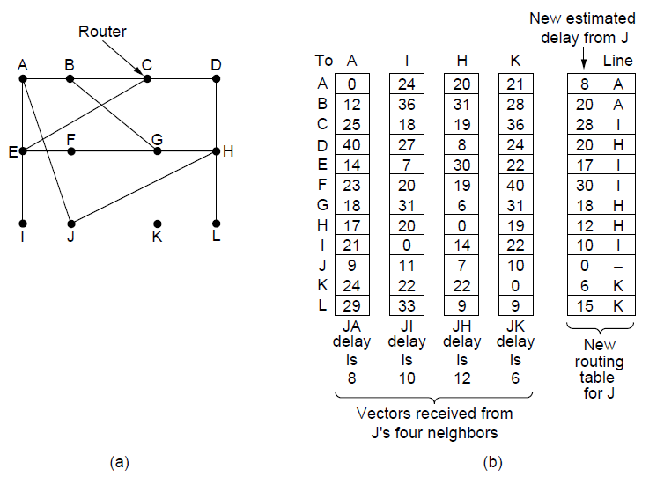
Distance Vector Routing (2)
Network
New vector for J
Vectors received at J from
Neighbors A, I, H and K

Slide 19
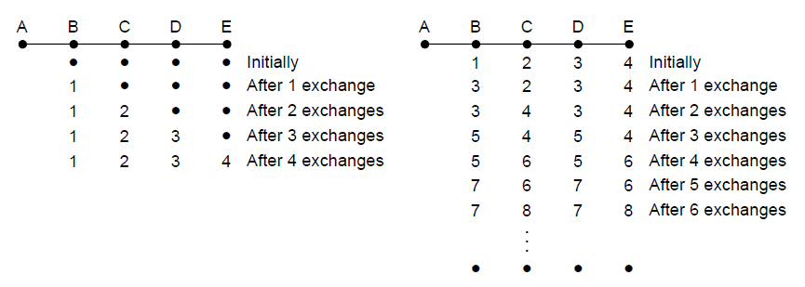
The Count-to-Infinity Problem
+
X
Good news of a path to A spreads quickly
Bad news of no path to A is learned slowly
Failures can cause DV to “count to infinity” while seeking a path to an unreachable node

Slide 20
Link State Routing (1)
Link state is an alternative to distance vector
More computation but simpler dynamics
Widely used in the Internet (OSPF, IS-IS)
Algorithm:
Each node floods information about its neighbors in LSPs (Link State Packets); all nodes learn the full network graph
Each node runs Dijkstra’s algorithm to compute the path to take for each destination
How can we send LSPs to all nodes?
Remember: No broadcast functionality in WANs!

Slide 21
Link State Routing (2) – LSPs
LSP (Link State Packet) for a node lists neighbors and weights of links to reach them
Network
LSP for each node

Slide 22
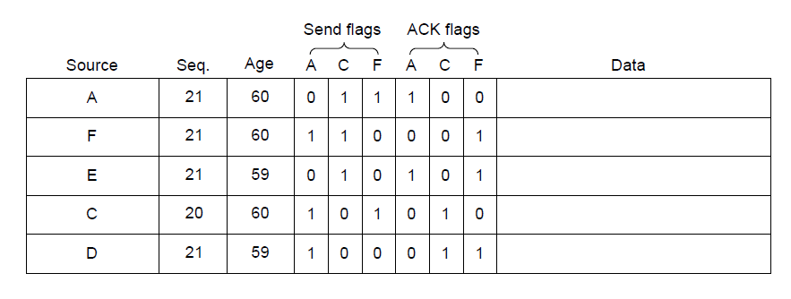
Link State Routing (3) – Reliable Flooding
Seq. number and age are used for reliable flooding
New LSPs are acknowledged on the lines they are received and sent on all other lines
Example shows the LSP database at router B

Slide 23
Distance Vector vs. Link State Routing
 | Distance Vector Routing | Link State Routing
Functionality
Message Content
Message Number
Challenge

Slide 24
Routing tables for the internet
IPv4: 32-bit addresses
IPv6: 128-bit addresses

Slide 25
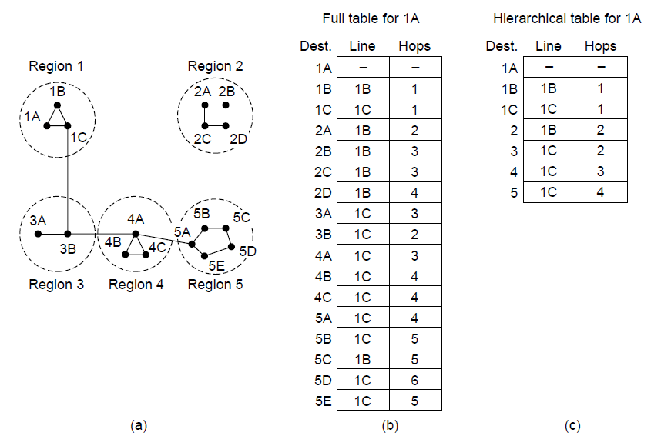
Hierarchical Routing
Hierarchical routing reduces the work of route computation but may result in slightly longer paths than flat routing
Best choice to reach nodes in 5 except for 5C

Slide 26
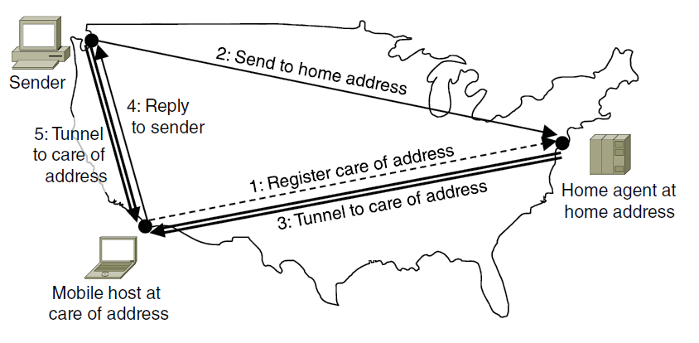
Routing for Mobile Hosts
Mobile hosts can be reached via a home agent
Fixed home agent tunnels packets to reach the mobile host; reply can optimize path for subsequent packets
No changes to routers or fixed hosts

Slide 27
Design Issues
Routing Algorithms
distance vector
link state routing
Congestion Control
Quality of Service

Slide 28
Congestion Control (1)
Handling congestion is the responsibility of the Network and Transport layers working together
We look at the Network portion here

Slide 29
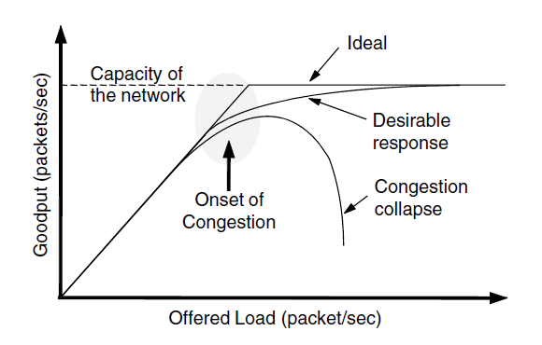
Congestion Control (2)
Congestion results when too much traffic is offered; performance degrades due to loss/retransmissions
Goodput (=useful packets) trails offered load

Slide 30
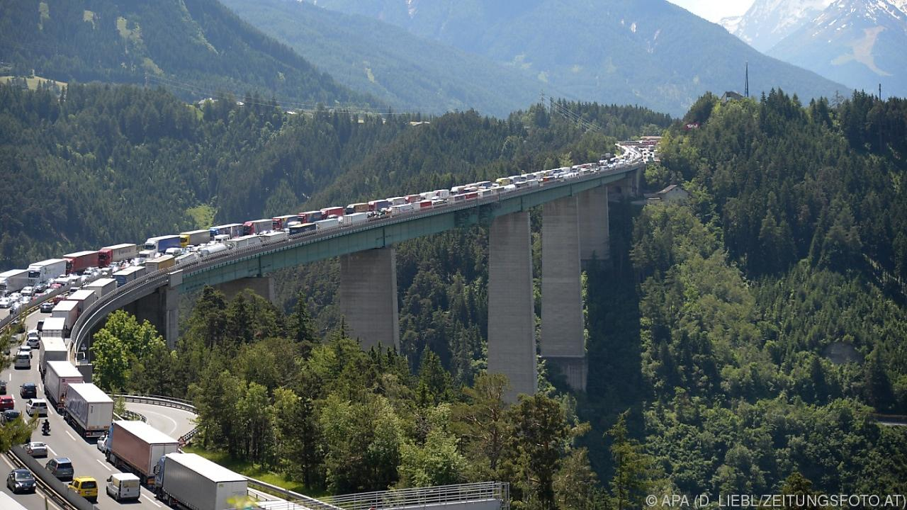
What can be done?

Slide 31
Congestion Control (3) – Approaches
Network must do its best with the offered load
Different approaches at different timescales
Nodes should also reduce offered load (Transport)

Slide 32
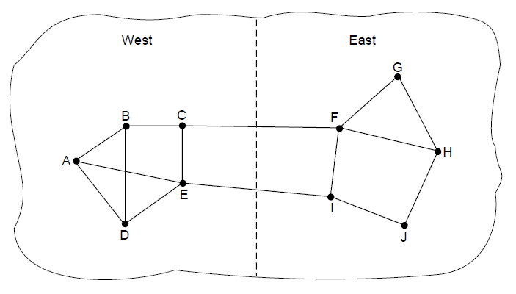
Traffic-Aware Routing
Choose routes depending on traffic, not just topology
E.g., use EI for West-to-East traffic if CF is loaded
But take care to avoid oscillations

Slide 33
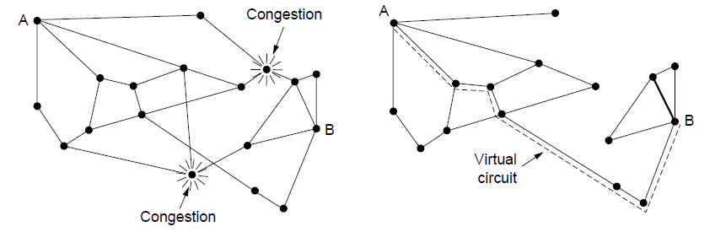
Admission Control
Admission control allows a new traffic load only if the network has sufficient capacity, e.g., with virtual circuits
Can combine with looking for an uncongested route
Network with some congested nodes
Uncongested portion and route AB around congestion

Slide 34
Traffic Throttling
Congested routers signal hosts to slow down traffic
ECN (Explicit Congestion Notification) marks packets and receiver returns signal to sender

Slide 35
Load Shedding (1)
When all else fails, network will drop packets (shed load)
Upper layers usually notice shedding and throttle load (TCP for instance)
Which packets to throw away?
→ Milk-or-wine problem

Slide 36
Design Issues
Routing Algorithms
distance vector
link state routing
Congestion Control
Quality of Service

Slide 37
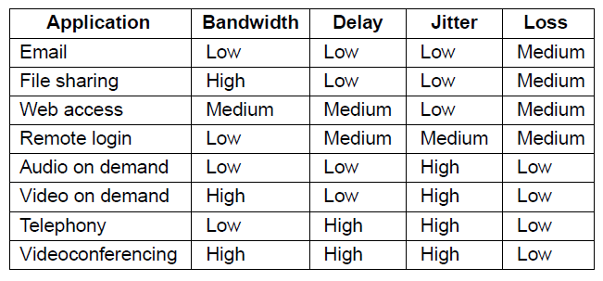
Application Requirements (1)
Different applications care about different properties
We want all applications to get what they need
.
“High” means a demanding requirement, e.g., low delay

Slide 38
How can we make guarantees?
Traffic shaping regulates the average rate and burstiness of data entering the network
Lets us make guarantees
Seen already: Sliding window (regulates indirectly the traffic)
Shape traffic here

Slide 39
Traffic Shaping: Token Bucket
Token bucket limits both the average rate (R) and short-term burst (B) of traffic
Bucket size is B, water enters at rate R and is removed to send
→ See demonstration

Slide 40
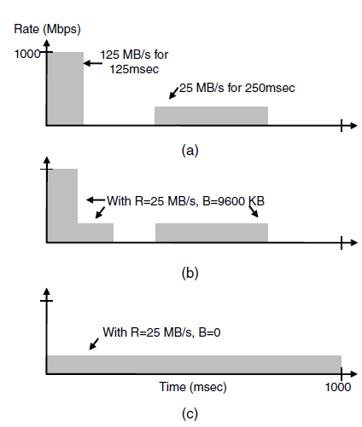
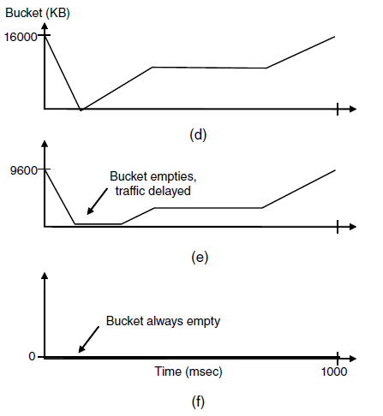
Traffic Shaping: Token Bucket (2)
How much is sent How much can be sent
Host traffic
Shaped by R=25 MB/s B=9,6 MB
Shaped by R=25 MB/s B=0 KB
Smaller bucket size delays traffic and reduces burstiness

Slide 41
Your turn
Router with two inputs A, B and C, and one output, D, and 100 MB internal memory
- A has token bucket with R= 10 Mbit/s, size 40 MB
- B has token bucket with R= 20 Mbit/s, size 70 MB
- D has token bucket with R= 55 Mbit/s, size 50 MB
- C would like token bucket with R=10 Mbit/s, size 60 MB
Can C’s wish be satisfied?

Slide 42
Buckets in series
A single token bucket may allow strong bursts
Put smaller buckets with higher rate behind
Token bucket with B=0 is called leaky bucket

Slide 43
Take home
Connectionless vs connection-oriented routing
Routing
Distance vector
Problem: Count to infinity
Link state
Challenge: Information propagation
Techniques for congestion control
Traffic shaping: Token-bucket

