Slide 1
Distributed Systems 4. Physical Layer
Simon Razniewski
Faculty of Computer Science
Free University of Bozen-Bolzano
A.Y. 2014/2015

Slide 2
The Physical Layer
Theoretical Basis for Data Communications
Guided Transmission Media
Wireless Transmission
Communication Satellites
Digital Modulation and Multiplexing
Public Switched Telephone Network
Mobile Telephone System

Slide 3
The Physical Layer
Foundation on which other layers build
Properties of wires, fiber, wireless limit what the network can do
Key problem is to send (digital) bits using only (analog) signals
This is called modulation
Application
Transport
Network
Link
Physical

Slide 4
Theoretical Basis for Data Communication
Communication rates have fundamental limits
Fourier analysis »
Bandwidth-limited signals »
Maximum data rate of a channel »

Slide 5
Fourier Analysis
A time-varying signal can be equivalently represented as a series of frequency components (harmonics):
=
Signal over time
a, b weights of harmonics

Slide 6
Bandwidth-Limited Signals
Having less bandwidth (harmonics) degrades the signal
8 harmonics
Lost!
Bandwidth
4 harmonics
Lost!
2 harmonics
Lost!

Slide 7
Maximum Data Rate of a Channel
Nyquist’s theorem (1924) relates the data rate to the bandwidth (B) and number of signal levels (V):
→ Maximum data rate of a binary of a binary signal over a 3kHz channel is 6000bps
Max. data rate = 2B log₂V bits/sec
How fast signal
can change
How many levels
can be seen

Slide 8
Visualization
http://www.intmath.com/fourier-series/fourier-graph-applet.php

Slide 9
Technologies

Slide 10
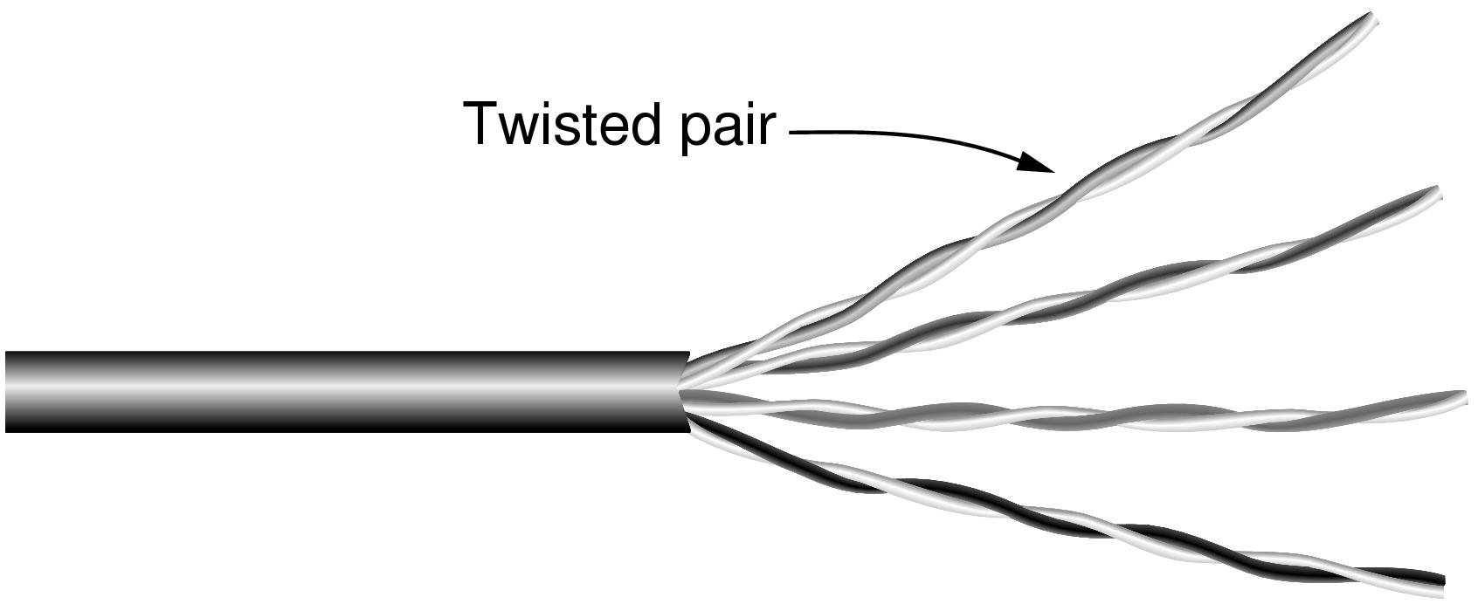
Wires – Twisted Pair
Very common; used in LANs, telephone lines
Twists reduce radiated signal (interference)
Category 5 UTP cable with four twisted pairs

Slide 11
Wires – Coaxial Cable (“Co-ax”)
Also common. Better shielding and more bandwidth for longer distances and higher rates than twisted pair.

Slide 12
Wires – Power Lines
Household electrical wiring is another example of wires
Convenient to use, but horrible for sending data

Slide 13
Fiber Cables (1)
Common for high rates and long distances
Long distance ISP links, Fiber-to-the-Home
Light carried in very long, thin strand of glass
Light source
(LED, laser)
Light trapped by
total internal reflection
Photodetector

Slide 14
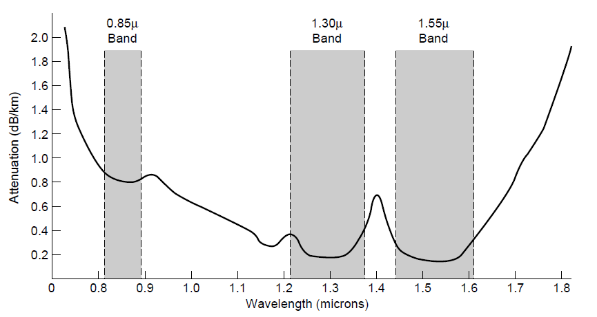
Fiber Cables (2)
Fiber has enormous bandwidth (THz) and tiny signal loss – hence high rates over long distances
3 dB = half point of energy

Slide 15
Fiber Cables (3)
Single-mode
Core so narrow (10um) light can’t even bounce around
Used with lasers for long distances, e.g., 100km
Multi-mode
Other main type of fiber
Light can bounce (50um core)
Used with LEDs for cheaper, shorter distance links
Fibers in a cable

Slide 16
Fiber Cables (4)
Comparison of the properties of wires and fiber:
Property | Wires | Fiber
Distance | Short (100s of m) | Long (tens of km)
Bandwidth | Moderate | Very High
Cost | Inexpensive | Less cheap
Convenience | Easy to use | Less easy
Security | Easy to tap | Hard to tap

Slide 17
Wireless Transmission
Electromagnetic Spectrum »
Radio Transmission »
Microwave Transmission »
Light Transmission »
Wireless vs. Wires/Fiber »

Slide 18
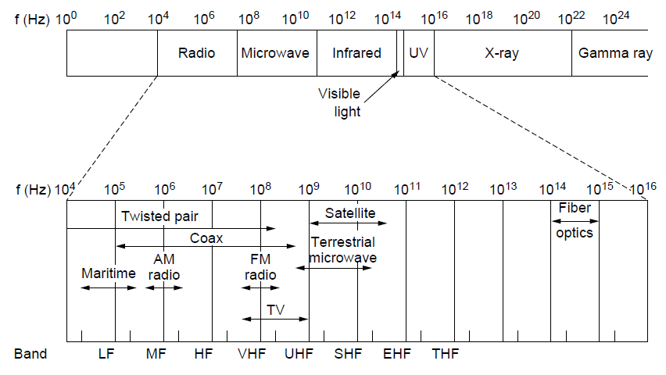
Electromagnetic Spectrum (1)
Different bands have different uses:
Radio: wide-area broadcast; Infrared/Light: line-of-sight
Microwave: LANs and 3G/4G;
Networking focus
Microwave

Slide 19
Electromagnetic Spectrum (2)
To manage interference, spectrum is carefully divided, and its use regulated and licensed, e.g., sold at auction.
300 MHz
3 GHz
WiFi (ISM bands)
3 GHz
Source: NTIA Office of Spectrum Management, 2003
30 GHz
Part of the US frequency allocations

Slide 20
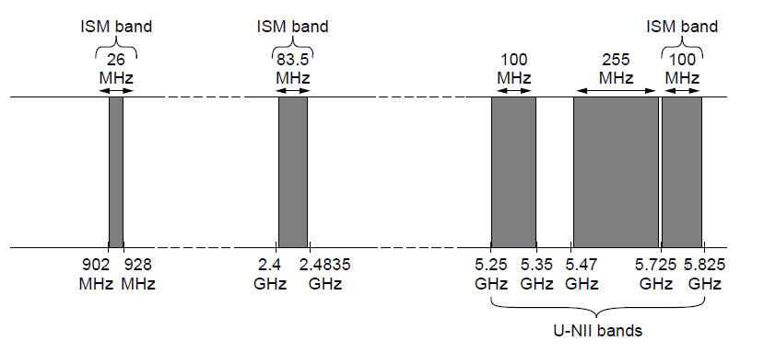
Electromagnetic Spectrum (3)
Fortunately, there are also unlicensed (“ISM”) bands:
Free for use at low power; devices manage interference
Widely used for networking; WiFi, Bluetooth, etc.
802.11
b/g/n
802.11a/g/n

Slide 21
Radio Transmission
Radio signals penetrate buildings well and propagate for long distances with path loss
In the VLF, LF, and MF bands, radio waves follow the curvature of the earth
In the HF band, radio waves bounce off the ionosphere.

Slide 22
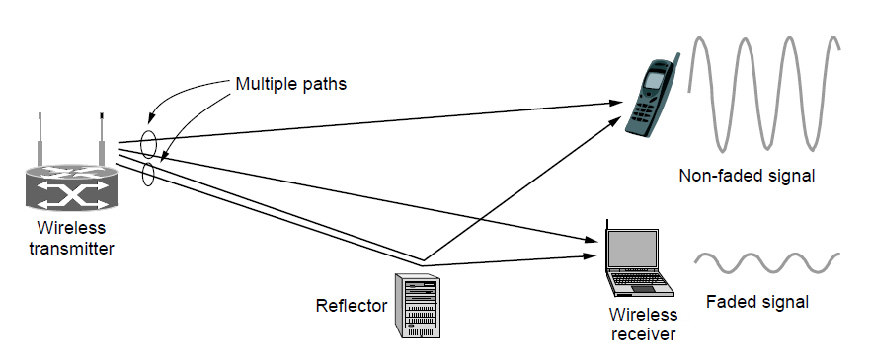
Microwave Transmission
Microwaves have much bandwidth and are widely used indoors (WiFi) and outdoors (3G, satellites)
Signal is attenuated/reflected by everyday objects
Strength varies due multipath fading, etc.

Slide 23
Wireless vs. Wires/Fiber
Wireless:
Easy and inexpensive to deploy
Naturally supports mobility
Naturally supports broadcast
Transmissions interfere and must be managed
Signal strengths hence data rates vary greatly
Wires/Fiber:
Easy to engineer a fixed data rate over point-to-point links
Can be expensive to deploy, esp. over distances
Doesn’t readily support mobility or broadcast

Slide 24
Communication Satellites
Satellites are effective for broadcast distribution and anywhere/anytime communications
Kinds of Satellites »
Geostationary (GEO) Satellites »
Low-Earth Orbit (LEO) Satellites »
Satellites vs. Fiber »

Slide 25
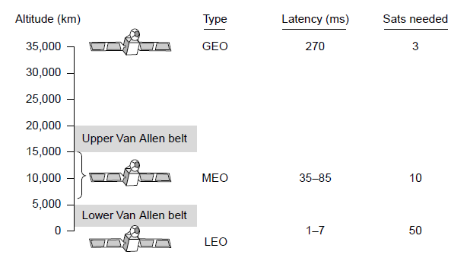
Kinds of Satellites
Satellites and their properties vary by altitude:
Geostationary (GEO), Medium-Earth Orbit (MEO), and Low-Earth Orbit (LEO)
Sats needed for global coverage

Slide 26
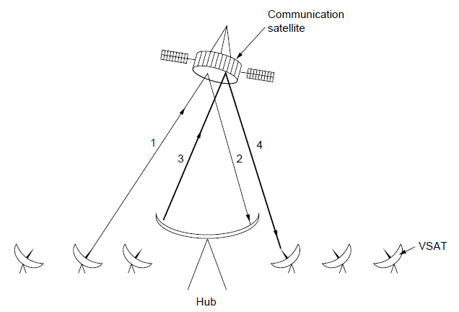
Geostationary Satellites
GEO satellites orbit 35,000 km above a fixed location
VSAT (computers) can communicate with the help of a hub
Different bands (L, S, C, Ku, Ka) in the GHz are in use but may be crowded or susceptible to rain.
GEO satellite
VSAT

Slide 27
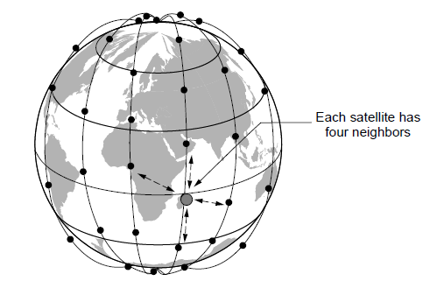
Low-Earth Orbit Satellites
Systems such as Iridium use many low-latency satellites for coverage and route communications via them
The Iridium satellites form six necklaces around the earth.

Slide 28
Satellite vs. Fiber
Satellite:
Can rapidly set up anywhere/anytime communications (after satellites have been launched)
Can broadcast to large regions
Limited bandwidth and interference to manage
Fiber:
Enormous bandwidth over long distances
Installation can be more expensive/difficult

Slide 29
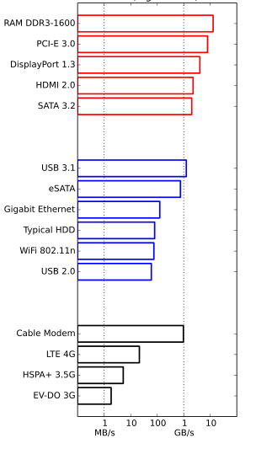
Bandwidth
Internal/Home network/
Internet link
Connection | Speed |  |  | Transmit 1 GB
type | bps | B/sec |  | hh : mm : ss
56K Modem | 56 K | 6.8 K |  | 42 : 36 : 31.69
Classic DSL | 512 K | 62.5 K |  | 4 : 39 : 37.22
Cable | 10 M | 1.221 M |  | : 14 : 09.93
OC-1 | 51.840 M | 6.328 M |  | : 2 : 45.70
Ethernet | 100.00 M | 12.207 M |  | : 1 : 25.90
OC-3 | 155.52 M | 18.984 M |  | : : 55.23
OC-12 | 622.08 M | 75.937 M |  | : : 13.81

Slide 30
Bandwidth is not everything..
7.1PB of storage (http://searchdatacenter.techtarget.com/review/Rackable-Systems-ICE-Cube-Modular-Data-Center)
transmission speed: 80 km/h
Bandwidth Rome-London (2kkm)?

Slide 31
Digital Modulation and Multiplexing
Modulation schemes send bits as signals; multiplexing schemes share a channel among users.
Baseband Transmission »
Passband Transmission »
Frequency Division Multiplexing »
Time Division Multiplexing »
Code Division Multiple Access »

Slide 32
Baseband Transmission
Line codes send symbols that represent one or more bits
NRZ is the simplest, literal line code (+1V=“1”, -1V=“0”)

Slide 33
Clock Recovery
To decode the symbols, signals need sufficient transitions
Otherwise long runs of 0s (or 1s) are confusing, e.g.:
Strategies:
Manchester coding, mixes clock signal in every symbol
4B/5B maps 4 data bits to 5 coded bits with 1s and 0s:
Scrambler XORs tx/rx data with pseudorandom bits
1
0 0 0 0 0 0 0 0 0 0 um, 0? er, 0?
Data | Code | Data | Code | Data | Code | Data | Code
0000 | 11110 | 0100 | 01010 | 1000 | 10010 | 1100 | 11010
0001 | 01001 | 0101 | 01011 | 1001 | 10011 | 1101 | 11011
0010 | 10100 | 0110 | 01110 | 1010 | 10110 | 1110 | 11100
0011 | 10101 | 0111 | 01111 | 1011 | 10111 | 1111 | 11101

Slide 34
Passband Transmission (1)
Modulating the amplitude, frequency/phase of a carrier signal sends bits in a (non-zero) frequency range
NRZ signal of bits
Amplitude shift keying
Frequency shift keying
Phase shift keying

Slide 35
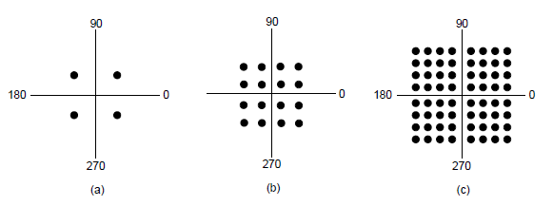
Passband Transmission (2)
Constellation diagrams are a shorthand to capture the amplitude and phase modulations of symbols:
BPSK
2 symbols
1 bit/symbol
QPSK
4 symbols
2 bits/symbol
QAM-16
16 symbols
4 bits/symbol
QAM-64
64 symbols
6 bits/symbol
BPSK/QPSK varies only phase
QAM varies amplitude and phase

Slide 36
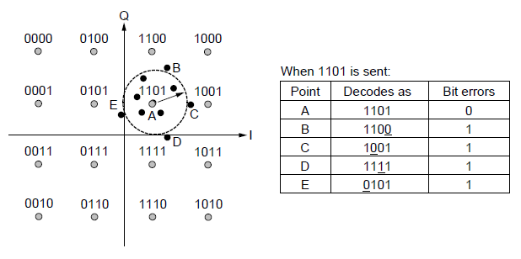
Passband Transmission (3)
Gray-coding assigns bits to symbols so that small symbol errors cause few bit errors:
B
E
A
C
D

Slide 37
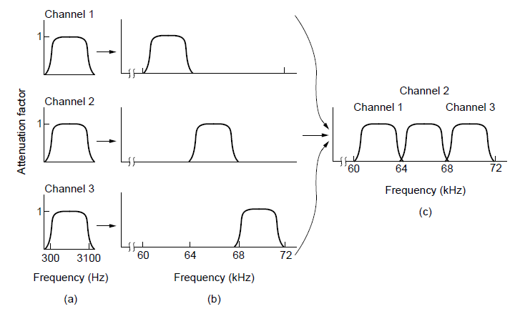
Frequency Division Multiplexing (1)
FDM (Frequency Division Multiplexing) shares the channel by placing users on different frequencies:
Overall FDM channel

Slide 38
Time Division Multiplexing (TDM)
Time division multiplexing shares a channel over time:
Users take turns on a fixed schedule; this is not packet switching or STDM (Statistical TDM)
Widely used in telephone / cellular systems

Slide 39
Code Division Multiple Access (CDMA)
CDMA shares the channel by giving users a code
Codes are orthogonal; can be sent at the same time
Widely used as part of 3G networks
Sender Codes
Transmitted
Signal
Receiver Decoding
+1
+1
S x A
+2
+2
Sum = 4
A sent “1”
A =
-1
-1
0
0
+2
+1
+1
0
0
Sum = -4
B sent “0”
B =
0
0
S x B
-1
-1
-2
-2
-2
+1
+1
S = +A -B
S x C
+2
Sum = 0
C didn’t send
C =
-1
-1
0
0
-2

Slide 40
The Public Switched Telephone Network
Structure of the telephone system »
Politics of telephones »
Local loop: modems, ADSL, and FTTH »
Trunks and multiplexing »
Switching »

Slide 41
Structure of the Telephone System
A hierarchical system for carrying voice calls made of:
Local loops, mostly analog twisted pairs to houses
Trunks, digital fiber optic links that carry calls
Switching offices, that move calls among trunks

Slide 42
Local loop (1): modems
Telephone modems send digital data over an 3.3 KHz analog voice channel interface to the POTS
Rates <56 kbps; early way to connect to the Internet

Slide 43
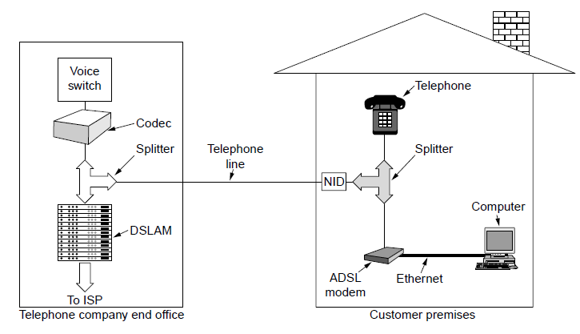
Local loop (2): Digital Subscriber Lines
DSL broadband sends data over the local loop to the local office using frequencies that are not used for POTS
Telephone/computers attach to the same old phone line
Rates vary with line
ADSL2 up to 12 Mbps
OFDM is used up to 1.1 MHz for ADSL2
Most bandwidth down

Slide 44
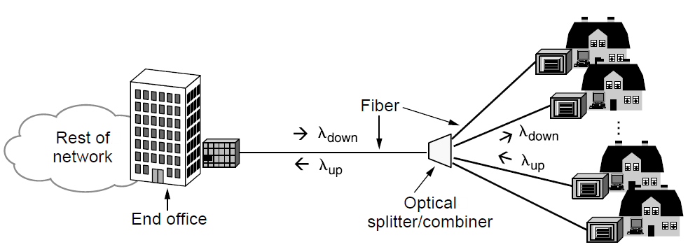
Local loop (3): Fiber To The Home
FTTH broadband relies on deployment of fiber optic cables to provide high data rates customers
One wavelength can be shared among many houses
Fiber is passive (no amplifiers, etc.)

Slide 45
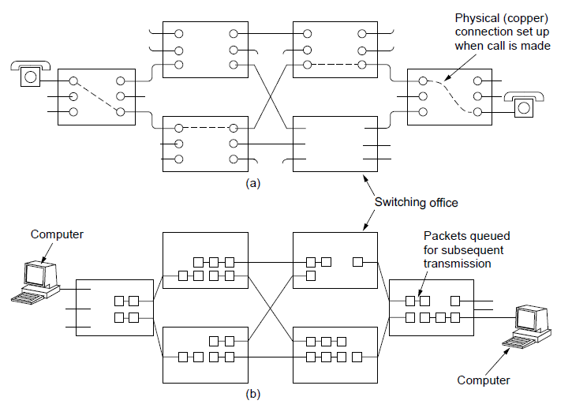
Switching (1)
PSTN uses circuit switching; Internet uses packet switching
PSTN:
Internet:

Slide 46
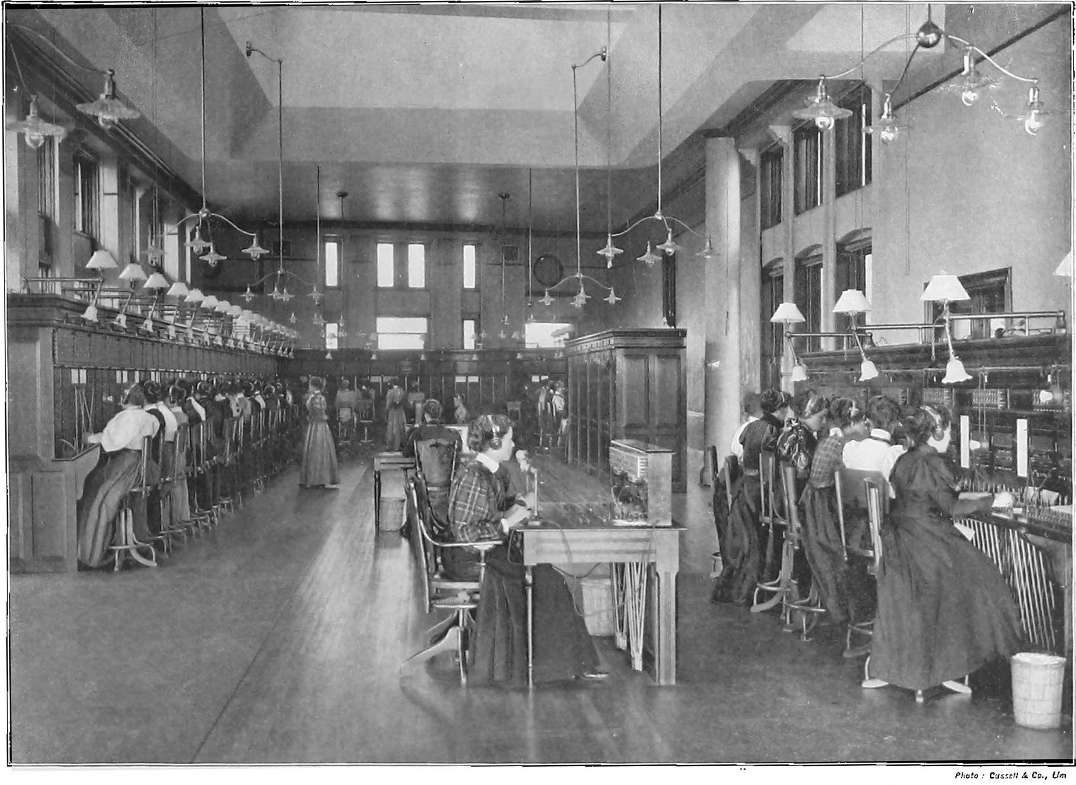

Slide 47
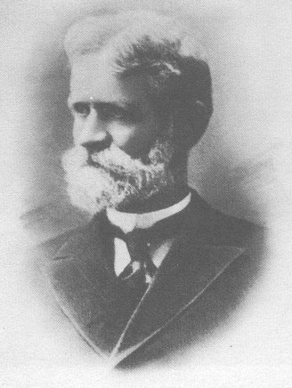
Strowger Switches (1891)

Slide 48
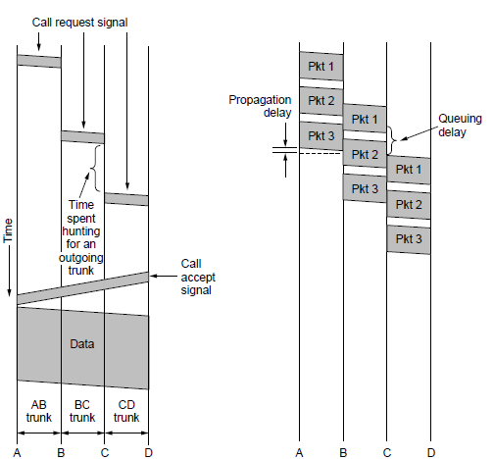
Switching (2)
Circuit switching requires call setup (connection) before data flows smoothly
Also teardown at end (not shown)
Packet switching treats messages independently
No setup, but variable queuing delay at routers
Circuits
Packets

Slide 49
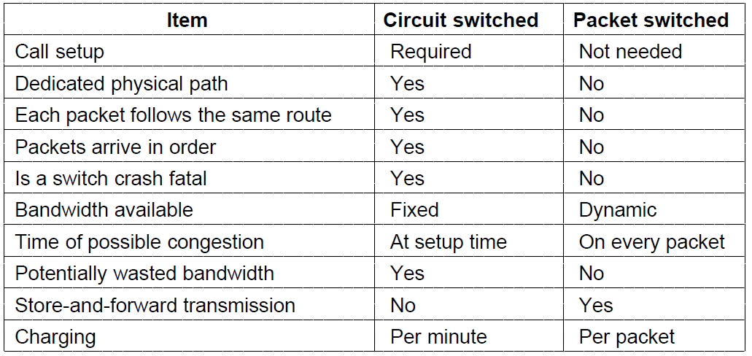
Switching (3)
Comparison of circuit- and packet-switched networks

Slide 50
Mobile Telephone System
Generations of mobile telephone systems »
Cellular mobile telephone systems »
GSM, a 2G system »
UMTS, a 3G system »

Slide 51
Generations of mobile telephone systems
1G, analog voice
AMPS (Advanced Mobile Phone System) is example, deployed from 1980s. Modulation based on FM (as in radio).
2G, analog voice and digital data
GSM (Global System for Mobile communications) is example, deployed from 1990s. Modulation based on QPSK.
3G, digital voice and data
UMTS (Universal Mobile Telecommunications System) is example, deployed from 2000s. Modulation based on CDMA
4G, digital data including voice
LTE (Long Term Evolution) is example, deployed from 2010s. Modulation based on OFDM

Slide 52
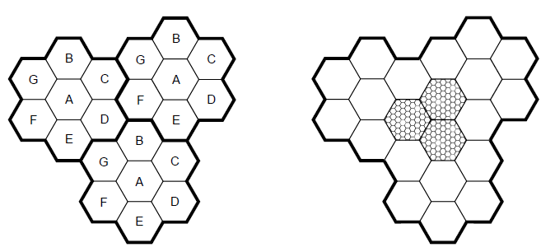
Cellular mobile phone systems
All based on notion of spatial regions called cells
Each mobile uses a frequency in a cell; moves cause handoff
Frequencies are reused across non-adjacent cells
To support more mobiles, smaller cells can be used
Cellular reuse pattern
Smaller cells for dense mobiles

Slide 53
GSM – Global System for Mobile Communications (1)
Mobile is divided into handset and SIM card (Subscriber Identity Module) with credentials
Mobiles tell their HLR (Home Location Register) their current whereabouts for incoming calls
Cells keep track of visiting mobiles (in the Visitor LR)

Slide 54
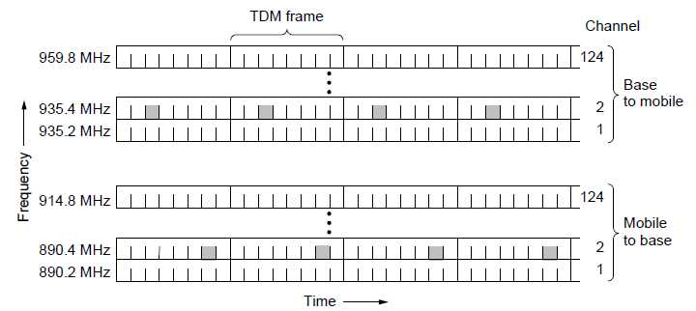
GSM – Global System for Mobile Communications (2)
Air interface is based on FDM channels of 200 KHz divided in an eight-slot TDM frame every 4.615 ms
Mobile is assigned up- and down-stream slots to use
Each slot is 148 bits long, gives rate of 27.4 kbps

Slide 55
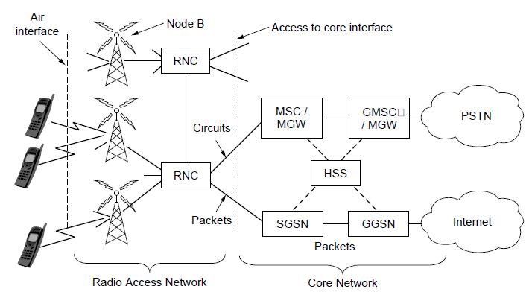
UMTS – Universal Mobile Telecommunications System (1)
Architecture is an evolution of GSM; terminology differs
Packets goes to/from the Internet via SGSN/GGSN
Internet

Slide 56
UMTS – Universal Mobile Telecommunications System (2)
Air interface based on CDMA over 5 MHz channels
Rates over users <14.4 Mbps (HSPDA) per 5 MHz
CDMA allows frequency reuse over all cells
CDMA permits soft handoff (connected to both cells)
Soft
handoff

Slide 57
Take home
Principal bandwidth limits
Nyquist’s theorem
CDMA for parallel access
Gray codes to reduce impact of errors for symbols carrying multiple bits of information

