Slide 1
Distributed Systems 3. Physical Layer
Simon Razniewski
Faculty of Computer Science
Free University of Bozen-Bolzano
A.Y. 2016/2017
Notes:
Interaktiv:
frequencies per signal rate – berechnen
bandwidth of a truck berechnen
(gray code)

Slide 2
The Physical Layer
Theoretical Basis for Data Communications
Transmission Media
Guided Transmission Media
Wireless Transmission
Communication Satellites
Digital Modulation and Multiplexing
Example Networks
Public Switched Telephone Network
Mobile Telephone System

Slide 3
The Physical Layer
Foundation on which other layers build
Properties of wires, fiber, wireless limit what the network can do
Key problem is to send (digital) bits using only (analog) signals
This is called modulation
Application
Transport
Network
Link
Physical

Slide 4
The Physical Layer
Theoretical Basis for Data Communications
Transmission Media
Guided Transmission Media
Wireless Transmission
Communication Satellites
Digital Modulation and Multiplexing
Example Networks
Public Switched Telephone Network
Mobile Telephone System

Slide 5
What limits communication?
Examples:
Light
Sound

Slide 6
Electromagnetic signals
Limiting factor 1: Bandwidth:
Maximum frequency that can be transmitted and decoded over a medium
Limited either due to:
Physical properties of the medium (e.g. attenuation for electrical signals)
Physical limits of the encoder/decoder
Measured in Hertz (1 Hz = 1/s)
Notes:
TV channel 6 Mhz
Wifi 20 Mhz
DSL 1 Mhz

Slide 7
Fourier Analysis
A time-varying signal can be equivalently represented as a series of frequency components (harmonics):
=
Signal over time
a, b weights of harmonics
Notes:
rms = root mean square

Slide 8
Visualization
http://www.intmath.com/fourier-series/fourier-graph-applet.php

Slide 9
Bandwidth-Limited Signals
Having less bandwidth (harmonics) degrades the signal
8 harmonics
Lost!
Bandwidth
4 harmonics
Lost!
2 harmonics
Lost!
Notes:
bandwidth = max frequency transmittable

Slide 10
Maximum Data Rate of a Channel
Nyquist’s theorem (1924) relates the data rate to the bandwidth (B) and limiting factor 2, the number of signal levels (V):
Maximum data rate of a binary signal over a 3kHz channel is 6Kbps
Shannon’s result relates data rate to bandwidth (B) and the signal-to-noise (S/N) ratio
→ Maximum data rate of over a 1 MHz DSL-line with signal-to-noise ratio 10000:1 (40 db) is 13 Mbps
Max. data rate = 2B log₂V bits/sec
How fast signal
can change
How many levels
can be seen
Max. data rate = B log₂(1+S/N)
Notes:
These are fundamental limits; real systems can only approach them.
Formula 1: Modem 56k modem same channel -> 512 levels
Formula 1: Wifi: 20 Mhz -> 40 Mbit/s
Formula 2: Wifi: 20 Mhz, SNR 1000 (30 db) -> 200 Mbit/s

Slide 11
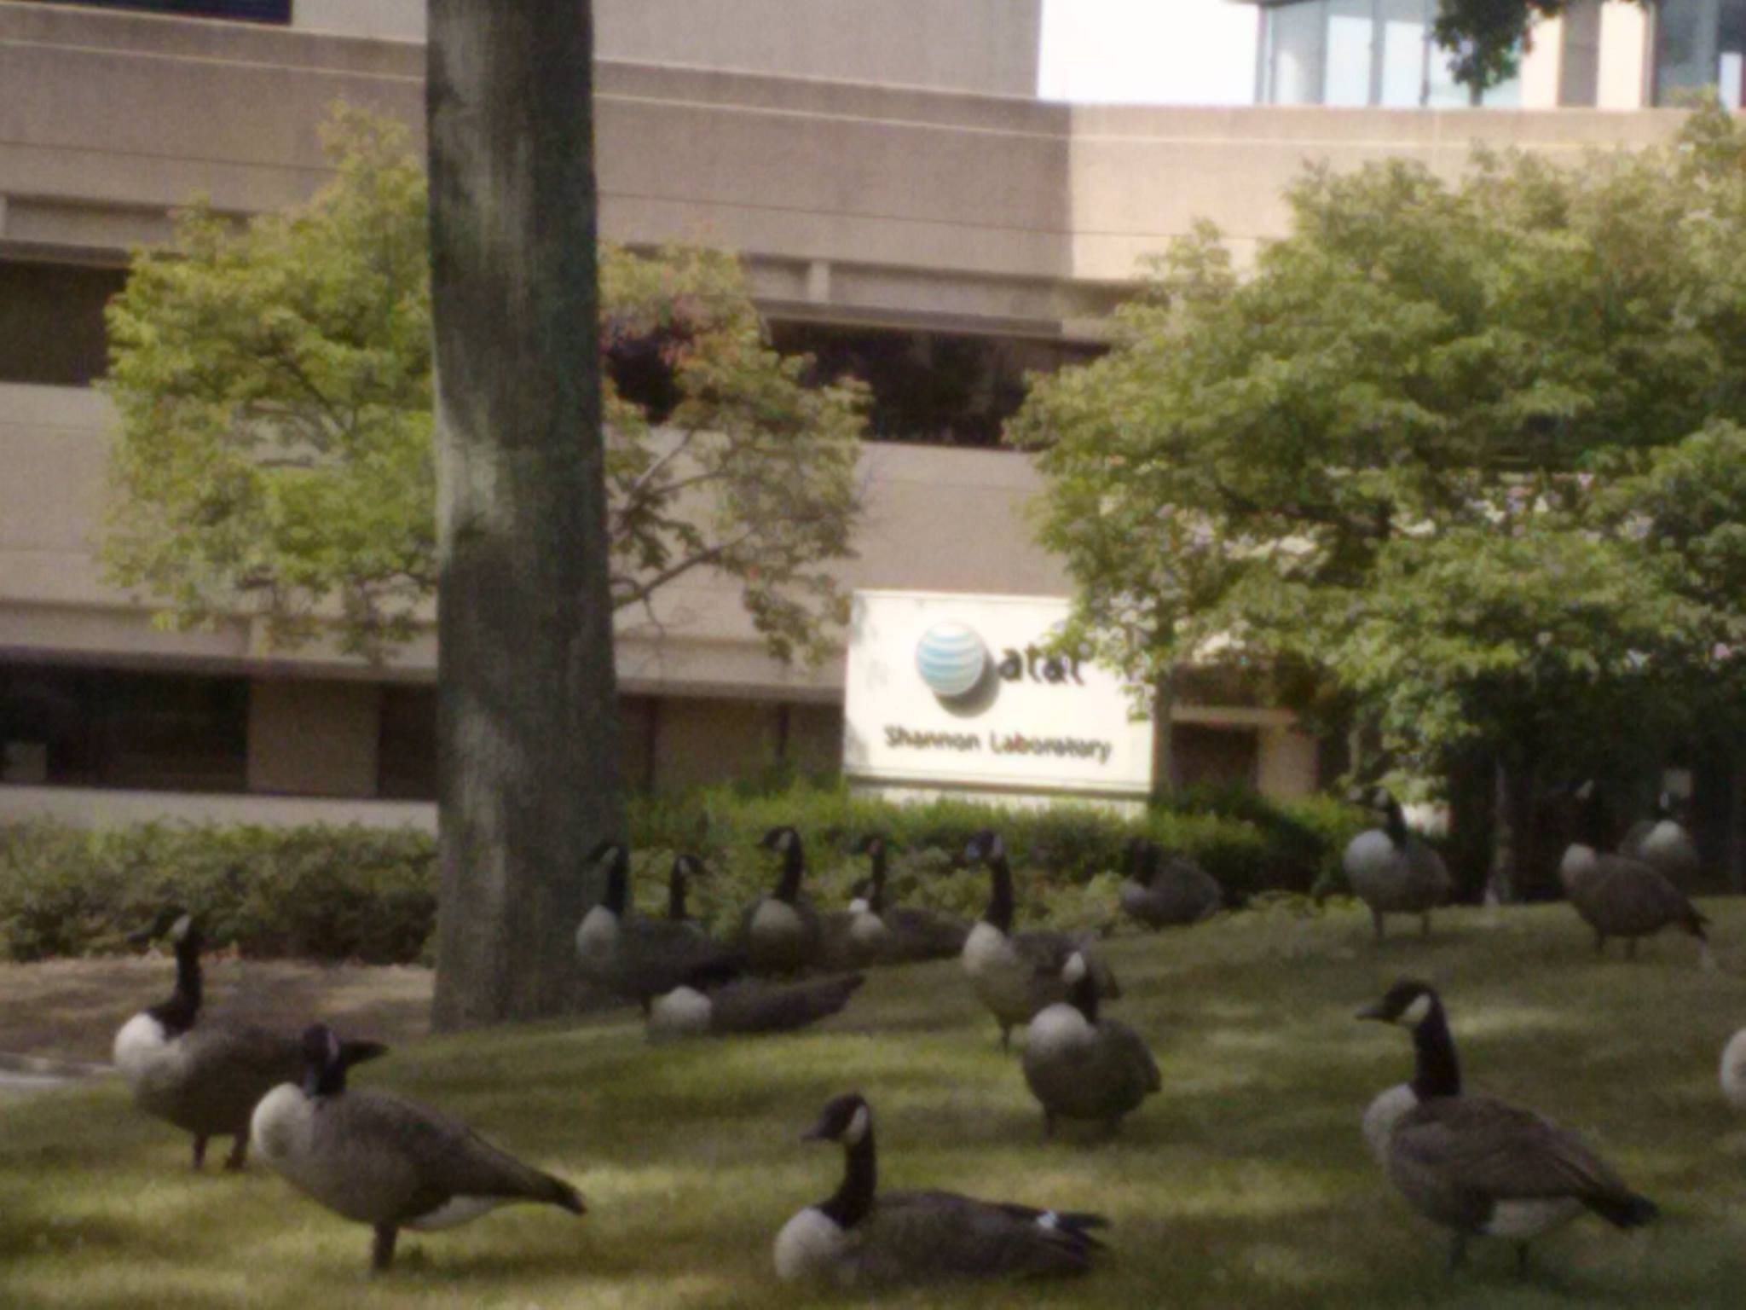
Notes:
Canada goose, not grey
Closed 2013
Florham park, NJ

Slide 12
The Physical Layer
Theoretical Basis for Data Communications
Transmission Media
Guided Transmission Media
Wireless Transmission
Communication Satellites
Digital Modulation and Multiplexing
Example Networks
Public Switched Telephone Network
Mobile Telephone System

Slide 13
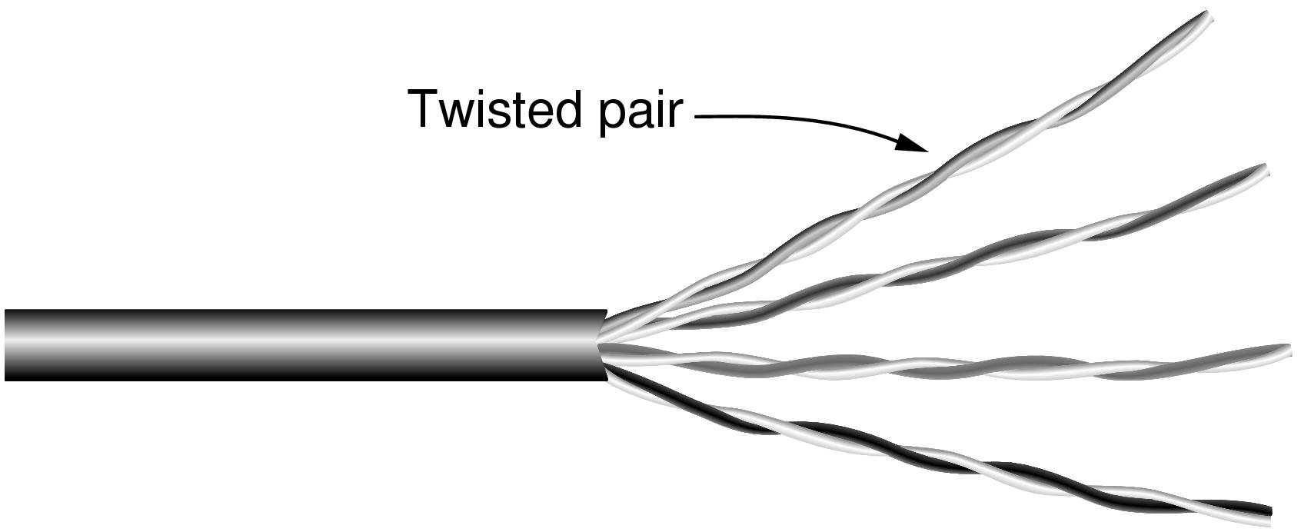
Wires – Twisted Pair
Very common; used in LANs, telephone lines
Twists reduce radiated signal (interference)
Category 5 UTP cable with four twisted pairs
Notes:
signal as diff between the two cables -> external noise affects both the same
phones to telco for some kilometers use this
several mbit/sec for few kilometers
CAT5 four such pairs
100 mbit lan uses two of them, one each direction
1gb lan uses all four both directions

Slide 14
Wires – Coaxial Cable (“Co-ax”)
Also common. Better shielding and more bandwidth for longer distances and higher rates than twisted pair.
Notes:
coax: few Ghz
old time: long distance phone, now replaced by fiber
for TV a lot
More expensive

Slide 15
Wires – Power Lines
Household electrical wiring is another example of wires
Convenient to use, but horrible for sending data
Notes:
It is horrible because it carries power signals at the same time and the wiring was not designed for data communications, e.g., it is not tightly twisted like twisted pair, and its electrical properties change as devices that are plugged in turn on and off. But it is convenient because it is already installed and many devices are plugged in to get power, so people are starting to use it.
In germany, internet offered that way some time
In italy, responders for electric counting can be switched on and of with this

Slide 16
Fiber Cables (1)
Common for high rates and long distances
Long distance ISP links, Fiber-to-the-Home
Light carried in very long, thin strand of glass
Light source
(LED, laser)
Light trapped by
total internal reflection
Photodetector
Notes:
optical fiber. It is widely used for links that run at high rates, particularly over long distances. The optical fiber is a very long, thin strand of glass. Either a LED or a laser (better quality, more expensive). The pulses of light are trapped in the fiber (total internal reflection) and follow it. At the other end a photodetector turns pulses of light into electrical signals.

Slide 17
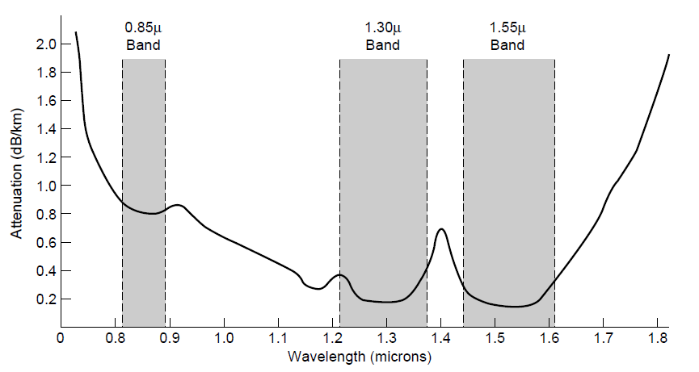
Fiber Cables (2)
Fiber has enormous bandwidth (THz) and tiny signal loss – hence high rates over long distances
3 dB = half point of energy
Notes:
This slide shows why fiber runs for high rates and long distances – attenuation is very low (can go 10km before the signal has lost 3dB or half its power) for enormous regions of bandwidth (30 *Terahertz* when wavelength is converted to frequency).

Slide 18
Fiber Cables (3)
Comparison of the properties of wires and fiber:
Property | Wires | Fiber
Distance | Short (100s of m) | Long (tens of km)
Bandwidth | Moderate | Very High
Cost | Inexpensive | Less cheap
Convenience | Easy to use | Less easy
Security | Easy to tap | Hard to tap
Notes:
Fiber gives you very high rates over long runs; wires score less highly on these properties and support high rates over much shorter runs. But wires are usually the inexpensive solution when the transmission/reception hardware is included. Wires are also easier to work with; fiber requires greater care with connections. Fiber has the advantage that it is very hard to tap as the light is confined only to the fiber or the fiber is broken. Wires are usually easy to tap because they radiate the signal well.

Slide 19
Wireless Transmission
Electromagnetic Spectrum »
Radio Transmission »
Microwave Transmission »
Light Transmission »
Wireless vs. Wires/Fiber »

Slide 20
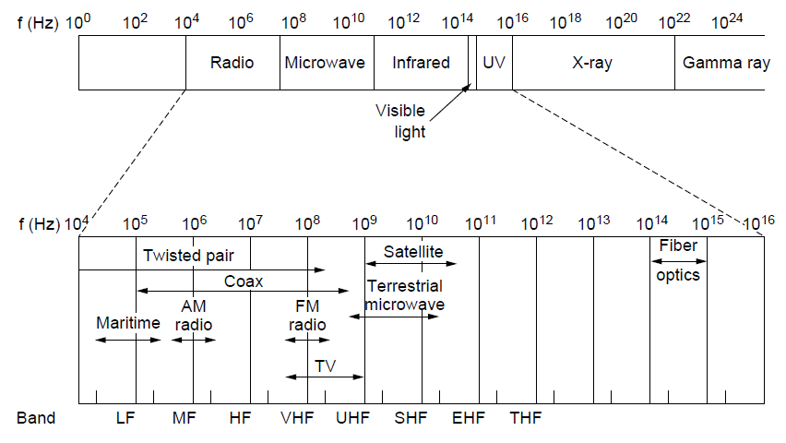
Electromagnetic Spectrum (1)
Different bands have different uses:
Radio: wide-area broadcast; Infrared/Light: line-of-sight
Microwave: LANs and 3G/4G;
Networking focus
Microwave

Slide 21
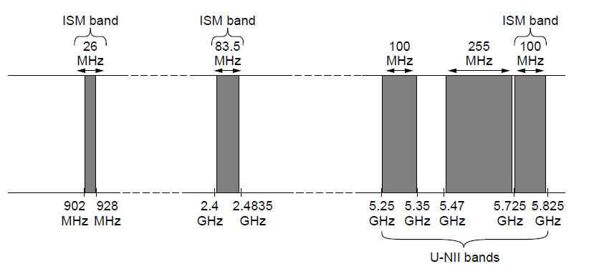
Electromagnetic Spectrum (3)
Fortunately, there are unlicensed (“ISM”) bands:
Free for use at low power; devices manage interference
Widely used for networking; WiFi, Bluetooth, etc.
802.11
b/g/n
802.11a/g/n
Notes:
These bands are used for WiFi, etc., not for cellular.

Slide 22
Electromagnetic Spectrum (2)
To manage interference, spectrum is carefully divided, and its use regulated and licensed, e.g., sold at auction.
300 MHz
3 GHz
WiFi (ISM bands)
3 GHz
Source: NTIA Office of Spectrum Management, 2003
30 GHz
(Excerpt of the US frequency allocations)
Notes:
TV, cellular, satellite frequencies are heavily regulated.

Slide 23
Radio Transmission
Radio signals penetrate buildings well and propagate for long distances with path loss
In the VLF, LF, and MF bands, radio waves follow the curvature of the earth
In the HF band, radio waves bounce off the ionosphere.
Notes:
The path loss makes the signal fall of at least as fast as 1/d^2 due to the RF energy being spread out over a greater region.

Slide 24
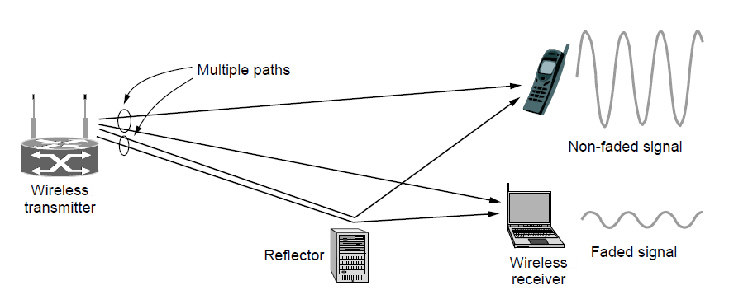
Microwave Transmission
Microwaves have much bandwidth and are widely used indoors (WiFi) and outdoors (3G, satellites)
Signal is attenuated/reflected by everyday objects
Strength varies due multipath fading, etc.
Notes:
The variation in signal strength as the sender/receiver move is a key hallmark of wireless. It means that data rates over wireless links can change dramatically; they are not fixed like a wire.
Routing around rain, reflections cancel out stuff, water absorbs them

Slide 25
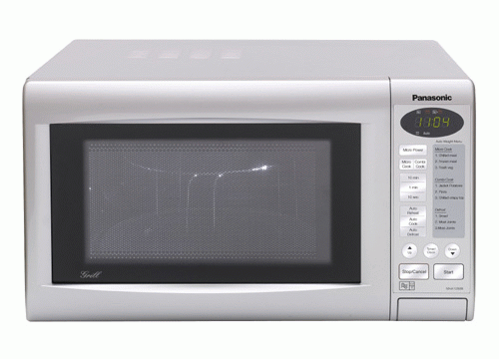
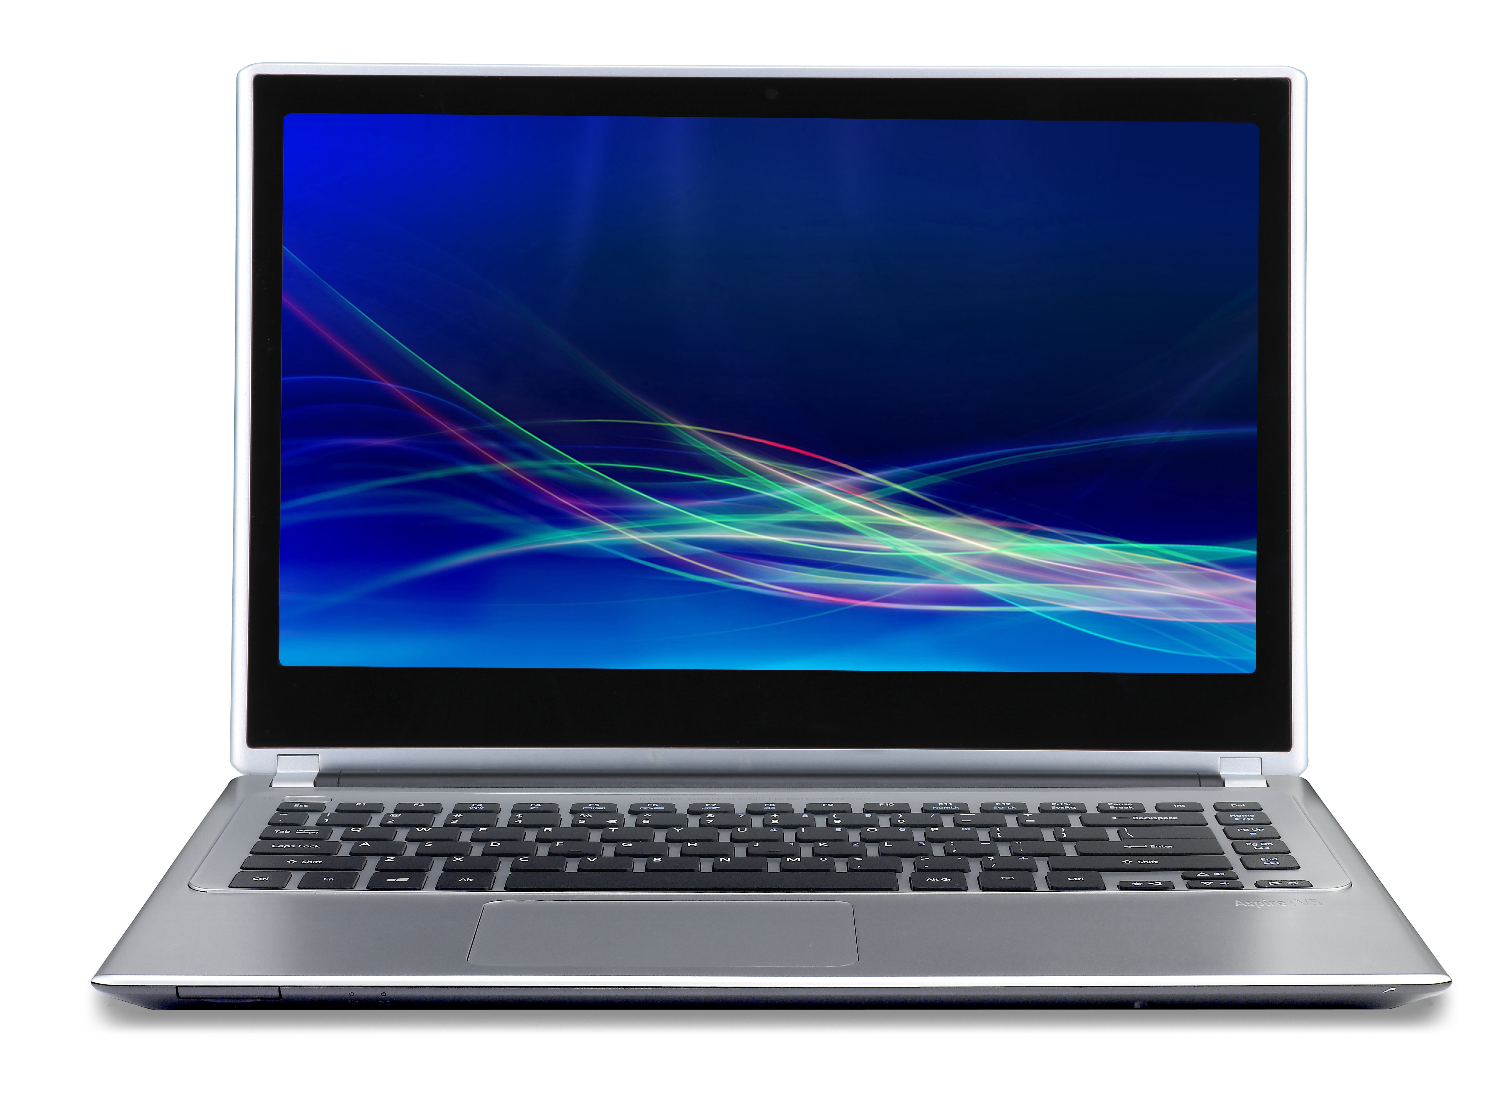
Source: http://www.howtogeek.com/171869/why-does-running-my-microwave-kill-my-wi-fi-connectivity/

Slide 26
Wireless vs. Wires/Fiber
Wireless:
Easy and inexpensive to deploy
Naturally supports mobility
Naturally supports broadcast
Transmissions interfere and must be managed
Signal strengths hence data rates vary greatly
Wires/Fiber:
Easy to engineer a fixed data rate over point-to-point links
Can be expensive to deploy, esp. over distances
Doesn’t readily support mobility or broadcast

Slide 27
Communication Satellites
Satellites are effective for broadcast distribution and anywhere/anytime communications
Kinds of Satellites »
Geostationary (GEO) Satellites »
Low-Earth Orbit (LEO) Satellites »
Satellites vs. Fiber »

Slide 28
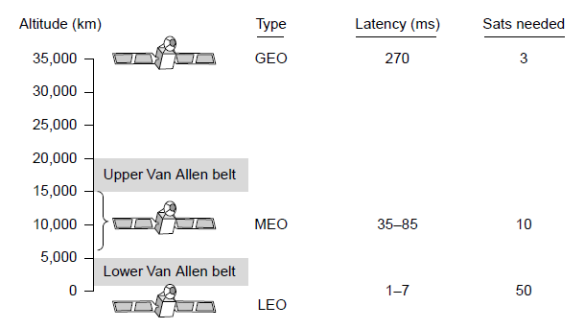
Kinds of Satellites
Satellites and their properties vary by altitude:
Geostationary (GEO), Medium-Earth Orbit (MEO), and Low-Earth Orbit (LEO)
Sats needed for global coverage
GPS, Galileo
Notes:
MEO is used for navigation systems such as the GPS (Global Positioning System) rather than data communications.

Slide 29
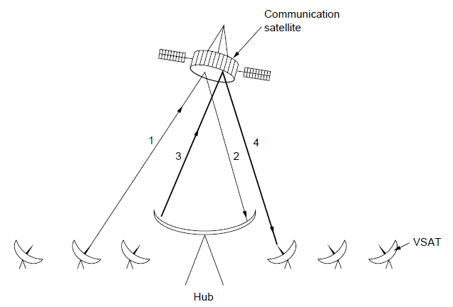
Geostationary Satellites
GEO satellites orbit 35,000 km above a fixed location
VSAT (computers) can communicate with the help of a hub
Different bands (L, S, C, Ku, Ka) in the GHz are in use but may be crowded or susceptible to rain.
GEO satellite
VSAT
Notes:
very small aperture antennas (1m only)

Slide 30
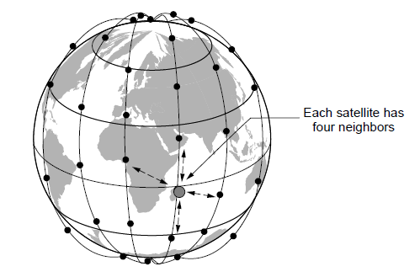
Low-Earth Orbit Satellites
Systems such as Iridium (satellite phones) use many low-latency satellites for coverage and route communications via them
The Iridium satellites form six necklaces around the earth.
Notes:
Since the satellites are LEO, it does not take long for signals from the Earth to go up and down compared to GEO satellites.
A bit outdated now, with mobile network coverage on ground good

Slide 31
Satellite vs. Fiber
Satellite:
Can rapidly set up anywhere/anytime communications (after satellites have been launched)
Can broadcast to large regions
Limited bandwidth and interference to manage
Fiber:
Enormous bandwidth over long distances
Installation can be more expensive/difficult

Slide 32
Bandwidth
Internal/Home Network
Internet link
Connection | Speed |  | Transmit 1 GB
type | bps | B/sec | hh : mm : ss
56K Modem | 56 K | 6.8 K | 42 : 36 : 31.69
Classic DSL | 512 K | 62.5 K | 4 : 39 : 37.22
Modern DSL | 10 M | 1.221 M | : 14 : 09.93
OC-1 | 51.840 M | 6.328 M | : 2 : 45.70
Ethernet | 100 M | 12.207 M | : 1 : 25.90
OC-3 | 155 M | 18.984 M | : : 55.23
OC-12 | 622 M | 75.937 M | : : 13.81
Notes:
optical carrier

Slide 33
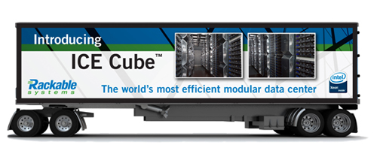
The best bandwidth in the world?
What if we send a truck forth and back?
7.1PB of storage (http://searchdatacenter.techtarget.com/review/Rackable-Systems-ICE-Cube-Modular-Data-Center)
transmission speed: 80 km/h
Bandwidth Rome-London (2000 km)?
Notes:
78 GB/s vs 75 GB/s
Send it forth and back and forth and back

Slide 34
The Physical Layer
Theoretical Basis for Data Communications
Transmission Media
Guided Transmission Media
Wireless Transmission
Communication Satellites
Digital Modulation and Multiplexing
Example Networks
Public Switched Telephone Network
Mobile Telephone System

Slide 35
Digital Modulation
Modulation schemes send bits as signals;
Single-dimension modulation (Baseband Transmission)
Multi-dimension modulation (Passband Transmission)

Slide 36
Baseband Transmission
Line codes send symbols that represent one or more bits
NRZ is the simplest, literal line code (+1V=“1”, -1V=“0”)

Slide 37
Baseband transmission (2)
To decode the symbols, signals need sufficient transitions
Otherwise long runs of 0s (or 1s) are confusing, e.g.:
Strategies:
Manchester coding, mixes clock signal in every symbol
4B/5B maps 4 data bits to 5 coded bits with 1s and 0s:
Scrambler XORs tx/rx data with pseudorandom bits
1
0 0 0 0 0 0 0 0 0 0 um, 0? er, 0?
Data | Code | Data | Code | Data | Code | Data | Code
0000 | 11110 | 0100 | 01010 | 1000 | 10010 | 1100 | 11010
0001 | 01001 | 0101 | 01011 | 1001 | 10011 | 1101 | 11011
0010 | 10100 | 0110 | 01110 | 1010 | 10110 | 1110 | 11100
0011 | 10101 | 0111 | 01111 | 1011 | 10111 | 1111 | 11101
Notes:
Strategies go from simplest to more complex and make progressively better use of bandwidth:
-Manchester is simple (every symbol has an embedded transition) but uses twice the bandwidth of a data signal
-4B/5B ensures no more than three 0s in a row (1s can be handled by making the signal level change to represent a 1) and needs 1.25X bandwidth
-scrambler needs no extra bandwidth (just data XOR sequence XOR sequence = data) but only makes long runs of 0s or 1s a low probability event

Slide 38
Passband Transmission (1)
Modulating the amplitude, frequency/phase of a carrier signal sends bits in a (non-zero) frequency range
NRZ signal of bits
Amplitude shift keying
Frequency shift keying
Phase shift keying
Notes:
nyquist says there is no point in sampling higher than 6000 times per second for binary signal over 3khz line
therefore, increase signal from binary to more

Slide 39
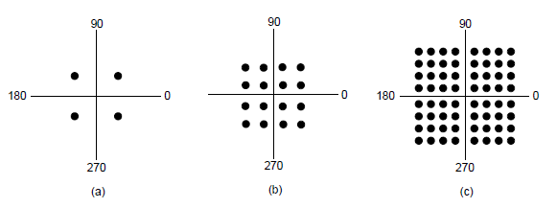
Passband Transmission (2)
Constellation diagrams are a shorthand to capture the amplitude and phase modulations of symbols:
BPSK
2 symbols
1 bit/symbol
QPSK
4 symbols
2 bits/symbol
QAM-16
16 symbols
4 bits/symbol
QAM-64
64 symbols
6 bits/symbol
BPSK/QPSK varies only phase
QAM varies amplitude and phase
Notes:
binary phase shift keying, quadrature amplitude modification
1. up/down
2. three different phasenverschiebungen
QAM: phase + amplitude + phase
3. => 4 bits per symbol
highest: 14bits/symbol => 33kb (+compression etc)

Slide 40
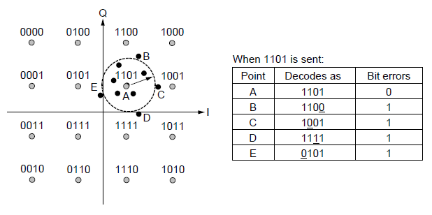
Twodimensional case – Gray coding
2 dimensions with four levels each
B
E
A
C
D

Slide 41
Gray code exercise
3 bit in a signal ranging from 0-8V
0-1V: 000
1-2V: 001
2-3V: 010
3-4V: 011
4-5V: 100
5-6V: 101
6-7V: 110
7-8V: 111
Why is this arrangement not good?
What would be a better one?

Slide 42
Multiplexing
Multiplexing schemes share a channel among users.
Frequency Division Multiplexing
Time Division Multiplexing
Will see dynamic schemes in the medium access control sublayer

Slide 43
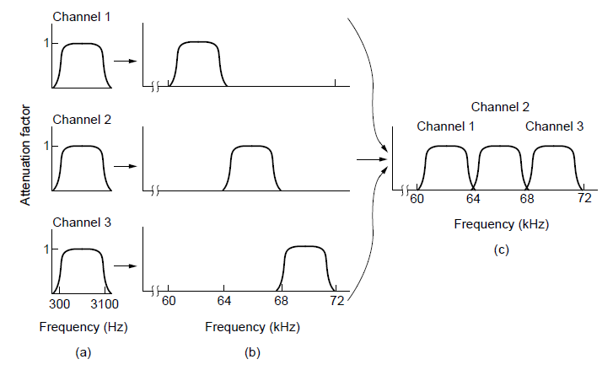
Frequency Division Multiplexing (1)
FDM (Frequency Division Multiplexing) shares the channel by placing users on different frequencies:
Overall FDM channel

Slide 44
Time Division Multiplexing (TDM)
Time division multiplexing shares a channel over time:
Users take turns on a fixed schedule; this is not packet switching or STDM (Statistical TDM)
Widely used in telephone / cellular systems

Slide 45
The Physical Layer
Theoretical Basis for Data Communications
Transmission Media
Guided Transmission Media
Wireless Transmission
Communication Satellites
Digital Modulation and Multiplexing
Example Networks
Public Switched Telephone Network
Mobile Telephone System

Slide 46
The Public Switched Telephone Network
Structure of the telephone system »
Politics of telephones »
Local loop: modems, ADSL, and FTTH »
Trunks and multiplexing »
Switching »

Slide 47
Structure of the Telephone System
A hierarchical system for carrying voice calls made of:
Local loops, mostly analog twisted pairs to houses
Trunks, digital fiber optic links that carry calls
Switching offices, that move calls among trunks

Slide 48
Local loop (1): modems
Telephone modems send digital data over an 3.3 KHz analog voice channel interface to the plain old phone network
Rates <56 kbps; early way to connect to the Internet

Slide 49
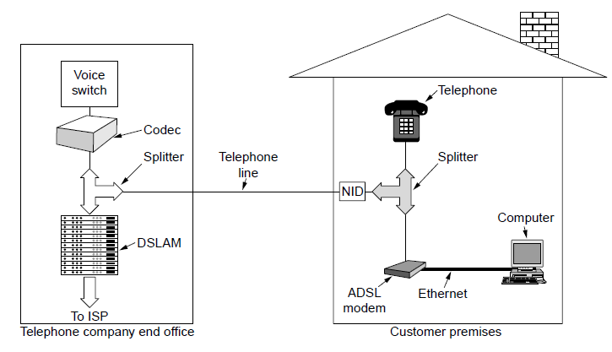
Local loop (2): Digital Subscriber Lines
DSL broadband sends data over the local loop to the local office using frequencies that are not used for POTS
Telephone/computers attach to the same old phone line
Rates vary with line
OFDM is used up to 1.1 MHz for ADSL2
Most bandwidth down
Notes:
ADSL for “asymmetric DSL” is the most popular version of DSL. Asymmetric cause more for down.
Orthogonal frequency-division multiplexing
Pay for getting filter removed…

Slide 50
Switching (1)
PSTN uses circuit switching; Internet uses packet switching
Notes:
public switched telephone network
Pro: only limit by speed of electricity
Pro: no congestion
Con: more expensive, less fault-proof

Slide 51
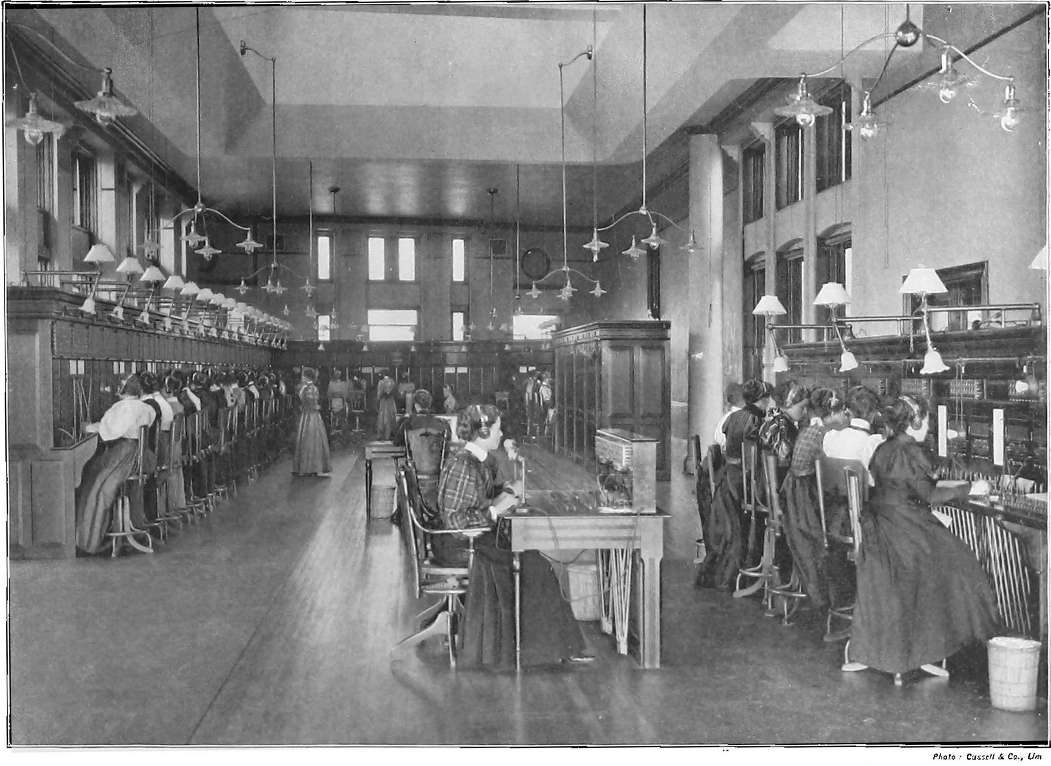

Slide 52
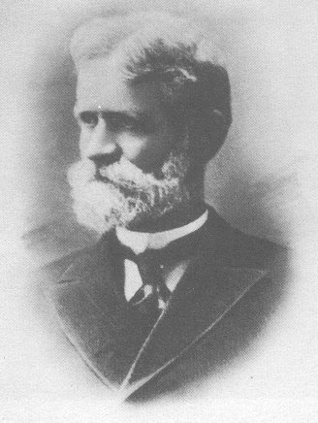
Strowger Switches (1891)
Notes:
Story: undertaker – 2 in missouri, manual connection, other one’s wife was operator => invented automatic switching

Slide 53
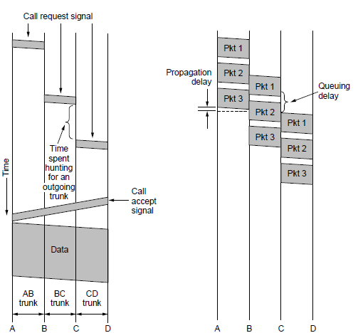
Switching (2)
Circuit switching requires call setup (connection) before data flows smoothly
Also teardown at end (not shown)
Packet switching treats messages independently
No setup, but variable queuing delay at routers
Circuits
Packets

Slide 54
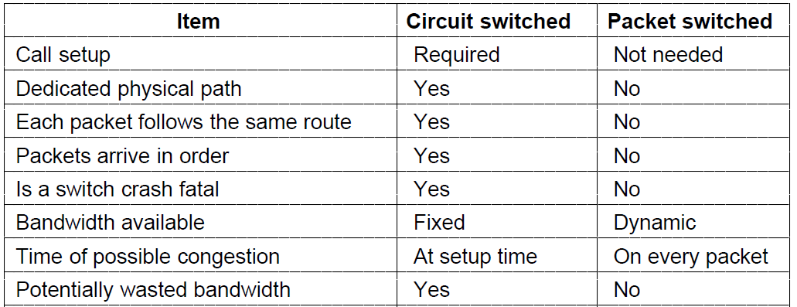
Switching (3)
Comparison of circuit- and packet-switched networks

Slide 55
Mobile Telephone System
Generations of mobile telephone systems »
Cellular mobile telephone systems »
GSM, a 2G system »
UMTS, a 3G system »

Slide 56
Generations of mobile telephone systems
1G, analog voice
AMPS (Advanced Mobile Phone System) is example, deployed from 1980s. Modulation based on FM (as in radio).
2G, analog voice and digital data
GSM (Global System for Mobile communications) is example, deployed from 1990s. Modulation based on QPSK.
First SIM cards 1991
3G, digital voice and data
UMTS (Universal Mobile Telecommunications System) is example, deployed from 2000s. Modulation based on CDMA
Frequency auctions: 200 €/inhabitant in Italy
4G, digital data including voice
LTE (Long Term Evolution) is example, deployed from 2010s. Modulation based on OFDM
Notes:
FM = freq division
QPSK = Quadrature Phase Shift Keying (QPSK)
CDMA = code division multiple access – overlay with different bytecodes parts…
OFDM = FDM on different subchannels, better for variable channels, when high end unreliable

Slide 57
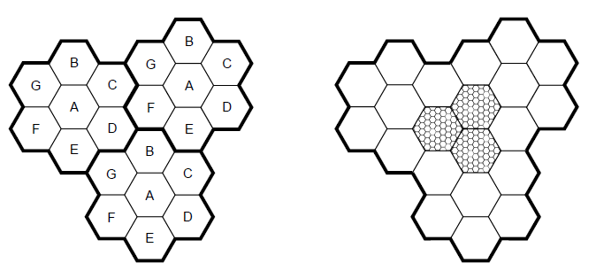
Cellular mobile phone systems
All based on notion of spatial regions called cells
Each mobile uses a frequency in a cell; moves cause handoff
Frequencies are reused across non-adjacent cells
Cellular reuse pattern
Smaller cells for dense mobiles
Notes:
General Packet Radio Service
Gateway GPRS support node (GGSN)
Serving GPRS support node (SGSN)

Slide 58
GSM – Global System for Mobile Communications (1)
Mobile is divided into handset and SIM card (Subscriber Identity Module) with credentials
IMSI (International Mobile Subscriber Identity
Authentication information
Mobiles tell their HLR (Home Location Register) their current whereabouts for incoming calls
Cells keep track of visiting mobiles (in the Visitor LR)
Notes:
Mobile switching center
Base station controller

Slide 59
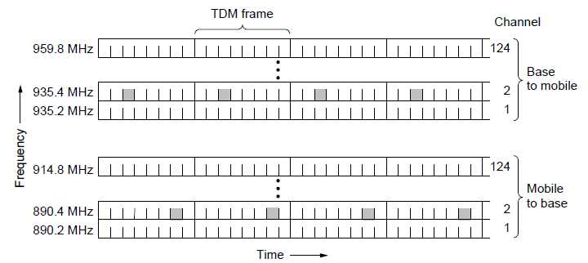
GSM – Global System for Mobile Communications (2)
Air interface is based on FDM channels of 200 KHz divided in an eight-slot TDM frame every 4.615 ms
Mobile is assigned up- and down-stream slots to use
Each slot is 148 bits long, gives rate of 27.4 kbps
Notes:
GSM runs mostly in 850 / 900 / 1800 / 1900 MHz spectrum depending on the country
Frequency division multiplexing, time division multiplexing
27.4 kbps is best case…

Slide 60
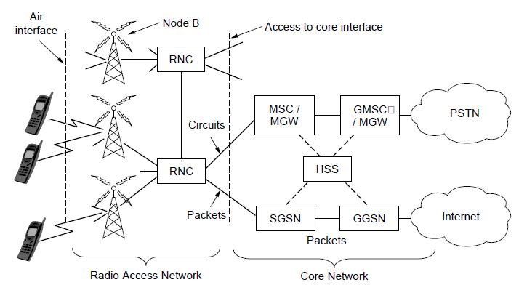
UMTS – Universal Mobile Telecommunications System (1)
Architecture is an evolution of GSM; terminology differs
Packets goes to/from the Internet via SGSN/GGSN
Internet

Slide 61
LTE
Voice calls are digital as well
Peak downlink: 86 Mbps → 325 Mbps

Slide 62
Learned today
Principal bandwidth limits
Nyquist’s and Shannon’s theorems
Cable vs Wifi, fiber and satellite
Modulation: Encoding of binary signals in electric waves
Structure of the phone network, DSL and mobile network

