Slide 1
Distributed Systems 10. Network Layer in the Internet
Simon Razniewski
Faculty of Computer Science
Free University of Bozen-Bolzano
A.Y. 2015/2016

Slide 2
The Network Layer
Remember:
Responsible for delivering packets between endpoints over multiple links
(Link layer: single link Transport layer: Uses this service)
Application
Transport
Network
Link
Physical

Slide 3
Network Layer in the Internet (1)
IP Version 4
IP Addresses
IP Version 6
Internet Control Protocols
Label Switching and MPLS
OSPF—An Interior Gateway Routing Protocol
BGP—The Exterior Gateway Routing Protocol
Mobile IP

Slide 4
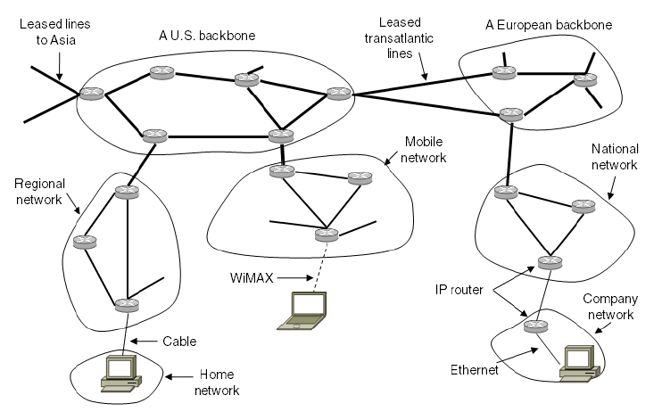
Network Layer in the Internet (3)
Internet is an interconnected collection of many networks that is held together by the IP protocol

Slide 5
IP Version 4 Protocol (1)
IPv4 (Internet Protocol) header is carried on all packets and has fields for the key parts of the protocol:

Slide 6
Wireshark

Slide 7
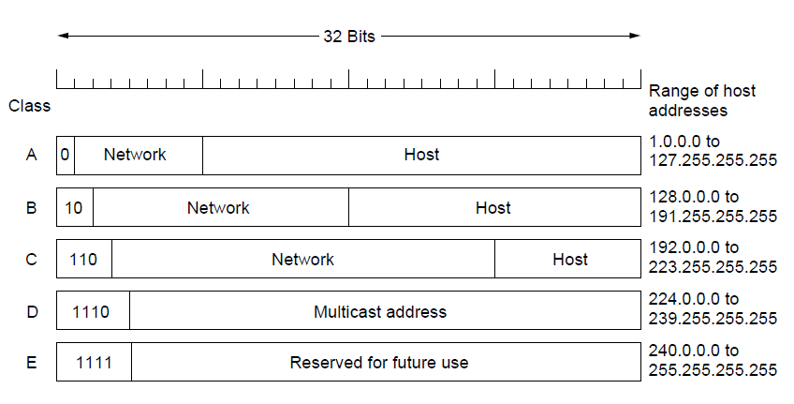
Hierarchical Routing – Classful Addresing
Old addresses came in blocks of fixed size (A, B, C)
Carries size as part of address, but lacks flexibility
Called classful (vs. classless) addressing
→ Router need only one entry per external subnet

Slide 8
IP Addresses (1) – Prefixes
Addresses are allocated in blocks called prefixes
Prefix is determined by the network portion
Written address/length, e.g., 18.0.31.0/24

Slide 9
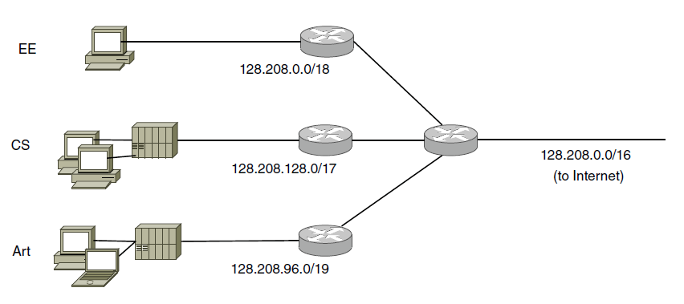
IP Addresses (2) – Subnets
Subnetting splits up IP prefix to help with management
Looks like a single prefix outside the network
ISP gives network
a single prefix
Network divides it into subnets internally

Slide 10
Your turn
Subnet A has address 141.89.228.0/26
How many addresses are in this subnet?
What is the lowest, what is the highest address in this subnet?
Computer B has the IPv4 address (including the subnet mask in CIDR notation) 141.89.228.65/26.
Computer C is reachable as 141.89.228.63/26.
Do they belong to the same subnet?

Slide 11
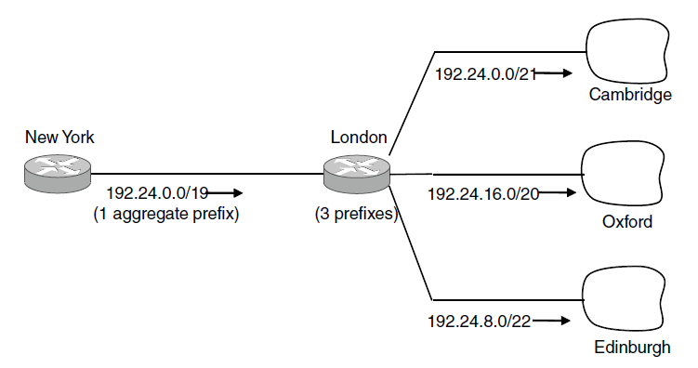
IP Addresses (3) – Aggregation
Aggregation joins multiple IP prefixes into a single larger prefix to reduce routing table size
→ Reduce size of the routing table
ISP advertises
a single prefix
ISP customers have different prefixes

Slide 12
Your turn (2)
Split the subnet 192.168.240.0/12 into four equal subnets and give the address of each subnet

Slide 13
IP Addresses (4) – Longest Matching Prefix
Packets are forwarded to the entry with the longest matching prefix or smallest address block
Complicates forwarding but adds flexibility
Except for this part!
Main prefix goes this way

Slide 14
IP Version 6 (1)
Major upgrade in the 1990s due to impending address exhaustion, with various other goals:
Support billions of hosts
Reduce routing table size
Simplify protocol
Better security
Attention to type of service
Aid multicasting
Roaming host without changing address
Allow future protocol evolution
Permit coexistence of old, new protocols, …
Deployment has been slow & painful, but may pick up pace now that addresses are all but exhausted

Slide 15
How many addresses?
Three hundred and forty undecillion, two hundred and eighty-two decillion, three hundred and sixty-six nonillion, nine hundred and twenty octillion, nine hundred and thirty-eight septillion, four hundred and sixty-three sextillion, four hundred and sixty-three quintillion, three hundred and seventy-four quadrillion, six hundred and seven trillion, four hundred and thirty-one billion, seven hundred and sixty-eight million, two hundred and eleven thousand, four hundred and fifty-six.

Slide 16
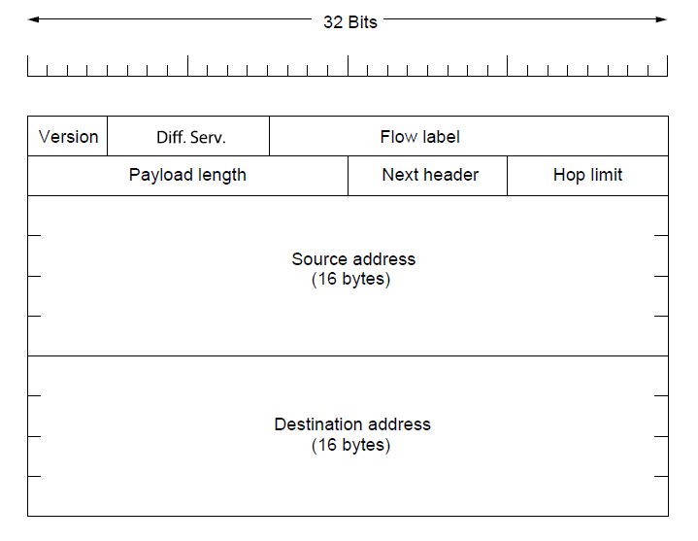
IP Version 6 (2 )
IPv6 protocol header has much longer addresses (128 vs. 32 bits) and is simpler (by using extension headers)

Slide 17
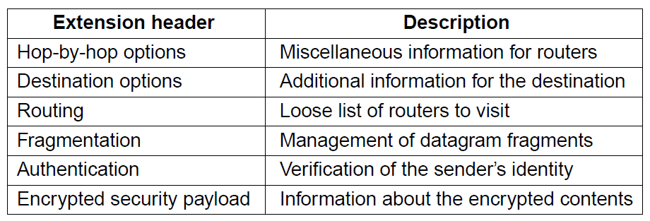
IP Version 6 (3)
IPv6 extension headers handles other functionality

Slide 18
IPv6 Deployment Status
https://www.vyncke.org/ipv6status/
http://test-ipv6.com/

Slide 19
Internet Control Protocols (1)
IP works with the help of several control protocols:
ICMP is a companion to IP that returns error info
Required, and used in many ways, e.g., for traceroute
ARP finds Ethernet address of a local IP address
Glue that is needed to send any IP packets
Host queries an address and the owner replies
DHCP assigns a local IP address to a host
Gets host started by automatically configuring it
Host sends request to server, which grants a lease

Slide 20
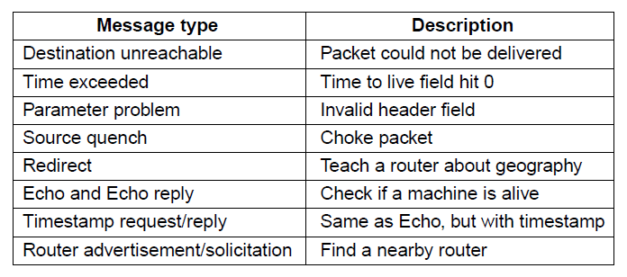
Internet Control Protocols (2)
Main ICMP (Internet Control Message Protocol) types:

Slide 21
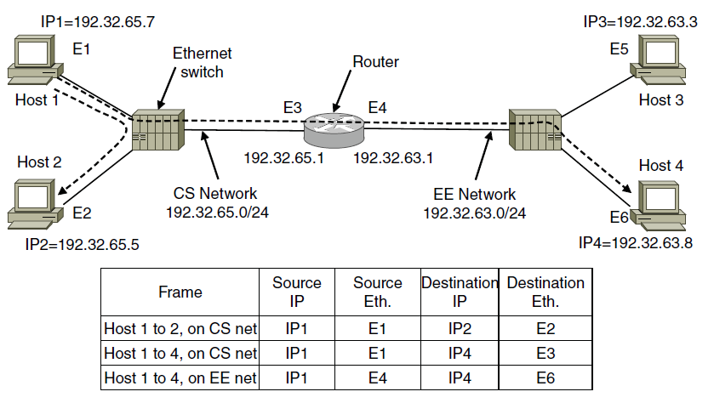
Internet Control Protocols (3)
ARP (Address Resolution Protocol) lets nodes find target Ethernet addresses [pink] from their IP addresses
Broadcast: “Who has IP X?”
Router takes all external addresses

Slide 22
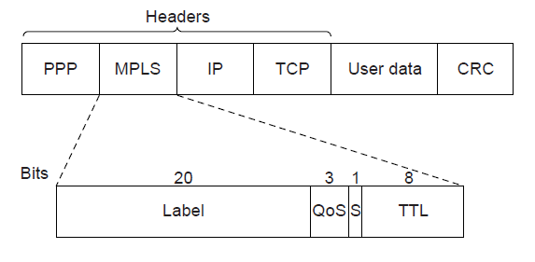
Label Switching and MPLS (1)
MPLS (Multi-Protocol Label Switching) sends packets along established paths; ISPs can use for QoS
Path indicated with label below the IP layer

Slide 23
Label Switching and MPLS (2)
Label added based on IP address on entering an MPLS network (e.g., ISP) and removed when leaving it
Forwarding only uses label inside MPLS network

Slide 24
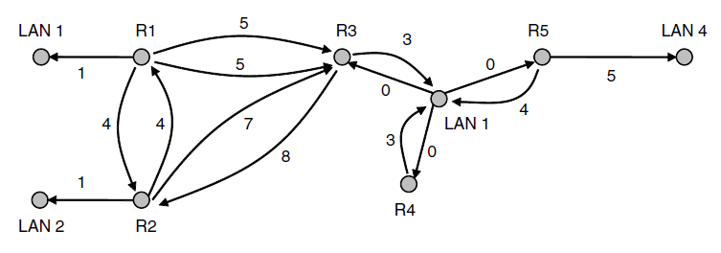
OSPF— Interior Routing Protocol
OSPF computes routes for a single network (e.g., ISP)
Models network as a graph of weighted edges
Network:
Graph:
3
Broadcast LAN modeled as a well-connected node

Slide 25
OSPF— Interior Routing Protocol (3)
OSPF (Open Shortest Path First) is link-state routing:
Uses messages below to reliably flood topology
Then runs Dijkstra to compute routes

Slide 26
BGP— Exterior Routing Protocol (1)
BGP (Border Gateway Protocol) computes routes across interconnected, autonomous networks
Key role is to respect networks’ policy constraints
Example policy constraints:
No commercial traffic for educational network
Never put Iraq on route starting at Pentagon
Choose cheaper network
Choose better performing network
Don’t go from Apple to Google to Apple

Slide 27
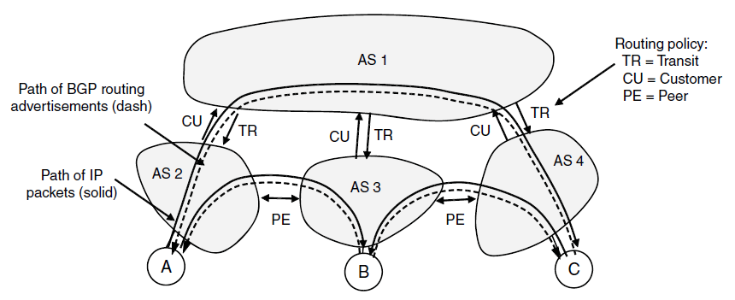
BGP— Exterior Routing Protocol (2)
Common policy distinction is transit vs. peering:
Transit carries traffic for pay; peers for mutual benefit
AS1 carries AS2↔AS4 (Transit) but not AS3 (Peer)

Slide 28
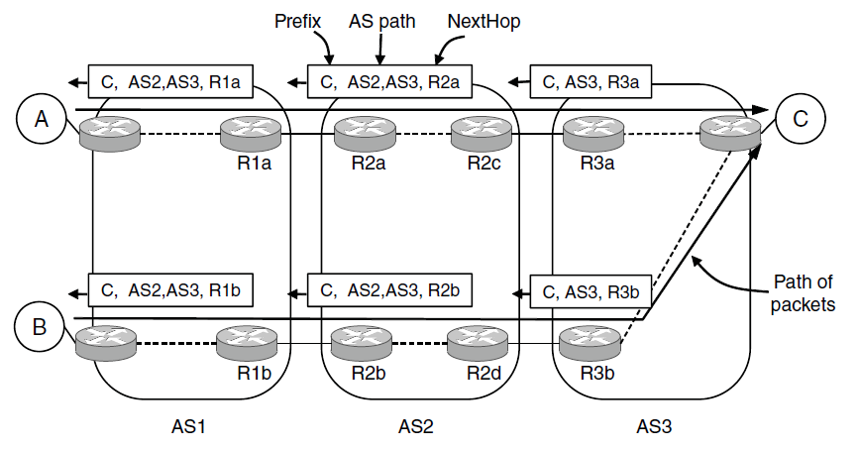
BGP— Exterior Routing Protocol (3)
BGP propagates messages along policy-compliant routes
Message has prefix, AS path (to detect loops) and next-hop IP (to send over the local network)

Slide 29
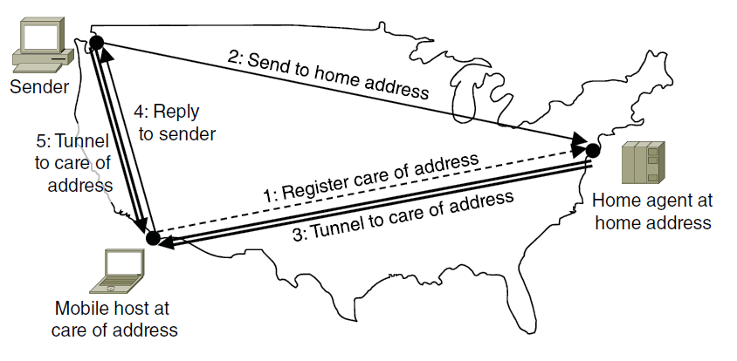
Mobile IP
Mobile hosts can be reached at fixed IP via a home agent
Home agent tunnels packets to reach the mobile host; reply can optimize path for subsequent packets
No changes to routers or fixed hosts

Slide 30
Take home
Internet Protocol (IP)
NETID+HOSTID
Subnetting
Internet
MPLS for sending along defined paths
OSPF inside a network
BGP between networks
IP Simulation: http://www.cs.stir.ac.uk/~kjt/software/comms/jasper/IP.html

