Slide 1
Distributed Systems 4. Data Link Layer
Simon Razniewski
Faculty of Computer Science
Free University of Bozen-Bolzano
A.Y. 2016/2017

Slide 2
The Data Link Layer
Responsible for delivering frames of information over a single link
Handles transmission errors and regulates the flow of data
Application
Transport
Network
Link
Physical

Slide 3
The Data Link Layer
Framing
Error Detection and Correction
Example Data Link Protocols

Slide 4
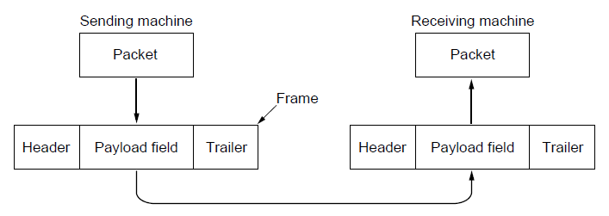
Frames
Link layer accepts packets from the network layer, and encapsulates them into frames that it sends using the physical layer; reception is the opposite process
Network
Link
Virtual data path
Physical
Actual data path

Slide 5
Possible Services
Unacknowledged connectionless service
Frame is sent with no connection / error recovery
Ethernet is example
Acknowledged connectionless service
Frame is sent with retransmissions if needed
Example is 802.11 (WiFi)
Connection-oriented service
Not in this layer

Slide 6
What is Framing, and why?

Slide 7
Framing Methods
Byte count for frames
Flag bytes with byte stuffing
Physical layer coding violations

Slide 8
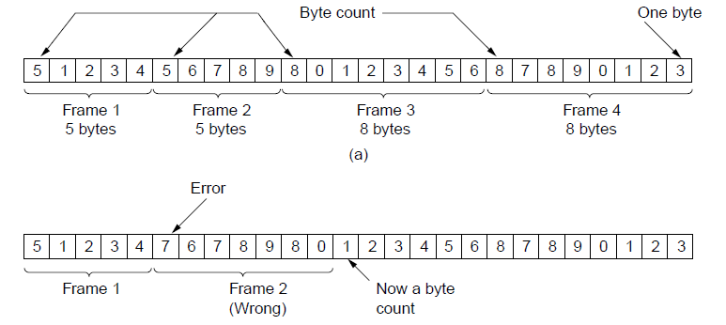
Framing – Byte count for frames
Frame begins with a count of the number of bytes in it
Simple, but difficult to resynchronize after an error
Expected
case
Error
case

Slide 9
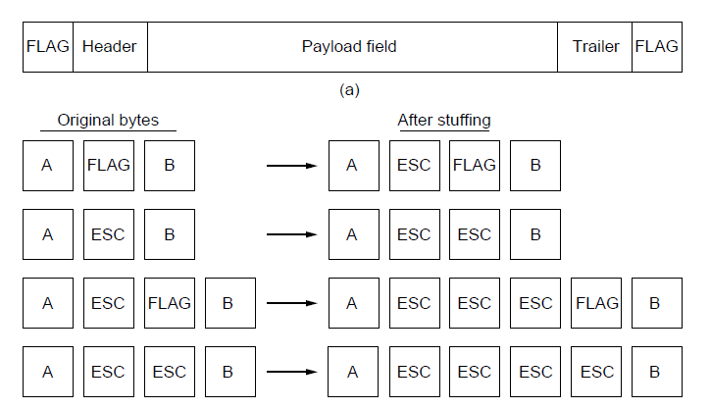
Framing – Byte stuffing
Special flag bytes delimit frames; occurrences of flags in the data must be stuffed (escaped)
Longer, but easy to resynchronize after error
Frame
format
Need to escape extra ESCAPE bytes too!
Stuffing
examples

Slide 10
Your turn
What are the frames that were sent?
FLAG A B ESC FLAG C FLAG FLAG ESC ESC ESC FLAG D F ESC FLAG A ESC ESC FLAG FLAG B ESC FLAG D B FLAG

Slide 11
Framing – Physical coding violation
How?

Slide 12
The Data Link Layer
Framing
Error Detection and Correction
Example Data Link Protocols

Slide 13
Error Detection and Correction
Two basic strategies:
Correct errors at receiver side (using error-correcting codes)
Detect errors at receiver side and request retransmission
Preferred method depends on the error probability
E.g. fiber: Error detection + retransmission
E.g. Wifi: Error correcting codes

Slide 14
FFFooouuunnndddaaatttiiiooonnn ooofff EEErrrrrrooorrr CCCooonnntttttrrrooolll: RRReeeddduuunnndddaaannncccyyy
AABsss yyyooouux cccaaanmn ssseeeaee, rrreeeddduuunnndddaaannncccyyy aaallllllouowwwsss tttooo ddteeettdeeekccttt aaannmddd cccooorrrrrreeecccttt sssmmnaaallllll eeerrgrrrooorrrsss,

Slide 15
Dd y knw: Natrl langge cntns a lt f rdndncy. Ths s th rsn tht w cn ndrstnd each otr evn in nsy nvrnmnts

Slide 16
Error Codes
Error codes add structured redundancy to data so errors can be either detected, or corrected.
Error detection codes:
Parity
Checksums
Cyclic redundancy codes (CRC)
Error correction codes:
Hamming codes
Reed-Solomon and Low-Density Parity Check codes
Mathematically complex, widely used in real systems

Slide 17
Error Detection – Parity
Parity bit is added as the modulo 2 sum of data bits
Equivalent to XOR; this is even parity
Ex: 1110 000 → 1110 0001
Detection checks if the sum is wrong (an error)
Simple way to detect an odd number of errors
Ex: 1 error, 1110 0101; detected, sum is wrong
Ex: 3 errors, 1101 1001; detected sum is wrong
Ex: 2 errors, 1110 1101; not detected, sum is right!
Error can also be in the parity bit itself
Random errors are detected with probability ½

Slide 18
Error Detection – Checksums
Checksum treats data as N-bit words and adds N check bits that are the modulo 2^{N} sum of the words
Ex: IPv4 protocol uses 16-bit checksum
Properties:
Improved error detection over parity bits
Detects bursts up to N errors
Detects random errors with probability 1-(1/2)^{N}
Vulnerable to systematic errors, e.g., added zeros

Slide 19
Error Detection – CRCs (1)
Adds bits so that transmitted frame evenly divisible by a fixed divisor
E.g., with divisor=23: Message Checksum (2 digits)
95
7342
18572965
CRCs do that on the level of polynoms
→ 1011 = x⁴+x²+x

Slide 20
Error Detection – CRCs (2)
Based on standard polynomials:
Ex: Ethernet 32-bit CRC is defined by:
Computed with simple shift/XOR circuits (hardware)
Stronger detection than checksums:
E.g., can detect all double bit errors
Not vulnerable to systematic errors

Slide 21
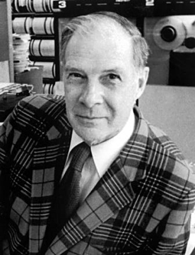
Richard Hamming (1915-1998)
1915-1998
American mathematician
Worked on the Manhattan project
Influence on foundations of communication and networking

Slide 22
Error Bounds – Hamming distance
Code turns data of n bits into codewords of n+k bits
Hamming distance is the minimum bit flips to turn one valid codeword into any other valid one.
Example with 4 codewords of 10 bits (n=2, k=8):
00→0000000000, 01→0000011111, 10→1111100000, and 11→1111111111
Hamming distance is 5
Bounds for a code with distance:
2d+1 – can correct d errors (e.g., 2 errors above)
d+1 – can detect d errors (e.g., 4 errors above)

Slide 23
Error Correction – Hamming code
Hamming code gives a simple way to add check bits and correct up to a single bit error:
Check bits are parity (XOR) over subsets of the codeword
Recomputing the parity sums (syndrome) gives the position of the error to flip, or 0 if there is no error
(7,4) Hamming code for (d₁,d₂,d₃,d₄,p₁,p₂,p₃)-ordering p₁ = d₁⊕d₂⊕d₃ p₂ = d₂⊕d₃⊕d₄ p₃ = d₃⊕d₄⊕d₁
Let’s encode 1001 and 0101
p₁
d₂
d₁
d₃
p₂
d₄
p₃

Slide 24
Decode the following four ASCII characters
0100 110 1001 110
0001 101 0000 000
0111 010 0110 001
1011 100 0110 001

Slide 25
Hamming Codes - Generalization
d data bits
r check bits
Values for d and r that satisfy the following equation allow to correct one error:
d+r+1 ≤ 2^{r}

Slide 26
Notes
Assignment
Namen in PDF und Kommentar in Code
Input: String → Char[] … Char → Byte → Bits
Sprache
…

Slide 27
Hamming code vs Gray code
?

Slide 28
Error Detection: IBANs
Example:
bank code 123456, bank abbreviation WEST
account number 98765432
Redundancy is in blue
http://www.ibancalculator.com/
IBAN: |  | GB82 WEST 1234 5698 7654 32
• Rearrange: |  | W E S T12345698765432 G B82
• Convert to integer (A=10, ..) |  | 3214282912345698765432161182
• Compute remainder: |  | 3214282912345698765432161182 | mod 97 = 1

Slide 29
The Data Link Layer
Framing
Error Detection and Correction
Example Data Link Protocols

Slide 30
Example Data Link Protocols
Packet over SONET »
PPP (Point-to-Point Protocol) »
ADSL (Asymmetric Digital Subscriber Loop) »

Slide 31
PPP
PPP (Point-to-Point Protocol) is a general method for delivering packets across links
Used e.g. to carry IP packets over fibers, or in ADSL
Framing uses a flag (0x7E) and byte stuffing
Connectionless unacknowledged service is used for IP packets
Errors are detected with a checksum
0x21 for IPv4
IP packet

Slide 32
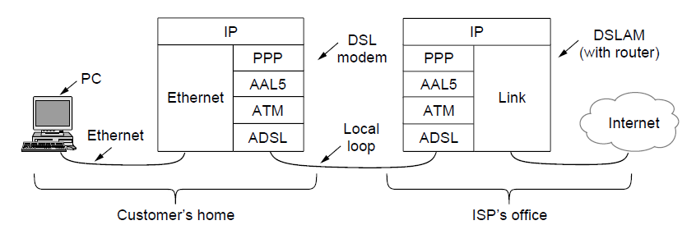
ADSL (1)
Widely used for broadband Internet over local loops
ADSL runs from modem (customer) to DSLAM (ISP)
IP packets are sent over PPP and AAL5/ATM (53 byte frame length)

Slide 33
ADSL (2)
PPP data is sent in AAL5 frames over ATM cells:
ATM is a link layer that uses short, fixed-size cells (53 bytes); each cell has a virtual circuit identifier
AAL5 is a format to send packets over ATM
PPP frame is converted to a AAL5 frame (PPPoA)

Slide 34
Learned today
Why framing is needed and how it can be done with byte stuffing
Redundancy and Hamming distance
(7,4)-Hamming code
Next
How to share a link (=Medium access control sublayer)
Assignment due Monday 20th: Hamming-code implementation

