Slide 1
7. Network Layer
Design Issues
Routing Algorithms
distance vector
link state routing
Congestion Control
Quality of Service
Network Layer of the Internet
IP
OSPF

Slide 2
The Network Layer
Responsible for delivering packets between endpoints over multiple links
(Link layer: single link Transport layer: Uses this service)
Application
Transport
Network
Link
Physical

Slide 3
Design Issues
Forward packet switching
Connectionless service – datagrams
Connection-oriented service – virtual circuits
Comparison of virtual-circuits and datagrams

Slide 4
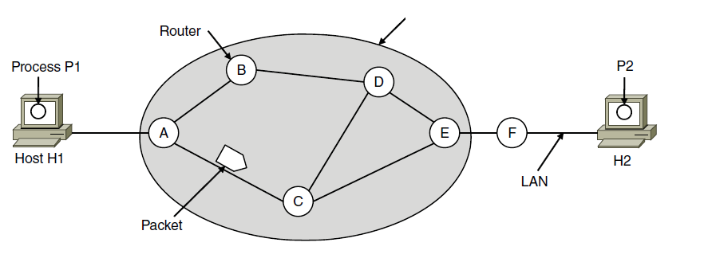
Forward Packet Switching
Hosts send packets into the network; packets are forwarded by routers
ISP’s equipment

Slide 5
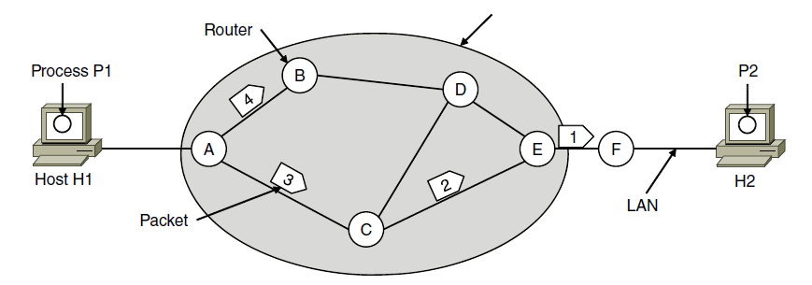
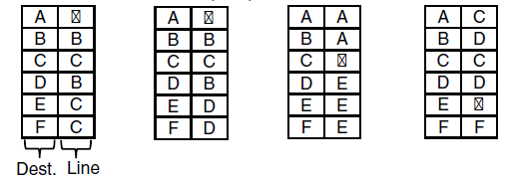
Connectionless Service – Datagrams
Packet is forwarded using destination address inside it
Different packets may take different paths
ISP’s equipment
A’s table (initially) A’s table (later) C’s Table E’s Table
Dest. Line

Slide 6
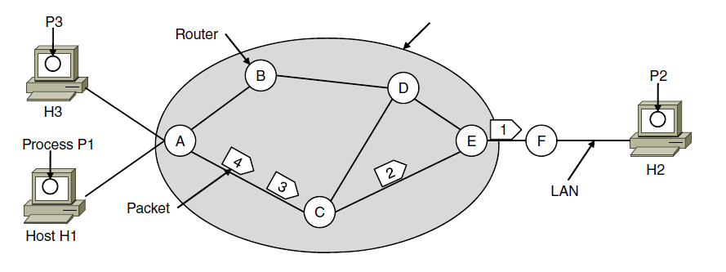
Connection-Oriented – Virtual Circuits
Packet is forwarded along a virtual circuit using tag inside it
Virtual circuit (VC) is set up ahead of time
ISP’s equipment
A’s table C’s Table E’s Table
In: Line Tag
Line Tag: Out

Slide 7
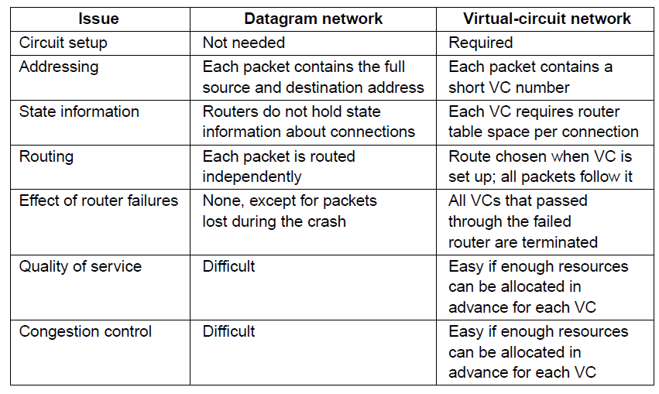
Comparison of Virtual-Circuits & Datagrams

Slide 8
7. Network Layer
Design Issues
Routing Algorithms
distance vector
link state routing
Congestion Control
Quality of Service
Network Layer of the Internet
IP
OSPF

Slide 9
Routing Algorithms (1)
Dijkstra’s Shortest path algorithm
Flooding
Distance vector routing
Link state routing
Hierarchical routing
Routing for mobile hosts

Slide 10
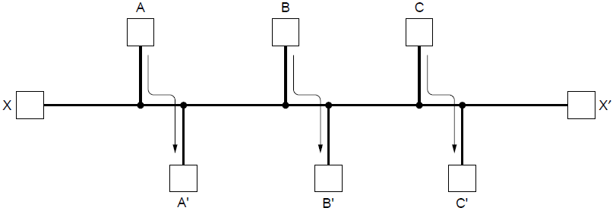
Routing Algorithms (2)
Routing is the process of discovering network paths
Model the network as a graph of nodes and links
Decide what to optimize (e.g., fairness vs efficiency)
Update routes for changes in topology (e.g., failures)
Forwarding is the sending of packets along a path

Slide 11
Shortest Path Algorithm (1)
Dijkstra’s algorithm computes a sink tree on the graph:
Each link is assigned a non-negative weight/distance
Shortest path is the one with lowest total weight
Using weights of 1 gives paths with fewest hops
Algorithm:
Start with sink, set distance at other nodes to infinity
Relax distance to other nodes
Pick the lowest distance node, add it to sink tree
Repeat until all nodes are in the sink tree

Slide 12
Dijkstra(StartingNode A) {
Queue<HashMap<Node,Integer> theQueue;
theQueue.addAll(A.reachableNodesWithDistance);
Integer[] shortestDistances = new Integer[maxNodeCount];
while (theQueue.isNotEmpty()) {
Node nearest = theQueue.removeNearest();
shortestDistances[nearest.id] = nearest.distance;
for (Node n : nearest.reachableNodesWithinDistance) {
int newDistance = nearest.distanceTo(n) + nearest.Distance;
if (!queue.containsKey(n) && shortestDistances[n.id] == null
|| queue.containsKey(n) && queue.get(n)>newDistance)
queue.put(n,newDistance);
}
}
}
N.B.: This is close to java, but the queue likely needs to be implemented as PriorityQueue

Slide 13
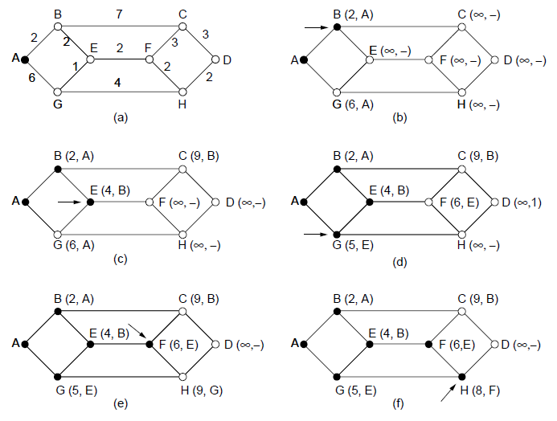
Shortest Path Algorithm (2)
A network and first five steps in computing the shortest paths from A to D. Pink arrows show the sink tree so far.

Slide 14
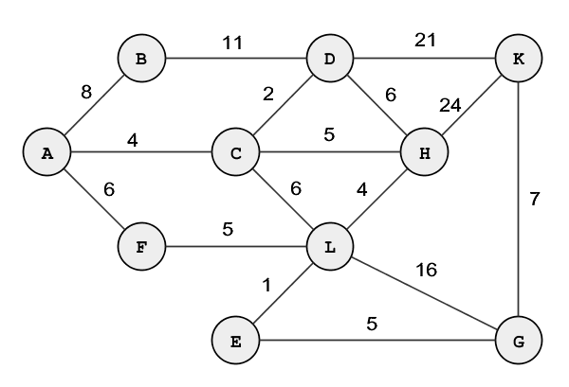
Your turn
Shortest paths from A?

Slide 15
Flooding
A simple method to send a packet to all network nodes
Each node floods a new packet received on an incoming link by sending it out all of the other links
Nodes need to keep track of flooded packets to stop the flood; even using a hop limit can blow up exponentially

Slide 16
Distance Vector Routing (1)
Distance vector is a distributed routing algorithm
Shortest path computation is split across nodes
Algorithm:
Each node knows distance of links to its neighbors
Each node advertises vector of lowest known distances to all neighbors
Each node uses received vectors to update its own
Repeat periodically

Slide 17
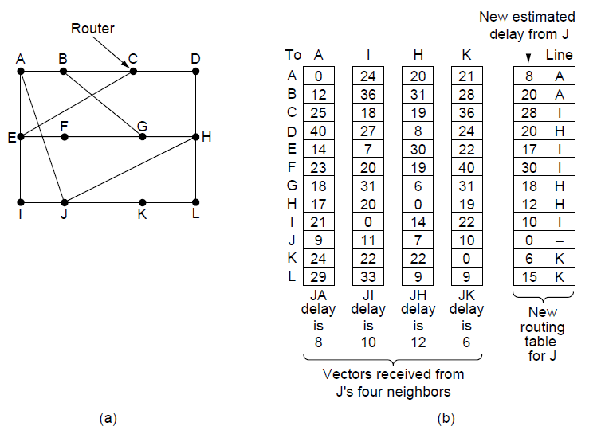
Distance Vector Routing (2)
Network
New vector for J
Vectors received at J from
Neighbors A, I, H and K

Slide 18
Distance Vector Routing (2)
Network
New vector for J
Vectors received at J from
Neighbors A, I, H and K

Slide 19
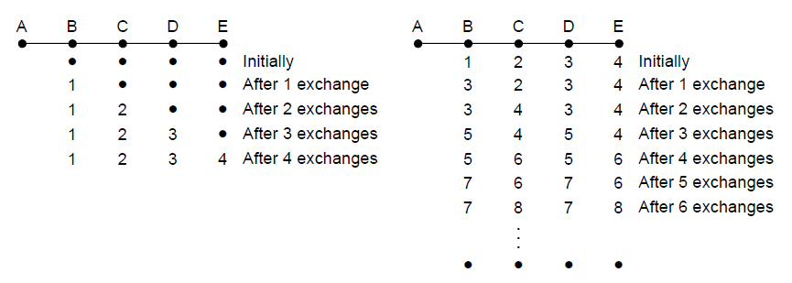
The Count-to-Infinity Problem
Failures can cause DV to “count to infinity” while seeking a path to an unreachable node
X
Good news of a path to A spreads quickly
Bad news of no path to A is learned slowly

Slide 20
Link State Routing (1)
Link state is an alternative to distance vector
More computation but simpler dynamics
Widely used in the Internet (OSPF, IS-IS)
Algorithm:
Each node floods information about its neighbors in LSPs (Link State Packets); all nodes learn the full network graph
Each node runs Dijkstra’s algorithm to compute the path to take for each destination

Slide 21
Link State Routing (2) – LSPs
LSP (Link State Packet) for a node lists neighbors and weights of links to reach them
Network
LSP for each node

Slide 22
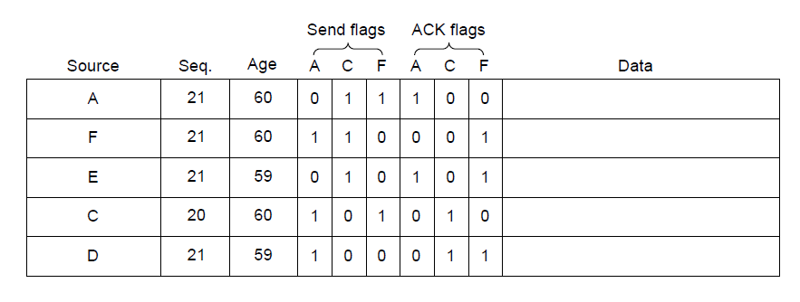
Link State Routing (3) – Reliable Flooding
Seq. number and age are used for reliable flooding
New LSPs are acknowledged on the lines they are received and sent on all other lines
Example shows the LSP database at router B

Slide 23
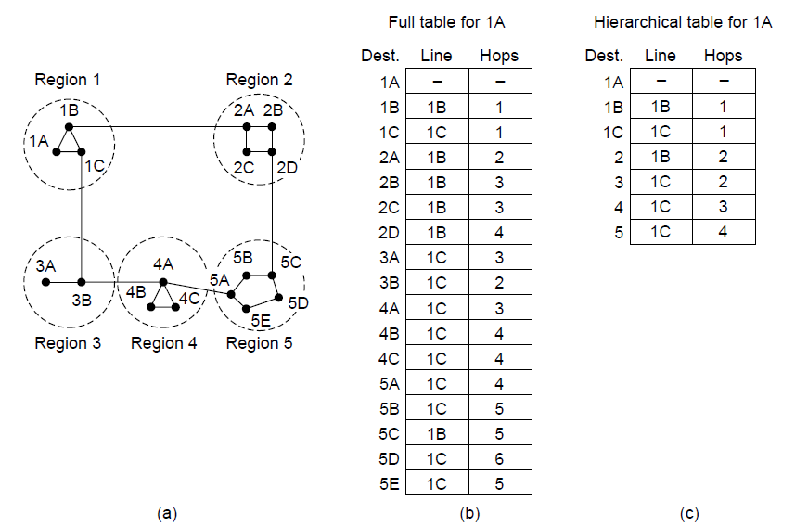
Hierarchical Routing
Hierarchical routing reduces the work of route computation but may result in slightly longer paths than flat routing
Best choice to reach nodes in 5 except for 5C

Slide 24
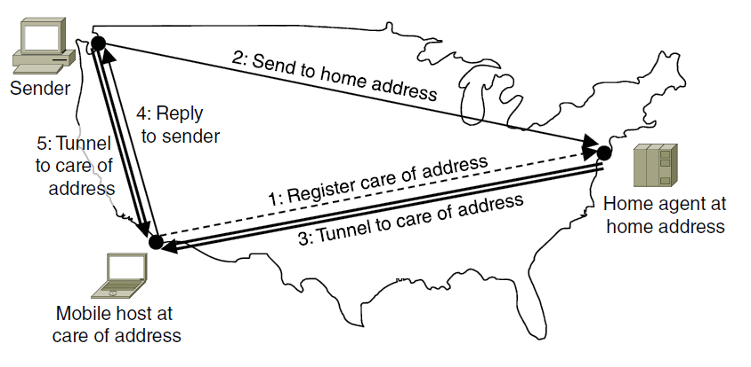
Routing for Mobile Hosts
Mobile hosts can be reached via a home agent
Fixed home agent tunnels packets to reach the mobile host; reply can optimize path for subsequent packets
No changes to routers or fixed hosts

Slide 25
Design Issues
Routing Algorithms
distance vector
link state routing
Congestion Control
Quality of Service
Network Layer of the Internet
IP
OSPF

Slide 26
Congestion Control (1)
Handling congestion is the responsibility of the Network and Transport layers working together
We look at the Network portion here
Traffic-aware routing »
Admission control »
Traffic throttling »
Load shedding »

Slide 27
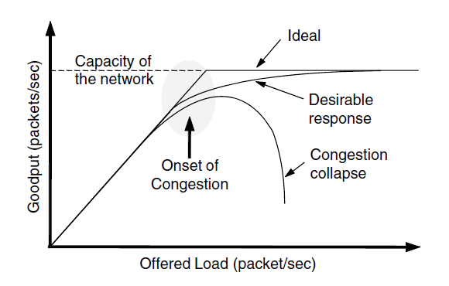
Congestion Control (2)
Congestion results when too much traffic is offered; performance degrades due to loss/retransmissions
Goodput (=useful packets) trails offered load

Slide 28
Congestion Control (3) – Approaches
Network must do its best with the offered load
Different approaches at different timescales
Nodes should also reduce offered load (Transport)

Slide 29
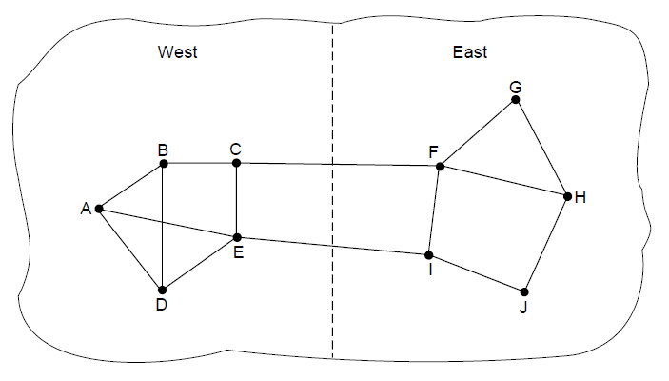
Traffic-Aware Routing
Choose routes depending on traffic, not just topology
E.g., use EI for West-to-East traffic if CF is loaded
But take care to avoid oscillations

Slide 30
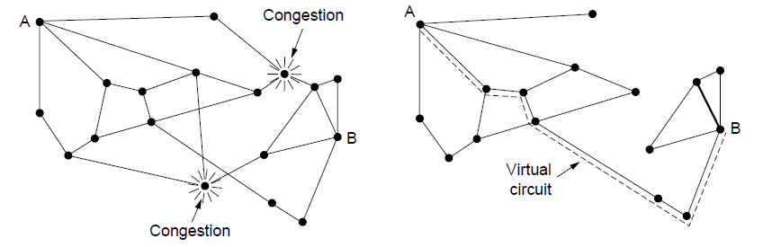
Admission Control
Admission control allows a new traffic load only if the network has sufficient capacity, e.g., with virtual circuits
Can combine with looking for an uncongested route
Network with some congested nodes
Uncongested portion and route AB around congestion

Slide 31
Traffic Throttling
Congested routers signal hosts to slow down traffic
ECN (Explicit Congestion Notification) marks packets and receiver returns signal to sender

Slide 32
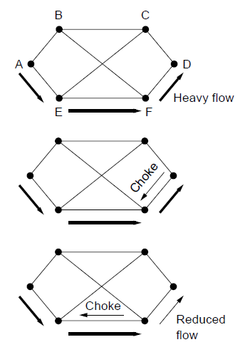
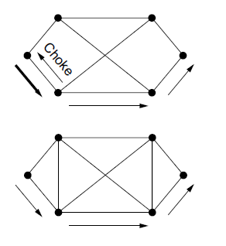
Load Shedding (1)
When all else fails, network will drop packets (shed load)
Can be done end-to-end or link-by-link
Link-by-link (right) produces rapid relief
1
4
2
5
3

Slide 33
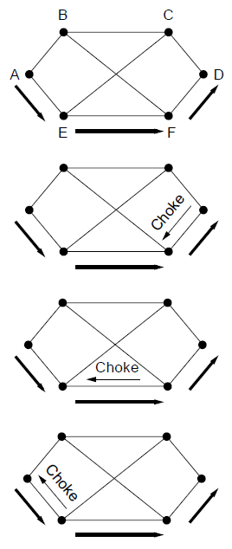
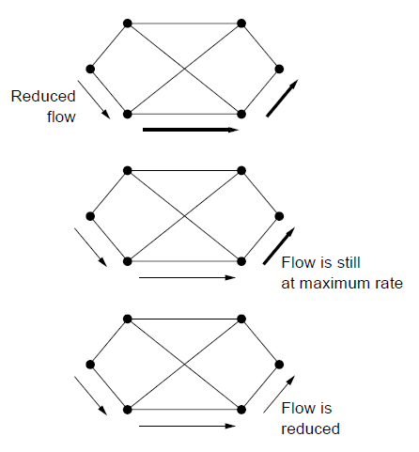
Load Shedding (2)
1
End-to-end (right) takes longer to have an effect, but can better target the cause of congestion
5
2
6
3
7
4

Slide 34
Design Issues
Routing Algorithms
distance vector
link state routing
Congestion Control
Quality of Service
Network Layer of the Internet
IP
OSPF

Slide 35
Quality of Service
Application requirements »
Traffic shaping »
Packet scheduling »
Admission control »
Integrated services »
Differentiated services »

Slide 36
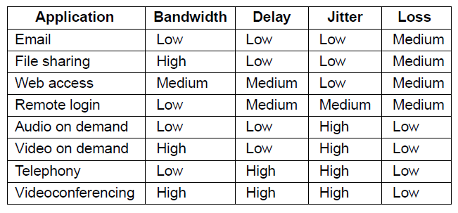
Application Requirements (1)
Different applications care about different properties
We want all applications to get what they need
.
“High” means a demanding requirement, e.g., low delay

Slide 37
Application Requirements (2)
Network provides service with different kinds of QoS (Quality of Service) to meet application requirements
Network Service | Application
Constant bit rate | Telephony
Real-time variable bit rate | Videoconferencing
Non-real-time variable bit rate | Streaming a movie
Available bit rate | File transfer
Example of QoS categories from ATM networks

Slide 38
Traffic Shaping (1)
Traffic shaping regulates the average rate and burstiness of data entering the network
Lets us make guarantees
Shape traffic here

Slide 39
Traffic Shaping (2)
Token/Leaky bucket limits both the average rate (R) and short-term burst (B) of traffic
For token, bucket size is B, water enters at rate R and is removed to send; opposite for leaky.
to send
to send
Leaky bucket
(need not full to send)
Token bucket
(need some water to send)

Slide 40
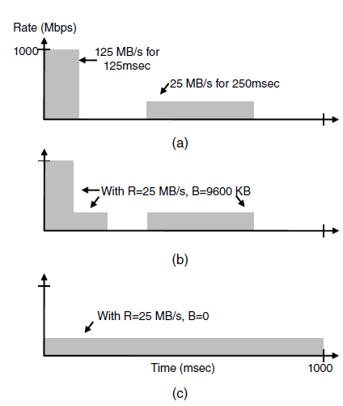
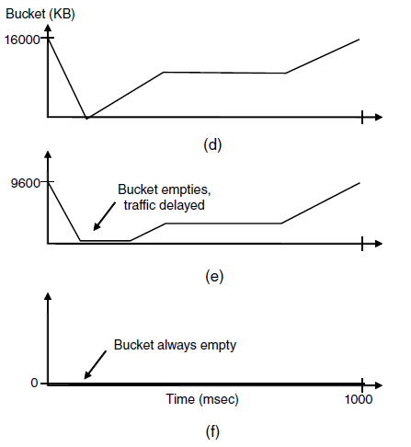
Traffic Shaping: Token Bucket
Host traffic
R=25 MB/s B=16 MB
Shaped by R=25 MB/s B=9,6 MB
Shaped by R=25 MB/s B=0 KB
Smaller bucket size delays traffic and reduces burstiness

Slide 41
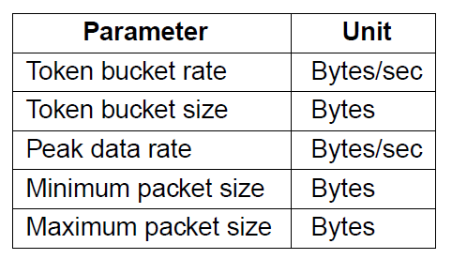
Admission Control (1)
Admission control takes a traffic flow specification and decides whether the network can carry it
Sets up packet scheduling to meet QoS
Example flow specification

Slide 42
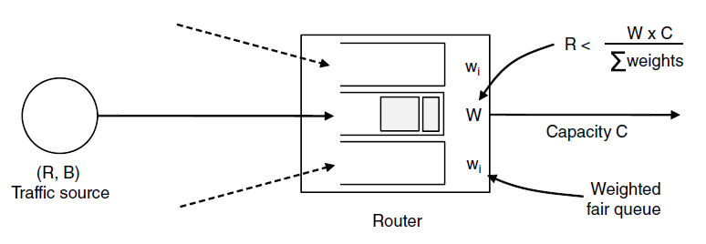
Admission Control (2)
Construction to guarantee bandwidth B and delay D:
Shape traffic source to a (R, B) token bucket
Run WFQ with weight W / all weights > R/capacity
Holds for all traffic patterns, all topologies

Slide 43
Design Issues
Routing Algorithms
distance vector
link state routing
Congestion Control
Quality of Service
Network Layer of the Internet
IP
OSPF

Slide 44
Network Layer in the Internet (1)
IP Version 4
IP Addresses
IP Version 6
Internet Control Protocols
Label Switching and MPLS
OSPF—An Interior Gateway Routing Protocol
BGP—The Exterior Gateway Routing Protocol
Mobile IP

Slide 45
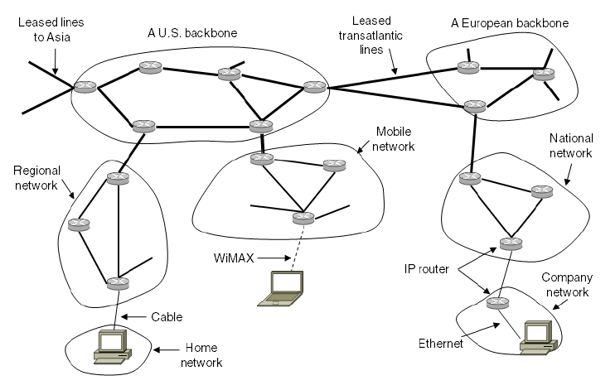
Network Layer in the Internet (3)
Internet is an interconnected collection of many networks that is held together by the IP protocol

Slide 46
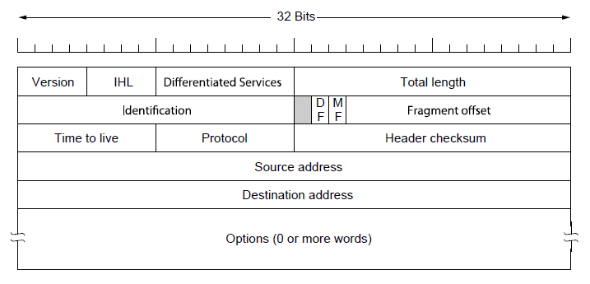
IP Version 4 Protocol (1)
IPv4 (Internet Protocol) header is carried on all packets and has fields for the key parts of the protocol:

Slide 47
Your turn
Given the following header, will the following packet pass a network with an MTU of 1920 bytes?
What will be different if paket is fragmented?

Slide 48
IP Addresses (1) – Prefixes
Addresses are allocated in blocks called prefixes
Prefix is determined by the network portion
Written address/length, e.g., 18.0.31.0/24

Slide 49
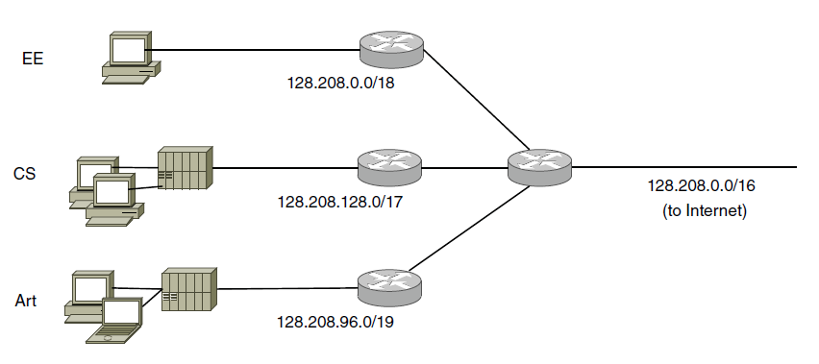
IP Addresses (2) – Subnets
Subnetting splits up IP prefix to help with management
Looks like a single prefix outside the network
ISP gives network
a single prefix
Network divides it into subnets internally

Slide 50
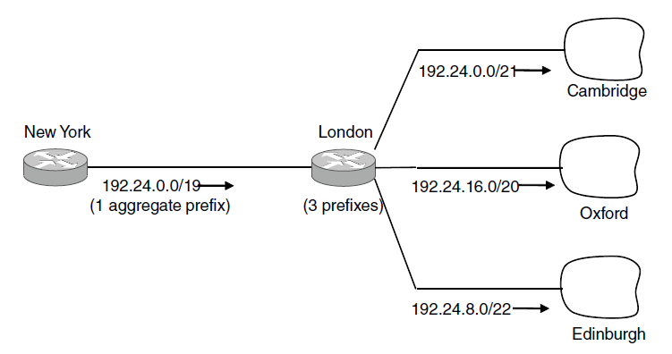
IP Addresses (3) – Aggregation
Aggregation joins multiple IP prefixes into a single larger prefix to reduce routing table size
ISP advertises
a single prefix
ISP customers have different prefixes

Slide 51
IP Addresses (4) – Longest Matching Prefix
Packets are forwarded to the entry with the longest matching prefix or smallest address block
Complicates forwarding but adds flexibility
Except for this part!
Main prefix goes this way

Slide 52
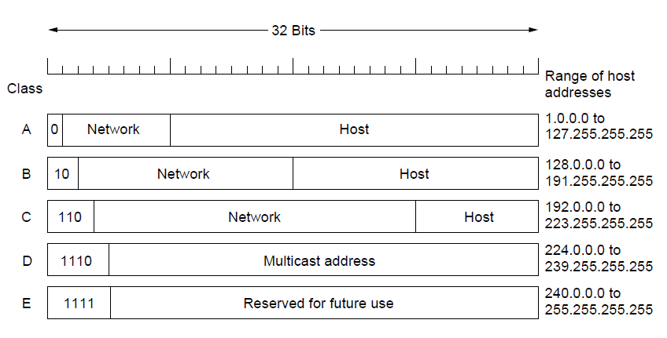
IP Addresses (5) – Classful Addresing
Old addresses came in blocks of fixed size (A, B, C)
Carries size as part of address, but lacks flexibility
Called classful (vs. classless) addressing

Slide 53
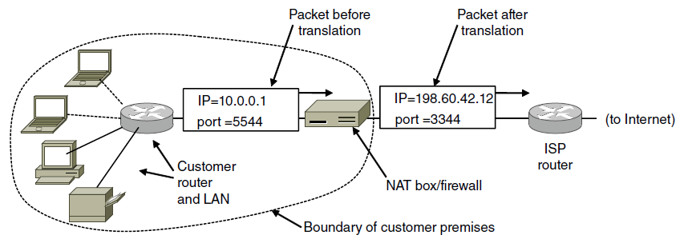
IP Addresses (6) – NAT
NAT (Network Address Translation) box maps one external IP address to many internal IP addresses
Uses TCP/UDP port to tell connections apart
Violates layering; very common in homes, etc.

Slide 54
Your turn
Computer A has the IPv4 address (including the subnet mask in CIDR notation) 141.89.228.65/26.
Computer B is reachable as 141.89.228.63/26.
Do they belong to the same subnet?

Slide 55
IP Version 6 (1)
Major upgrade in the 1990s due to impending address exhaustion, with various other goals:
Support billions of hosts
Reduce routing table size
Simplify protocol
Better security
Attention to type of service
Aid multicasting
Roaming host without changing address
Allow future protocol evolution
Permit coexistence of old, new protocols, …
Deployment has been slow & painful, but may pick up pace now that addresses are all but exhausted

Slide 56
Three hundred and forty undecillion, two hundred and eighty-two decillion, three hundred and sixty-six nonillion, nine hundred and twenty octillion, nine hundred and thirty-eight septillion, four hundred and sixty-three sextillion, four hundred and sixty-three quintillion, three hundred and seventy-four quadrillion, six hundred and seven trillion, four hundred and thirty-one billion, seven hundred and sixty-eight million, two hundred and eleven thousand, four hundred and fifty-six.

Slide 57
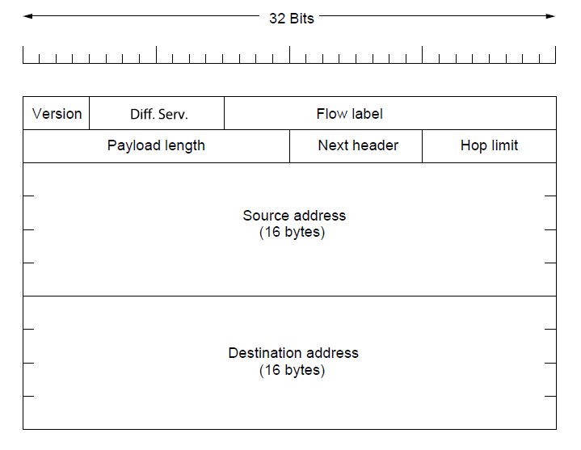
IP Version 6 (2 )
IPv6 protocol header has much longer addresses (128 vs. 32 bits) and is simpler (by using extension headers)

Slide 58
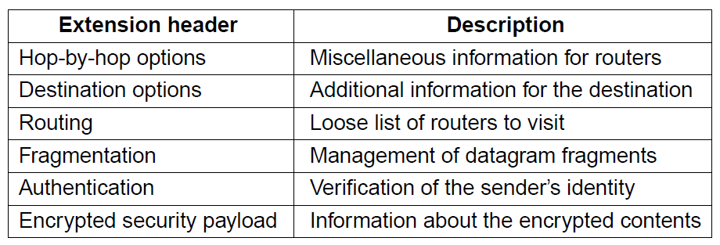
IP Version 6 (3)
IPv6 extension headers handles other functionality

Slide 59
Internet Control Protocols (1)
IP works with the help of several control protocols:
ICMP is a companion to IP that returns error info
Required, and used in many ways, e.g., for traceroute
ARP finds Ethernet address of a local IP address
Glue that is needed to send any IP packets
Host queries an address and the owner replies
DHCP assigns a local IP address to a host
Gets host started by automatically configuring it
Host sends request to server, which grants a lease

Slide 60
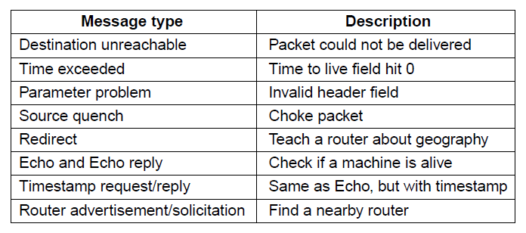
Internet Control Protocols (2)
Main ICMP (Internet Control Message Protocol) types:

Slide 61
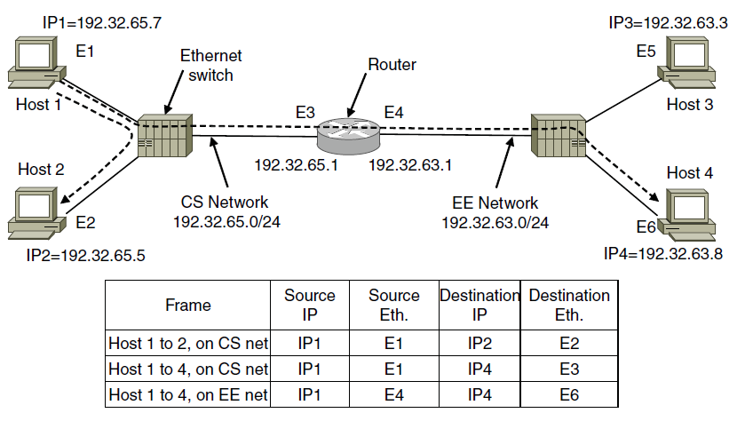
Internet Control Protocols (3)
ARP (Address Resolution Protocol) lets nodes find target Ethernet addresses [pink] from their IP addresses

Slide 62
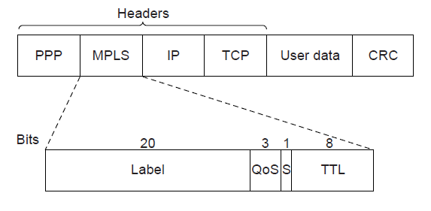
Label Switching and MPLS (1)
MPLS (Multi-Protocol Label Switching) sends packets along established paths; ISPs can use for QoS
Path indicated with label below the IP layer

Slide 63
Label Switching and MPLS (2)
Label added based on IP address on entering an MPLS network (e.g., ISP) and removed when leaving it
Forwarding only uses label inside MPLS network

Slide 64
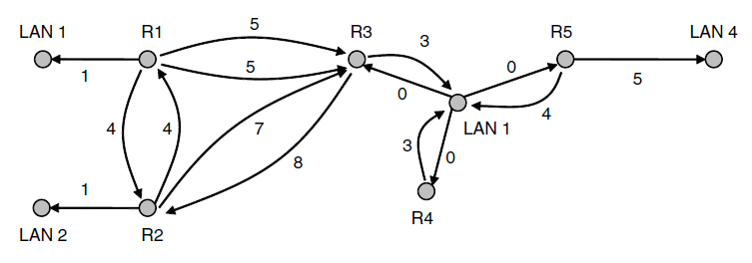
OSPF— Interior Routing Protocol (1)
OSPF computes routes for a single network (e.g., ISP)
Models network as a graph of weighted edges
Network:
Graph:
3
Broadcast LAN modeled as a well-connected node

Slide 65
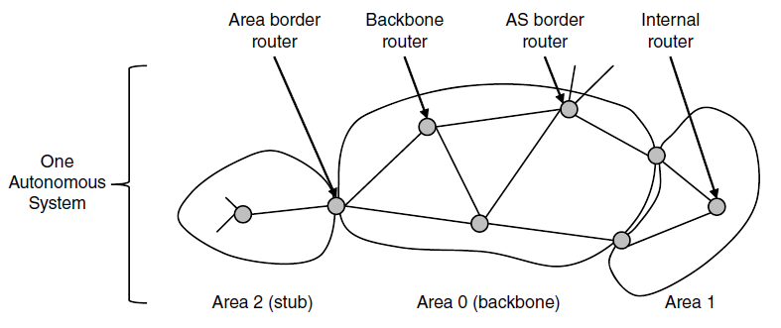
OSPF— Interior Routing Protocol (2)
OSPF divides one large network (Autonomous System) into areas connected to a backbone area
Helps to scale; summaries go over area borders

Slide 66
OSPF— Interior Routing Protocol (3)
OSPF (Open Shortest Path First) is link-state routing:
Uses messages below to reliably flood topology
Then runs Dijkstra to compute routes

Slide 67
BGP— Exterior Routing Protocol (1)
BGP (Border Gateway Protocol) computes routes across interconnected, autonomous networks
Key role is to respect networks’ policy constraints
Example policy constraints:
No commercial traffic for educational network
Never put Iraq on route starting at Pentagon
Choose cheaper network
Choose better performing network
Don’t go from Apple to Google to Apple

Slide 68
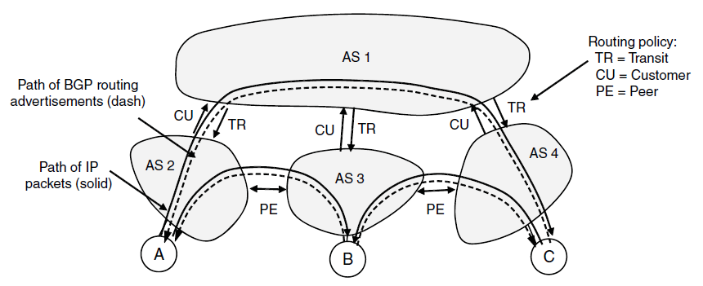
BGP— Exterior Routing Protocol (2)
Common policy distinction is transit vs. peering:
Transit carries traffic for pay; peers for mutual benefit
AS1 carries AS2↔AS4 (Transit) but not AS3 (Peer)

Slide 69
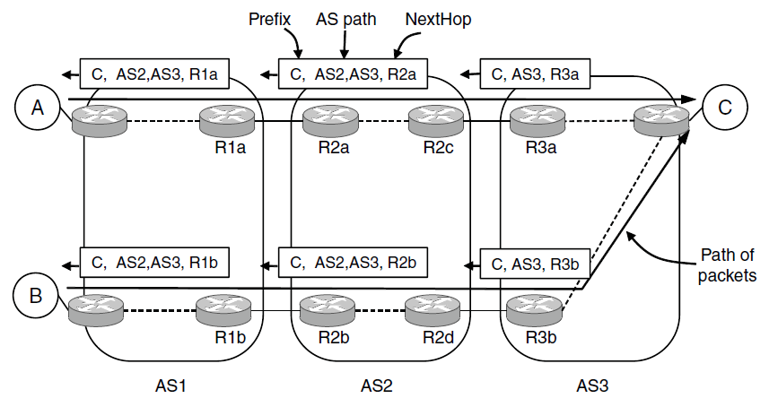
BGP— Exterior Routing Protocol (3)
BGP propagates messages along policy-compliant routes
Message has prefix, AS path (to detect loops) and next-hop IP (to send over the local network)

Slide 70
Mobile IP
Mobile hosts can be reached at fixed IP via a home agent
Home agent tunnels packets to reach the mobile host; reply can optimize path for subsequent packets
No changes to routers or fixed hosts

Slide 71
Take home
IP-Addresses: NETID+HOSTID
Routing
Distance vector
Problem: Count to infinity
Link state
Challenge: Information propagation
Internet
OSPF inside a network
BGP between networks

