Slide 1
Distributed Systems 15. Application Layer
Simon Razniewski
Faculty of Computer Science
Free University of Bozen-Bolzano
A.Y. 2015/2016

Slide 2
Various
Question:
Gaming – how to connect to a server (LAN/Internet)
Assignment
Buffering only relevant for console applications
GUI is also fine

Slide 3
The Application Layer
Uses transport services to build distributed applications
Application
Transport
Network
Link
Physical

Slide 4
Requirements and Constraints
Three dimensions for applications
Data loss: does the application work even when some data are lost?
Bandwidth: does the application fix a (minimum) rate for the information exchange?
Timing: does the application accept delays?

Slide 5
Examples
Application | Data loss | Bandwidth | Timing
File transfer | no | elastic | no
E-mail | no | elastic | no
Web documents | no | elastic | no
Real-time audio/video | Loss-tolerant | Audio: 1Kbps-1Mbps Video: 10Kb+ | 100 ms
Online games | Loss-tolerant | 1 Kbps – 100 Kbps | 100 ms
Financial applications | no | elastic | yes/no
Name services | no | elastic | yes

Slide 6
Choosing a Transport Protocol
Application | A-Protocol | T-Protocol | Why?
File transfer | FTP | TCP | Require reliable data transfer services
E-mail | SMTP | TCP
Web | HTTP | TCP
Remote terminal access | Telnet | TCP
Streaming multimedia | Proprietary | UDP or TCP | Speed more important
Internet telephony | Proprietary | UDP
Online games | Proprietary | UDP | Speed more important
Network management | SNMP | UDP | Minimally intrusive
Name services | DNS | UDP | Speed more important
http://gamedev.stackexchange.com/questions/431/is-the-tcp-protocol-good-enough-for-real-time-multiplayer-games

Slide 7
Application Layer
DNS – Domain Name System
Email
The Web
…though there are many more…..

Slide 8
DNS – Domain Name System
The DNS resolves high-level human readable names for computers to low-level IP addresses
DNS name space
Domain Resource records
Name servers

Slide 9
Internet Domain Name System (DNS)
Design dates back to 1987 (Mockapetris)
Before all host names and addresses in one large master file stored on one central host downloaded by computers that needed to resolve names
What were the drawbacks of that approach?

Slide 10
Internet Domain Name System (cntd)
Distributed naming database
Hierarchical name structure reflects administrative structure of the Internet
Rapidly resolves domain names to IP addresses
exploits caching heavily
typical query time ~100 milliseconds
Scales to millions of computers
partitioned database
caching
Resilient to failure of a server
replication (e.g., 13 root servers, 6 servers for .it, etc.)

Slide 11
Access to DNS
Host/dig (linux)
command for name resolution and reverse resolution
nslookup (windows)
command/tool to query DNS servers for arbitrary info
/etc/resolv.conf (linux)
file containing IP address of default name server
Java JNDI (= Java Naming and Directory Interface)
provides interface for querying DNS
https://blog.thesysadmins.co.uk/nslookup-common-usage-examples.html

Slide 12
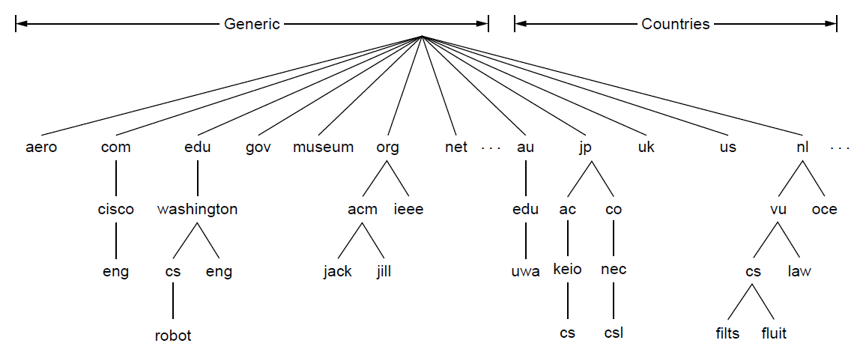
The DNS Name Space (1)
DNS namespace is hierarchical from the root down
Different parts delegated to different organizations
The computer robot.cs.washington.edu

Slide 13
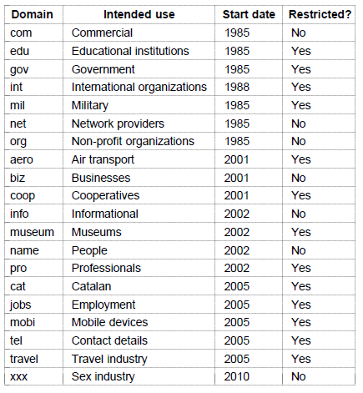
The DNS Name Space (2)
Generic top-level domains are controlled by ICANN who appoints registrars to run them

Slide 14
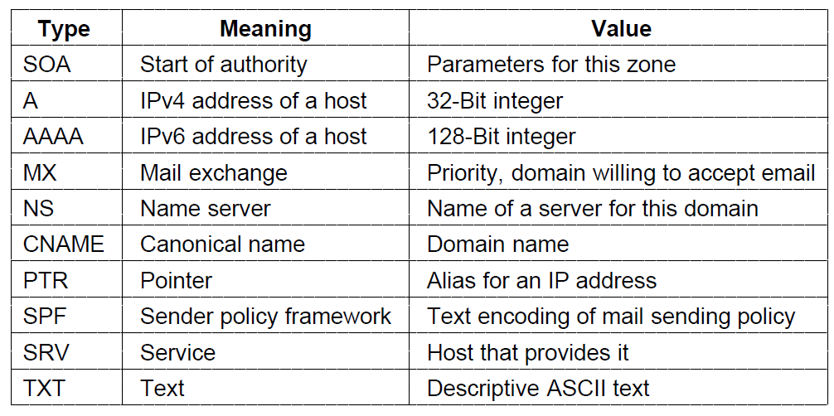
Domain Resource Records (1)
The key resource records in the namespace are IP addresses (A/AAAA) and name servers (NS), but there are others too (e.g., MX)

Slide 15
nslookup unibz.it
nslookup -type=mx unibz.it

Slide 16
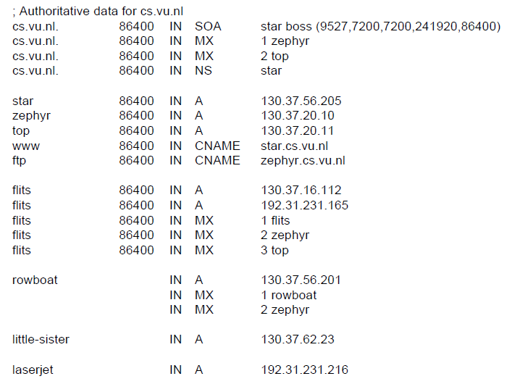
Domain Resource Records (2)
Name server
IP addresses of computers
Mail gateways
A portion of a possible DNS database for cs.vu.nl.

Slide 17
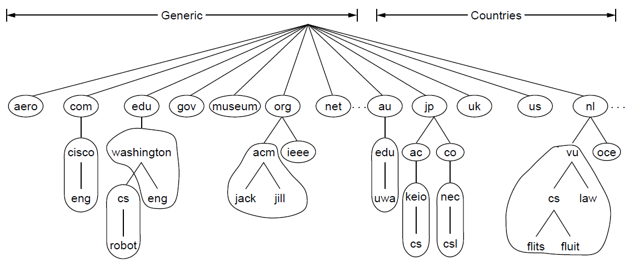
Name Servers (1)
Name servers contain data for portions of the name space called zones (circled).
One zone

Slide 18
Name Servers (2)
Finding the IP address for a given hostname is called resolution and is done with the DNS protocol.
Resolution:
Computer requests local name server to resolve
Local name server asks the root name server
Root returns the name server for a lower zone
Continue down zones until name server can answer
DNS protocol:
Runs on UDP port 53, retransmits lost messages
Caches name server answers for better performance

Slide 19
Wireshark
…

Slide 20
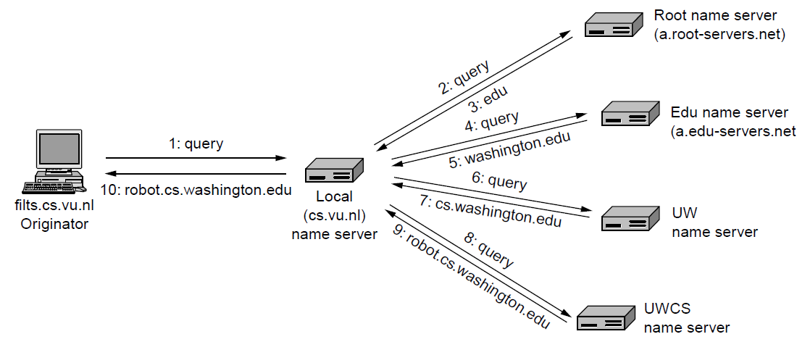
Recursive lookup
Example of a computer looking up the IP for a name (recursive lookup)

Slide 21
Name Resolution on the WWW
URL
http://www.unibz.it:80/SiteCollectionImages/Headings/Objects/coins.jpg
DNS lookup
Resource ID (IP number, port number, pathname)
193.206.186.198
80
/SiteCollectionImages/Headings/Objects/coins.jp
ARP lookup
(Ethernet) Network address
2:60:8c:2:b0:5a
file
Socket
Web server
*

Slide 22
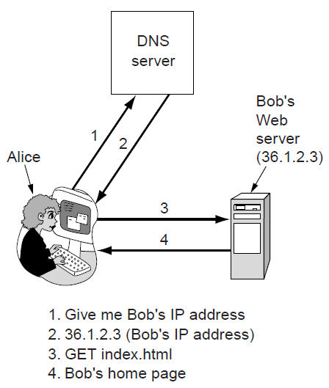
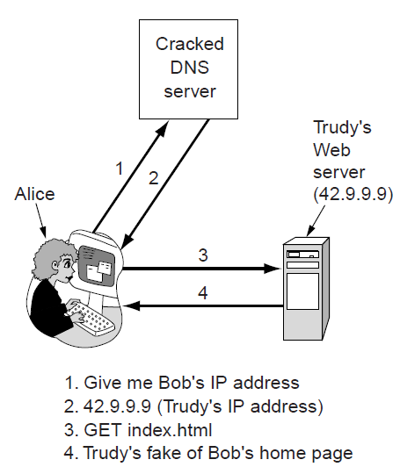
Phising
DNS names are included as part of URLs – so spoofing DNS resolution causes Alice contact Trudy not Bob
Trudy sends spoofed reply

Slide 23
Phising (2)
DNSsec (DNS security) adds strong authenticity to DNS
Responses are signed with private keys
Public keys are included; client starts with top-level
Deployment slow
For current status, see e.g. http://en.wikipedia.org/wiki/List_of_Internet_top-level_domains
Resource Record set for bob.com.
Has Bob’s public key (KEY), and is signed by .com server (SIG)
=> Allows to verify whether answers to DNS lookups at bob.com are really from Bob
http://security.stackexchange.com/questions/62711/how-browser-detects-phishing-pages

Slide 24
Application Layer
DNS – Domain Name System
Email
The Web

Slide 25
Architecture and Services (1)
The key components and steps (numbered) to send email
Outgoing:
SMTP
Incoming:
POP3 (older)
IMAP (newer)
e.g. Outlook
e.g. Outlook server
Architecture of the email system

Slide 26
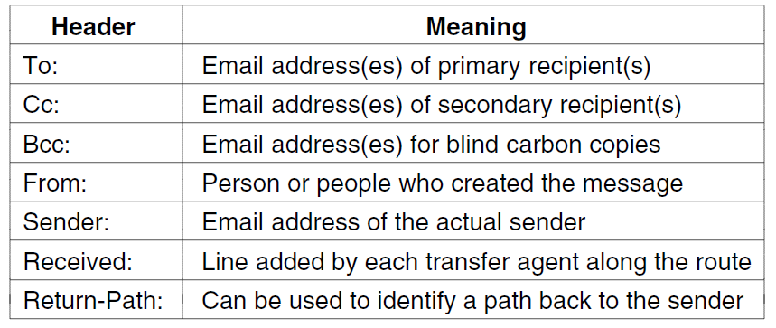
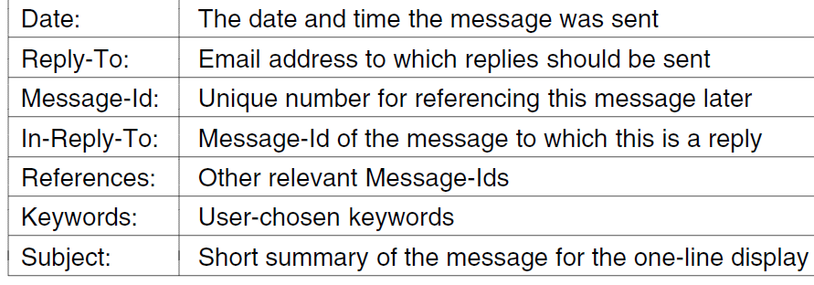
Message Formats (1)
Header fields related to message transport; headers are readable ASCII text

Slide 27
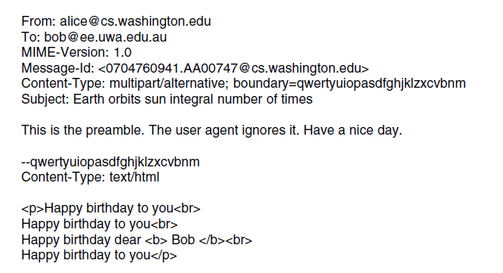
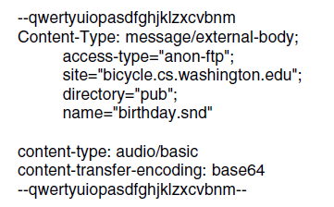
Message Formats (2)
Putting it all together: a multipart message containing HTML and audio alternatives.
One part (HTML)
Another
(audio)

Slide 28
Message Transfer (1)
Messages are transferred with SMTP (Simple Mail Transfer Protocol)
Readable text commands
Submission from user agent to mail transfer agent (MTA) on port 587
One MTA to the next MTA on port 25
Other protocols for final delivery (older POP3, newer IMAP)

Slide 29
telnet mail3.unibz.it 25
HELO
HELP
MAIL FROM:<blabla@gmx.de>
RCPT TO:<razniewski@inf.unibz.it>
DATA
blablabla
.
QUIT
More: http://stackoverflow.com/questions/18652001/send-mail-via-cmd-console

Slide 30
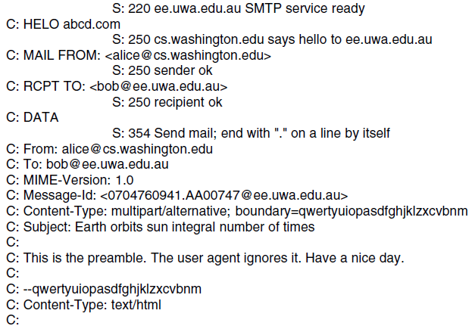
Message Transfer (2)
Sending a message:
From Alice to Bob
SMTP commands are marked [pink]
. . . (rest of message) . . .

Slide 31
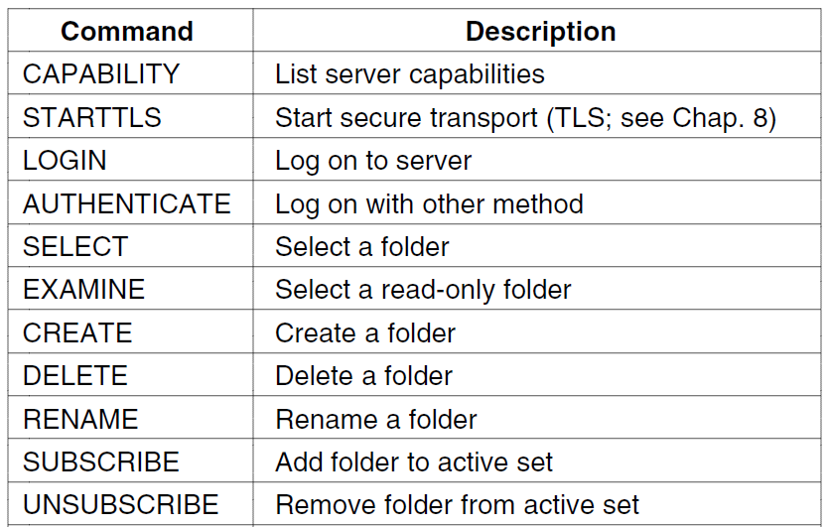
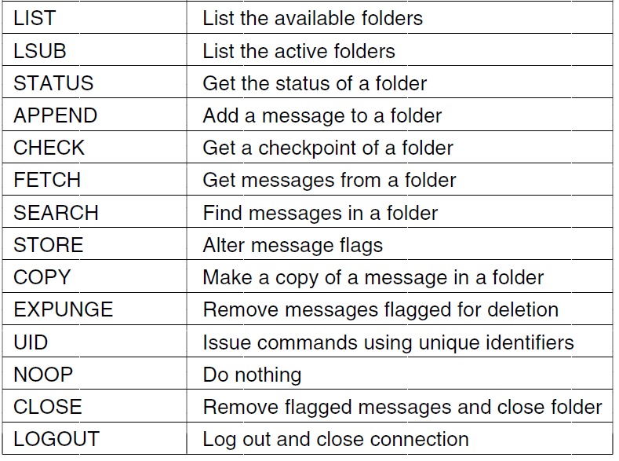
Final Delivery (1)
User agent uses POP3 or IMAP for final delivery
Has commands to manipulate folders / messages [right]
Alternatively, a Web interface (with proprietary protocol) might be used

Slide 32
The World Wide Web
Architectural overview
Static Web pages
Dynamic pages and Web applications
HTTP – HyperText Transfer Protocol

Slide 33
World Wide Web - History
Architectural framework for accessing linked document via the Internet
Born to share information among international teams of researchers in particle physics working for CERN (European Center for Nuclear Research)
1989: idea, Tim Berners-Lee
1991: first textual prototype
1993: first graphical browser (Mosaic)
1994: Netscape founded to provide client and servers for the web
1994: CERN and M.I.T. sign an agreement creating the World Wide Web Consortium (W3C)
Goal: research, standardization and interoperation for the web
1994-1997: browsers war between Netscape and Microsoft (with Internet Explorer)
Then Opera Safari, Firefox, Chrome…

Slide 34
WWW From the Client’s Viewpoint
Client = browser
The user specifies an URL and gets access to a (web) page that contains text, images, even videos
Internet media types for multiple content, + plugins/helper processes for interpreting it
Pages are constituted of hypertext
They contain special elements (hyperlinks) that point to other pages, possibly hosted to other domains/hosts
By following hyperlinks, the user transparently navigates among pages hosted in distant places in the world
The idea of hypertext can be traced back to 1945 (M.I.T. professor of electrical engineering, Vannevar Bush)

Slide 35
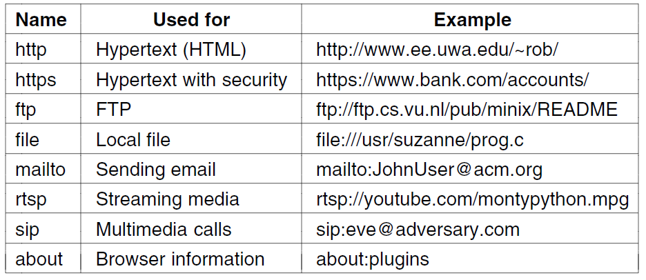
Architectural Overview (1)
Pages are named with URLs (Uniform Resource Locators)
Example: http://www.phdcomics.com/comics.php
Protocol
Server
Page on server
Our
focus
Common URL protocols

Slide 36
Architectural Overview (2)
Steps a client (browser) takes to follow a hyperlink:
Determine the protocol (HTTP)
Ask DNS for the IP address of server
Make a TCP connection to server
Send request for the page; server sends it back
Fetch other URLs as needed to display the page
Close idle TCP connections
Steps a server takes to serve pages:
Accept a TCP connection from client
Get page request and map it to a resource (e.g., file name)
Get the resource (e.g., file from disk)
Send contents of the resource to the client.
Release idle TCP connections

Slide 37
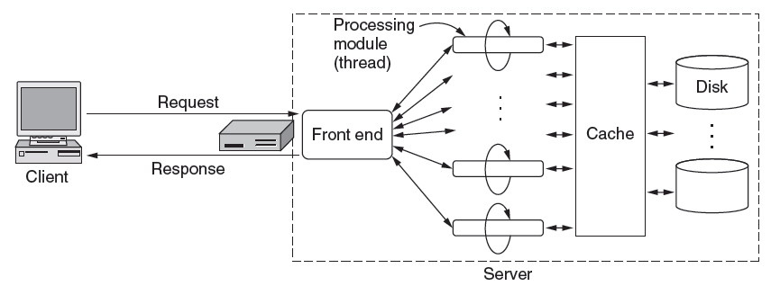
Architectural Overview (3)
To scale performance, Web servers can use:
Caching, multiple threads, and a front end

Slide 38
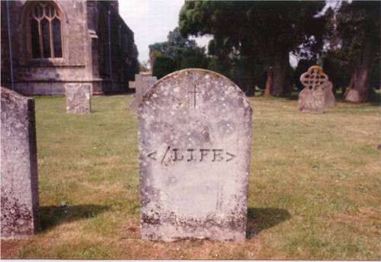
HTML

Slide 39
Static Web Pages
Static Web pages are simply files
Have the same contents for each viewing
Can be visually rich and interactive nonetheless:
HTML that mixes text and images
Forms that gather user input
Style sheets that tailor presentation
Vector graphics, videos, and more (over) . . .

Slide 40
HTML Forms
How to communicate data from the client to the server?
HTML 2.0 → forms in the web pages
User can fill in the fields, and then “submit” to the server the information
GET: as part of a request, in the URL, using ampersands and percent encoding (may be cached)
POST: send information separately
advised for sensitive content

Slide 41
Dynamic Pages & Web Applications (1)
Dynamic pages are generated by programs running at the server (with a database) and the client
E.g., PHP at server, JavaScript at client
Pages vary each time like using an application

Slide 42
Dynamic Pages & Web Applications (2)
Web applications use a set of technologies that work together, e.g. AJAX:
HTML: present information as pages.
DOM: change parts of pages while they are viewed.
XML: let programs exchange data with the server.
Asynchronous way to send and retrieve XML data.
JavaScript as a language to bind all this together.

Slide 43
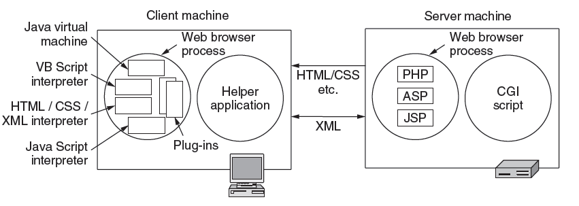
Dynamic Pages & Web Applications (3)
Web applications use a set of technologies, revisited:

Slide 44
HTTP (1)
HTTP (HyperText Transfer Protocol) is a request-response protocol that runs on top of TCP
Fetches pages from server to client
Server usually runs on port 80
Headers are given in readable ASCII
Content is described with MIME types
Protocol has support for pipelining requests
Protocol has support for caching

Slide 45
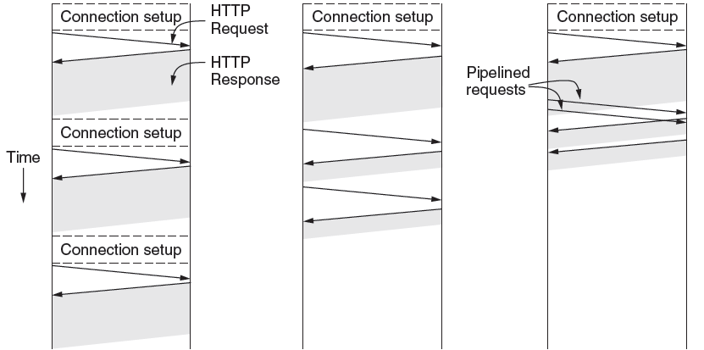
HTTP (2)
HTTP uses persistent connections to improve performance
One connection for each request
Sequential requests on one connection
Pipelined requests on one connection

Slide 46
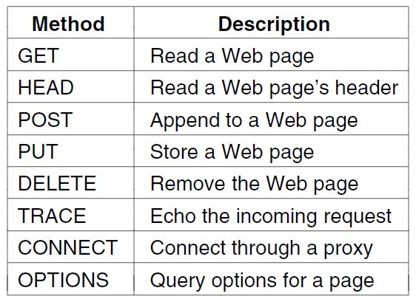
HTTP (3)
HTTP has several request methods.
Fetch a page
Used to send input data to a server program

Slide 47
HTTP (4)
Response codes tell the client how the request fared:

Slide 48
HTTP (5)
Many headers carry key information:
Function | Example Headers
Browser capabilities (client → server) | User-Agent, Accept, Accept-Charset, Accept-Encoding, Accept-Language
Caching related (mixed directions) | If-Modified-Since, If-None-Match, Date, Last-Modified, Expires, Cache-Control, ETag
Browser context (client → server) | Cookie, Referer, Authorization, Host
Content delivery (server → client) | Content-Encoding, Content-Length, Content-Type, Content-Language, Content-Range, Set-Cookie

Slide 49
HTTP (6)
HTTP caching checks to see if the browser has a known fresh copy, and if not if the server has updated the page
Uses a collection of headers for the checks
Can include further levels of caching (e.g., proxy)

Slide 50
HTTP Message Format
Not only requests for pages are supported by HTTP
In general, HTTP supports different requests and corresponding responses
You can take a look at HTTP messages by using telnet
telnet www.unibz.it 80 <ENTER>
…
GET /inf/ HTTP/1.0 <ENTER> <ENTER>
=> Let’s try

Slide 51
Stateless vs Stateful
HTTP is a stateless protocol
Good for performance and for the original intention of the web (accessing documents)
Now the web is used for many other needs
E-commerce, e-mail access, financial transactions, …
These uses typically require to keep a “state” of the interaction
User authentication, user cart, …
State using IP address → not ideal

Slide 52
Cookies
HTTP server response may contain a small amount (<4K) of information (cookie)
Cookies are locally stored by the client
It is possible to disable this behavior
Each cookie contains
Domain: which domain can use the cookie (browsers can check that server is not cheating)
Path: which parts of the server’s tree can use the cookie (typically / → the whole tree)
Content: key=value(s) pairs
Expires
if absent → cookie non-persisting (discarded by the browser when it exits)
if provided → determines the expiration date of the persistent cookie
Secure: if yes, the cookie can be returned only to a secure server

Slide 53
Cookies (2)
Examples of cookies
Let’s check our browser..

Slide 54
Use of Cookie
When the client asks a certain URL, it checks if there are cookies that correspond to it
In this case, they are attached as part of the HTTP request header
The server can interprets the received cookies to change its behavior
E.g., show the content of the user’s cart if there is a cart cookie whose values contain the identifiers of the chosen items
Web tracking…
=> Try to catch some cookies in the lab!

Slide 55
Net Neutrality
https://www.youtube.com/watch?v=xjOxNiHUsZw
Tasks
Describe what net neutrality refers to
Find an argument in favour of net neutrality
Find an argument against net neutrality

Slide 56
Take home
DNS
built upon UDP
recursive resolution
Email
SMTP for message transfer
POP3/IMAP for final delivery
HTML
Markup language for static webpages
HTTP
Build upon TCP
Cookies
Caching
Net neutrality

