Slide 1
Distributed Systems 4. Data Link Layer
Simon Razniewski
Faculty of Computer Science
Free University of Bozen-Bolzano
A.Y. 2015/2016

Slide 2
The Data Link Layer
Responsible for delivering frames of information over a single link
Handles transmission errors and regulates the flow of data
Application
Transport
Network
Link
Physical

Slide 3
The Data Link Layer
Framing
Error Detection and Correction
Elementary Data Link Protocols
Example Data Link Protocols

Slide 4
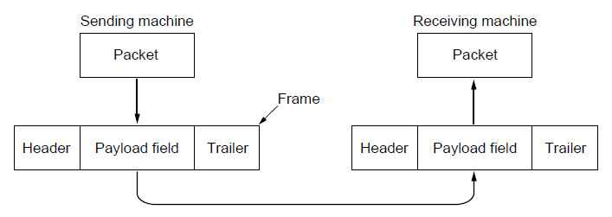
Frames
Link layer accepts packets from the network layer, and encapsulates them into frames that it sends using the physical layer; reception is the opposite process
Network
Link
Virtual data path
Physical
Actual data path

Slide 5
Possible Services
Unacknowledged connectionless service
Frame is sent with no connection / error recovery
Ethernet is example
Acknowledged connectionless service
Frame is sent with retransmissions if needed
Example is 802.11 (WiFi)
Connection-oriented service
Not in this layer

Slide 6
Why Framing?

Slide 7
Framing Methods
Byte count for frames
Flag bytes with byte stuffing
Flag bits with bit stuffing
Physical layer coding violations
Use non-data symbol to indicate frame

Slide 8
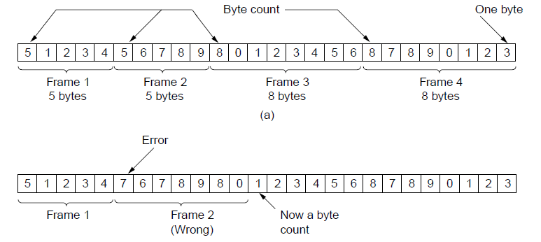
Framing – Byte count for frames
Frame begins with a count of the number of bytes in it
Simple, but difficult to resynchronize after an error
Expected
case
Error
case

Slide 9
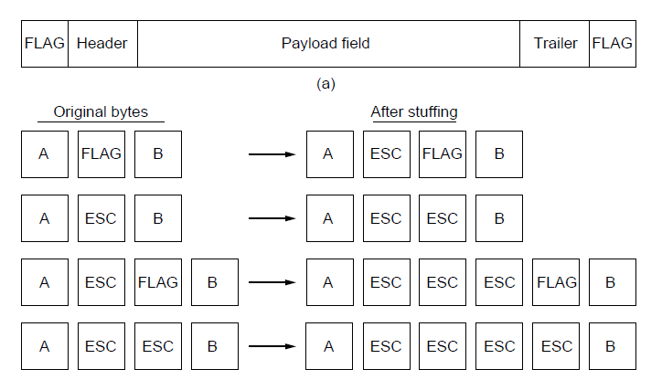
Framing – Byte stuffing
Special flag bytes delimit frames; occurrences of flags in the data must be stuffed (escaped)
Longer, but easy to resynchronize after error
Frame
format
Need to escape extra ESCAPE bytes too!
Stuffing
examples

Slide 10
Your turn
What are the frames that were sent?
FLAG A B ESC FLAG C FLAG FLAG ESC ESC ESC FLAG D F ESC FLAG A ESC ESC FLAG FLAG B ESC FLAG D B FLAG

Slide 11
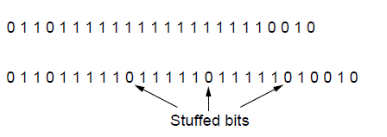
Framing – Bit stuffing
Stuffing done at the bit level:
Frame flag has six consecutive 1s (not shown)
On transmit, after five 1s in the data, a 0 is added
On receive, a 0 after five 1s is deleted
Data bits
Transmitted bits
with stuffing

Slide 12
Framing – Physical coding violation
How?

Slide 13
The Data Link Layer
Framing
Error Detection and Correction
Elementary Data Link Protocols
Example Data Link Protocols

Slide 14
Error Detection and Correction
Two basic strategies:
Correct errors at receiver side (using error-correcting codes)
Detect errors at receiver side and request retransmission
Preferred method depends on the error probability
E.g. fiber: Error detection + retransmission
E.g. Wifi: Error correcting codes

Slide 15
FFFooouuunnndddaaatttiiiooonnn ooofff EEErrrrrrooorrr CCCooonnntttttrrrooolll: RRReeeddduuunnndddaaannncccyyy
Dd y knw: Natrl langge cntns a lt f rdndncy. Ths s th rsn tht w cn ndrstnd each otr evn in nsy nvrnmnts
For byte streams without inherent redundancy, we can add redundancy like shown in the title.

Slide 16
Error Codes
Error codes add structured redundancy to data so errors can be either detected, or corrected.
Error detection codes:
Parity
Checksums
Cyclic redundancy codes (CRC)
Error correction codes:
Hamming codes
Reed-Solomon and Low-Density Parity Check codes
Mathematically complex, widely used in real systems

Slide 17
Error Detection – Parity
Parity bit is added as the modulo 2 sum of data bits
Equivalent to XOR; this is even parity
Ex: 1110 000 → 1110 0001
Detection checks if the sum is wrong (an error)
Simple way to detect an odd number of errors
Ex: 1 error, 1110 0101; detected, sum is wrong
Ex: 3 errors, 1101 1001; detected sum is wrong
Ex: 2 errors, 1110 1101; not detected, sum is right!
Error can also be in the parity bit itself
Random errors are detected with probability ½

Slide 18
Error Detection – Checksums
Checksum treats data as N-bit words and adds N check bits that are the modulo 2^{N} sum of the words
Ex: IPv4 protocol uses 16-bit checksum
Properties:
Improved error detection over parity bits
Detects bursts up to N errors
Detects random errors with probability 1-(1/2)^{N}
Vulnerable to systematic errors, e.g., added zeros

Slide 19
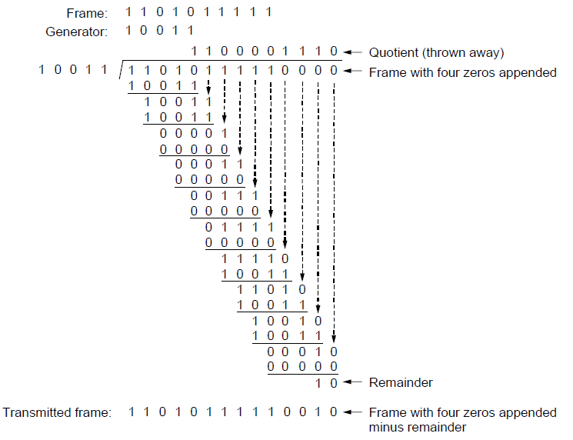
Error Detection – CRCs (1)
Adds bits so that transmitted frame viewed as a polynomial is evenly divisible by a generator polynomial
Start by adding 0s to frame and try dividing
Offset by any reminder to make it evenly divisible

Slide 20
Error Detection – CRCs (2)
Based on standard polynomials:
Ex: Ethernet 32-bit CRC is defined by:
Computed with simple shift/XOR circuits (hardware)
Stronger detection than checksums:
E.g., can detect all double bit errors
Not vulnerable to systematic errors

Slide 21
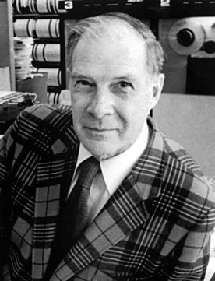
Richard Hamming (1915-1998)
1915-1998
American mathematician
Worked on the Manhattan project
Influence on foundations of communication and networking

Slide 22
Error Correction – Hamming code
Hamming code gives a simple way to add check bits and correct up to a single bit error:
Check bits are parity (XOR) over subsets of the codeword
Recomputing the parity sums (syndrome) gives the position of the error to flip, or 0 if there is no error
(7,4) Hamming code for (d₁,d₂,d₃,d₄,p₁,p₂,p₃)-ordering p₁ = d₁⊕d₂⊕d₃ p₂ = d₂⊕d₃⊕d₄ p₃ = d₃⊕d₄⊕d₁
Let’s encode 1001 and 0101
p₁
d₂
d₁
d₃
p₂
d₄
p₃

Slide 23
Decode the following four ASCII characters
0100 110 1001 110
0001 101 0000 000
0111 010 0110 001
1011 100 0110 001

Slide 24
Hamming Codes - Generalization
d data bits
r check bits
Values for d and r that satisfy the following equation allow to correct one error:
d+r+1 ≤ 2^{r}

Slide 25
Hamming code vs Gray code
??

Slide 26
Error Detection: IBANs
Example:
bank code 123456, bank abbreviation WEST
account number 98765432
Redundancy is in blue
http://www.ibancalculator.com/
IBAN: |  | GB82 WEST 1234 5698 7654 32
• Rearrange: |  | W E S T12345698765432 G B82
• Convert to integer (A=10, ..) |  | 3214282912345698765432161182
• Compute remainder: |  | 3214282912345698765432161182 | mod 97 = 1

Slide 27
Error Bounds – Hamming distance
Code turns data of n bits into codewords of n+k bits
Hamming distance is the minimum bit flips to turn one valid codeword into any other valid one.
Example with 4 codewords of 10 bits (n=2, k=8):
0000000000, 0000011111, 1111100000, and 1111111111
Hamming distance is 5
Bounds for a code with distance:
2d+1 – can correct d errors (e.g., 2 errors above)
d+1 – can detect d errors (e.g., 4 errors above)

Slide 28
Error Control - Preference
Which method is better when?
Example:
Error probability: 10⁻⁶
Frame size: 1k bits
(7,4)-Hamming code versus one parity bit?

Slide 29
The Data Link Layer
Framing
Error Detection and Correction
Elementary Data Link Protocols
Example Data Link Protocols

Slide 30
Elementary Data Link Protocols
Link layer environment »
Utopian Simplex Protocol »
Stop-and-Wait Protocol for Error-free channel »
Stop-and-Wait Protocol for Noisy channel »
Sliding Window concept »

Slide 31
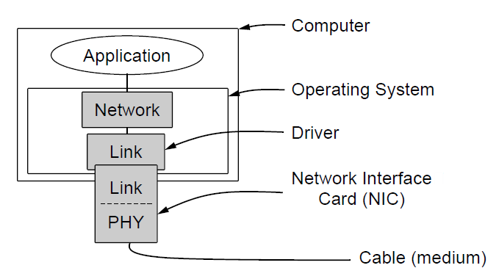
Link layer environment (1)
Commonly implemented as NICs and OS drivers; network layer (IP) is often OS software

Slide 32
Link layer environment (2)
Link layer protocol implementations use system calls
Group | Library Function | Description
Network layer | from_network_layer(&packet) to_network_layer(&packet) enable_network_layer() disable_network_layer() | Take a packet from network layer to send Deliver a received packet to network layer Let network cause “ready” events Prevent network “ready” events
Physical layer | from_physical_layer(&frame) to_physical_layer(&frame) | Get an incoming frame from physical layer Pass an outgoing frame to physical layer
Events & timers | wait_for_event(&event) start_timer(seq_nr) stop_timer(seq_nr) start_ack_timer() stop_ack_timer() | Wait for a packet / frame / timer event Start a countdown timer running Stop a countdown timer from running Start the ACK countdown timer Stop the ACK countdown timer

Slide 33
Utopian Simplex Protocol (=Ethernet)
An optimistic protocol to get us started
Assumes no errors, and receiver as fast as sender
Considers one-way data transfer
That’s it, no error or flow control …
}
Sender loops blasting frames
Receiver loops eating frames

Slide 34
Stop-and-Wait – Error-free channel
Protocol (p2) ensures sender can’t outpace receiver:
Receiver returns a dummy frame (ack) when ready
Only one frame out at a time – called stop-and-wait
We added flow control!
Sender waits to for ack after passing frame to physical layer
Receiver sends ack after passing frame to network layer

Slide 35
Stop-and-Wait – Noisy channel (=Wifi)
ARQ (Automatic Repeat reQuest) adds error control
Receiver acks frames that are correctly delivered
Sender sets timer and resends frame if no ack
For correctness, frames and acks must be numbered
Else receiver can’t tell retransmission (due to lost ack or early timer) from new frame
For stop-and-wait, 2 numbers (1 bit) are sufficient
→ Maximum data rate?

Slide 36
Sliding Window concept (1)
Sender maintains window of frames it has sent
Needs to buffer them for possible retransmission
Window advances with next acknowledgements
Receiver maintains window of frames it can receive
Needs to keep buffer space for arrivals
Window advances with in-order arrivals

Slide 37
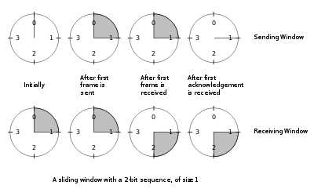
Sliding Window concept (2)
A sliding window advancing at the sender and receiver
Ex: window size is 1, with a 3-bit sequence number.

Slide 38
Sliding Window concept (3)
Larger windows enable pipelining for efficient link use
Stop-and-wait (w=1) is inefficient for long links
Best window (w) depends on bandwidth-delay (BD)
Want w ≥ 2BD to ensure high link utilization
Different choices for errors/buffering
Go-Back-N: Retransmit all frames since first faulty frame
Selective Repeat: Retransmit only faulty frames

Slide 39
The Data Link Layer
Framing
Error Detection and Correction
Elementary Data Link Protocols
Example Data Link Protocols

Slide 40
Example Data Link Protocols
Packet over SONET »
PPP (Point-to-Point Protocol) »
ADSL (Asymmetric Digital Subscriber Loop) »

Slide 41
Packet over SONET/SDH
Packet over SONET is the method used to carry IP packets over SONET optical fiber links (backbone of Internet)
Uses PPP (Point-to-Point Protocol) for framing
Protocol stacks
PPP frames may be split over SONET payloads

Slide 42
PPP
PPP (Point-to-Point Protocol) is a general method for delivering packets across links
Framing uses a flag (0x7E) and byte stuffing
“Unnumbered mode” (connectionless unacknow-ledged service) is used to carry IP packets
Errors are detected with a checksum
0x21 for IPv4
IP packet

Slide 43
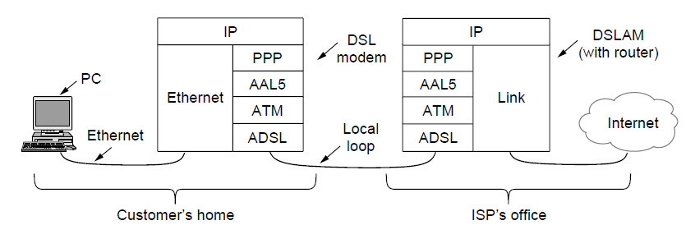
ADSL (1)
Widely used for broadband Internet over local loops
ADSL runs from modem (customer) to DSLAM (ISP)
IP packets are sent over PPP and AAL5/ATM (over)

Slide 44
ADSL (2)
PPP data is sent in AAL5 frames over ATM cells:
ATM is a link layer that uses short, fixed-size cells (53 bytes); each cell has a virtual circuit identifier
AAL5 is a format to send packets over ATM
PPP frame is converted to a AAL5 frame (PPPoA)
AAL5 frame is divided into 48 byte pieces, each of which goes into one ATM cell with 5 header bytes

Slide 45
Take home
Why framing is needed and how it can be done with byte stuffing
Error detection + retransmission versus error correction
(7,4)-Hamming code
Acknowledgements with sliding windows
Next
Lecture: Some link layer exercises
Real lecture: How to share a link (Medium access control sublayer)
Real lab: Experimenting with a simple link layer protocol simulation

