Slide 1
Distributed Systems 6. Medium Access Control Sublayer
Simon Razniewski
Faculty of Computer Science
Free University of Bozen-Bolzano
A.Y. 2014/2015

Slide 2
The MAC Sublayer
Responsible for deciding who sends next on a multi-access link
An important part of the link layer, especially for LANs
Application
Transport
Network
Link
Physical
MAC is in here!

Slide 3
Medium Access Control Sublayer
Channel Allocation
Multiple Access Protocols
Practically used protocols
Ethernet
Wireless LANs
RFID
Data Link Layer Switching

Slide 4
Medium Access Control Sublayer
Channel Allocation
Multiple Access Protocols
Practically used protocols
Ethernet
Wireless LANs
RFID
Data Link Layer Switching

Slide 5
Static Channel Allocation
For fixed channel and traffic from N users
Divide up bandwidth using FTM, TDM, CDMA, etc.
Example: FM radio
Why not a good idea for LANs?

Slide 6
Multiple Access Protocols
Dynamic allocation gives the channel to a user when they need it. Potentially N times as efficient for N users.
Contention protocols
ALOHA
CSMA (Carrier Sense Multiple Access)
Collision-free protocols
Token ring
Bitmap
Binary counter
Limited-contention protocols
Adaptive treewalk
Wireless LAN protocols

Slide 7
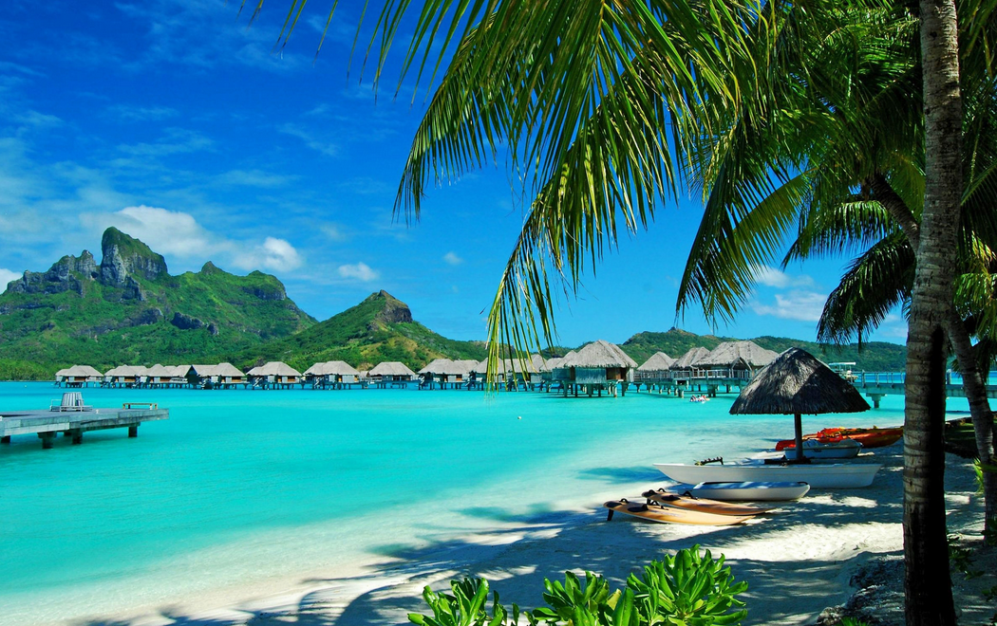

Slide 8
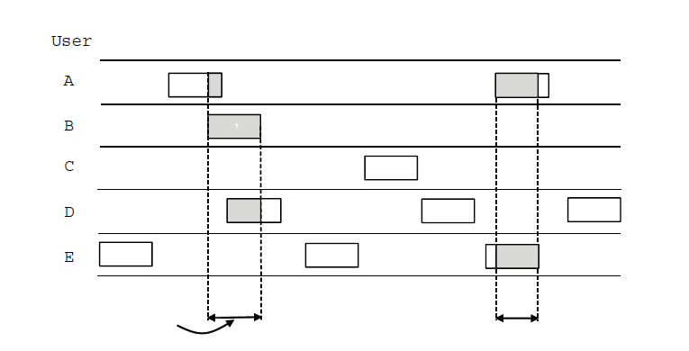
ALOHA (1)
In pure ALOHA, users transmit frames whenever they have data; users retry after a random time for collisions
Efficient and low-delay under low load
`
User
A
B
C
D
E
Collision
Collision
Time

Slide 9
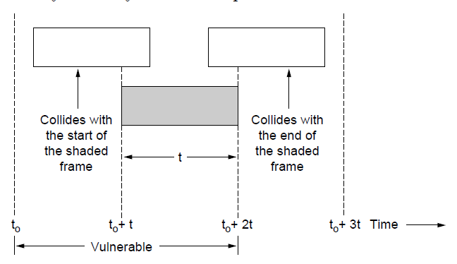
ALOHA (2)
Collisions happen when other users transmit during a vulnerable period that is twice the frame time
Synchronizing senders to slots can reduce collisions

Slide 10
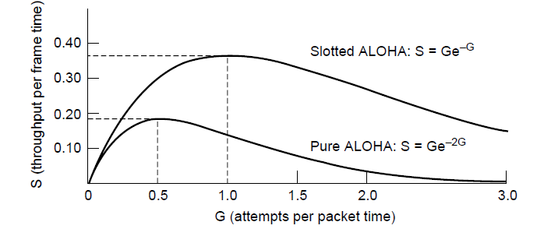
ALOHA (3)
Slotted ALOHA is twice as efficient as pure ALOHA
Low load wastes slots, high loads causes collisions
Efficiency up to 1/e (37%) for random traffic models

Slide 11
CSMA (1)
CSMA improves on ALOHA by sensing the channel
User doesn’t send if it senses someone else
Variations on what to do if the channel is busy:
1-persistent (greedy) sends as soon as idle
Nonpersistent waits a random time then tries again
p-persistent sends with probability p when idle (slotted)

Slide 12
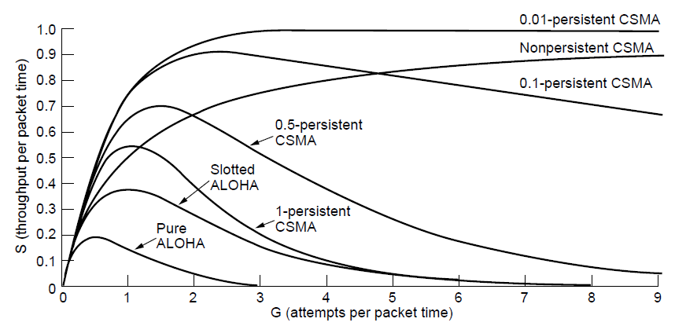
CSMA (2) – Persistence
CSMA outperforms ALOHA, and being less persistent is better under high load

Slide 13
CSMA (3) – Collision Detection
CSMA/CD improvement is to detect/abort collisions
Reduced contention times improve performance
Collision time is much shorter than frame time

Slide 14
CSMA/CD
http://scisweb.ulster.ac.uk/~kevin/com320/labs/Simulations/csmacd.swf

Slide 15
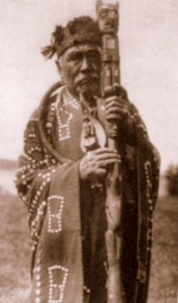
Collision-Free – Token Ring

Slide 16
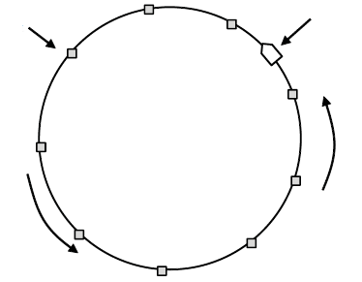
Collision-Free – Token Ring
Token sent round ring defines the sending order
Station with token may send a frame before passing
Idea can be used without ring too, e.g., token bus
Token
Station
Direction of
transmission

Slide 17
Collision-Free – Bitmap
Collision-free protocols avoid collisions entirely
Senders must know when it is their turn to send
The basic bit-map protocol:
Sender set a bit in contention slot if they have data
Senders send in turn; everyone knows who has data
Problems?

Slide 18
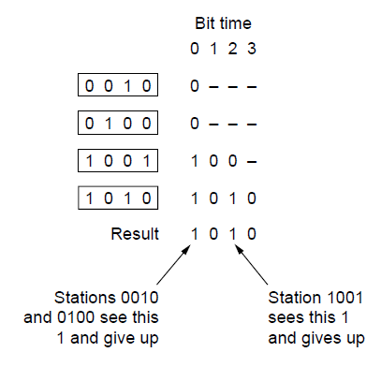
Collision-Free – Countdown
Binary countdown improves on the bitmap protocol
Stations send their address in contention slot (log N bits instead of N bits)
Medium ORs bits; stations give up when they send a “0” but see a “1”
Station that sees its full address is next to send

Slide 19
Contention vs collision-free protocols
Contention protocols good for low load, but bad for high load.
Collision-free ones bad for low load, acceptable for high load
Still, if load is very high, static schemes may be better, due to unnecessary sending order resolution (if everybody wants to send anyway)
Idea: Combine contention and collision-free protocols, iteratively ask less nodes to compete
Example: Test of urin samples of US soldiers in WWII

Slide 20
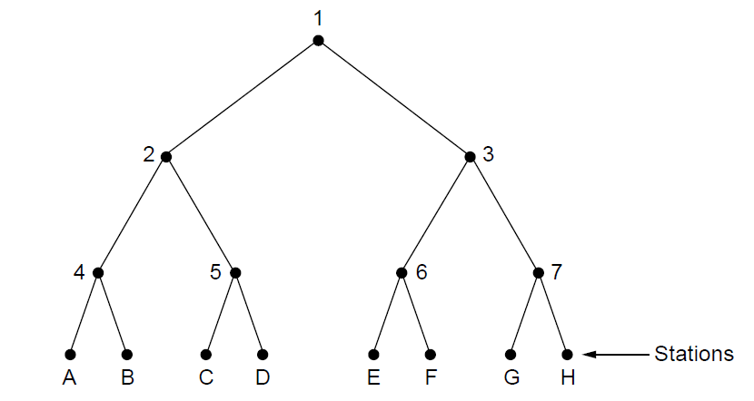
Limited Contention (2) –Adaptive Tree Walk
Tree divides stations into groups (nodes) to poll
Depth first search under nodes with poll collisions
Start search at lower levels if >1 station expected
Level 0
What happens when A, C and G want to send?
Level 1
Level 2

Slide 21
Your turn
16 stations, of which all prime numbers want to send.
What happens?

Slide 22
Wireless LAN Protocols (1)
Wireless has complications compared to wired.
Nodes may have different coverage regions
Leads to problems with hidden and exposed terminals
Nodes can’t detect all collisions, i.e., sense while sending
Makes collisions expensive and to be avoided

Slide 23
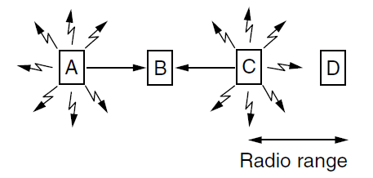
Wireless LANs (2) – Hidden terminals
Hidden terminals are senders that cannot sense each other but nonetheless collide at intended receiver
Want to prevent; loss of efficiency
A and C are hidden terminals when sending to B

Slide 24
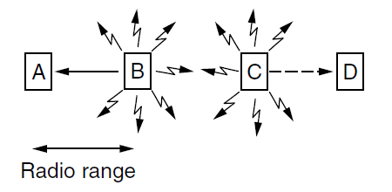
Wireless LANs (3) – Exposed terminals
Exposed terminals are senders who can sense each other but still transmit safely (to different receivers)
Desirably concurrency; improves performance
B → A and C → D are exposed terminals

Slide 25
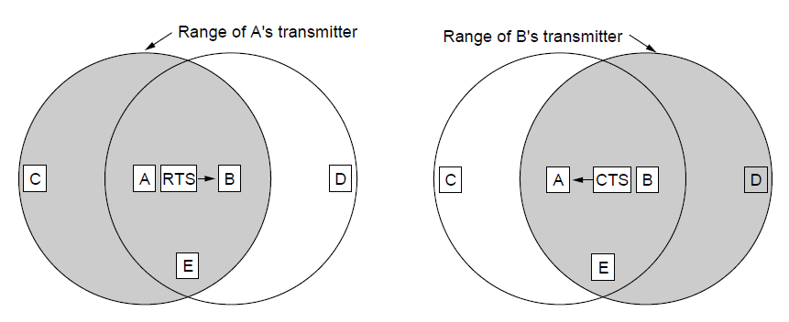
Wireless LANs (4) – MACA
MACA protocol grants access for A to send to B:
A sends RTS to B [left]; B replies with CTS [right]
A can send with exposed but no hidden terminals
A sends RTS to B; C and E hear and defer for CTS
B replies with CTS; D and E hear and defer for data

Slide 26
Medium Access Control Sublayer
Channel Allocation
Multiple Access Protocols
Practically used protocols
Ethernet
Wireless LANs
RFID
Data Link Layer Switching

Slide 27
Ethernet
Classic Ethernet (bus)
Switched/Fast Ethernet (virtual 1:1 connections using switches)

Slide 28
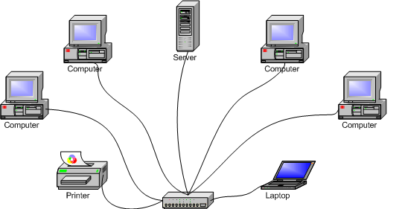
Classic Ethernet (1) – Physical Layer
One shared coaxial cable to which all hosts attached
10 Mbps: Manchester encoding
100 Mbps: 4B/5B encoding
1000 Mbps: 8B/10B encoding
Hosts run the classic Ethernet CSMA/CS protocol for access
Hub

Slide 29
Classic Ethernet (2) – MAC
MAC protocol is 1-persistent CSMA/CD (earlier)
Random delay (backoff) after collision is computed with BEB (Binary Exponential Backoff)
Frame format is still used with modern Ethernet.
Ethernet
(DIX)
IEEE 802.3
Problem: Frame length – bandwidth – round-trip-time tradeoff

Slide 30
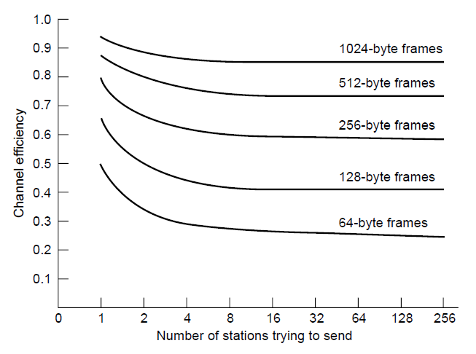
Classic Ethernet (4) – Performance
Efficient for large frames, even with many senders
Degrades for small frames (and long LANs)
10 Mbps Ethernet,
64 byte min. frame

Slide 31
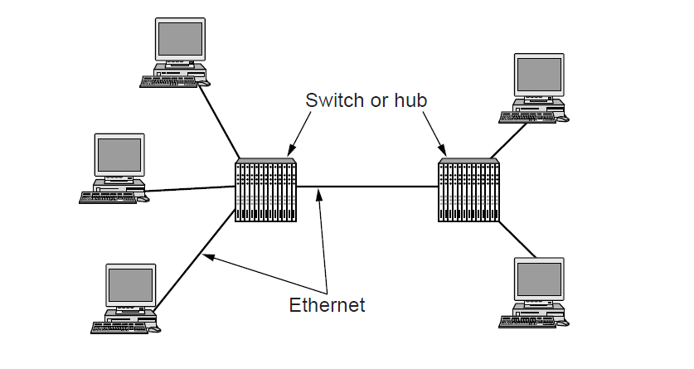
Fast Ethernet (3)
Fast Ethernet extended Ethernet from 10 to 100 Mbps and more
Twisted pair (with Cat 5) dominates the market

Slide 32
Wireless LANs
802.11 physical layer
802.11 MAC
802.11 frames

Slide 33
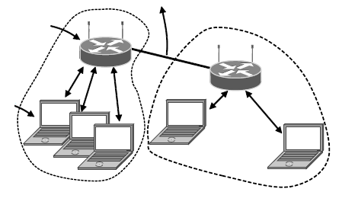
802.11 Architecture/Protocol Stack (1)
Wireless clients associate to a wired AP (Access Point)
Called infrastructure mode; there is also ad-hoc mode with no AP, but that is rare.
To Network
Access Point
Client

Slide 34
802.11 physical layer
NICs are compatible with multiple physical layers
E.g., 802.11 a/b/g
Name | Technique | Max. Bit Rate
802.11b | Spread spectrum, 2.4 GHz | 11 Mbps
802.11g | OFDM, 2.4 GHz | 54 Mbps
802.11a | OFDM, 5 GHz | 54 Mbps
802.11n | OFDM with MIMO, 2.4/5 GHz | 600 Mbps

Slide 35
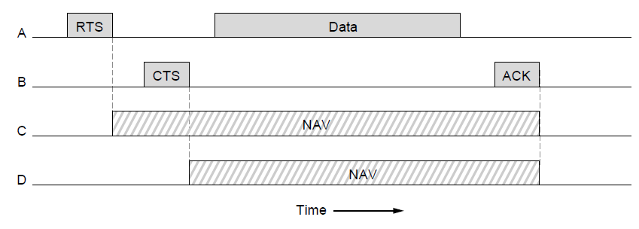
802.11 MAC (2)
Base station mode: Base station pulls, no collisions
Ad-hoc mode: CSMA/CD with RTS/CTS
Stations block themselves with NAV signals

Slide 36
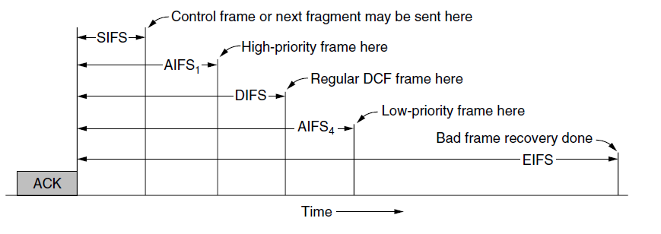
802.11 MAC (3)
Different backoff slot times add quality of service
Short intervals give preferred access, e.g., control, VoIP

Slide 37
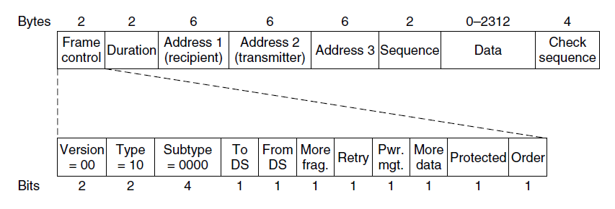
802.11 Frames
Frames vary depending on their type (Frame control)
Data frames have 3 addresses to pass via APs

Slide 38
RFID
Gen 2 Architecture »
Gen 2 Physical Layer »
Gen 2 Tag Identification Layer »
Gen 2 Frames »

Slide 39
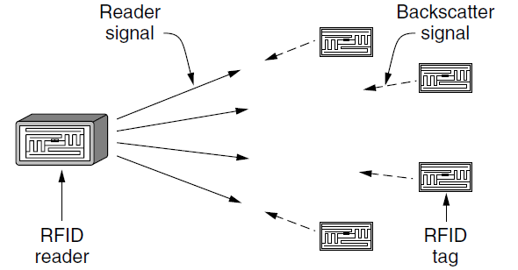
RFID Gen 2 Architecture
Reader signal powers tags; tags reply with backscatter

Slide 40
RFID Gen 2 Physical Layer
Reader uses duration of on period to send 0/1
Tag backscatters reader signal in pulses to send 0/1

Slide 41
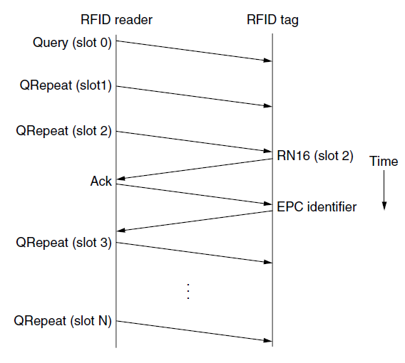
RFID Gen 2 Tag Identification Layer
Reader sends query and sets slot structure
Tags reply (RN16) in a random slot; may collide
Reader asks one tag for its identifier (ACK)
Process continues until no tags are left

Slide 42
Gen 2 Frames
Reader frames vary depending on type (Command)
Query shown below, has parameters and error detection
Tag responses are simply data
Reader sets timing and knows the expected format
Query message

Slide 43
Medium Access Control Sublayer
Channel Allocation
Multiple Access Protocols
Practically used protocols
Ethernet
Wireless LANs
RFID
Data Link Layer Switching

Slide 44
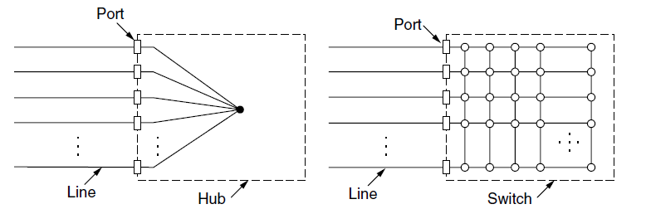
Switched/Fast Ethernet (1)
Hubs wire all lines into a single CSMA/CD domain
Switches isolate each port to a separate domain
Much greater throughput for multiple ports
No need for CSMA/CD with full-duplex lines

Slide 45
Data Link Layer Switching
Uses of switches
Learning switches
Spanning Tree algorithm
Old term Bridge for switches with only two ports

Slide 46
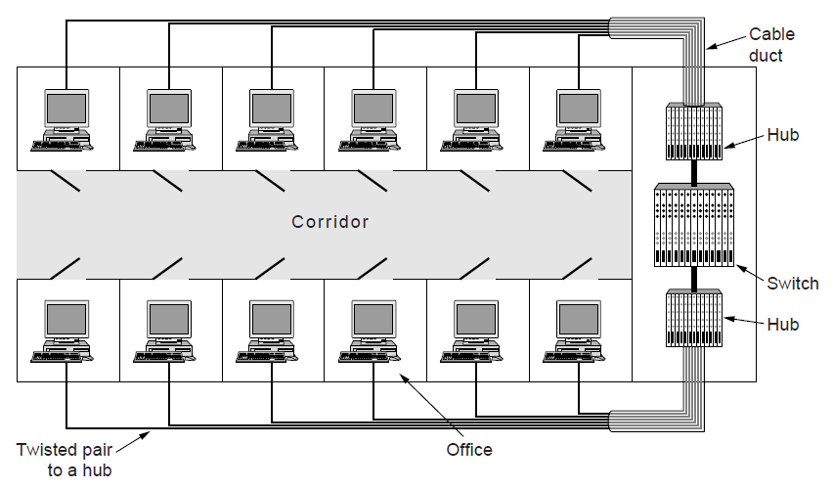
Uses of Switches
Common setup is a building with centralized wiring
Switches are placed in or near wiring closets

Slide 47
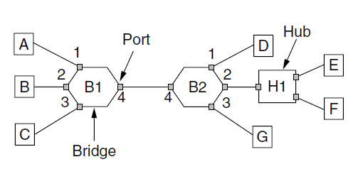
Learning Switches (1)
Switch

Slide 48
Learning Switches (2)
Backward learning algorithm picks the output port:
Associates source address on frame with input port
Frame with destination address sent to learned port
Unlearned destinations are sent to all other ports
Needs no configuration
Forget unused addresses to allow changes
Bandwidth efficient for two-way traffic

Slide 49
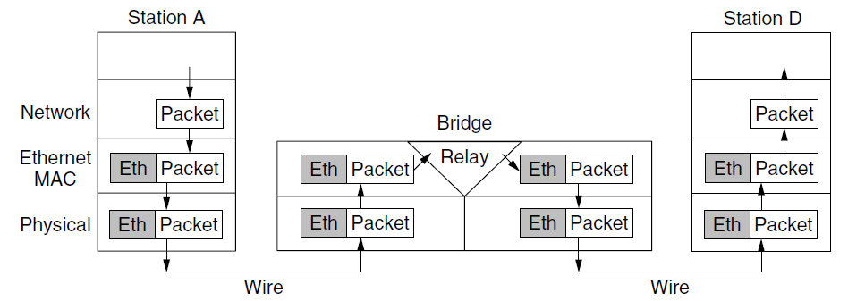
Learning Switches (3)
Switches extend the Link layer:
Use but don’t remove Ethernet header/addresses
Do not inspect Network header
Switch

Slide 50
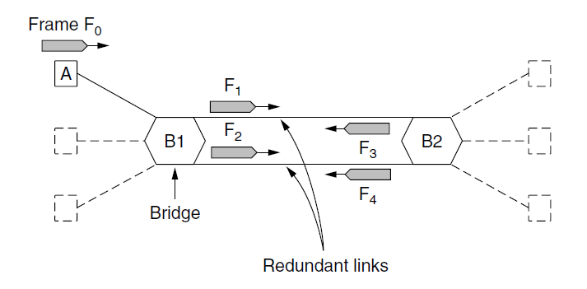
Loops – Problem
Switch topologies with loops and only backward learning will cause frames to circulate for ever
Need a solution to avoid loops support to solve problem
Switch

Slide 51
Spanning Tree – Algorithm
Subset of forwarding ports for data is use to avoid loops
Selected with the spanning tree algorithm by Perlman
I think that I shall never see
A graph more lovely than a tree.
A tree whose crucial property
Is loop-free connectivity.
A tree which must be sure to span.
So packets can reach every LAN.
First the Root must be selected
By ID it is elected.
Least cost paths from Root are traced
In the tree these paths are placed.
A mesh is made by folks like me
Then bridges find a spanning tree.
– Radia Perlman, 1985.

Slide 52
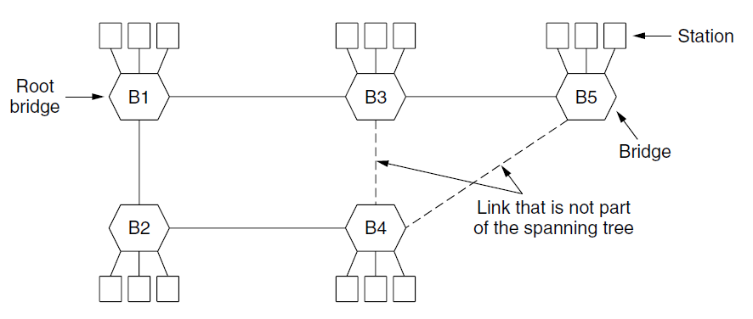
Spanning Tree (2) – Example
After the algorithm runs:
B1 is the root, two dashed links are turned off
B4 uses link to B2 (lower than B3 also at distance 1)
B5 uses B3 (distance 1 versus B4 at distance 2)
Switch
Switch

Slide 53
Take home
Protocols for multiple access
Contention protocols: ALOHA, CSMA/CD
Contention-free protocols: Token ring, bitmaps
Mixed protocols: Adaptive tree walk
Practically used techniques
Ethernet: CSMA/CD with random backoff
WiFi: RTS/CTS to avoid problems with hidden stations
Link Layer switching:
Spanning trees to avoid infinite looping

