Slide 1
Distributed Systems 33. Multiagent Systems
Simon Razniewski
Faculty of Computer Science
Free University of Bozen-Bolzano
A.Y. 2015/2016

Slide 2
So far…
Client/Server architecture = central control
P2P systems = decentralized, but only information sharing
IP routing = decentralized message passing
What about decentralized “physical” agents?

Slide 3
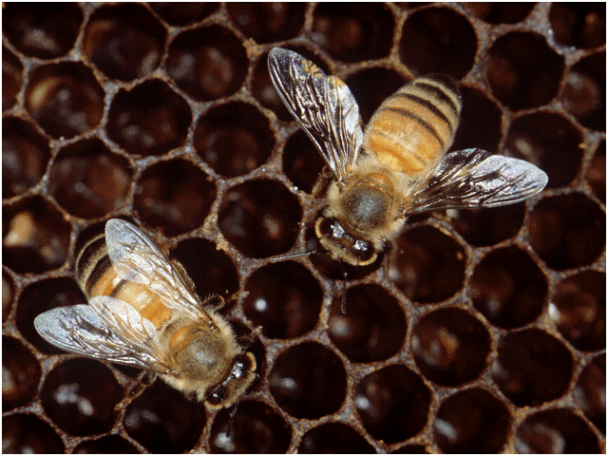
Inspiration: Nature

Slide 4
Bees
Efficiency via Specialization: division of labour in the colony
Queen, workers, drones
Communiation about food sources via “dance”
Regulate hive temperature

Slide 5
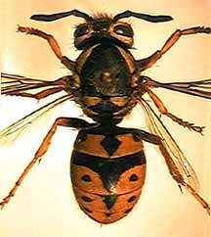
Wasps

Slide 6
Wasps
Pulp foragers, water foragers, builders, cleaners, feeders
Complex nests
Horizontal columns
Protective covering
Central entrance hole

Slide 7
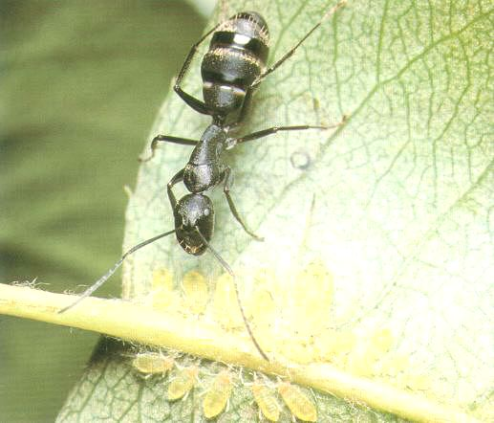
Ants

Slide 8
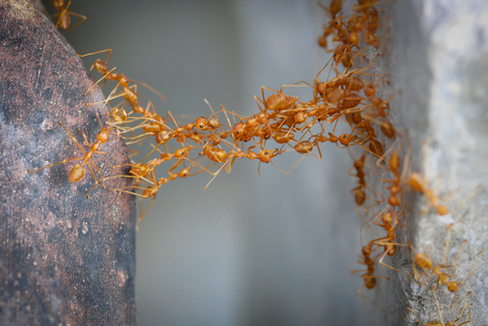
Ants
Organizing highways to and from their foraging sites by leaving pheromone trails
Form chains from their own bodies to create a bridge to pull and hold leafs together with silk
Division of labour
Inner workers, outer workers, cleaners, nurses, soldiers, wake-up ants, storage ants

Slide 9
Summary of Insects
The complexity and sophistication of self-organization is carried out with no clear leader
Interaction and specialization increases evolutionary “fitness” of the colonies
The modeling of social insects by means of self-organization can help design artificial distributed problem solving devices. This is also known as Swarm Intelligent Systems or Multiagent Systems

Slide 10
Multi-agent Systems
A multi-agent system (M.A.S.) is a computerized system composed of multiple interacting intelligent agents within an environment. Multi-agent systems can be used to solve problems that are difficult or impossible for an individual agent or a monolithic system to solve.
[Wikipedia]

Slide 11
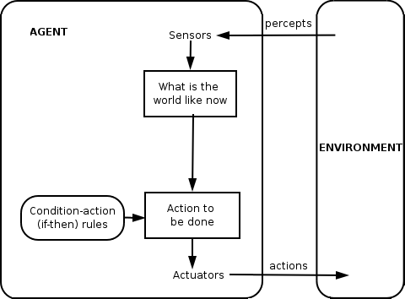
A simple agent

Slide 12
Why to study decentralized agents?
Communication not possible
Increased reliability
Model human/animal behaviour
Find better solutions than with centralized systems

Slide 13
1. Communication not possible
N.B. Funding vs. reality…

Slide 14
2. Increased Reliability
No single point of failure
No complex plans which fail if minor variances occur

Slide 15
Amazon Robotics (former KIVA)
https://www.youtube.com/watch?v=quWFjS3Ci7A
See also:
http://ieeexplore.ieee.org/stamp/stamp.jsp?arnumber=6295687

Slide 16
3. Model human/animal behaviour
Boids
Artificial fish
Massive
Robo soccer

Slide 17
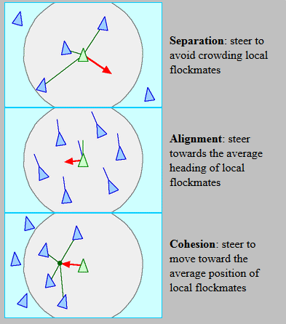
Bird swarms
Can be simulated with three rules [Reynolds 1986]

Slide 18
http://hp.vector.co.jp/authors/VA009508/Java/Boids/boids.html

Slide 19
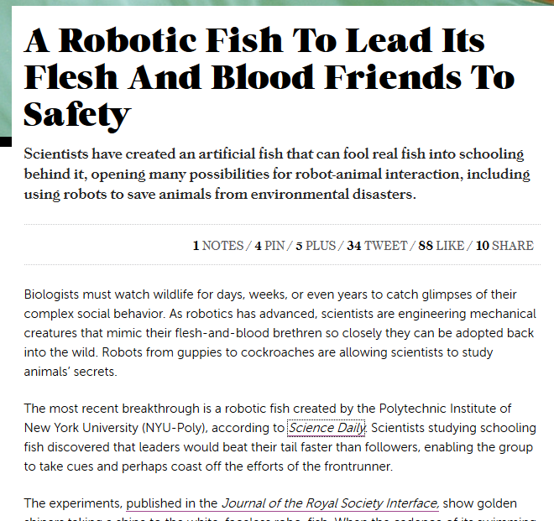
fastcoexist, 2012

Slide 20
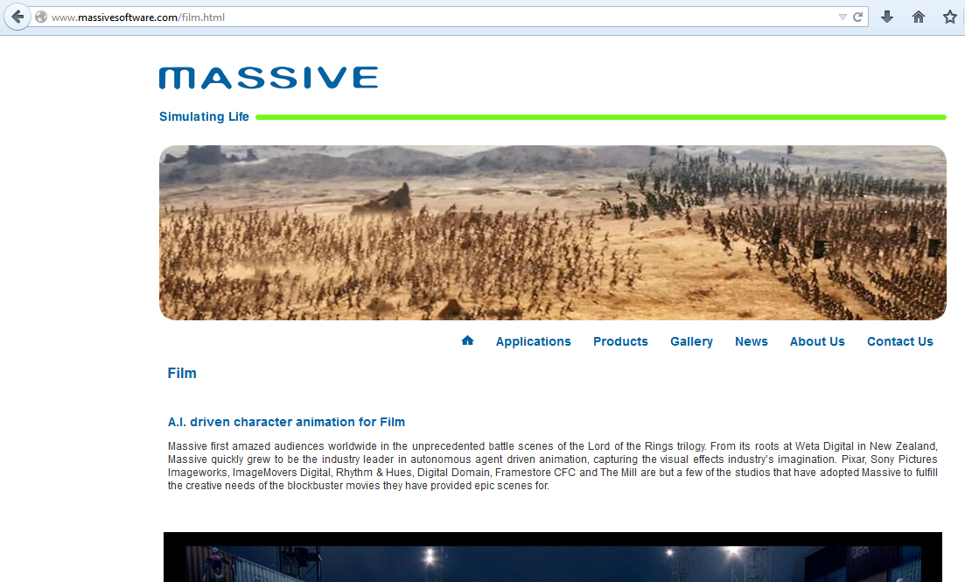

Slide 21
Robo soccer
Small size
https://www.youtube.com/watch?v=hZE1YQCghLk
Humanoids
https://www.youtube.com/watch?v=dhooVgC_0eY

Slide 22
4. Find better solutions than with centralized systems → Decentralized algorithms
Remember link state and distance vector routing?

Slide 23
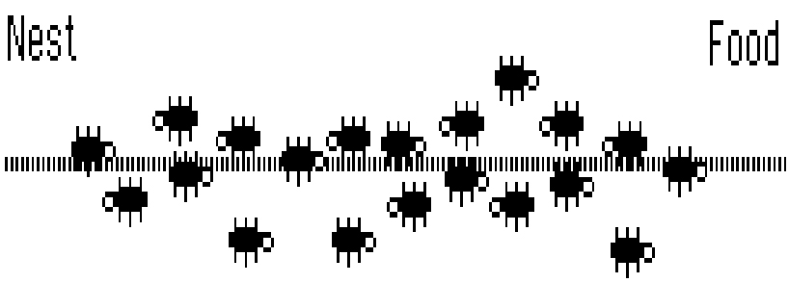
A Look at Real Ant Behaviour

Slide 24
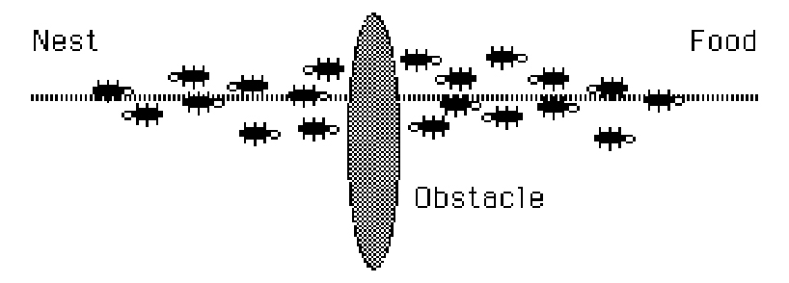
Interrupt The Flow

Slide 25
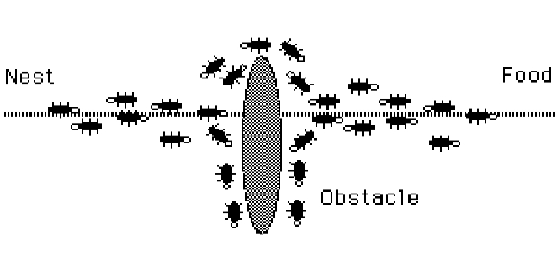
Random Walks..

Slide 26
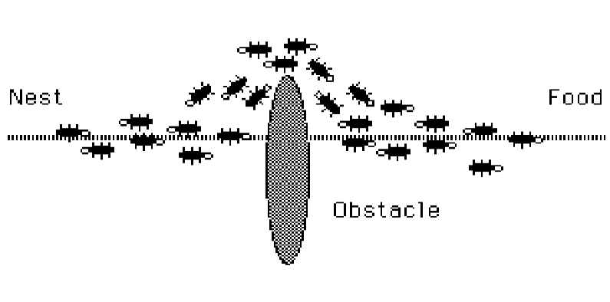
The New Shortest Path

Slide 27
Travelling Salesperson Problem
Initialize
Loop /* at this level each loop is called an iteration */
Each ant is positioned on a starting node
Loop /* at this level each loop is called a step */
Each ant applies a state transition rule to incrementally
build a solution and a local pheromone updating rule
Until all ants have built a complete solution
A global pheromone updating rule is applied
Until End_condition
M. Dorigo, L. M. Gambardella : ftp://iridia.ulb.ac.be/pub/mdorigo/journals/IJ.16-TEC97.US.pdf
Ant Colony System: A Cooperative Learning Approach to the Traveling Salesman Problem

Slide 28
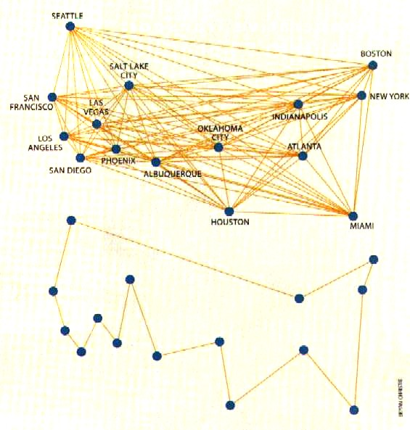
Traveling Sales Ants

Slide 29
The AntMe Environment

Slide 30
What is AntMe
A simulation environment for ant colonies
Players can write their own ant AIs and compete for points earned through collecting food and fighting bugs
..let’s see

Slide 31
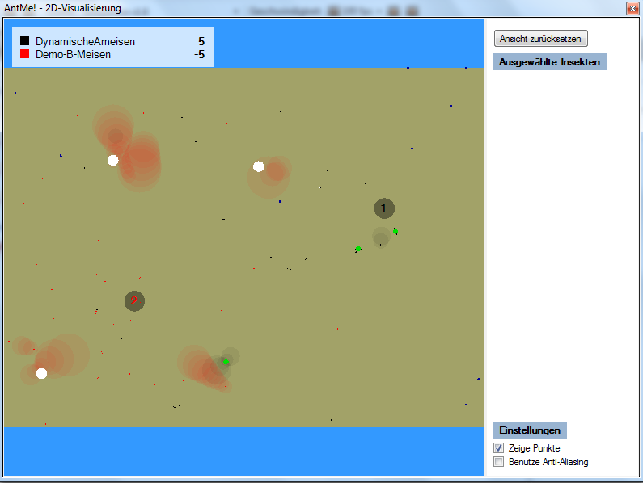
Bugs
Markers
Sugar
Fruit
Anthill
Ants

Slide 32
How it works
New ants are spawned continuously (maximum ants per colony at any moment: 100)
Ants have a limited range before they need to return to the anthill
Points for:
bringing a fruit home: 250
bringing sugar home: 1 per piece (standard ant load: 5 pieces)
killing a bug: 150
Sugar, fruits and bugs respawn as well

Slide 33
Castes (=Specializations)
Ants have default stats
Speed: 4 steps/round
Turning speed: 8 degree per round
Load capacity: 5 units
View range: 60 steps
Range: 1,5x the map
Energy: 100 HP
Attack: 10 HP/round
Custom castes of ants (workers, fighters, scouts, …) can be created by improving one skill and degrading another
The distribution of ants can be freely chosen (e.g. first 5 scouts, then 10 fighters, then 5 workers for every fighter)

Slide 34
Environment
C# (very similar to Java)
Visual Studio 2012 or newer
DirectX needed for 3D-Simulation (optional)
Environment ready on the lab machines

Slide 35
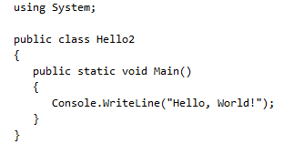
C#
For a thorough comparison to Java see http://www.harding.edu/fmccown/java_csharp_comparison.html

Slide 36
antIntelligence.cs
Tells the ants what to do in certain situations (“event-driven programming”)
Most important events:
Tick() – called in every simulation step
Spots(Sugar sugar/Fruit fruit) – called when the ant spots food
TargetReached(Sugar sugar/Fruit fruit) – called when the ant reaches food
Waits() – called whenever the ant has no task
Empty functions are already in the template

Slide 37
Behaviour is fully determined by what you write into each of these functions!

Slide 38
Example: Random walks
public override void Waits()
{
Random random = new Random();
int degrees = random.Next(-50, 50);
this.TurnByDegrees(degrees);
this.GoAhead(20);
}

Slide 39
Example: Bringing back sugar
public override void Spots(Sugar s)
{
if (CurrentLoad == 0) GoToTarget(s);
}
public override void TargetReached(Sugar s)
{
Take(s);
GoBackToAnthill();
}

Slide 40
Using markers
public override void TargetReached(Sugar s)
{
MakeMark(123,9999);
Take(s);
GoBackToAnthill();
}
public override void SmellsFriend(Marker m)
{
if (m.Information==123 && CurrentLoad == 0)
this.GoToTarget(m);
}

Slide 41
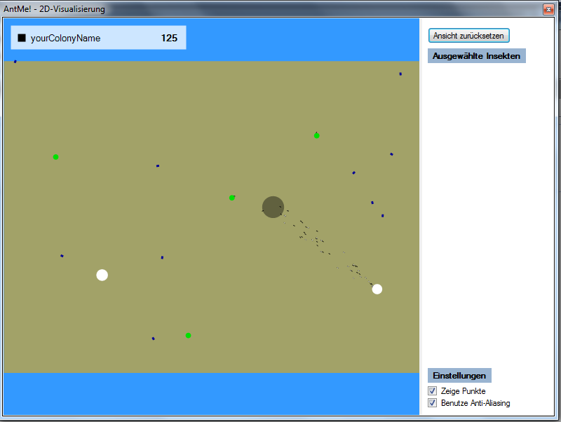
Your first ant street

Slide 42
Commands
Fields
int CurrentLoad()
int CurrentSpeed()
int CurrentEnergy()
int FriendlyAntsInViewrange()
int DistanceToAnthill()
int DistanceToTarget()
boolean IsTired() (returns true after the ant has covered one third of its range)
int Direction()
int WalkedRange()
Other
Coordinate.GetDistanceBetween(Item a, Item b)
ChooseType(Dictionary (string, int) count) – to determine the caste of a newly spawned ant
RandomNumber.Number(1,1000);
Turning:
TurnAround();
TurnByDegrees(int degrees);
TurnToDirection(int direction);
TurnToTarget(Item Target);
Moving
Stop();
GoAhead();
GoAhead(int steps)
GoToTarget(Item Target)
GoBackToAnthill()
Attack
Attack(Insect Target)
Carrying
Take(Food Food);
Drop()
Marking
MakeMark(int information, int range) – the larger the range, the shorter the mark exists

Slide 43
Castes
Skill range: -1 to 2.
Examples:
[Caste(Name = “Worker",
AttackModificator = -1,
EnergyModificator = 0,
LoadModificator = 2,
RangeModificator = 0,
RotationSpeedModificator = -1,
SpeedModificator = 1,
ViewRangeModificator = -1
)]
[Caste(Name = “Fighter",
AttackModificator = 2,
EnergyModificator = 1,
LoadModificator = -1,
RangeModificator = 0,
RotationSpeedModificator = -1,
SpeedModificator = 0,
ViewRangeModificator = -1
)]
public override string ChooseType(Dictionary<string, int> count)
{
if (count[“Fighter"] > 9 )
return “Worker";
else return “Fighter";
}

Slide 44
Further references
http://www.ningelgen.eu/05_Informatik/InformatikDateien/Kapitel%205_03%20ObjektorientierteAmeisen.pdf
http://de.wikipedia.org/wiki/AntMe!#Tutorials
A full command list is also on the course page

Slide 45
Take home
Decentral approach of multiagent systems increases reliability
Allows study of human/animal behaviour
Performance of multiagents for decentralized algorithms: Big expectations, limited results so far

