Slide 1
Distributed Systems 9. Network Layer in the Internet
Simon Razniewski
Faculty of Computer Science
Free University of Bozen-Bolzano
A.Y. 2016/2017

Slide 2
The Network Layer
Remember:
Responsible for delivering packets between endpoints over multiple links
(Link layer: single link Transport layer: Uses this service)
Application
Transport
Network
Link
Physical

Slide 3
Outline
IP Version 4
IP Addresses
IP Version 6
Internet Control Protocols
Label Switching and MPLS
OSPF—An Interior Gateway Routing Protocol
BGP—The Exterior Gateway Routing Protocol

Slide 4
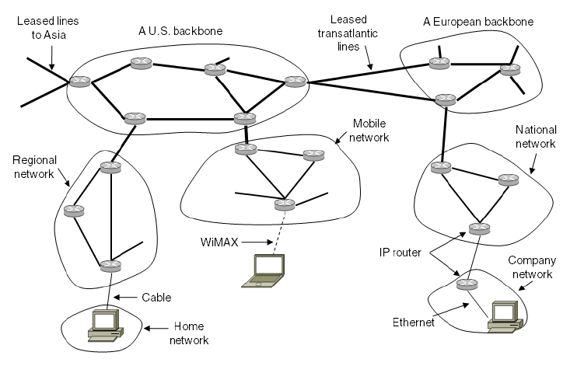
Network Layer in the Internet
Internet is an interconnected collection of many networks that is held together by the IP protocol

Slide 5
IP Version 4 Protocol (1)
IPv4 (Internet Protocol) header is carried on all packets and has fields for the key parts of the protocol:

Slide 6
Wireshark

Slide 7
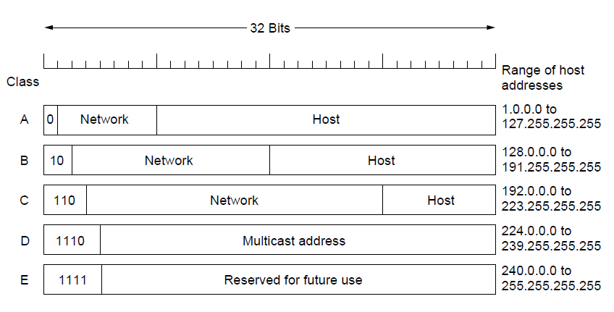
Hierarchical Routing – Classful Addresing
Old addresses came in blocks of fixed size (A, B, C)
Carries size as part of address, but lacks flexibility
Called classful (vs. classless) addressing
→ Router need only one entry per external subnet

Slide 8
IP Addresses (1) – Prefixes
Addresses are allocated in blocks called prefixes
Prefix is determined by the network portion
Written address/length, e.g., 18.0.31.0/24

Slide 9
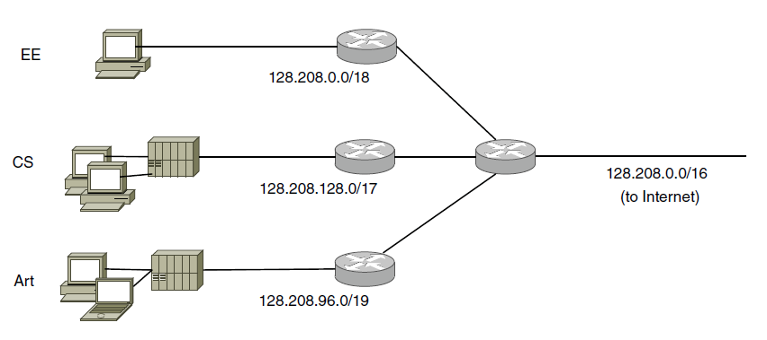
IP Addresses (2) – Subnets
Subnetting splits up IP prefix to help with management
Looks like a single prefix outside the network
ISP gives network
a single prefix
Network divides it into subnets internally

Slide 10
Your turn
Subnet A has address 141.89.228.0/26
How many addresses are in this subnet?
What is the lowest, what is the highest address in this subnet?
Computer B has the IPv4 address (including the subnet mask in CIDR notation) 141.89.228.65/26.
Computer C is reachable as 141.89.228.63/26.
Do they belong to the same subnet?

Slide 11
IP Version 6 (1)
Major upgrade in the 1990s due to impending address exhaustion, with various other goals:
Support billions of hosts
Simpler protocol
Better security
Attention to type of service
Allow future protocol evolution
Deployment has been slow & painful, but is expected to pick up pace
6/2016: All IPv4 spaces except Africa are exhausted (Source: http://www.networkcomputing.com/networking/ipv6-progress-report-going-mainstream/1699620417)
IPv6 Adoption: https://www.google.com/intl/en/ipv6/statistics.html
Machine check: http://test-ipv6.com/

Slide 12
How many addresses?
Three hundred and forty undecillion, two hundred and eighty-two decillion, three hundred and sixty-six nonillion, nine hundred and twenty octillion, nine hundred and thirty-eight septillion, four hundred and sixty-three sextillion, four hundred and sixty-three quintillion, three hundred and seventy-four quadrillion, six hundred and seven trillion, four hundred and thirty-one billion, seven hundred and sixty-eight million, two hundred and eleven thousand, four hundred and fifty-six.

Slide 13
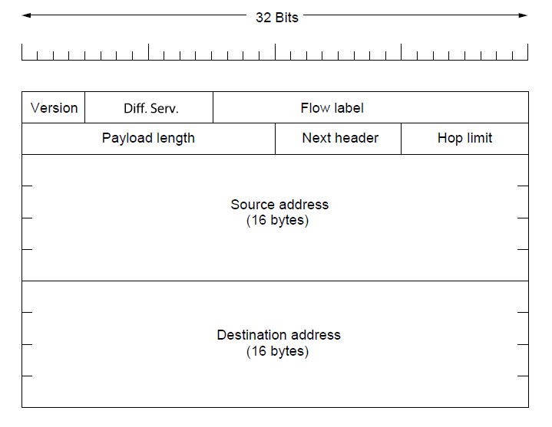
IP Version 6 (2 )
IPv6 protocol header has much longer addresses (128 vs. 32 bits) and is simpler (by using extension headers)
Extensions allow encryption, authentication, routing preferences, ….

Slide 14
Internet Control Protocols (1)
IP works with the help of several control protocols:
ICMP is a companion to IP that returns error info
Required, and used in many ways, e.g., for traceroute
ARP finds Ethernet address of a local IP address
Glue that is needed to send any IP packets
Host queries an address and the owner replies
DHCP assigns a local IP address to a host
Gets host started by automatically configuring it
Host sends request to server, which grants a lease

Slide 15
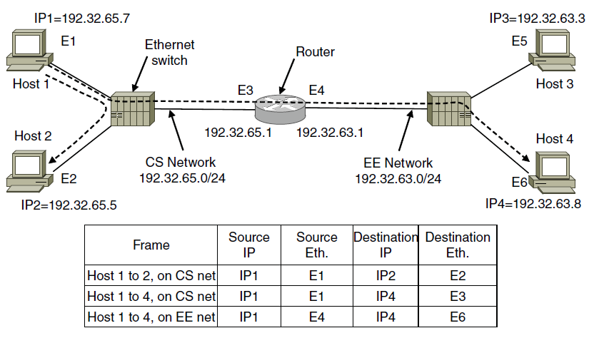
Internet Control Protocols (3)
ARP (Address Resolution Protocol) lets nodes find target Ethernet addresses [pink] from their IP addresses
Broadcast: “Who has IP X?”
Router takes all external addresses

Slide 16
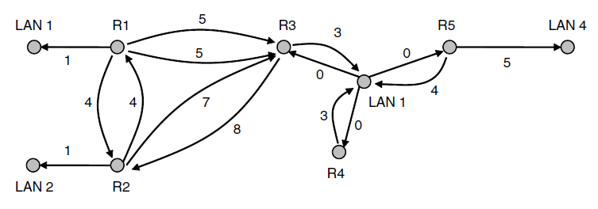
OSPF— Interior Routing Protocol
OSPF (Open Shortest Path First) computes routes for a single network (e.g., ISP)
Models network as a graph of weighted edges
Network:
Graph:
OSPF is link-state routing:
Uses messages below to reliably flood topology
Then runs Dijkstra to compute routes

Slide 17
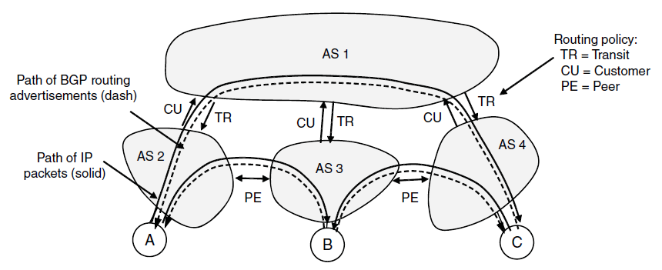
BGP— Exterior Routing Protocol (1)
BGP (Border Gateway Protocol) computes routes across interconnected, autonomous networks
Key role is to respect networks’ policy constraints
Example policy constraints:
No commercial traffic for educational network
Never put Iraq on route starting at Pentagon
Choose cheaper network
Choose better performing network

Slide 18
Learned today
Internet Protocol (IP)
Network address + host address
IPv4 vs IPv6
ARP for finding MAC addresses
Internet
OSPF inside a network
BGP between networks
IP Simulation: http://www.cs.stir.ac.uk/~kjt/software/comms/jasper/IP.html

