Slide 1
Distributed Systems 6. Medium Access Control Sublayer
Simon Razniewski
Faculty of Computer Science
Free University of Bozen-Bolzano
A.Y. 2016/2017

Slide 2
The MAC Sublayer
Responsible for deciding who sends next on a multi-access link
An important part of the link layer, especially for LANs
Application
Transport
Network
Link
Physical
MAC is in here!

Slide 3
Medium Access Control Sublayer
Channel Allocation Theory
Ethernet
Wireless Channel Allocation Theory
WiFi
Data Link Layer Switching

Slide 4
Medium Access Control Sublayer
Channel Allocation Theory
Ethernet
Wireless Channel Allocation Theory
WiFi
Data Link Layer Switching

Slide 5
Static Channel Allocation
For fixed channel and traffic from N users
Divide up bandwidth using FDM or TDM
Example: FM radio
Why not a good idea for LANs?

Slide 6
Multiple Access Protocols
Dynamic allocation gives the channel to a user when they need it. Potentially N times as efficient for N users.
Contention protocols
ALOHA
CSMA (Carrier Sense Multiple Access)
Collision-free protocols
Token ring
Bitmap
Limited-contention protocols
Adaptive treewalk
Wireless LAN protocols

Slide 7
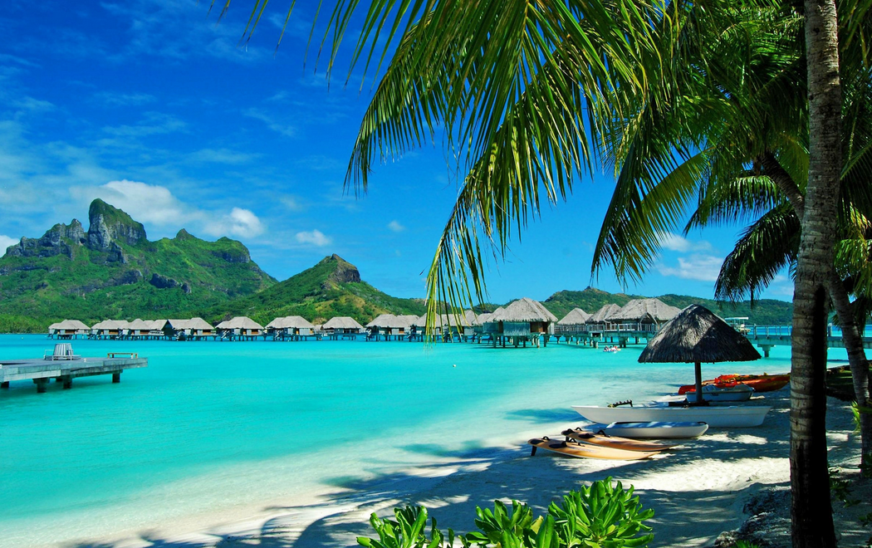
ALOHA

Slide 8
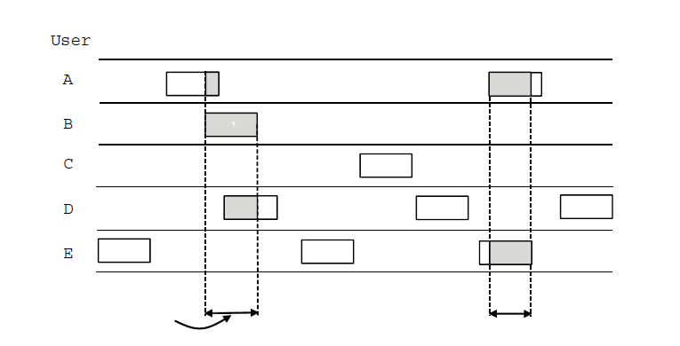
ALOHA (1)
In pure ALOHA, users transmit frames whenever they have data; users retry after a random time for collisions
Efficient and low-delay under low load
`
User
A
B
C
D
E
Collision
Collision
Time

Slide 9
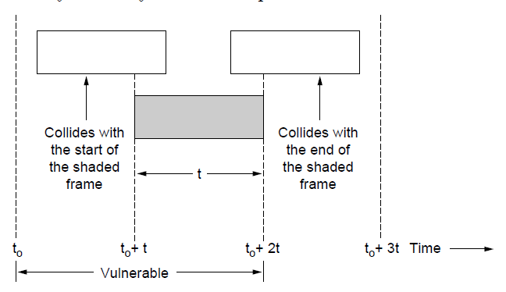
ALOHA (2)
Collisions happen when other users transmit during a vulnerable period that is twice the frame time
Synchronizing senders to slots can reduce collisions

Slide 10
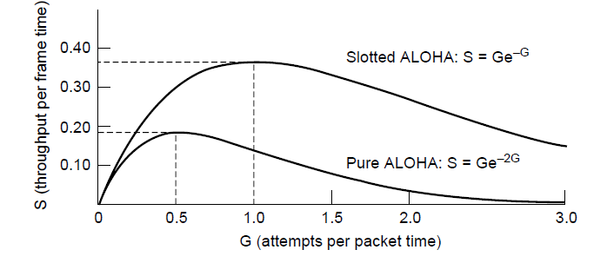
ALOHA (3)
Slotted ALOHA is twice as efficient as pure ALOHA
Low load wastes slots, high loads causes collisions
Efficiency up to 1/e (37%) for random traffic models

Slide 11
Carrier sensing multiple access (CSMA)
CSMA improves on ALOHA by sensing the channel
User doesn’t send if it senses someone else
Variations on what to do if the channel is busy:
1-persistent (greedy) sends as soon as idle
Nonpersistent waits a random time then tries again
p-persistent sends with probability p when idle (slotted)

Slide 12
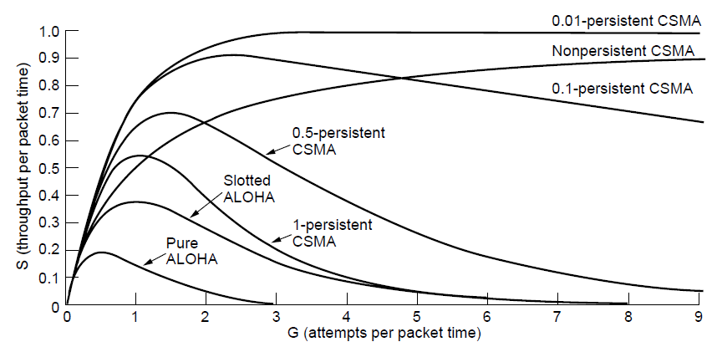
CSMA (2) – Persistence
CSMA outperforms ALOHA, and being less persistent is better under high load

Slide 13
CSMA (3) – Collision Detection
CSMA/CD improvement is to detect/abort collisions
Reduced contention times improve performance
Collision time is much shorter than frame time

Slide 14
CSMA/CD
http://scisweb.ulster.ac.uk/~kevin/com320/labs/Simulations/csmacd.swf

Slide 15
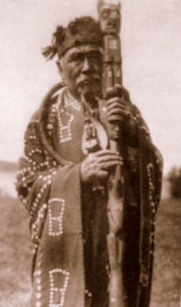
Collision-Free – Token Ring
A Kwakwaka'wakw man with a talking stick (Source: Wikipedia)

Slide 16
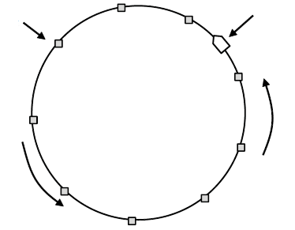
Collision-Free – Token Ring
Token sent round ring defines the sending order
Station with token may send a frame before passing
Idea can be used without ring too, e.g., token bus
Token
Station
Direction of
transmission

Slide 17
Collision-Free – Bitmap
Optimization to reduce impact of empty slots
The basic bit-map protocol:
Sender set a bit in contention slot if they have data
Senders send in turn; everyone knows who has data
Problems?

Slide 18
Contention vs. Contention-free protocols
10 participants: CSMA versus Token Ring
Ideal

Slide 19
Contention vs collision-free protocols
Contention protocols good for low load, but bad for high load.
Collision-free ones bad for low load, acceptable for high load
Still, if load is very high, static schemes may be better, due to unnecessary sending order resolution (if everybody wants to send anyway)
Can we combine contention and collision-free protocols?

Slide 20
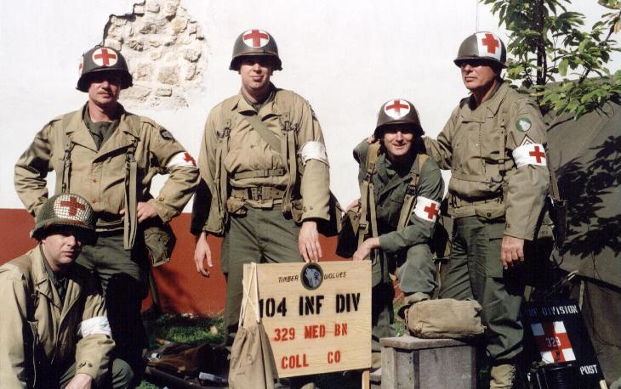
Blood samples from 1000 soldiers
One of them is sick.
Lab analysis of samples is expensive
How many samples need to be checked to find the sick soldier?

Slide 21
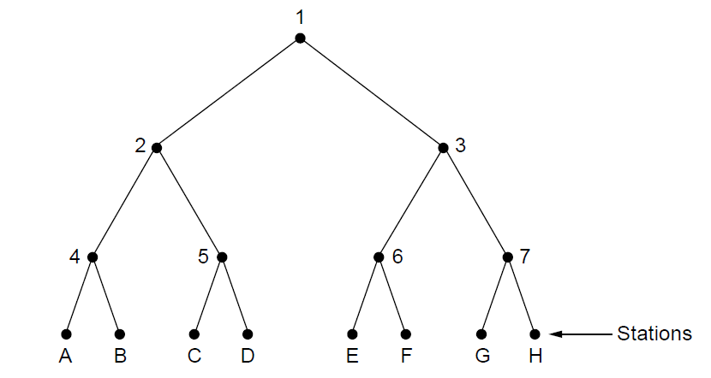
Limited Contention – Adaptive Tree Walk
Tree divides stations into groups (nodes) to poll
Depth first search under nodes with poll collisions
Start search at lower levels if >1 station expected
Level 0
What happens when A, C and G want to send?
Level 1
Level 2

Slide 22
Your turn
16 stations, of which all prime numbers want to send.
What happens on the channel?

Slide 23
Medium Access Control Sublayer
Channel Allocation Theory
Ethernet
Wireless Channel Allocation Theory
WiFi
Data Link Layer Switching

Slide 24
MAC-Adresses
Typically hardcoded by the manufacturer
Ipconfig /all
IEEE manages three spaces: MAC-48, EUI-48, and EUI-64
Great for spying

Slide 25
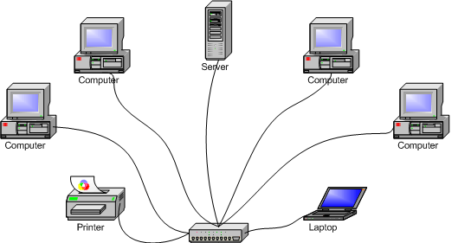
Ethernet (1) – Physical Layer
One shared cable to which all hosts attached
10 Mbps: Manchester encoding
100 Mbps: 4B/5B encoding
1000 Mbps: 8B/10B encoding
Hosts run the classic Ethernet CSMA/CD protocol for access
Hub

Slide 26
Ethernet (2) – MAC
MAC protocol waits randomly longer in case of repeated collisions
Random delay (backoff) after collision is computed with BEB (Binary Exponential Backoff)
→ After first collision, wait between 0 and 1 time units, after second, between 0 and 3, after third, between 0 and 7, …
IEEE 802.3
Problem: Frame length – bandwidth – round-trip-time tradeoff

Slide 27
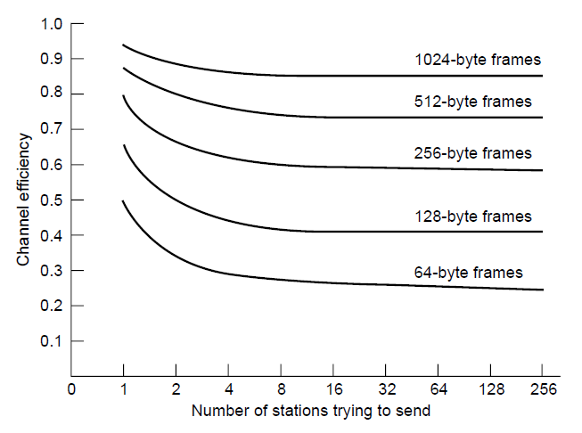
Ethernet (4) – Performance
Efficient for large frames, even with many senders
Degrades for small frames (and long LANs)
10 Mbps Ethernet,
64 byte min. frame

Slide 28
Medium Access Control Sublayer
Channel Allocation Theory
Ethernet
Wireless Channel Allocation
WiFi
Data Link Layer Switching

Slide 29
Wireless LAN Protocols (1)
Wireless has complications compared to wired.
Nodes may have different coverage regions
Leads to problems with hidden and exposed terminals
Nodes can’t detect all collisions, i.e., sense while sending
Makes collisions expensive and to be avoided

Slide 30
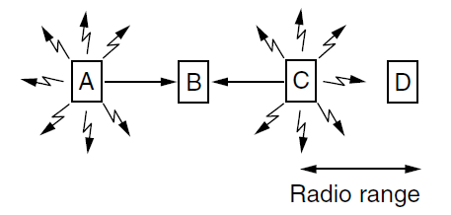
Wireless LANs (2) – Hidden terminals
Hidden terminals are senders that cannot sense each other but nonetheless collide at intended receiver
Want to prevent; loss of efficiency
A and C are hidden terminals when sending to B

Slide 31
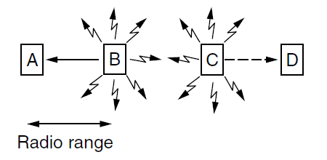
Wireless LANs (3) – Exposed terminals
Exposed terminals are senders who can sense each other but still transmit safely (to different receivers)
Desirably concurrency; improves performance
B → A and C → D are exposed terminals

Slide 32
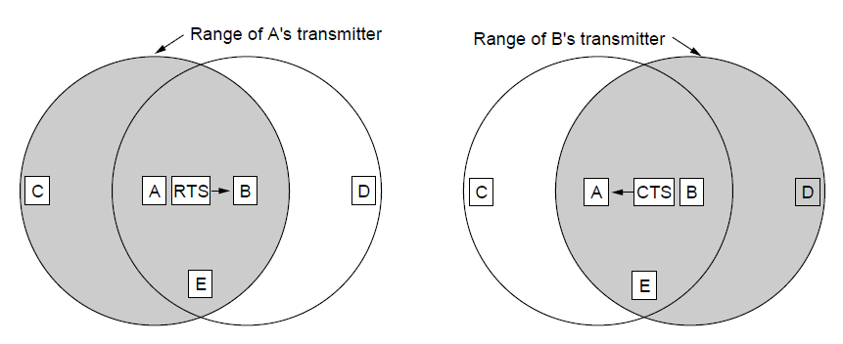
Wireless LANs (4) – MACA
MACA protocol grants access for A to send to B:
A sends RTS to B [left]; B replies with CTS [right]
A can send with exposed but no hidden terminals
A sends RTS to B; C and E hear and defer for CTS
B replies with CTS; D and E hear and defer for data

Slide 33
Medium Access Control Sublayer
Channel Allocation Theory
Ethernet
Wireless Channel Allocation Theory
WiFi
Data Link Layer Switching

Slide 34
802.11 physical layer
NICs are compatible with multiple physical layers
E.g., 802.11 a/b/g
Name | Technique | Max. Bit Rate
802.11b | Spread spectrum, 2.4 GHz | 11 Mbps
802.11g | OFDM, 2.4 GHz | 54 Mbps
802.11a | OFDM, 5 GHz | 54 Mbps
802.11n | OFDM with MIMO, 2.4/5 GHz | 600 Mbps

Slide 35
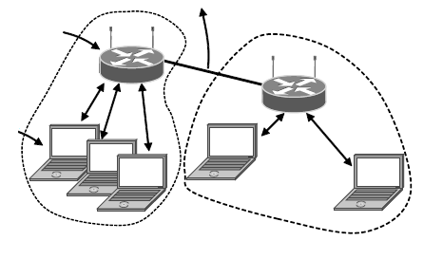
802.11 Architecture
Wireless clients associate to a wired AP (Access Point)
Called infrastructure mode; there is also ad-hoc mode with no AP, but that is rare.
To Network
Access Point
Client

Slide 36
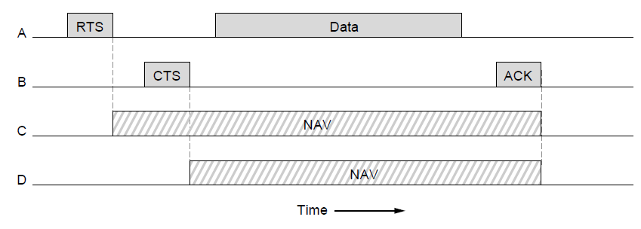
802.11 MAC
Base station mode: Base station pulls, no collisions
Ad-hoc mode: CSMA/CD with RTS/CTS
NAV = channel not available

Slide 37
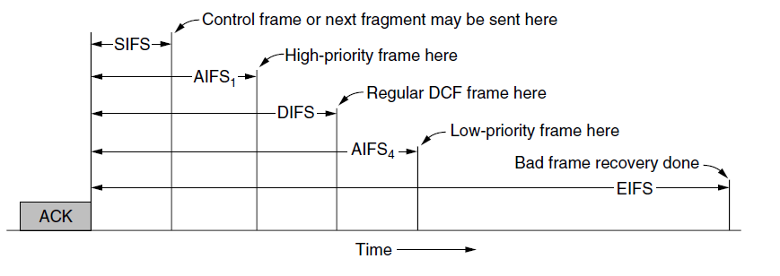
802.11 MAC (2)
Different backoff slot times add quality of service
Short intervals give preferred access, e.g., control, VoIP

Slide 38
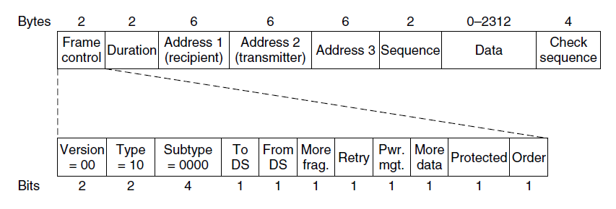
802.11 Frames
Frames vary depending on their type (Frame control)
Data frames have 3 addresses to pass via APs

Slide 39
Medium Access Control Sublayer
Channel Allocation Theory
Ethernet
Wireless Channel Allocation
WiFi
Data Link Layer Switching

Slide 40
Data Link Layer Switching
How to set up Ethernets?
Hubs
Switches
Routers (are part of the Network layer)

Slide 41
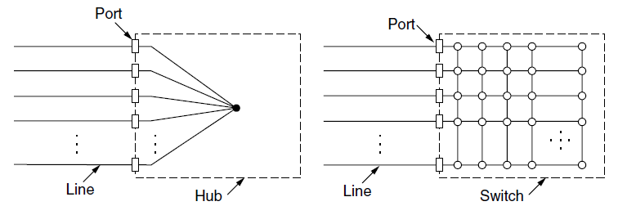
Switched/Fast Ethernet (1)
Hubs wire all lines into a single CSMA/CD domain
Switches isolate each port to a separate domain
Much greater throughput for multiple ports
No need for CSMA/CD with full-duplex lines

Slide 42
Learning Switches (2)
Backward learning algorithm picks the output port:
Associates source address on frame with input port
Frame with destination address sent to learned port
Unlearned destinations are sent to all other ports
Needs no configuration
Forget unused addresses to allow changes

Slide 43
Learned today
Protocols for multiple access
Contention protocols: ALOHA, CSMA/CD
Contention-free protocols: Token ring, Bitmap
Mixed protocols: Adaptive tree walk
Practically used
Ethernet/WiFi: CSMA/CD with random exponential backoff
Link Layer switching:
Hubs vs. Switches
Next: Network Layer

