Slide 1
Distributed Systems 13. Security
Simon Razniewski
Faculty of Computer Science
Free University of Bozen-Bolzano
A.Y. 2014/2015

Slide 2
Outline
Symmetric methods
One-time-pads
Asymmetric methods
RSA
Example protocols/methods
PGP
TLS (former SSL)
Man-in-the-middle and the importance of certificates
Encryption in Java
VPN

Slide 3
Network Security
Security concerns a variety of threats and defenses across all layers
Encryption is an important building block of secure networking
Best security is avoidance ☺
Application
Transport
Network
Link
Physical

Slide 4
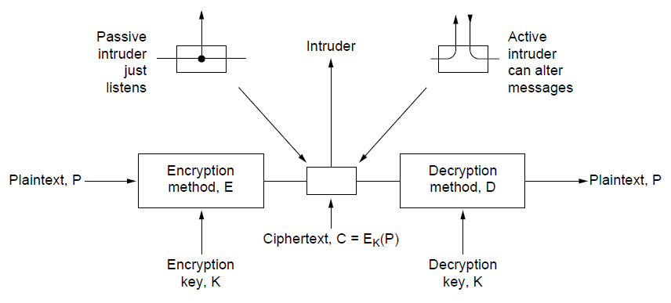
Encryption: General model
The encryption model
Kerckhoff’s principle: Algorithms (E, D) are public; only the keys (K, K’) are secret
Symmetric methods: K=K’
Trudy
Alice
Bob
‘

Slide 5
Terminology
Plain text
Cipher text
Cipher: Algorithm for encryption and decryption
Encryption: Plain text → Cipher text
Decryption: Cipher text →Plain text
Key: Parameter for cipher
Symmetric key ciphers: Same key used for encryption and decryption
Asymmetric key ciphers: Keys used for encryption and decryption are different

Slide 6
Fundamental Cryptographic Principles
Messages must contain some redundancy
All encrypted messages decrypt to something
Redundancy lets receiver recognize a valid message
But redundancy helps attackers break the design
Some method is needed to foil replay attacks
Without a way to check if messages are fresh then old messages can be copied and resent
For example, add a date stamp to messages

Slide 7
Symmetric-Key Algorithms
Encryption and decryption key are the same

Slide 8
Substitution Ciphers
Substitution ciphers replace each group of letters in the message with another group of letters to disguise it
Simple single-letter substitution cipher

Slide 9
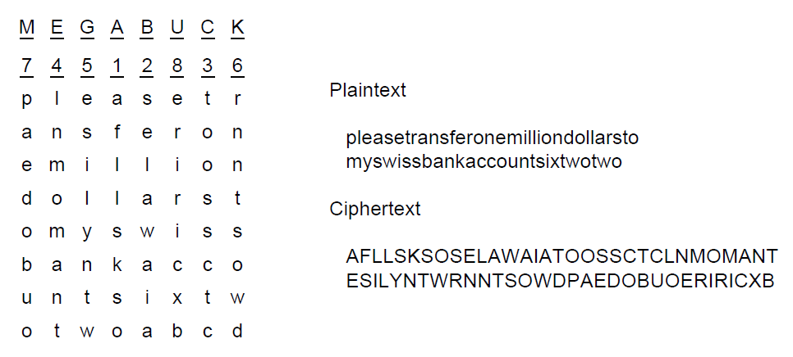
Transposition Ciphers
Transposition ciphers reorder letters to disguise them
Key gives column order
Column 5
6
7
8
Simple column transposition cipher

Slide 10
One-Time Pads
Simple scheme for perfect secrecy:
XOR message with secret pad to encrypt, decrypt
Pad is as long as the message and can’t be reused!
It is a “one-time” pad to guarantee secrecy
Different secret pad decrypts to the wrong plaintext
→For guaranteed security:
1) Create offline a large random file
2) Transmit it offline to your friends
3) Use it for your communication

Slide 11
Building blocks of state-of-the art ciphers
Block ciphers operate a block at a time
Product cipher combines transpositions/substitutions
Permutation
(transposition)
box
Substitution
box
Product with multiple P- and S-boxes

Slide 12
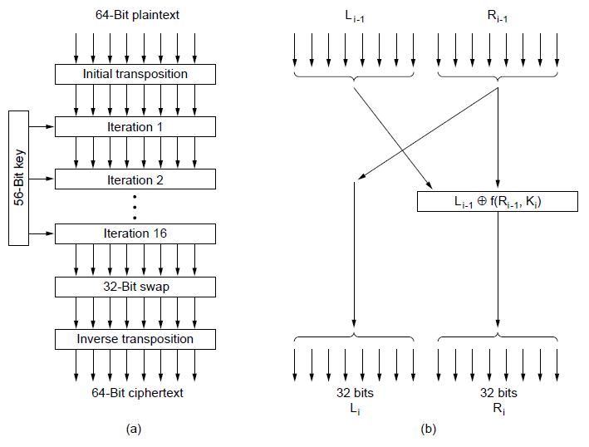
Data Encryption Standard (1)
DES encryption was widely used (but no longer secure)
Contains
transpositions & substitutions
DES steps
A single iteration

Slide 13
Advanced Encryption Standard (1)
AES is the successor to DES:
Symmetric block cipher, key lengths up to 256 bits
Openly designed by public competition (1997-2000)
Available for use by everyone
Built as software (e.g., C) or hardware (e.g., x86)
Winner was Rijndael cipher
Now a widely used standard

Slide 14
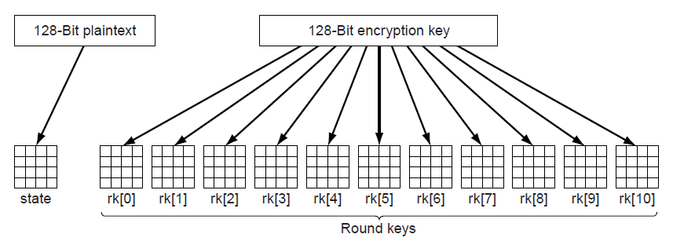
Advanced Encryption Standard (2)
AES uses 10 rounds for 128-bit block and 128-bit key
Each round uses a key derived from 128-bit key
Each round has a mix of substitutions and rotations
All steps are reversible to allow for decryption
Round keys are derived from 128-bit secret key

Slide 15
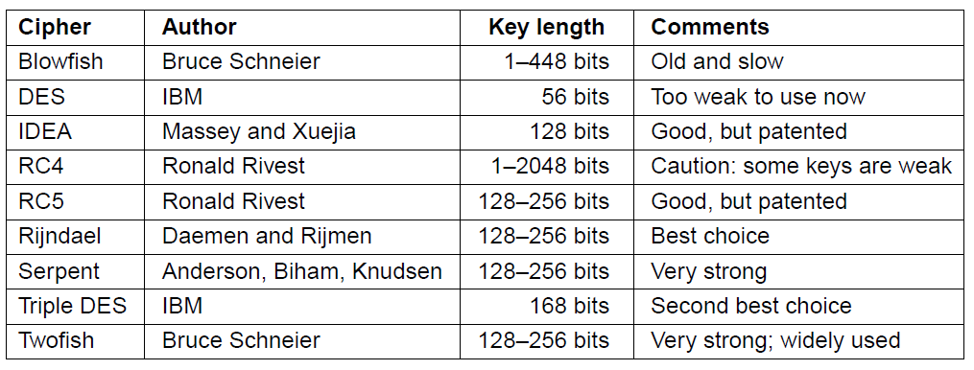
Other Ciphers
Some common symmetric-key cryptographic algorithms
Can be used in combination, e.g., AES over Twofish

Slide 16
Asymmetric Techniques
Keys for encryption and decryption are different
→ Solves the key-setup problem of symmetric methods!
RSA (by Rivest, Shamir, Adleman – 1977)
equivalent technique four years earlier at GCHQ
..next assignment

Slide 17
Asymmetric Techniques (2)
Downsides of keys for symmetric-key designs:
Key must be secret, yet be distributed to both parties
For N users there are N² pairwise keys to manage
Asymmetric algorithms split the key into public and private parts that are mathematically related:
Private part is not distributed; easy to keep secret
Only one public key per user needs to be managed
Security depends on the chosen mathematical property
Much slower than symmetric-key, e.g., 1000X
So used to set up per-session symmetric keys

Slide 18
RSA
RSA is a widely used public-key encryption method whose security is based on the difficulty of factoring large numbers
Key generation:
Choose two large primes, p and q
Compute n = p × q and z = ( p − 1) × (q − 1).
Choose d to be relatively prime to z
Find e such that (e × d) mod z = 1
Public key is (e, n), and private key is (d, n)
Encryption (of k bit message, for numbers up to n):
Cipher = Plain^{e} (mod n)
Decryption:
Plain = Cipher^{d} (mod n)

Slide 19
RSA in Java
see Eclipse…

Slide 20
Create Keys
KeyPairGenerator keyGen = KeyPairGenerator.getInstance("RSA");
keyGen.initialize(1024);
KeyPair key = keyGen.generateKeyPair();
File privateKeyFile = new File(PRIVATE_KEY_FILE);
File publicKeyFile = new File(PUBLIC_KEY_FILE);
privateKeyFile.createNewFile();
publicKeyFile.createNewFile();
// Saving the Public key in a file
ObjectOutputStream publicKeyOS = new ObjectOutputStream(
new FileOutputStream(publicKeyFile));
publicKeyOS.writeObject(key.getPublic());
publicKeyOS.close();
// Saving the Private key in a file
ObjectOutputStream privateKeyOS = new ObjectOutputStream(
new FileOutputStream(privateKeyFile));
privateKeyOS.writeObject(key.getPrivate());
privateKeyOS.close();

Slide 21
Encrypt
public static byte[] encrypt(String text, PublicKey key) throws NoSuchAlgorithmException, NoSuchPaddingException, InvalidKeyException, IllegalBlockSizeException, BadPaddingException
{
byte[] cipherText = null;
// get an RSA cipher object and print the provider
final Cipher cipher = Cipher.getInstance("RSA");
// encrypt the plain text using the public key
cipher.init(Cipher.ENCRYPT_MODE, key);
cipherText = cipher.doFinal(text.getBytes());
return cipherText;
}

Slide 22
Decrypt
public static String decrypt(byte[] text, PrivateKey key) throws NoSuchAlgorithmException, NoSuchPaddingException, InvalidKeyException, IllegalBlockSizeException, BadPaddingException
{
byte[] decryptedText = null;
// get an RSA cipher object and print the provider
final Cipher cipher = Cipher.getInstance("RSA");
// decrypt the text using the private key
cipher.init(Cipher.DECRYPT_MODE, key);
decryptedText = cipher.doFinal(text);
return new String(decryptedText);
}

Slide 23
Print Keys in Human-readable Form
private static void printKeys(PrivateKey privateKey, PublicKey publicKey) throws InvalidKeySpecException, NoSuchAlgorithmException
{
KeyFactory fact = KeyFactory.getInstance("RSA");
RSAPublicKeySpec pub = fact.getKeySpec(publicKey,
RSAPublicKeySpec.class);
RSAPrivateKeySpec priv = fact.getKeySpec(privateKey,
RSAPrivateKeySpec.class);
System.out.println("Printing keys...");
System.out.println(" Public exponent: " + pub.getPublicExponent().toString());
System.out.println(" Public modulus: " + pub.getModulus().toString());
System.out.println(" Private exponent: " + priv.getPrivateExponent().toString());
System.out.println(" Private modulus: " + priv.getModulus().toString());
}

Slide 24
code also on the course webpage..

Slide 25
Further References
http://www.javamex.com/tutorials/cryptography/rsa_encryption_2.shtml
https://javadigest.wordpress.com/2012/08/26/rsa-encryption-example/
(http://www.java2s.com/Tutorial/Java/0490__Security/BasicRSAexample.htm)

Slide 26
Safety?
Factorize n
Factorization: No efficient algorithm known to date
Largest factorized difficult number so far: 768 bits (RSA768), required utilizing hundreds of machines over a span of two years.
300 bit numbers can be factorized on standard laptops in hours!
However, no proof for the nonexistence of efficient algorithms known
Does the NSA already have such an algorithm?
Quantum computers allow polynomial factorization
….???
Strong random number generators needed

Slide 27
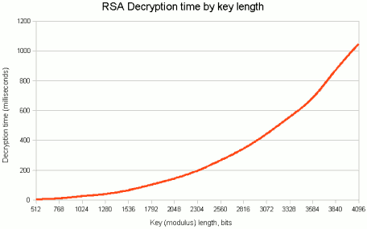
(Decryption with known key, not code breaking!)
Recommended key length: 2048 bits

Slide 28
Acoustic Attack
https://www.youtube.com/watch?v=DU-HruI7Q30

Slide 29
Digital Signatures
Allow verification of messages
What does that mean?
Receiver can verify claimed identity of sender.
Sender cannot later repudiate contents of message.
Receiver cannot have modified message himself.

Slide 30
Public-Key Signatures
Assumes encryption and decryption are inverses that can be applied in either order
Relies on private key kept and secret
RSA & DSS (Digital Signature Standard) widely used

Slide 31
Public Key Signatures - Requirements?
Receiver can verify claimed identity of sender?
Sender cannot later repudiate contents of message?
Receiver cannot have modified message himself?

Slide 32
Common approach: Message Digests
Message Digest (MD) converts arbitrary-size message (P) into a fixed-size identifier MD(P) with properties:
Given P, easy to compute MD(P).
Given MD(P), effectively impossible to find P.
Given P no one can find P′ so that MD(P′) = MD(P).
Changing 1 bit of P produces very different MD.
Advantage: Faster
Message digests (also called cryptographic hash) can “stand for” messages in protocols, e.g., authentication
Example: SHA-1 160-bit hash, widely used
Example: MD5 128-bit hash – now known broken
…remember MD5 password hashes?

Slide 33
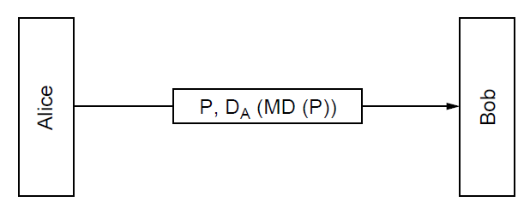
Message Digests (2)
Public-key signature for message authenticity but not confidentiality with a message digest
Message sent in the clear
Alice signs
message digest

Slide 34
Message Digests (3)
In more detail: example of using SHA-1 message digest and RSA public key for signing nonsecret messages

Slide 35
Management of Public Keys (1)
Is RSA safe?
What if public keys are forged?
Trudy replaces E_{B} with E_{T} and acts as a “(wo)man in the middle”
Alice thinks she is encrypting messages with Bob’s public key
But it is Trudy’s public key
Trudy then encrypts the messages with Bob’s public key
→Bob does not notice

Slide 36
Management of Public Keys
We need a trusted way to distribute public keys
Certificates
Public Key infrastructures

Slide 37
Certificates
CA (Certification Authority) issues signed statements about public keys; users trust CA and it can be offline
- need to trust public key of CA
A possible certificate

Slide 38
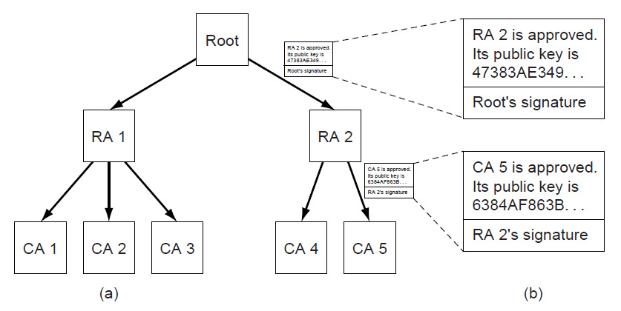
Public Key Infrastructures (PKIs)
PKI is a system for managing public keys using CAs
Scales with hierarchy, may have multiple roots
Also need CRLs (Certificate Revocation Lists)
Trust anchor
Chain of certificates for CA 5
Hierarchical PKI

Slide 39
Root Certificate Agencies
Rank | Issuer | market share
1. | Comodo | 33.6%
2. | Symantec Group | 33.2%
3. | Go Daddy Group | 13.2%
4. | GlobalSign | 11.3%
5. | DigiCert | 2.9%

Slide 40
→ Firefox
see also https://wiki.mozilla.org/CA:IncludedCAs

Slide 41
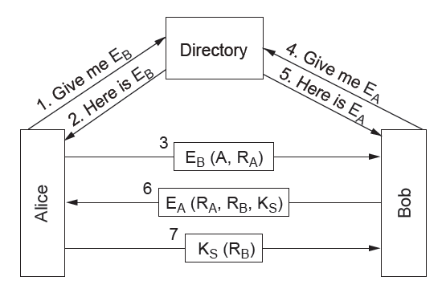
Public-Key Cryptography
Mutual authentication using public-key cryptography
Alice and Bob get each other’s public keys (E_{A}, E_{B}) from a trusted directory; shared K_{S} is the result

Slide 42
Kerberos
https://www.youtube.com/watch?v=kp5d8Yv3-0c
Default for windows domains

Slide 43
Email Security
Use of security for authenticated, confidential email
PGP—Pretty Good Privacy

Slide 44
PGP—Pretty Good Privacy (1)
PGP uses public- and symmetric-key cryptography for email secrecy and signatures; it also manages keys
Levels of public-key strengths:
Casual (384 bits):
Can be broken easily today.
Commercial (512 bits):
Breakable by three-letter organizations.
Military (1024 bits):
Not breakable by anyone on earth.
Alien (2048 bits):
Unbreakable by anyone on other planets

Slide 45
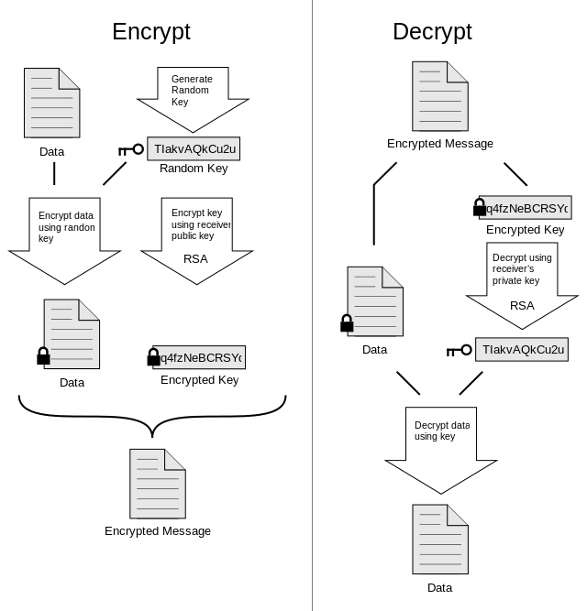
PGP

Slide 46
Web Security
Applications of security to the Internet
Secure naming
SSL—Secure Sockets Layer
IPSec
Many other issues with downloaded code

Slide 47
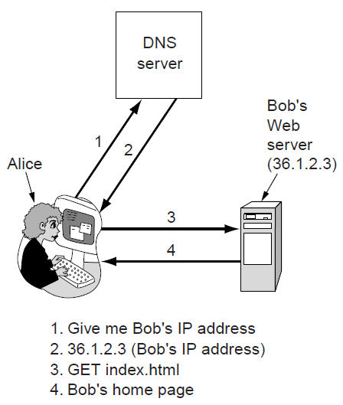
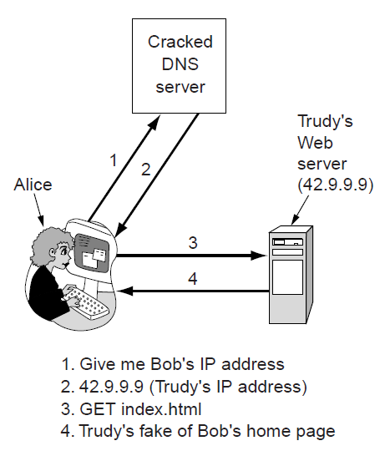
Secure Naming (1)
DNS names are included as part of URLs – so spoofing DNS resolution causes Alice contact Trudy not Bob (reason: DNS over UDP!)
Trudy sends spoofed reply

Slide 48
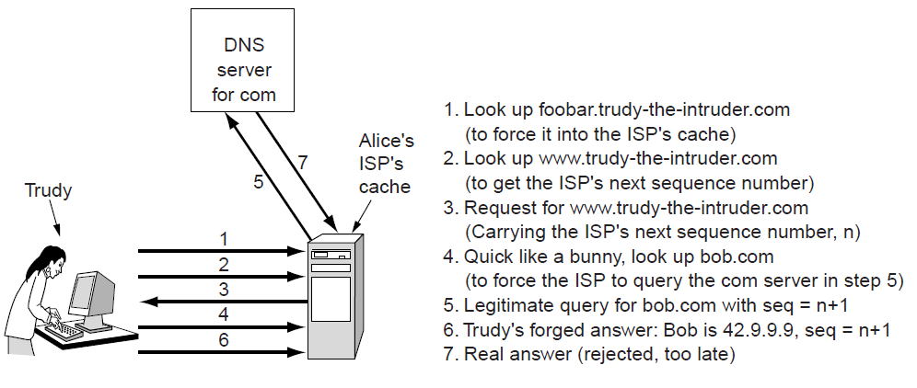
Secure Naming (2)
How Trudy spoofs the DNS for bob.com in more detail
To counter, DNS servers randomize seq. numbers
DNS cache at Alice’s ISP

Slide 49
Secure Naming (3)
DNSsec (DNS security) adds strong authenticity to DNS
Responses are signed with private keys
Public keys are included; client starts with top-level
Deployment slow
For current status, see e.g. http://en.wikipedia.org/wiki/List_of_Internet_top-level_domains
Resource Record set for bob.com.
Has Bob’s public key (KEY), and is signed by .com server (SIG)
=> Allows to verify whether answers to DNS lookups at bob.com are really from Bob

Slide 50
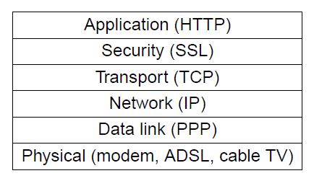
SSL—Secure Sockets Layer (1)
SSL provides an authenticated, secret connection between two sockets; uses public keys with X.509
TLS (Transport Layer Security) is the IETF version of Netscape’s SSL
SSL runs on top of TCP and below
the application
HTTPS means
HTTP over SSL
SSL in the protocol stack

Slide 51
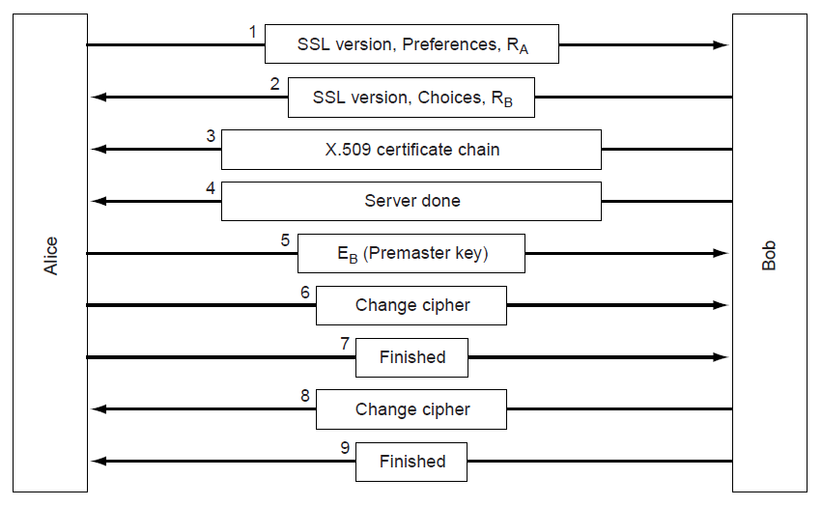
SSL—Secure Sockets Layer (2)
Phases in SSL V3 connection establishment (simplified)
Only the client (Alice) authenticates the server (Bob)
Session key computed on both sides (E_{B}, R_{A}, R_{B})

Slide 52
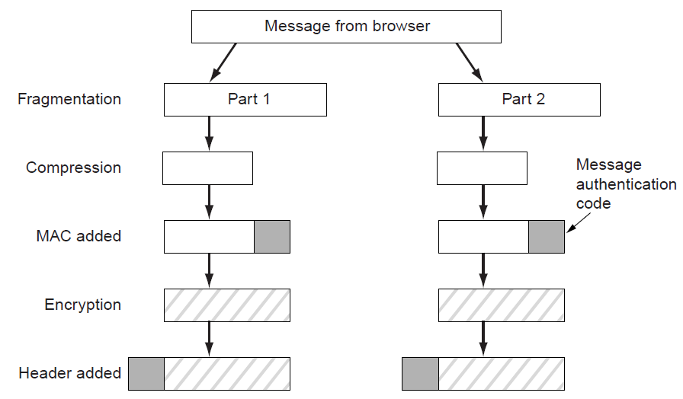
SSL—Secure Sockets Layer (3)
Data transmission using SSL. Authentication and encryption for a connection use the session key.
(hash)

Slide 53
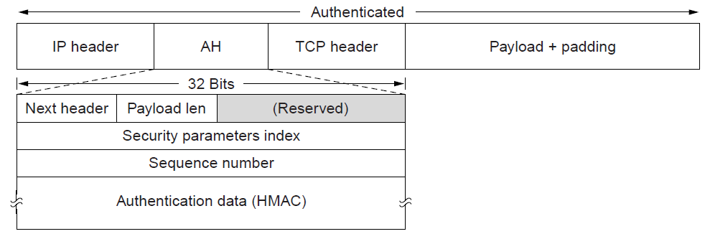
IPsec (1)
IPsec adds confidentiality and authentication to IP
Secret keys are set up for packets between endpoints called security associations
Adds AH header; inserted after IP in transport mode
Identifies security association
AH (Authentication Header) provides integrity and anti-replay

Slide 54
IPsec (2)
ESP (Encapsulating Security Payload) provides secrecy and integrity; expands on AH
Adds ESP header and trailer; inserted after IP header in transport or before in tunnel mode
Transport mode
Tunnel mode
Whole IP packet is wrapped

Slide 55
Private Networks
Quite secure
attacks require physical tapping
expensive
Virtual private networks (VPNs) allow private networks over public networks
Ease of use of the network
Only VPN needs to be secured, instead of each internal application individually

Slide 56
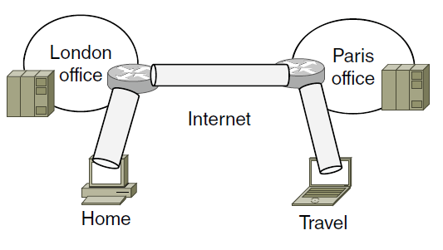
Virtual Private Networks (1)
VPNs (Virtual Private Networks) join disconnected islands of a logical network into a single virtual network
Islands are joined by tunnels over the Internet
Tunnel
VPN joining London, Paris, Home, and Travel

Slide 57
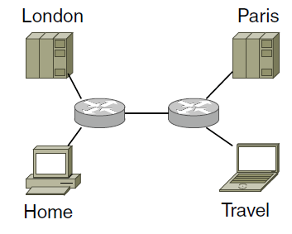
Virtual Private Networks (2)
VPN traffic travels over the Internet but VPN hosts are separated from the Internet
Need a gateway to send traffic in/out of VPN
Topology as seen from inside the VPN

Slide 58
Tunneling
Can happen at different layers/using different technology
IPSec
Network Layer
setting done (in principle) in network adapter settings
VPN Clients
Link Layer
commonly setup using virtual network adapters that use SSL
Common solution for individuals (e.g. Cisco AnyConnect, OpenVPN)
Router-to-router
Tunneling becomes transparent to connected devices
Common solution for connecting offices

Slide 59
Only a glimpse
Other relevant topics
Denial of service attacks
Traffic analysis
Social issues
Privacy
Freedom of speech
TOR network

Slide 60
Take home
Symmetric vs. asymmetric encryption
former is faster
latter solves the problem of key exchange
Remaining problem: Where to get public keys from
Solution: Certificates
How RSA works
RSA in Java
VPN

