Slide 1
Distributed Systems 14. Application Layer
Simon Razniewski
Faculty of Computer Science
Free University of Bozen-Bolzano
A.Y. 2016/2017

Slide 2
The Application Layer
Which services from the transport layer does it use?
Which services does it provide?
Application
Transport
Network
Link
Physical

Slide 3
Which transport protocol?
Choose one:
Reliable transmission: All packages will eventually arrive
Timing: Packages arrive as fast as possible

Slide 4
Which transport protocol (2)
Application | A-Protocol | T-Protocol | Why?
File transfer | FTP | TCP | Require reliable data transfer services
E-mail | SMTP | TCP
Web | HTTP | TCP
Remote terminal access | SSH/Telnet | TCP
Streaming multimedia | Proprietary | UDP or TCP | Speed more important
Internet telephony | Proprietary | UDP
Online games | Proprietary | UDP | Speed more important
Network management | SNMP | UDP | Minimally intrusive
Name services | DNS | UDP | Speed more important
http://gamedev.stackexchange.com/questions/431/is-the-tcp-protocol-good-enough-for-real-time-multiplayer-games

Slide 5
Application Layer
DNS – Domain Name System
Email
The Web
Net neutrality

Slide 6
Domain Name System
The DNS resolves high-level human readable names for computers to low-level IP addresses
Design dates back to 1983 (RFC 882/883 Paul Mockapetris, USC)
Before all host names and addresses were in one large master file stored on one central host downloaded by computers that needed to resolve names
Problems?

Slide 7
Domain Name System (2)
Can also be seen as a distributed database
Rapidly resolves domain names to IP addresses
exploits caching heavily
typical query time ~100 milliseconds
Scales to millions of computers
partitioned database
caching
Resilient to failure of a server
replication (e.g., 13 root servers, 6 servers for .it, etc.)

Slide 8
Access to DNS
Host/dig (linux)
command for name resolution and reverse resolution
nslookup (windows)
command/tool to query DNS servers for arbitrary info
/etc/resolv.conf (linux)
file containing IP address of default name server
Java
InetAddress.getByName(..)
Java Naming and Directory Interface (JNDI) for further queries
https://blog.thesysadmins.co.uk/nslookup-common-usage-examples.html

Slide 9
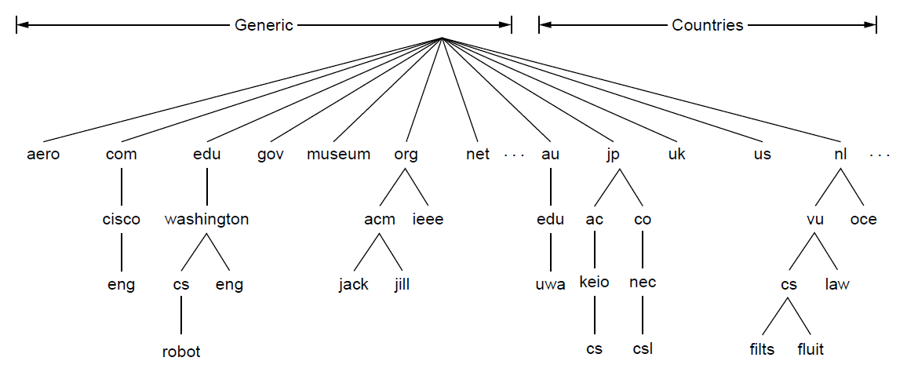
The DNS Name Space (1)
DNS namespace is hierarchical from the root down
Different parts delegated to different organizations
The computer robot.cs.washington.edu

Slide 10
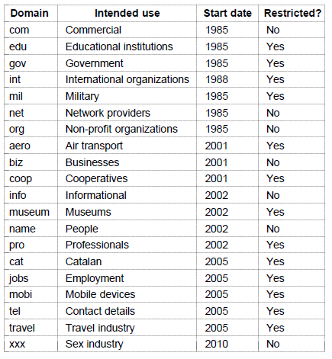
The DNS Name Space (2)
Generic top-level domains are controlled by ICANN who appoints registrars to run them

Slide 11
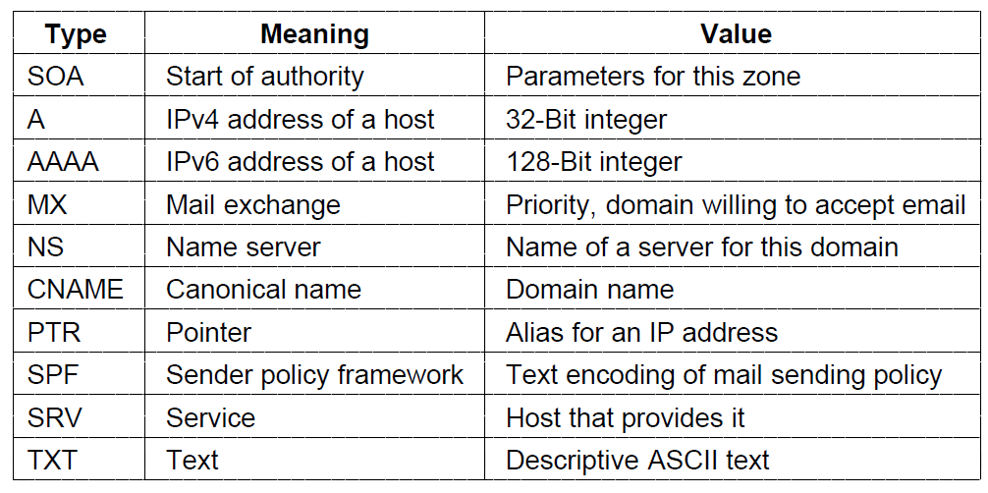
DNS Records
The key resource records in the namespace are IP addresses (A/AAAA) and name servers (NS), but there are others too (e.g., MX)

Slide 12
nslookup unibz.it
nslookup -type=mx unibz.it

Slide 13
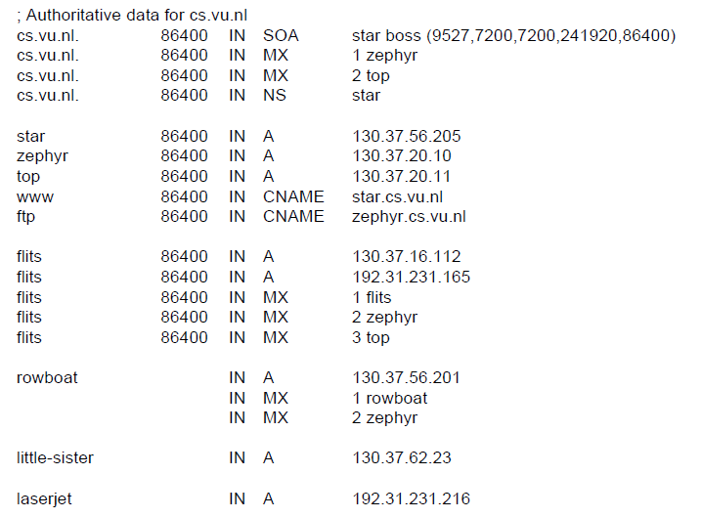
DNS Records (2)
Name server
IP addresses of computers
Mail gateways
A portion of a possible DNS database for cs.vu.nl.

Slide 14
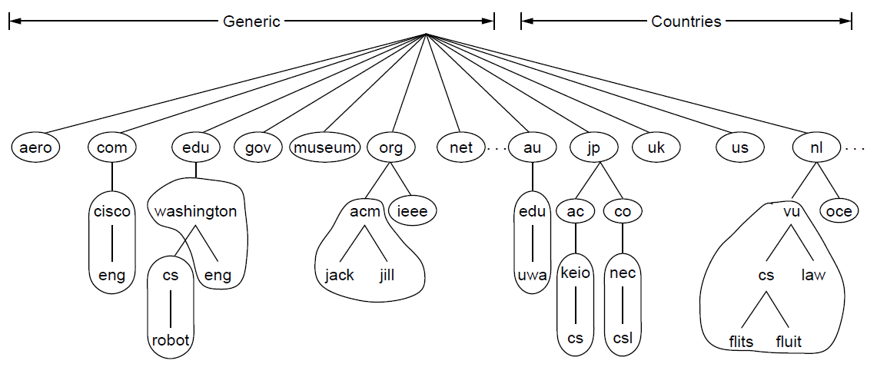
Name Servers
Name servers contain data for portions of the name space called zones (circled).
One zone

Slide 15
Wireshark
…

Slide 16
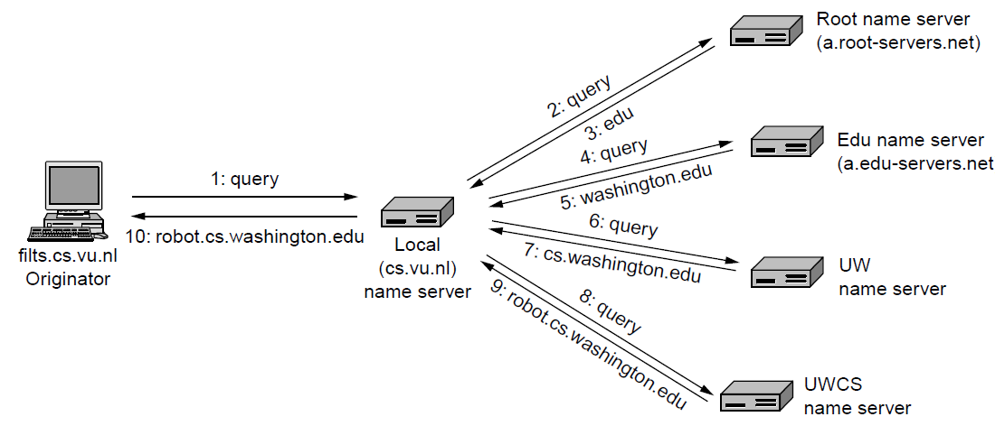
Name resolution algorithm
DNS protocol:
Runs on UDP port 53, retransmits lost messages
Caches name server answers for better performance
Lookup algorithm:

Slide 17
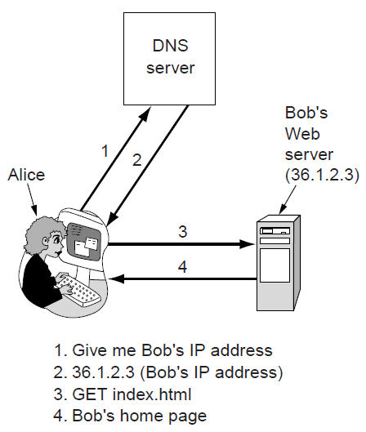
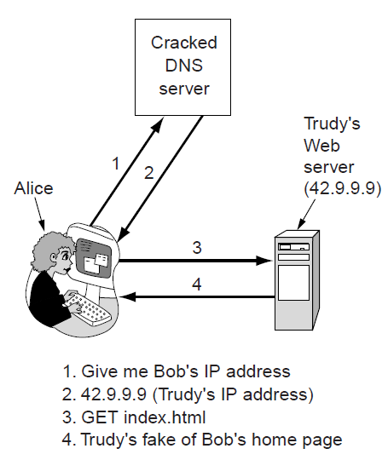
Phishing
DNS names are included as part of URLs – so spoofing DNS resolution causes Alice contact Trudy not Bob
Trudy sends spoofed reply
DNSsec (DNS security) adds security using public-private-cryptography
Deployment slow
For current status, see e.g. http://en.wikipedia.org/wiki/List_of_Internet_top-level_domains

Slide 18
Application Layer
DNS – Domain Name System
Email
The Web
Net neutrality

Slide 19
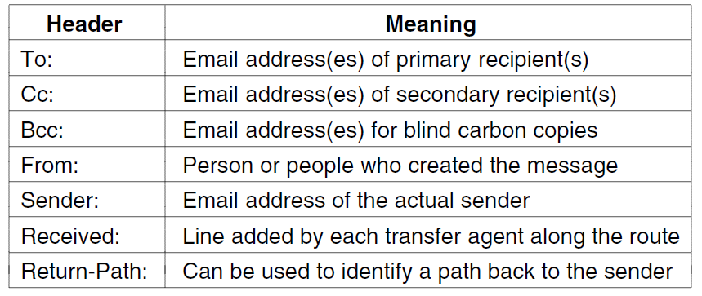
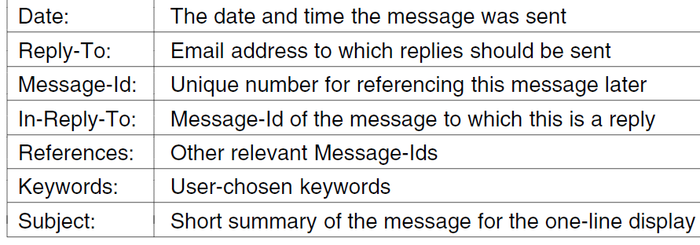
Email Format
RFC 5322: Header fields related to message transport; are readable ASCII text

Slide 20
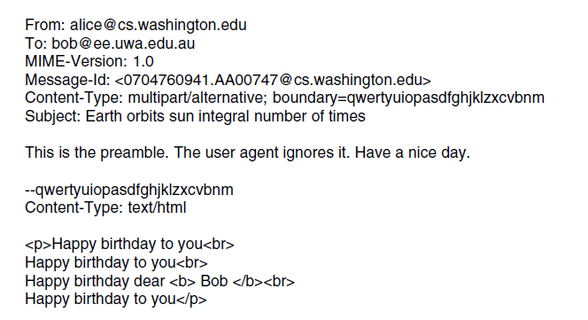
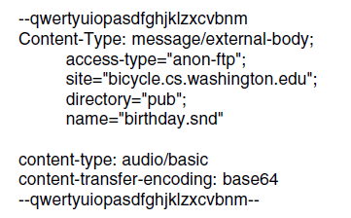
Email Format: Example
A multipart message containing HTML and audio alternatives.
One part (HTML)
Another
(audio)

Slide 21
Email architecture
The key components and steps to send email
Outgoing:
SMTP
Incoming:
POP3 (older)
IMAP (newer)
e.g. Outlook
e.g. Outlook server
Architecture of the email system

Slide 22
Message Transfer
Messages are transferred with SMTP (Simple Mail Transfer Protocol)
Originally plaintext; encryption later added (STARTLS)
Submission from user agent to mail transfer agent (MTA) on port 587
One MTA to the next MTA on port 25
Protocols for final delivery
POP3 (older)
IMAP (newer)
Deal with downloading, replication, …

Slide 23
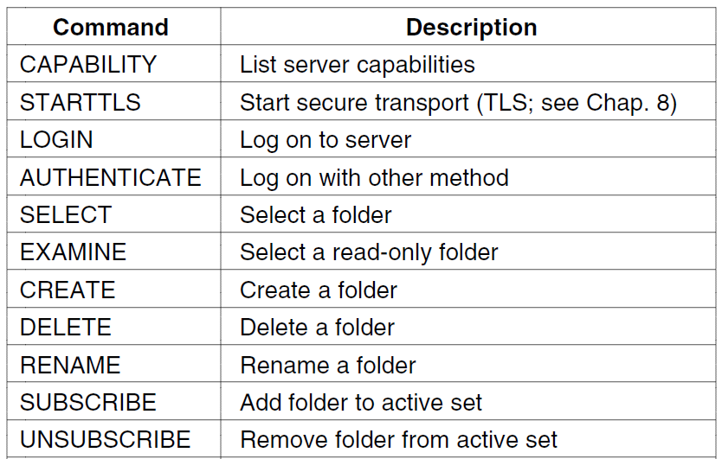
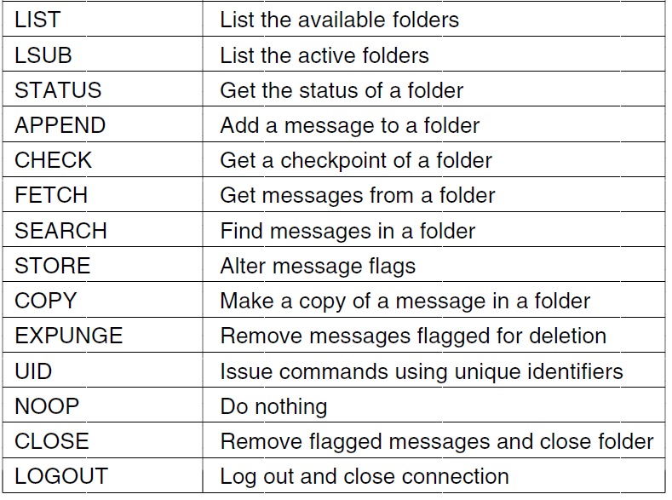
Final Delivery
User agent uses POP3 or IMAP for final delivery
Outlook, Thunderbird, …
Has commands to manipulate folders / messages [right]
Alternatively, a Web interface might be used
Gmail, Hotmail, …
Proprietary protocol

Slide 24
Application Layer
DNS – Domain Name System
Email
The Web
Net neutrality

Slide 25
The Web From the Client’s Viewpoint
Client = browser
The user specifies an URL and gets access to a (web) page that contains text, images, videos, …
Plugins/helper processes for interpreting various content
Pages are constituted of hypertext
Contain hyperlinks that point to other pages, possibly hosted to other domains/hosts
By following hyperlinks, the user transparently navigates among pages hosted in distant places in the world

Slide 26
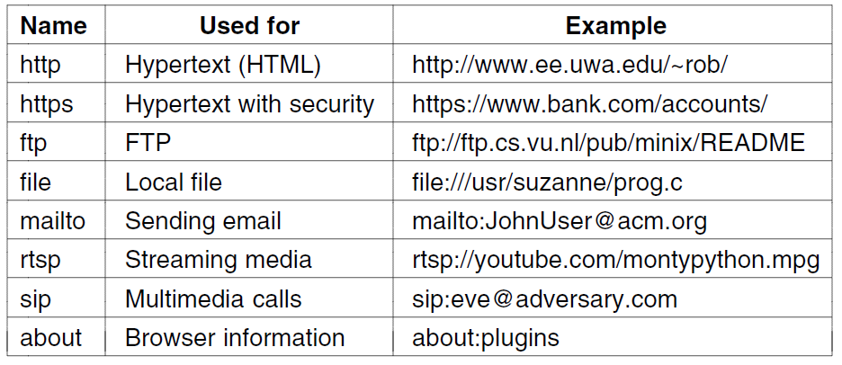
Architectural Overview (1)
Pages are named with URLs (Uniform Resource Locators)
Example: http://www.phdcomics.com/comics.php
Protocol
Server
Page on server
Our
focus
Common URL protocols
What is www for?

Slide 27
Architectural Overview (2)
Steps a client (browser) takes to follow a hyperlink:
Determine the protocol (HTTP)
Ask DNS for the IP address of server
Make a TCP connection to server
Send an HTTP request for the page; server sends it back
Fetch other URLs as needed to display the page
Close idle TCP connections
Steps a server takes to serve pages:
Accept a TCP connection from a client
Get page request and map it to a resource (e.g., file name)
Get the resource (e.g., file from disk)
Send contents of the resource to the client.
Release idle TCP connections

Slide 28
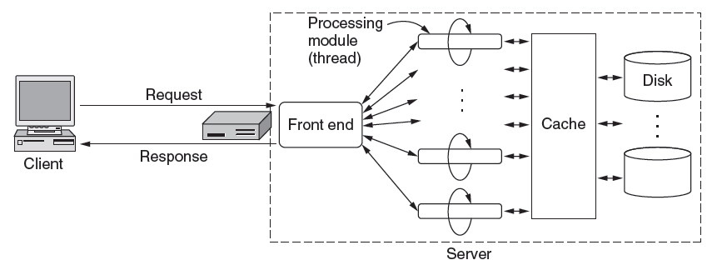
Architectural Overview (3)
To scale performance, Web servers frequently use:
Load-balancing, caching, multithreading

Slide 29
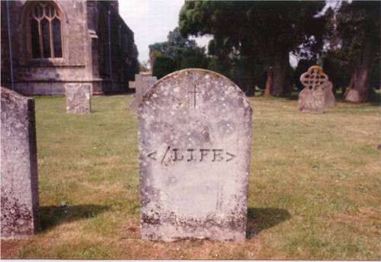
HTML

Slide 30
HTTP (1)
HTTP (HyperText Transfer Protocol) is a request-response protocol that runs on top of TCP
Fetches content from server to client
Server usually runs on port 80
Headers are given in readable ASCII
Content is described with MIME types
Protocol has support for pipelining requests
Protocol has support for caching

Slide 31
HTTP (2)
Response codes tell the client how the request fared:

Slide 32
HTTP (3)
Many headers carry key information:
Function | Example Headers
Browser capabilities (client → server) | User-Agent, Accept, Accept-Charset, Accept-Encoding, Accept-Language
Caching related (mixed directions) | If-Modified-Since, If-None-Match, Date, Last-Modified, Expires, Cache-Control, ETag
Browser context (client → server) | Cookie, Referer, Authorization, Host
Content delivery (server → client) | Content-Encoding, Content-Length, Content-Type, Content-Language, Content-Range, Set-Cookie

Slide 33
HTTP Caching
Uses conditional GET for cached content
You can take a look at HTTP messages by using telnet
telnet www.unibz.it 80 <ENTER>
…
GET /inf/ HTTP/1.0 <ENTER> <ENTER>

Slide 34
Stateless vs Stateful
HTTP is stateless
Good for performance and for the original intention of the web (accessing documents)
Now the web is used for many other needs
E-commerce, e-mail access, financial transactions, …
These uses typically require to keep a “state” of the interaction
User authentication, user cart, …
State using IP address → ???

Slide 35
Cookies
HTTP messages may contain a small amount (<4K) of information (cookies)
Cookies are locally stored by the client
Examples:

Slide 36
Cookies (2)
When the client requests a certain URL, it checks if there are cookies that correspond to it
In this case, they are attached as part of the HTTP request header
The server can interprets the received cookies to change its behavior
E.g., show the content of the user’s cart if there is a cart cookie with an ID
Cookies are a frequent object of privacy discussions (see e.g. recent EU guidelines)
Can be disabled
But: Modern tracking techniques do not rely on cookies!

Slide 37
Application Layer
DNS – Domain Name System
Email
The Web
Net neutrality

Slide 38
Net Neutrality
https://www.youtube.com/watch?v=xjOxNiHUsZw
Tasks
Describe what net neutrality refers to
Identify an argument in favour of net neutrality
Identify an argument against net neutrality

Slide 39
Learned today
DNS
Distributed architecture
Name resolution algorithm
Email
SMTP for message transfer
POP3/IMAP for final delivery
HTTP
Architecture overview
Cookies
Net neutrality
Lab today: Simulating DNS resolution and observing HTTP

