Slide 1
Distributed Systems 15. Multiagent systems and swarms
Simon Razniewski
Faculty of Computer Science
Free University of Bozen-Bolzano
A.Y. 2014/2015

Slide 2
Reasons for distributed systems so far
Performance
1 server can serve 1000 clients
2 servers can serve ……..?
Dependability
1 server has 99% availability
2 servers have ……….. availability

Slide 3
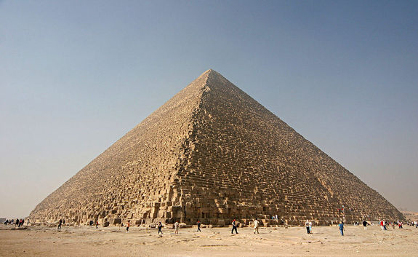
Emergence?
4000 workers 20 years[http://www.livescience.com/18589-cost-build-great-pyramid-today.html]
→ 1 worker 80000 years?

Slide 4
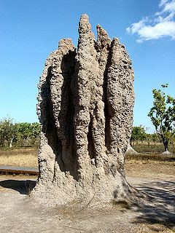
Emergence!
Collaboration of (relatively) simple agent makes larger goals achievable
Emergence is a process whereby larger entities, patterns, and regularities arise through interactions among smaller or simpler entities that themselves do not exhibit such properties.

Slide 5
Swarm systems
Replace central coordination by “intelligent” agents
Loosely similar to “thin clients” vs “fat clients”
Reason
Increased reliability
Easier handling of complex/nonlinear environments
Hope for emergence

Slide 6
An Overview
Real world insect examples
Theory of swarm intelligence
From insects to real algorithms
Example applications

Slide 7
1. Real World Insect Examples

Slide 8
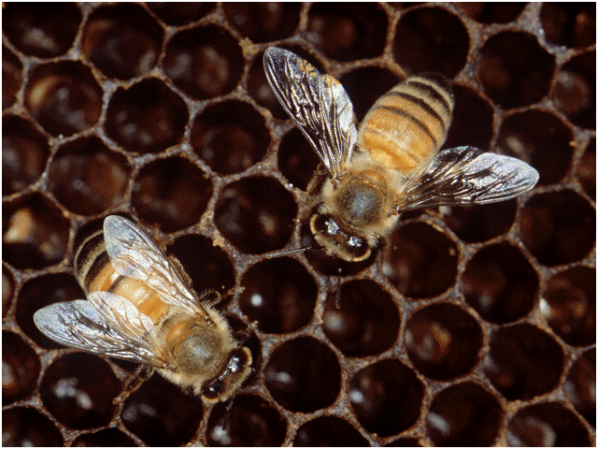
Bees

Slide 9
Bees
Colony cooperation
Regulate hive temperature
Efficiency via Specialization: division of labour in the colony
Communication : Food sources are exploited according to quality and distance from the hive
Notes:
Efficiency : Iindustrial Revolution
build a series of parallel wax combs, organized in concentric rings of brood, pollen collection & honey production

Slide 10
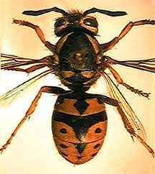
Wasps

Slide 11
Wasps
Pulp foragers, water foragers & builders
Complex nests
Horizontal columns
Protective covering
Central entrance hole
Notes:
Division of labour

Slide 12
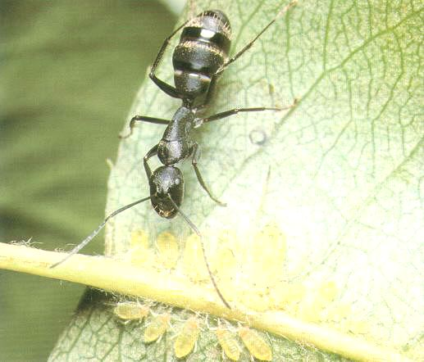
Ants
Notes:
Focus of presentation.
Why?
Easy to study
Predictable..
Ants in Pants was my favorite game

Slide 13
Ants
Organizing highways to and from their foraging sites by leaving pheromone trails
Form chains from their own bodies to create a bridge to pull and hold leafs together with silk
Division of labour between major and minor ants

Slide 14
Social Insects
Problem solving benefits include:
Flexible
Robust
Decentralized
Self-Organized
Notes:
Page 19
flex: take away major or minor and they compensate
robust: recover from changes in the environment shown in just a couple of slides
decentralized: In the case of ants Individual ants have their own agenda yet the cooperation and integration of these actions needs no supervisor.
self-organized: complex issue that will be discussed shortly.

Slide 15
Summary of Insects
The complexity and sophistication of Self-Organization is carried out with no clear leader
What we learn about social insects can be applied to the field of Intelligent System Design
The modeling of social insects by means of Self-Organization can help design artificial distributed problem solving devices. This is also known as Swarm Intelligent Systems or Multiagent Systems
Notes:
All of the social organizations involved with ants, bees, wasps and termites are quite impressive
Page 7

Slide 16
2. Swarm Intelligence in Theory

Slide 17
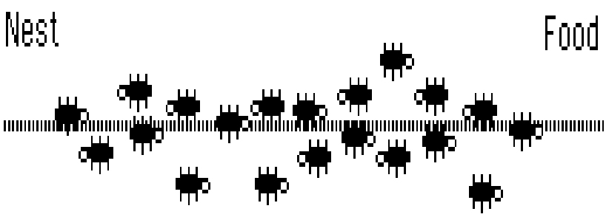
An In-depth Look at Real Ant Behaviour
Notes:
We want to talk in depth about how the algorithm works here

Slide 18
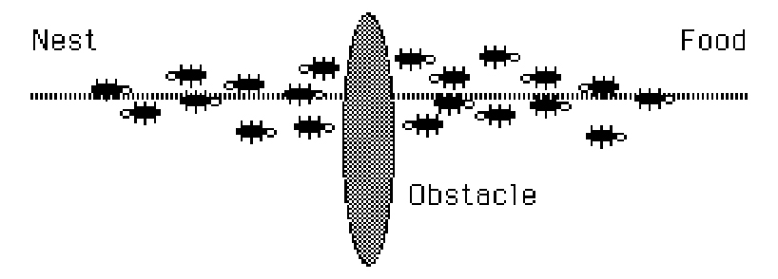
Interrupt The Flow

Slide 19
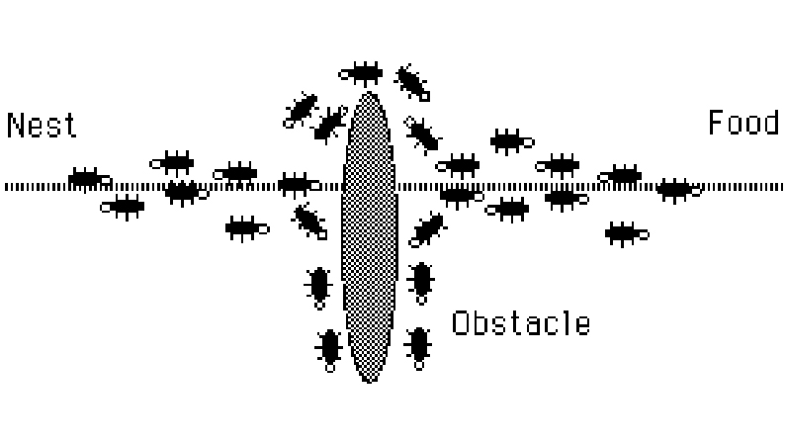
The Path Thickens!

Slide 20
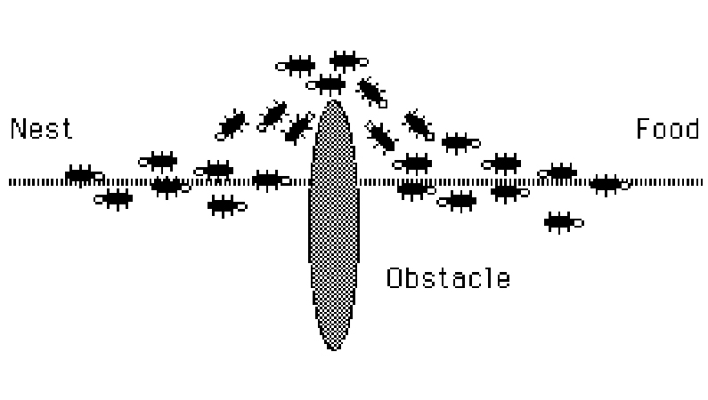
The New Shortest Path

Slide 21
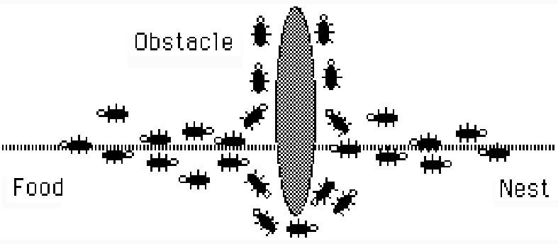
Adapting to Environment Changes
Notes:
This is achieved because ants choose to follow a path withcertain probability, therefore ants are always re-testing paths that were previously found to ineffiecient.

Slide 22
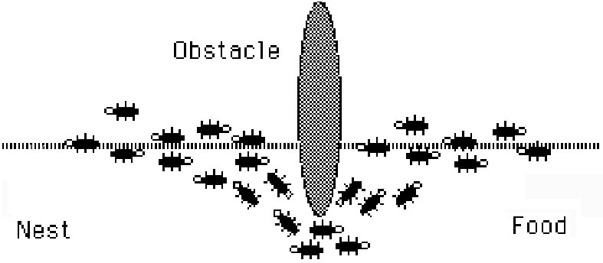
Adapting to Environment Changes
Notes:
Fully optimal solution found again.

Slide 23
Problems Regarding Swarm Intelligent Systems
Swarm Intelligent Systems are hard to ‘program’ since the problems are usually difficult to define
Solutions are emergent in the systems
Solutions result from behaviors and interactions among and between individual agents
Notes:
read in book....
defining the problem and discovering the solution....
look in book for more information

Slide 24
Four Ingredients of Self Organization
Positive Feedback
Negative Feedback
Amplification of Fluctuations - randomness
Reliance on multiple interactions

Slide 25
Types of Interactions For Social Insects
Direct Interactions
Acoustic, visual contact
Indirect Interactions (Stigmergy)
Individual behavior modifies the environment, which in turn modifies the behavior of other individuals
chemical (pheromones)
spatial

Slide 26
Stigmergy in Action

Slide 27
3. From Insects to Real Algorithms

Slide 28
Travelling Salesperson Problem
Initialize
Loop /* at this level each loop is called an iteration */
Each ant is positioned on a starting node
Loop /* at this level each loop is called a step */
Each ant applies a state transition rule to incrementally
build a solution and a local pheromone updating rule
Until all ants have built a complete solution
A global pheromone updating rule is applied
Until End_condition
M. Dorigo, L. M. Gambardella : ftp://iridia.ulb.ac.be/pub/mdorigo/journals/IJ.16-TEC97.US.pdf
Ant Colony System: A Cooperative Learning Approach to the Traveling Salesman Problem

Slide 29
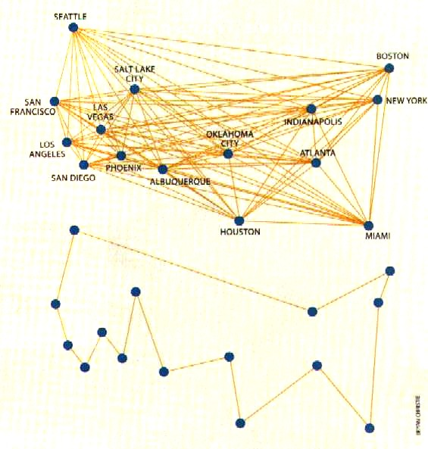
Traveling Sales Ants

Slide 30
Welcome to the Real World

Slide 31
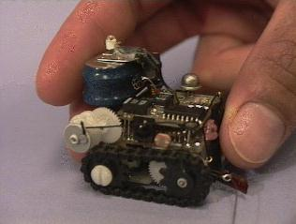
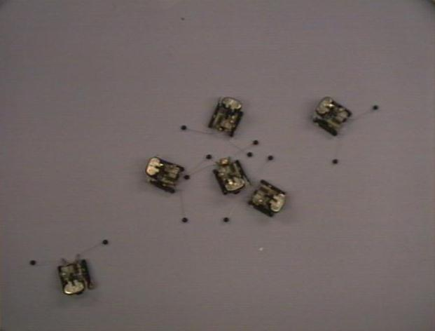
Robots
Collective task completion
No need for overly complex algorithms
Adaptable to changing environment

Slide 32
Robo soccer
Humanoids
https://www.youtube.com/watch?v=dhooVgC_0eY
Small size
https://www.youtube.com/watch?v=hZE1YQCghLk

Slide 33
Bird swarms
Can be simulated with three rules [Reynolds 1986]

Slide 34
fastcoexist, 2012

Slide 35
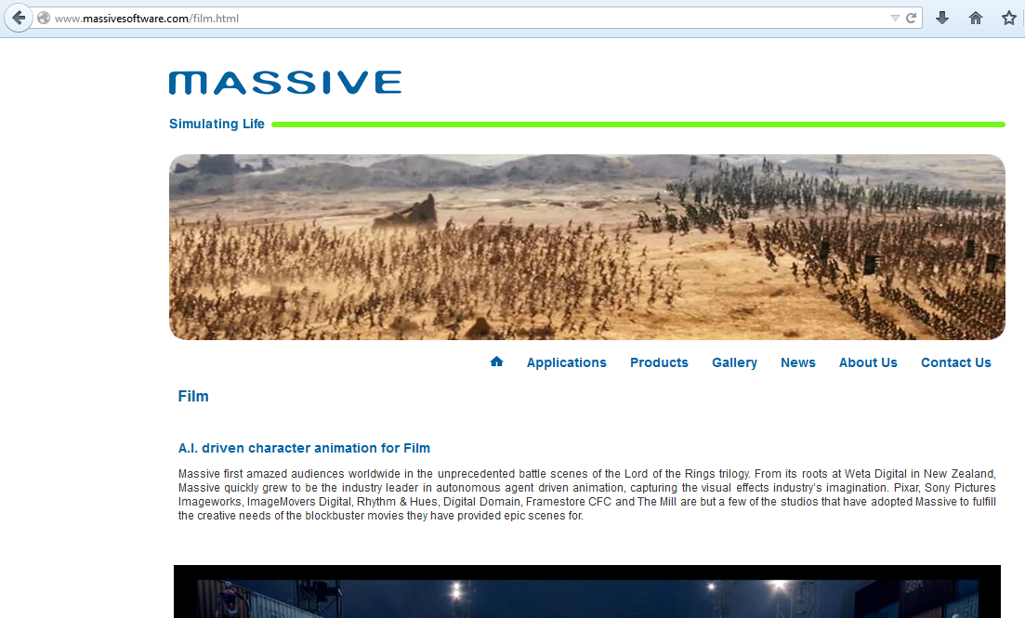

Slide 36
Hopes
Miniaturization
Telecommunications
Cleaning Ship Hulls
Medical
Pipe Inspection
Satellite Maintenance
Self-Assembling Robots
Engine Maintenance
Job Scheduling
Pest Eradication
Combinatorial Optimization
Interacting Chips in Mundane Objects
Data Clustering
Vehicle Routing
Distributed Mail Systems
Optimal Resource Allocation

Slide 37
Closing Remarks
Big expectations, mediocre achievements so far
No clear boundaries
The future…???

Slide 38
Dumb parts, properly connected into a swarm, yield smart results. Kevin Kelly

