Slide 1
DNS and HTTP
Q: Why we could not access websites by IP address, as received by DNS?
A: “It's not uncommon for tens, if not hundreds of websites to be located on a single web server. When that happens, an IP address just isn't enough.”
→ HTTP header carries resource field that allows to identify the exact resource
Source: http://serverfault.com/questions/149440/why-i-cannot-access-my-website-with-its-ipaddress-but-only-with-sitename-is-th

Slide 2
Overview
Network Layers done
Next: Distributed Systems Engineering
Remote procedure call and method invocation
P2P
Cryptography
Multiagents
Coordination
RPI Labs on Distributed Algorithms
Guest lectures
Raspberry Pi Cluster “Bobo”, Julian Sanin (4.5.)
Networking at Brennercom, Georg Herbst (19.5.)

Slide 3
Distributed Systems 17. RPC and Java RMI
Simon Razniewski
Faculty of Computer Science
Free University of Bozen-Bolzano
A.Y. 2016/2017

Slide 4
Outline
Remote Procedure Call (RPC)
Distributed Objects Paradigm
Using the Java Remote Method Invocation (RMI)

Slide 5
Communication Paradigms
Message-oriented communication
Based on two main primitives: send and receive
Communication is explicit
Socket.send(…)
Socket.receive(…)
Birrel and Nelson proposed an alternative way (early 80’s)
Allow programs to invoke procedures located at remote machines!
→ Remote Procedure Call (RPC)

Slide 6
Remote Procedure Call (RPC)
Abstraction over message passing
The most common framework for distributed applications and distributed application middleware.
Used both by operating systems and by applications.
Between processes on different machines
E.g., client-server model
NFS (network file system)
DCOM, CORBA, Java RMI, …
Between processes on the same machine
More structured than simple message passing
Between subsystems of an operating system
Windows XP (called Local Procedure Call)

Slide 7
Remote Procedure Call (RPC)
Fundamental idea:
A server process exports an interface of procedures or functions that can be called by client programs
similar to library API, class definitions, etc.
Clients make local procedure/function calls
As if directly linked with the server process
Under the cover:
procedure/function call is converted into a message exchange with remote server process.

Slide 8
Classical procedure/function call
file
buffer
bytes to read
count = read(fd, buf, bytes)
Parameters are inserted in the stack by the push primitive
Stack before the call is issued
When read terminates, it puts the value in a registry, removes the return address and returns the control to the caller

Slide 9
Remote Procedure Call
Would like to do the same if the called procedure or function is on a remote server
Make location transparent to caller

Slide 10
Solution: RPC Stubs
A client-side stub is a function that looks to the client as if it were a callable server function
I.e., same API as the server’s implementation of the function
A server-side stub looks like a caller to the server
I.e., like a piece of code invoking the server function
The client program thinks it is invoking the server
but is calling into the client-side stub
The server program thinks it is called by the client
but is really called by the server-side stub
The stubs send messages to each other to make the RPC happen transparently (almost!)

Slide 11
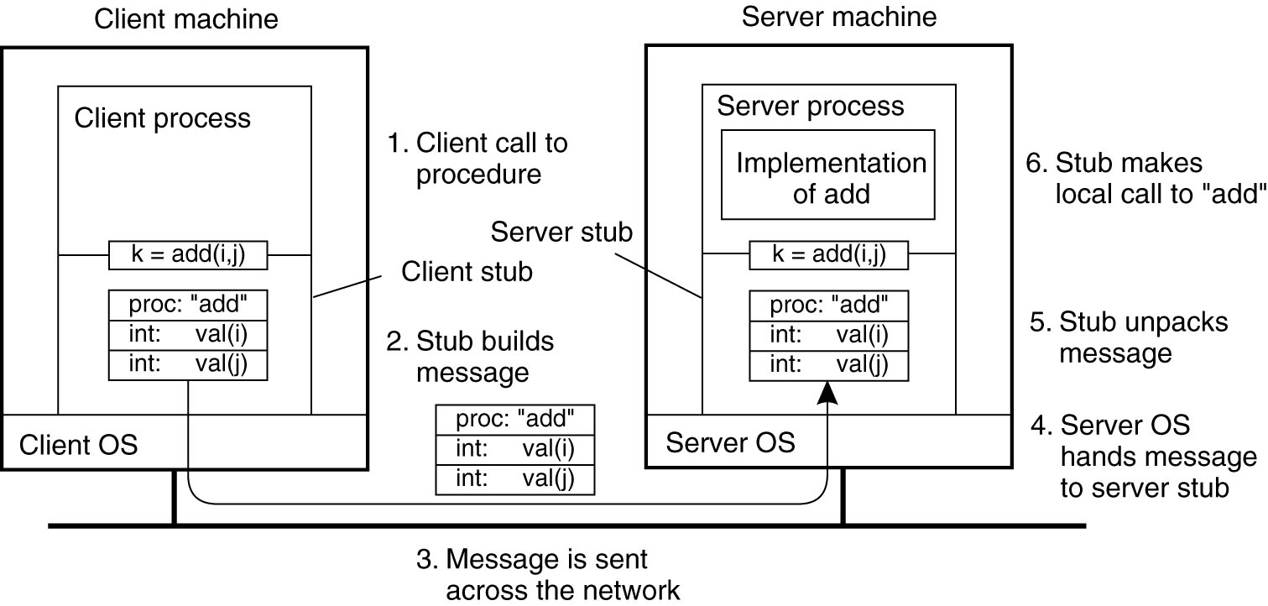
Illustration
Figure 4-7. The steps involved in a doing a remote computation through RPC.

Slide 12
Remote Procedure Call message exchange
The hard work of building messages, formatting, uniform representation, etc., is buried in the stubs
have to take care encode parameters and send them over the network
Stubs usually created automatically by frameworks
→ Application developers need not think about technicalities of communication
RPC issues
What are semantics of parameter passing?
E.g., pass by reference?
How to bind (locate & connect) to servers?

Slide 13
Pointers and References
delete(int element, List l)
Pointers are only valid within one address space
Cannot be interpreted by another process
Even on same machine
Pointers and references are ubiquitous in C, C++, Java, …
Solution: Copy and overwrite on return

Slide 14
How to locate RPC services?
Binding is the process of connecting a client to a server
the server, when it starts up, exports its interface
identifies itself to a network name server
tells RPC runtime that it is alive and ready to accept calls
the client, before issuing any calls, imports the server
RPC runtime uses the name server to find the location of the server and establish a connection
The import and export operations are explicit in the server and client programs

Slide 15
Architecture of a RPC System
Registry
lookup
register
Method invocation
Client
Server
Client Stub
Server Stub
Runtime Support
Runtime Support
Network Support
Network Support
Physical information flow
Logical information flow

Slide 16
Java Remote Method Invocation (RMI)‏
Distributed objects extend RPC to object-oriented programming
Java RMI is a sample implementation
Java RMI enables different virtual machines to share objects, like in a shared address space

Slide 17
Java RMI Registry
RMI Registry is a naming service
Separately Running service
Can be initiated within a program or using Java’s “rmiregistry” tool
Server programs register remote objects
Given the object a name under which it can be found
Client programs lookup object references that match this service name
Registry names have a URL format
rmi://<hostname>:<port>/<ServiceName>
E.g. rmi://localhost:1099/CalculatorService
E.g. rmi://194.80.36.30:1099/ChatService

Slide 18
Java.rmi.Naming
Interface
Remote Object
Server Program
Client Program
Naming.bind(“rmi://localhost/TestService”, Obj)‏
Naming.lookup(“rmi://localhost:1099/TestService”)‏
Client
Server
RMIRegistry

Slide 19
Parameter Passing
Parameter Passing in Java RMI is different from standard Java
In Java RMI
Primitives and objects are passed by value
Are serialized and a copy is passed
Any changes to the copy do not affect the original
Remote objects are passed by reference
Reference (stub) is sent
Further calls to the reference are RMI calls which modify the original object

Slide 20
Note on server-side objects
When a remote object is made available on a server, the latter starts accepting incoming connections (from clients) on a specific port
Since a remote object can be accessed by several clients:
safe access to this object must be guaranteed (i.e., use concurrent programming techniques where needed)‏

Slide 21
Building a Java RMI system
An RMI system must be composed of the following parts:
1. An interface definition of the remote services;
2. The implementations of the remote services;
3. A server to host the remote services;
4. An RMI Naming service
5. A client program that uses the remote services.

Slide 22
The java.rmi.Remote Interface
Classes of remote objects must implement the Remote interface
java.rmi
Here is the interface
interface Remote { }
???
•
in
•
•
Remote is an example of a “marker interface” (like Serializable)
Marker interfaces indicate that classes implementing them are intended for special purposes
Alternative: Implement UnicastRemoteObject
Like threads: Implement runnable or extend Threads

Slide 23
Creating Object Registries
Approach 1: rmiregistry
•
–
A command distributed with Java that can be run at the OS command line to
start a registry
Takes an optional argument: the port on which to listen for requests (default is 1099)
The registry created in this fashion continues to run even if the server JVM
Terminates
Such a registry can be used by several servers
If a server terminates, any references to remote objects on the server in such a registry
will continue to exist
If a client tries to access a nonexistent remote object, an exception is thrown
Approach 2: LocateRegistry.createRegistry()
LocateRegistry is a class in java.rmi.registry
static Registry createRegistry (int port)
–
–

Slide 24
Example:
Addition Server
•
Application contains four files
–
AdderInterface.java
Remote interface for adding two integers
Adder.java
Remote object class
AdditionServer.java
Server hosting an Adder
AdditionClient.java
Client accessing the adding function
–
–
–

Slide 25
Interface
public interface AdderInterface extends Remote {
public int add(int a,int b) throws Exception;
}

Slide 26
Object implementing the remote interface
public class Adder extends UnicastRemoteObject implements AdderInterface {
public Adder () throws RemoteException { }
public int add(int a, int b) throws Exception {
int result = a+b;
return result;
}
}

Slide 27
Server hosting the service
public class AdditionServer {
public static void main (String[] args) {
try {
System.setSecurityManager(new SecurityManager());
LocateRegistry.createRegistry(1099);
Adder a = new Adder();
Naming.rebind("rmi://localhost/ABC", a);
System.out.println("Addition Server is ready.");
}catch (Exception e) {
System.out.println("Addition Server failed: " + e);
}
}
}

Slide 28
Client calling the service
public class AdditionClient {
public static void main (String[] args) {
AdderInterface a;
try {
System.setSecurityManager(new SecurityManager());
a = (AdderInterface)Naming.lookup("rmi://localhost/ABC");
int result = a.add(9,10);
System.out.println("Result is: " + result);
}catch (Exception e) {
System.out.println(“Exception: " + e);
}
}
}

Slide 29
Security Policy
grant {
permission java.security.AllPermission;
};
As VM argument (e.g. in Eclipse):
Relative path:
-Djava.security.policy=file:${workspace_loc}/PROJECTNAME/security.policy
Absolute path:
-Djava.security.policy=file:"C:\Users\simon\Workspace\RMIServerSide\security.policy“
Or as command-line argument:
java -Djava.security.policy=“PATH\security.policy" AdditionServer
(Replace PROJECTNAME with your project’s name, or PATH with the path to the security policy file)

Slide 30
Troubleshooting
Ensure same package structure for interface on client and server side
Server and client need to be on the same network
Make sure that “-Djava.security.policy…” is given as VM argument, not as program argument
MacOS: Approach that worked was to set security file within the code using System.setProperty("java.security.policy","file:/Users/JohnSmith/Documents/workspace/RMIChat/src/security.policy");
RPIs:
Run rmiregistry from the same directory as the code
Create a static mapping for raspberrypi to the own IP in /etc/hosts

Slide 31
Learned today
RPC is a common paradigm for distributed applications
Hides networking complexity
Distributed objects paradigm extends this to object oriented programming
Idea of client-side/server-side stubs that make calls appear as if local
Java RMI is a distributed object framework
RMI registry for resource lookup
Semantics of parameter passing
Security.policy file
Next assignment: Port your chat application to RMI (due 1.5.)

