Slide 1
Distributed Systems 0. Overview
Simon Razniewski
Faculty of Computer Science
Free University of Bozen-Bolzano
A.Y. 2014/2015

Slide 2
Lecturer
Simon Razniewski
KRDB Research Centre
Faculty of Computer Science
FUB – POS 2.08
Piazza Domenicani 3
razniewski@inf.unibz.it
Office hours: by previous arrangement via e-mail

Slide 3
Goals
Understand principles and concepts underlying computer networks and distributed systems
communication, concurrency, coordination
Learn how to design reliable, cooperative (basic) distributed applications
Gain practical skills on the development of simple distributed systems (in Java)
Improve your software engineering expertise

Slide 4
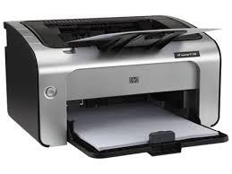
Why?
Make resources accessible
Notes:
printers, storage, compute power, web pages

Slide 5
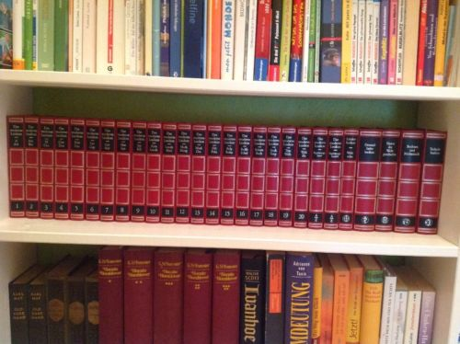
Why?
Make information accessible

Slide 6
Why?
Enable distant communication
Notes:
Email, chat, skype

Slide 7
Areas
Distributed systems hide the network complexity …
… but in order to understand and develop them, we need competencies in
Computer networks
Concurrency & Inter-process communication
Distributed
Systems
Computer
Networks
Concurrency
&
Inter-process
Communication

Slide 8
Tentative Schedule
Introduction to distributed systems
Multi-threading in JAVA and synchronization issues
OSI Reference Model, layers
Internet Protocols (UDP, TCP/IP, HTTP, …)
Java Socket and client/server programming
Naming
Distributed Architectures
Remote Procedure Call
Coordination
Consistency issues
Fault-tolerance
Security
Web Services
Cloud Computing

Slide 9
Material
Slides!
Books
A.S. Tanenbaum, M. van Steen. Distributed Systems: Principles and Paradigms (2nd edition). Prentice Hall, 2007.
A.S. Tanenbaum. Computer Networks (4th edition). Prentice Hall, 2003.
J.F. Kurose, K.W. Ross. Computer Networking – A Top-Down Approach (5th edition). Pearson Education, 2010.
G. Coulouris, J. Dollimore, T. Kindberg. Distributed Systems: Concepts and Design (4th edition). Addison-Wesley, 2005.
Javadoc + documentation about threads and inter-process communication

Slide 10
Evaluation
Exam: 70%
Six assignments: Up to 30%
Every two weeks
Publication Monday, due Friday the week after
First one due 6.3.
Only the assignments with a grade higher than the exam mark count
Assignments can only improve the overall grade
To pass the course, the exam grade has to be at least 18

Slide 11
Slide sources
Course slides from previous versions of this course by Nutt, Montali and Pirro
Slides by Tanenbaum

